Slide 1
Compliment App
Check In

Slide 2
Proposal
Small compliment-giving app
Connects to google sheets
Custom compliments
Chooses random compliment from list
Ideal Use Case
Two app users exchange google sheet sharing links
Update throughout lifetime of use
Perfect for SOs
Made in Unity

Slide 3



Starting Point
Engine - Unity
Familiar with engine and C#
Unity 3D for ~ 3 years
Not much experience with 2D or data management
Data Management - Google Sheets
Obvious basic understanding
No experience with google API
No experience pushing/pulling from Sheets
Art - Adobe Illustrator
About 3 years of experience
Least worried about
Gaining experience through mimicry and random tutorials
Unity Logo: https://cdn4.iconfinder.com/data/icons/logos-brands-5/24/unity-512.png
Google Sheets Logo: https://www.gstatic.com/images/branding/product/1x/sheets_512dp.png
Adobe Illustrator Logo: https://www.vispronet.com/blog/wp-content/uploads/2017/12/2000px-Adobe_Illustrator_CC_icon.svg_-e1514410475242.png

Slide 4


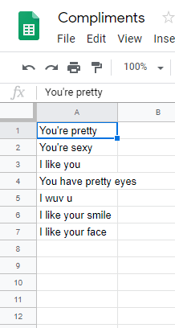

Where I am
Sheets -> Unity
Gets compliments from Sheets
Stores compliments in save file
Now accepts any Sheet URL (New)
Random compliments
Selects randomly from sheet
Does not repeat back to back
Functionality First
I have the app working how I want
Base structure/MVP is done

Slide 5
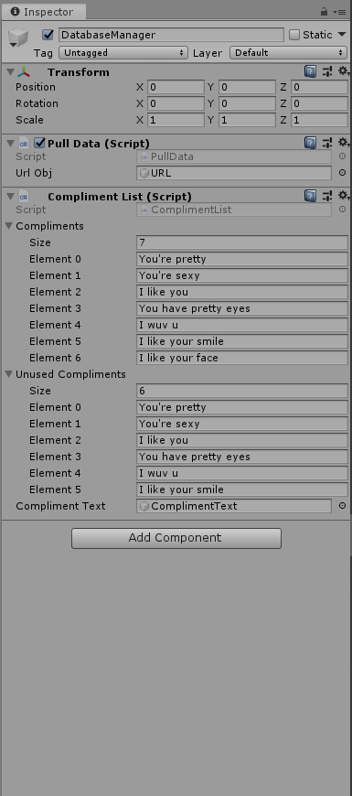
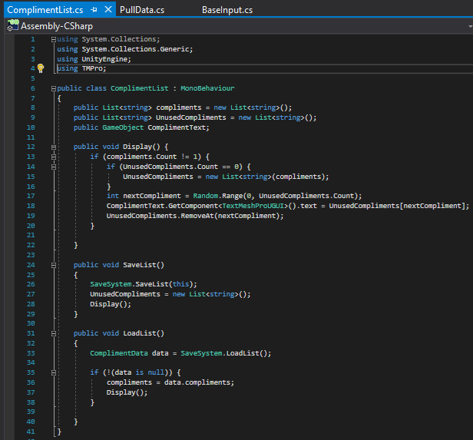
Where I am
Randomly Chosen
One list of all compliments
One list of “unused” compliments
Random element selected from “unused” then deleted
Refil “unused” when empty
Save/Load System
Save the list of compliments onto device
On “Start” app will reload last list of compliments
Won’t refresh with call to database unless “Refresh” is pressed

Slide 6
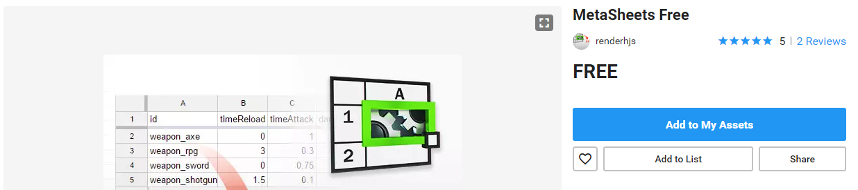
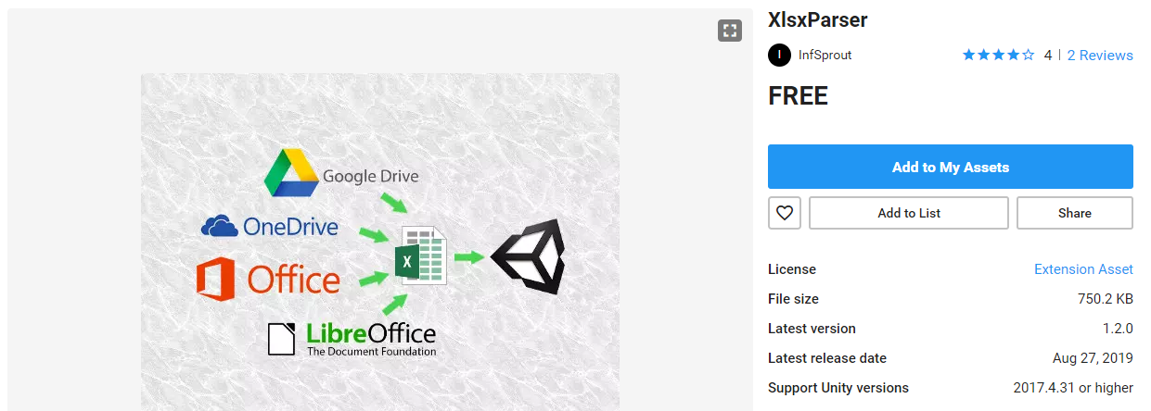
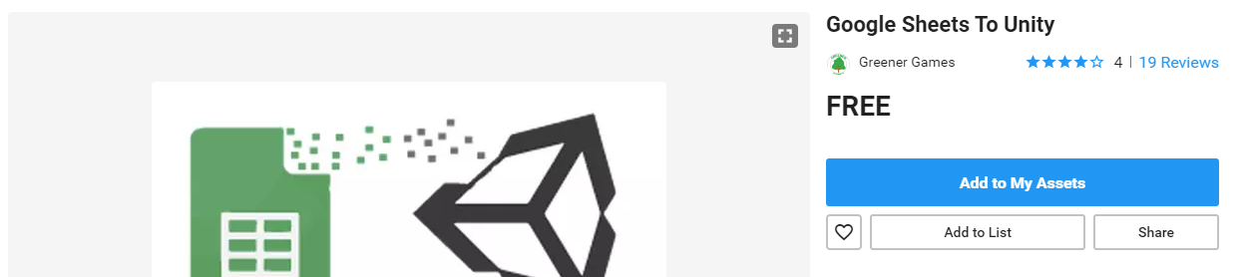
Failure
Plugins Galore
My wheels spun for the first 3 weeks
Tried 3 different Sheets -> Unity plugins with no success
MetaSheets
Used as a C# plugin to help code variable names
XlsxParser and Google Sheets to Unity
Used in-editor to help in construction of game
Not meant for real-time in-app use
All plugins were free at: https://assetstore.unity.com/

Slide 7
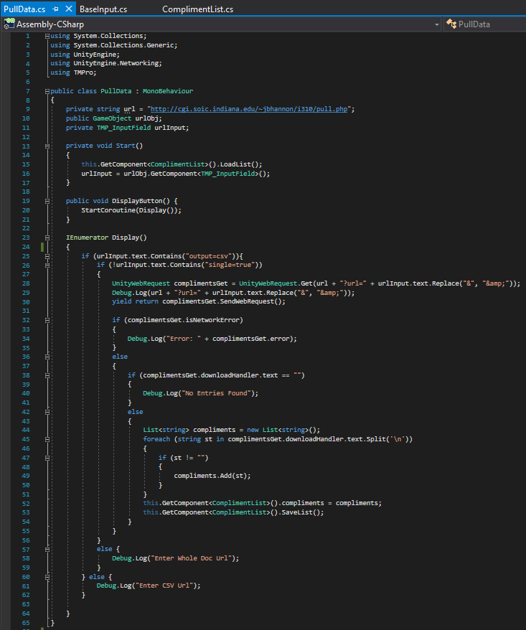
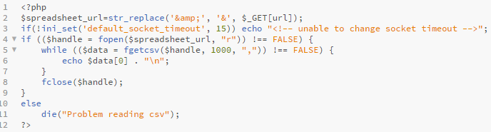

Success
Work Around!
I know I can go to a URL with Unity
I know that PHP can access Sheets
Why not combine them?
My Solution
Build the query URL in Unity with Input object
Pass URL to sheet in URL to PHP
Use PHP to grab each row and print out for Unity to grab
Download and separate with Unity into a list
Hardest Part Solved!
Unity Logo: https://cdn4.iconfinder.com/data/icons/logos-brands-5/24/unity-512.png
Google Sheets Logo: https://www.gstatic.com/images/branding/product/1x/sheets_512dp.png
PHP Logo: https://miro.medium.com/max/3840/1*coYi138tZjMKg-ZSQ-vuAQ.png

Slide 8
Future Plans
ART!!!
Technical aspect is done
Time for polish!
UI to add
Background
Custom Buttons (Heart)
Separate settings screen
Setup tutorial
Possibly allow people to upload background images
Not sure how to technically achieve this

Slide 9
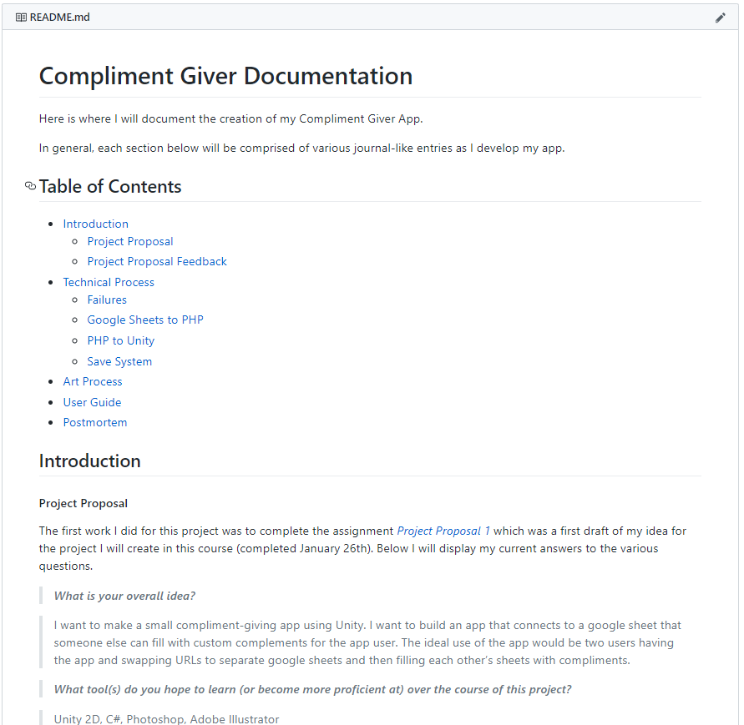
Conclusion
Work coming along
Hardest part out of the way
Time to make it look better and test
Documentation is going well
Need to work more on tying pieces together with descriptive text
Making my documentation with GitHub Markdown
Easily accessible and changeable from anywhere
Comments wanted
How would you like the app to hide its settings?
How much tutorial would you need to use the app?
Should I push toward use for SOs or keep it platonic?
UI choices
Backgrounds
Phrasing

Slide 10
Questions or Comments?

