Slide 1
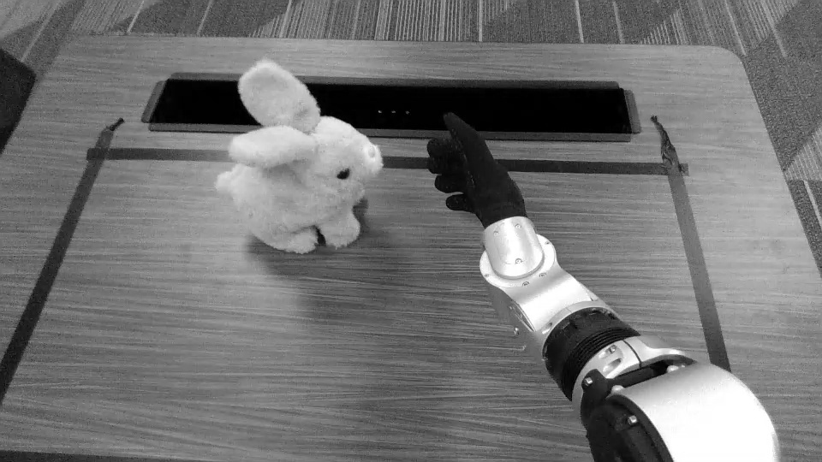
TRACKING DEMONSTRATED
INTERCEPTION ATTEMPT PENDING
Real-Time Moving-Object Interception
with a Unitree G1
From VLA experimentation to safety-bounded geometric control
[Presenter 1 · School] · [Presenter 2 · School] [Presenter 3 · School] · [Presenter 4 · School]
UC Santa Cruz Summer AI Academy
REAL XR DEMONSTRATION DATA
1
Notes:
TIME 0:45 · PRESENTER 1
“This project investigates real-time moving-object interception with a Unitree G1 humanoid. The practical target is controlled palm contact with a moving plush bunny—not a verified fingered grasp. The system combines live perception, prediction, inverse kinematics, trajectory shaping, and robot-side safety. Physical visual tracking has been demonstrated. The optimized interception path is the final bounded hypothesis, and today’s live segment will show guarded tracking followed by one interception attempt.”
The image is a real XR demonstration-data frame, not autonomous execution.
SOURCE: docs/presentation/README.md; CURRENT_STATUS.md

Slide 2
Moving targets turn latency into the central problem
02
THE TARGET MOVES THROUGHOUT THE LOOP
SEE
LOCATE
PREDICT
MOVE
VERIFY
RGB + depth
3D position
crossing
arm target
fresh + safe
Controlled palm contact
must remain inside joint, collision, tabletop, freshness, and operator limits.
~57 camera FPS 49–51 YOLO FPS
representative dry-run perception
Representative July 27 dry runs; perception speed alone does not establish interception
2
Notes:
TIME 1:00 · PRESENTER 1
“Detection alone does not solve interception. The bunny continues moving while a frame is captured, transmitted, detected, fused with depth, converted into a three-dimensional target, and translated into arm motion. That makes end-to-end latency the central problem. The loop must see, locate, predict, move, and continuously verify. Representative dry runs reached about 57 camera frames per second and 49 to 51 YOLO inferences per second, so perception became fast enough to expose the next bottleneck: producing current, safe arm motion before the target moved away.”
SOURCE: docs/presentation/TECHNICAL_EXPLAINER.md; EXPERIMENTS_AND_RESULTS.md

Slide 3
Each result exposed the next bottleneck
03
VISION
PHYSICAL IK
SIM + DATA
VLA
REAL-TIME PIVOT
60 FPS-class camera + YOLO
guarded tracking demonstrated
9,312 controller trials 547 episodes
36 attempts 0 authorized
local analytic IK + Ruckig
see reliably
move safely
scale experiments
test learning
attack latency
The project did not abandon learning.
It used negative results to choose the shortest defensible live path.
Simulation evidence is not hardware validation
3
Notes:
TIME 1:05 · PRESENTER 1
“The project evolved through evidence rather than one fixed implementation. First, the team established a stable camera and detector. Next, guarded inverse kinematics moved the physical arm and tracked the bunny, but the response lagged. Simulation then increased experiment throughput, including 9,312 controller trials. A combined real-and-sim dataset made the VLA question testable. Thirty-six VLA attempts exposed problems in target semantics, consistency, and promotion safety. Those findings did not make the learning work irrelevant; they justified a narrower deterministic path based on fast local IK, smooth Ruckig execution, and the safety boundary already demonstrated on hardware.”
[Handoff to Presenter 2]
SOURCE: docs/presentation/PROJECT_JOURNEY.md

Slide 4
The robot retains final authority
04
GB10 · PERCEPTION AND GEOMETRY
D435I
YOLO
RGB–D
α–β
UNITREE G1
RGB + depth
bunny box
3D point
position + velocity
250 Hz
CROSSING
PINOCCHIO
CHECKS
RUCKIG
robot-local safety controller
place + time
joint update
joint · collision · table
smooth motion
Only this process publishes Unitree arm commands.
OFFLINE RESEARCH
Dual RTX 3090 · Isaac Sim · MuJoCo/MJX · RLDS/TFDS · UniFoLM-VLA evaluation
No learned or Cartesian proposal publishes directly to the motors
4
Notes:
TIME 1:05 · PRESENTER 2
“The live path separates perception from final hardware authority. On the GB10, the RealSense supplies color and depth, YOLO finds the bunny, RGB-depth fusion creates a three-dimensional point, and an alpha-beta filter estimates position and velocity. A plane-crossing predictor chooses an interception point and time. Pinocchio proposes a joint update; joint, collision, and tabletop checks validate it; Ruckig limits velocity, acceleration, and jerk. The Unitree G1 still owns the final command boundary through a robot-local 250-hertz safety controller. Isaac Sim, MuJoCo, dataset conversion, and VLA evaluation remain offline research infrastructure.”
SOURCE: docs/presentation/TECHNICAL_EXPLAINER.md

Slide 5
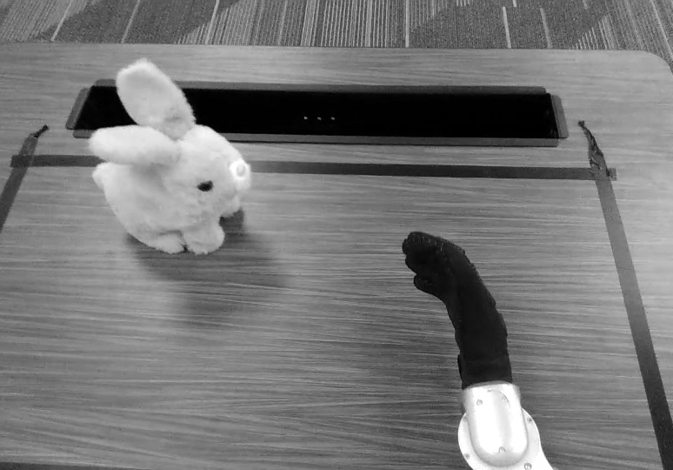
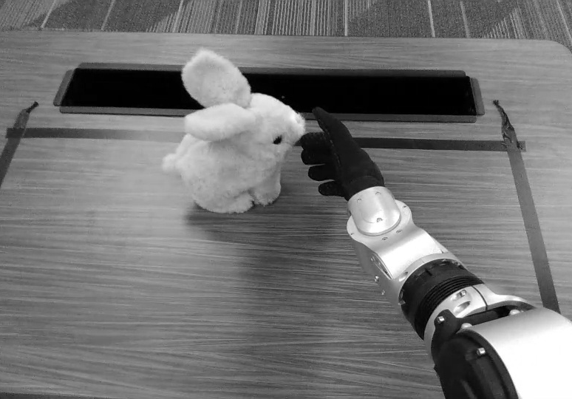
A sim-to-real dataset made the VLA question testable
05
REAL XR DEMONSTRATION DATA · APPROACH SEQUENCE
480 simulation + 67 real = 547 episodes
127
97
67
32,051
audited
accepted
canonical real
frames
session-held-out train · validation · sealed test
Artifact-verified manifests; real frames shown are demonstration data, not autonomous execution
5
Notes:
TIME 1:10 · PRESENTER 2
“The VLA program required a common data contract across simulation and real demonstrations. The latest canonical dataset contains 547 episodes and 32,051 frames: 480 generated in Isaac Sim and 67 captured through real XR teleoperation. Real data was deliberately filtered. Of 127 audited episodes, 97 were accepted for materialization and 67 passed the timing, motion, image, and contact contract. Train, validation, and sealed-test splits were separated by capture session to limit leakage risk. The frames shown here are real demonstration data; they illustrate the task and data collection, not autonomous success.”
[Handoff to Presenter 3]
SOURCE: docs/presentation/EXPERIMENTS_AND_RESULTS.md

Slide 6
Action semantics mattered more than training longer
06
36 attempts → 32 checkpoint-producing → 0 authorized
WEIGHTED RIGHT-HAND ADE · LOWER IS BETTER
absolute action
0.12517 m
31.8%
absolute → relative
relative to current pose
0.08535 m
21.6%
achieved future state
0.06695 m
relative → future-aligned
Longer training did not improve the original pilot.
The label definition was the breakthrough.
Offline evaluation only
6
Notes:
TIME 1:15 · PRESENTER 3
“The training store records 36 training or smoke attempts, and 32 produced action checkpoints. The largest improvements came from redefining the action, not extending optimization. Predicting absolute pose produced 0.12517 meters weighted right-hand error. Anchoring motion relative to the measured current pose reduced that error by 31.8 percent. The next experiment aligned the target with the state actually achieved after sensing, inference, transport, and actuation delay. Error fell again, from 0.08535 to 0.06695 meters—a further 21.6 percent. Longer training did not beat the original pilot. The critical discovery was that the model had been trained against the wrong moment in the robot’s motion.”
SOURCE: docs/presentation/VLA_EXPERIMENT_HISTORY.md; VLA_TIMING_ALIGNMENT_RESULTS.md

Slide 7
Lower offline error still produced inconsistent motion
07
0
BASELINE
Did not beat holding the current pose or predicting the mean action.
robot-authorized checkpoints
2.14×
Predicted displacement exceeded the real-validation target motion.
8.8%
Normalized outputs saturated at the clipping limit.
NOT PROMOTED
Accuracy, calibration, consistency, and safety all mattered.
No measured production VLA inference-time claim is used
7
Notes:
TIME 1:00 · PRESENTER 3
“The better metric was not enough to justify deployment. The selected model still lost to trivial hold-pose and mean-action baselines. On real validation, its predicted displacement was 2.14 times the target motion, and 8.8 percent of normalized outputs saturated. These failures indicate inconsistency and action-calibration problems that average displacement error alone can hide. The campaign therefore ended with zero robot-authorized checkpoints. This was a deliberate promotion decision: a policy needed to beat baselines, respond to visual input, maintain reasonable action scale, pass simulation, and survive the same deterministic safety gateway used by geometric control.”
[Handoff to Presenter 4]
SOURCE: docs/presentation/EXPERIMENTS_AND_RESULTS.md; VLA_EXPERIMENT_HISTORY.md

Slide 8
Local servoing changed the timing regime
08
OFFLINE CANONICAL BENCHMARK
230.3 ms
0.080 ms
≈2,879×
per-call latency gap
bounded global solve
bounded analytic local step
Different contracts
A global solve searches for a complete pose. A local step repeatedly corrects from measured state.
0.136 → 0.080 ms
41% less local Jacobian compute
LIVE DEMONSTRATION FOLLOWS
guarded tracking + one bounded interception attempt
The ≈2,879× figure is not an end-to-end robot speedup
8
Notes:
TIME 1:15 + 1:30 LIVE DEMO · PRESENTER 4 / OPERATOR
“The deterministic pivot changed the control contract. The existing bounded global solver required a median 230.3 milliseconds per benchmark target. The new analytic local solver performs one bounded correction in 0.080 milliseconds. That is an approximately 2,879-times per-call latency gap, but it is not a claim that the complete robot became 2,879 times faster: one value is a full global solve and the other is a repeated local servo step. Within the local method itself, replacing a finite-difference Jacobian with Pinocchio’s analytic Jacobian reduced median compute from 0.136 to 0.080 milliseconds, or about 41 percent, while preserving the same one-step error reduction.”
DEMO CUE: “The timing shift made a real-time geometric path plausible. The live demonstration will now show target acquisition, guarded tracking, and one bounded interception attempt.”
DEMO: 20 seconds setup, 60 seconds execution, 10 seconds takeaway. Use assigned operator, spotter, and physical e-stop. If setup misses the rehearsed cutoff, use the real-frame sequence and continue.
SOURCE: docs/G1_IK_BACKEND_EVALUATION.md

Slide 9
The live path remains bounded by deterministic safety
09
ACQUIRE
PREVIEW
COMMIT
HOLD
EXPIRE
stable track
reachable crossing
revalidated target
complete / brief loss
stale
A target is rejected when any boundary fails.
250 Hz
fresh RGB + paired depth
measured arm state
robot-local guard
joint + discontinuity limits
self-collision + swept path
network or heartbeat loss triggers a bounded release
table-plane clearance
heartbeat + following error
Describe only the behavior actually observed during the live attempt
9
Notes:
TIME 1:00 · PRESENTER 3
“The live attempt does not remove the deterministic boundary. The controller first acquires a stable track, previews a reachable crossing, commits only after revalidation, and then holds or expires. Motion is rejected when RGB or depth becomes stale, the arm state is missing, a joint step is too large, collision or table clearance fails, or robot-local following and heartbeat checks fail. The 250-hertz robot controller owns the final release behavior. The demonstration should therefore be interpreted as one bounded physical test, not as proof that every moving-object case is solved.”
Describe the actual demo outcome without converting one attempt into a success rate.
SOURCE: docs/presentation/CURRENT_STATUS.md; TECHNICAL_EXPLAINER.md

Slide 10
The remaining question is physical, not computational
10
DEMONSTRATED
OFFLINE EVIDENCE
PENDING
live perception
547-episode data contract
repeatable fast tracking
guarded arm movement
VLA ablations
fault-response validation
physical bunny tracking
analytic IK benchmark
bounded interception outcome
No verified fingered grasp.
No standardized physical success rate.
No learned policy authorized.
The final hypothesis:
faster local control can preserve tracking quality while reducing enough lag for interception.
Demonstrated, offline, and pending are intentionally separated
10
Notes:
TIME 0:55 · PRESENTER 2
“The evidence classes remain separate. Live perception, guarded arm movement, and physical bunny tracking have been demonstrated. The dataset, VLA ablations, and analytic IK timing are offline evidence. Repeatable fast-path tracking, deliberate fault-response tests, and the bounded interception outcome remain physical validation tasks. The current configuration does not establish a fingered grasp, a standardized physical success rate, or an authorized learned policy. The remaining hypothesis is therefore precise: can the faster local controller preserve the earlier tracking quality while reducing enough end-to-end lag for safe interception?”
[Handoff back to Presenter 1]
SOURCE: docs/presentation/CURRENT_STATUS.md; EVIDENCE_INDEX.md

Slide 11
Evidence—not optimism—determined the final system
PHYSICAL TRACKING
established that the guarded loop was feasible
VLA EXPERIMENTS
corrected assumptions about actions, timing, and consistency
LOCAL CONTROL
created a practical final real-time hypothesis
Can it follow fast enough— with evidence and safety?
Questions
UC Santa Cruz Summer AI Academy
[Replace with four presenter names]
Main presentation ends here · appendix follows
11
Notes:
TIME 0:40 · PRESENTER 1
“Three conclusions define the project. Physical tracking established that the guarded perception-to-motion loop was feasible. The VLA program corrected assumptions about how actions, time, and consistency should be represented, while strict promotion gates prevented an unreliable policy from reaching the robot. The analytic local controller then created a practical final hypothesis for real-time interception without removing deterministic safety. The project moved from asking whether the robot could follow the target to asking whether it could follow fast enough—with current evidence and bounded risk.”
“Thank you. We are happy to take questions.”
SOURCE: docs/presentation/README.md; CURRENT_STATUS.md

Slide 12
Appendix · Technology map
12
RealSense D435I
RGB + per-pixel depth
YOLO
real-time bunny detection
RGB–depth fusion
pixel coordinates → torso-frame 3D
Alpha–beta filter
smoothed position + velocity
Plane crossing
future interception point + time
Pinocchio
G1 kinematics + collision geometry
Ruckig
velocity · acceleration · jerk limits
ROS 2 / DDS
state, depth, commands, services
Isaac Sim
synthetic demonstrations + contact scenes
MuJoCo / MJX
lightweight controller search
RLDS / TFDS
sequential robot-data contract
UniFoLM-VLA
image + instruction + state → proposal
Reactive Q&A appendix
12
Notes:
Use only when a question asks how a named technology fits the system.

Slide 13
Appendix · The 36 VLA attempts
13
1
Initial full training
complete adaptation path
2
Timing-aligned targets
one- and three-frame future state
5
v28 staged schedule
simulation → mixed → real
4
Loss-weight controls
translation, rotation, absolute future
4
Dynamic-action pilots
23 actions vs right arm vs history
2
v29 motion-focused data
67 real episodes + moving windows
6
Pose23 representation
absolute vs anchored relative
7
v29 automated campaign
restarts, seeds, warm starts, gates
2
Longer relative training
more optimization did not help
3
v30 active horizon
infrastructure/evaluation failure
32 attempts produced action checkpoints; 0 were authorized for robot execution
13
Notes:
Use to answer questions about what the 36 attempts actually changed.

Slide 14
Appendix · Canonical IK benchmark
14
Backend
Success / acceptance
Mean position error
Median latency
Unsafe
Bounded SciPy global IK
64 / 64
1.13 mm
230.3 ms
0
MuJoCo DLS reference
0 / 64
9.53 mm
15.2 ms
0*
Finite-difference local DLS
64 / 64 accepted
0.30 mm / step
0.136 ms
0
Analytic Pinocchio local DLS
64 / 64 accepted
0.30 mm / step
0.080 ms
0
*No unsafe output in the small interior reference set; the reference did not converge.
Global solves and local servo steps have different contracts.
230.3 ÷ 0.080 = 2,878.75
Offline canonical benchmark
14
Notes:
Use to answer methodological questions about the approximately 2,879× per-call comparison.

Slide 15
Appendix · Research scale and secondary evidence
15
9,312
controller candidates evaluated in six hours
2.38%
failure rate in the selected simulation campaign
simulation only
not a hardware default
22
attempts before the v29 adaptive campaign paused
77.6%
active-motion windows in real training data
no-progress stop
v30 audit
754 GB
datasets, models, runs, and worktrees inspected
25,756
lines removed from the focused demo branch
research store
183 files
Secondary context; these values are not one end-to-end score
15
Notes:
Use only when a question asks about research scale, simulation, or repository focus.

Slide 16
Appendix · Evidence and anticipated questions
16
DEMONSTRATED
Observed on physical hardware
Why not deploy the best VLA?
It failed baselines, magnitude, consistency, and saturation gates.
ARTIFACT-VERIFIED
Recorded in a manifest or report
Was IK really 2,879× faster?
It is a per-call global-solve/local-step gap, not end-to-end speedup.
SOURCE-VERIFIED
Implementation exists in the repository
PENDING
Implementation exists; physical validation remains
Why use simulation?
It increased coverage without treating simulation as physical proof.
Why interception, not grasping?
The current target is controlled palm contact.
What remains?
Repeatable fast tracking, induced fault tests, and bounded physical interception.
Reactive Q&A appendix
16
Notes:
Use the relevant answer first, then expand from the evidence appendix if requested.

