Slide 1
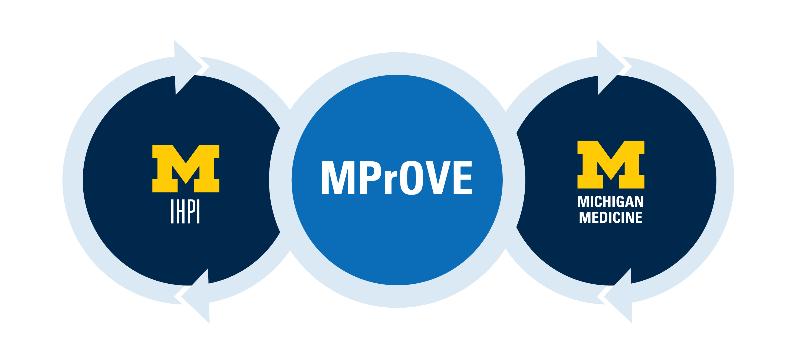

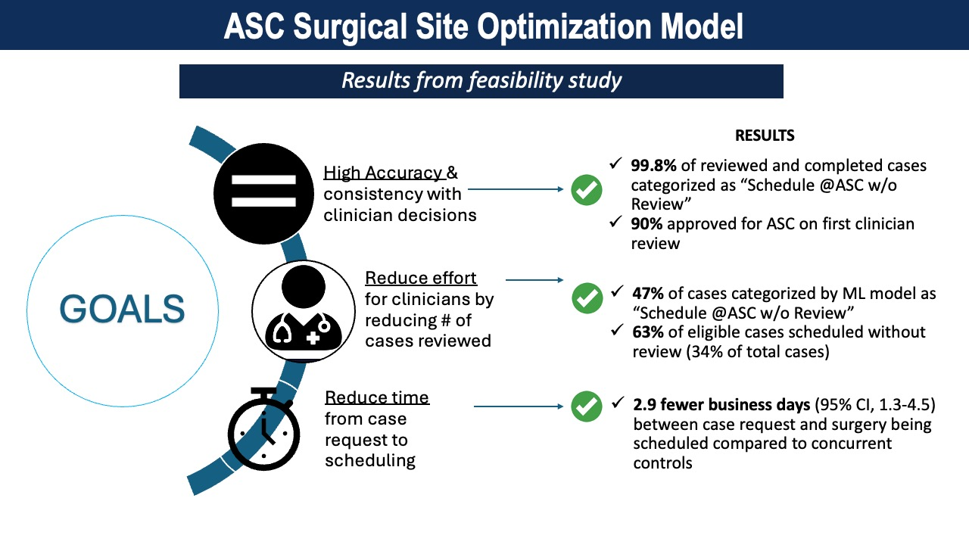


Feasibility of Using Machine Learning to Assess Patient Suitability for Surgery at an Ambulatory Surgical Center
James Henderson, PhD^{1,2}, Timothy P. Hofer, MD MSc^{1,2}, Anthony Cuttitta^{1,2} MPH, Bernard Jiang² MD, Wendy Benedict^{1,2} BS, Nicholas Box^{1,2} BA, Jillian Etcubañez² PA-C,
Shawna Lorch² CHES, Gretchen Pagac² MSN, RN, CNOR, Sapan Ambani² MD, Lesly Dossett^{1,2} MD, MPH
¹ Michigan Program on Value Enhancement, University of Michigan, Ann Arbor, MI; ² Michigan Medicine, Ann Arbor, MI
Background
For appropriate patients, surgery at an ambulatory surgical center (ASC) rather than a hospital-based outpatient department (HOPD) is safe, cost effective, and associated with increase patient satisfaction. We
We implemented a machine learning model to stratify patients by suitability for surgery at an ambulatory surgical center (ASC).
In a feasibility study, the model reduce manual clinical review by 30%, allowed surgeries to be scheduled 3 days sooner, and did not increase
late cancellations or other adverse events.
Table 1. Results.
Measure | Intervention |  | Control |  | Difference in Differences
 | Pre, N (%) | Post, N (%) | Pre, N (%) | Post, N (%) | DID (95% CI)
Total Cases | 90 (100) | 90 (100) | 160 (100) | 119 (100) | -
Scheduled w/o prior review | 2 (2.2) | 63 (70) | 4 (2.5) | 5 (4.2) | 66.1% (55.2-76.9%)
Scheduled Cases | 87 (100) | 86 (100) | 151 (100) | 113 (100) | -
Days until scheduled, mean (SD) | 3.4 (4.0) | 2.2 (2.8) | 4.3 (4.4) | 6.1 (5.4) | -2.9 (-4.5 to -1.3)
7-day cancellations | 0 (0.0) | 1 (1.75) | 3 (2.2) | 5 (6.8) | -2.8% (-9.9 to -4.3%)
Rescheduled to HOPD | 1 (1.5) | 2 (3.5) | 3 (2.2) | 3 (4.1) | 0.4% (-7.0 to 7.8%)
Research Question
Is it feasible to reduce manual clinical reviews for ASC suitability while providing non-inferior outcomes by stratifying patients using machine learning?
Population Studied
N = 985 Surgical Oncology patients requested for surgery January 26 – November 1, 2023, at two freestanding ASCs within an academic health system.
CI = Confidence Interval, DID = Difference in Differences, HOPD = Hospital Based Outpatient Department, SD = Standard Deviation
Methods
Feasibility study using a difference-in-difference (DID) design.
Intervention: Surgical cases classified by model as “Schedule @ASC w/o Review” do not require clinical review prior to scheduling.
Intervention arm: 2 surgeons &1 scheduler
Control arm: 3 surgeons & 1 scheduler
Pre period: January 26-June 28, 2023
Post period: June 29-November 1, 2023
Statistical comparisons are average marginal effects from a DID regression design.
Figure 1. Implementation Schematic
CASE REQUEST
Surgical team submits a case request for an ASC site
MPrOVE MODEL REVIEW
Model Categorizes Case as
“Schedule @ASC w/o Review”
or
“Review Required”
ASC REVIEW BY PREOP CLINIC
“Review Required”
or Control Group
ASC Review Determines ASC Suitability
Machine Learning Model
Predicts two outcomes: (1) Outcome of initial clinical review (order logit) and (2) Location (ASC vs HOPD) of completed surgery (logit).
Random effects for surgical procedure.
SCHEDULING
“Schedule @ASC w/o Review” and Intervention Arm
Patient is scheduled for surgery without review
After ASC Review is complete, patient is scheduled for surgery
Conclusion
In this feasibility study of surgical oncology patients, our machine learning model eliminated 1/3 of manual clinical reviews and was not associated with increased adverse events. A larger study (in progress) is needed to establish benefit and non-inferiority for adverse events in a broader population.
Acknowledgements
This quality improvement project was carried out by MPrOVE in cooperation with clinical partners at Michigan Medicine. The authors have no conflicts of interest to disclose.
Implication
Machine learning can effectively screen for patients suitable for surgery at an ambulatory surgical center and may be useful for reducing manual clinical reviews.
https://jbhender.github.io/research/hsr/
Academy_Health_2024.pdf

