Slide 1



Toward Accurate and Robust Cross-Ratio based Gaze Trackers Through Learning from Simulation
Jia-Bin Huang¹, Qin Cai², Zicheng Liu²,
Narendra Ahuja¹, and Zhengyou Zhang²
¹
²

Slide 2

Glint
Pupil
Iris
Limbus
Sclera
Cornea (like a spherical mirror)
Mike @ Monster University

Slide 3
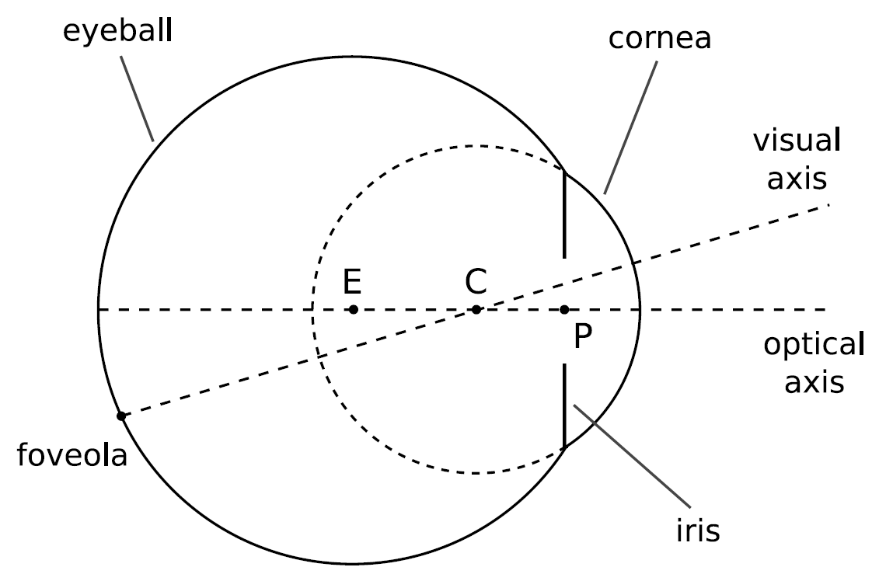
Geometric Model of an Eye

Slide 4
Gaze Estimation using Pupil Center and Corneal Reflections
Model-based
Interpolation-based
Cross-Ratio based

Slide 5
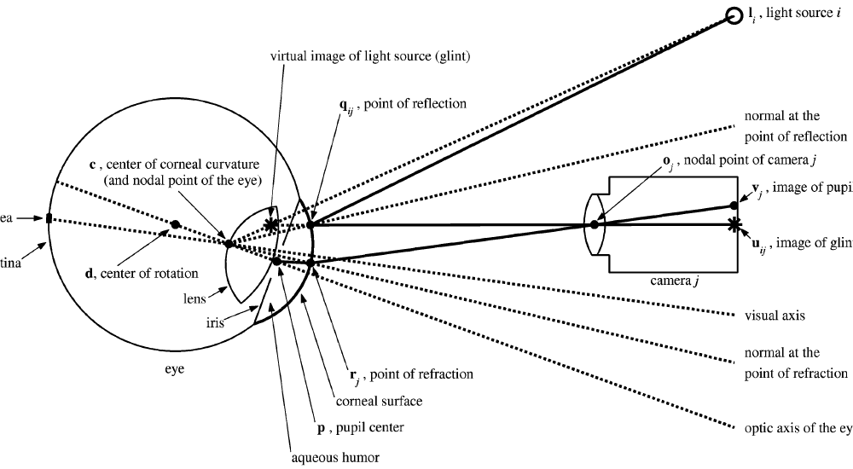
Model-based Gaze Estimation
Detailed geometric modeling between light sources, corneal, and camera [Guestrin and Eizenman, 2006]
Pros
Accurate (reported performance < 1º)
3D gaze direction
Head pose invariant
Cons
Need careful hardware calibration
Figure from [Guestrin and Eizenman, 2006]

Slide 6
Interpolation-based Gaze Estimation
Learn polynomial regression from subject-dependent calibration
Directly map from normalized to Point of Regard (2D PoR) [Cerrolaza et al., 2008]
Pros
Simple to implement
No need for hardware calibration
Cons
Head pose sensitive

Slide 7
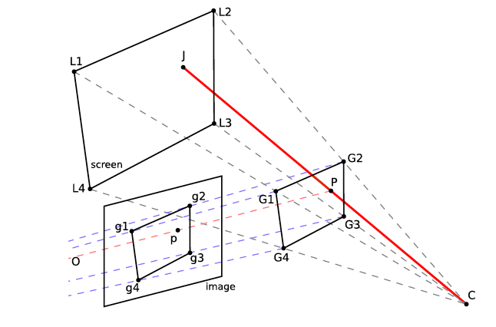
Cross-Ratio based Gaze Estimation
Gaze estimation by exploiting invariance of a plane projectivity [Yoo et al. 2002]
Pros
Simple to implement
No need for hardware calibration
Head pose invariant
Cons
Large subject dependent bias occur because simplifying assumptions
Figure from [Coutinho and Morimoto 2012]

Slide 8



The Basic Form of Cross-Ratio Method
Display
Corneal
Image

Slide 9
Two Sources of Errors [Kang et al. 2008]
Angular deviation of visual axis and optical axis
Virtual image of pupil center is not coplanar with corneal reflections

Slide 10
Improve Accuracy for Stationary Head
Homography correction + Residual interpolation
CR-HOM_{N} [Hansen-2010]
CR-HOM [Kang-2007]
Homography correction
CR-DV [Coutinho-2006]
Scale and translation correction
CR-Multi [Yoo-2005]
Scale correction
CR [Yoo-2002]
No correction

Slide 11
Improve Robustness for Head Movements
No adaptation
Adapt to eye depth variations
Adapt to eye movements Assumptions 1) weak perspective 2) fixed eye parameters.
CR [Yoo-2002]
CR-DD [Coutinho and Morimoto 2010]
PL-CR [Coutinho and Morimoto 2012]

Slide 12
Accuracy of Gaze Prediction for Stationary Head
Homography correction + Residual interpolation
CR-HOM_{N} [Hansen-2010]
Homography correction
CR-HOM [Kang-2007]
PL-CR [Coutinho-2012]
This paper
Scale and translation correction
CR-DV [Coutinho-2006]
CR-DD [Coutinho-2010]
Scale correction
CR-Multi [Yoo-2005]
No correction
Robustness to Head Movement
CR [Yoo-2002]
No adaptation
Adapt to eye depth variations only
Adapt to eye movements Assumptions 1) weak perspective 2) fixed eye parameters.
Adapt to eye movements No assumptions on 1) weak perspective 2) fixed eye parameters

Slide 13

How? The Main Idea
Build upon the homography normalization method [Hansen et al 2010]
Improving accuracy and robustness simultaneously by introducing the Adaptive Homography Mapping

Slide 14
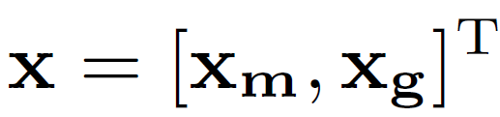



Adaptive Homograph Mapping
Two types of predictor variables
: capture the head movements relative to the calibration position
Affine transformation between the glints quadrilateral
: capture gaze direction for spatially-varying mapping
Pupil center position in the normalized space
: polynomial regression of degree two with parameter

Slide 15



Training Adaptive Homography Mapping
Exploit large amount of simulated data
the set of sampled head position in 3D
the set of calibration target index in the screen space
Objective function

Slide 16

Minimizing the Objective Function
Minimize an algebraic error at each sampled head position
Use the solution from algebraic error minimization as initialization Minimize the re-projection errors using the Levenberg-Marquardt algorithm

Slide 17
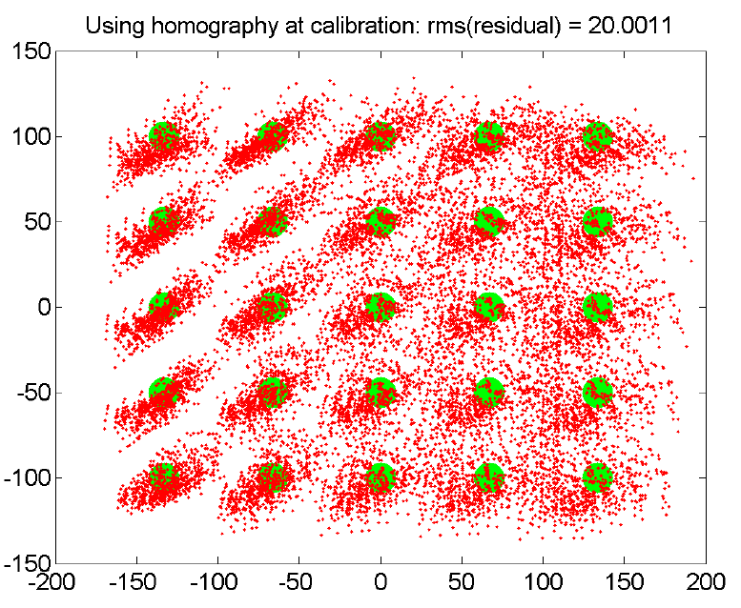
Visualize the Training Process
Eye gaze prediction results using the bias-correcting homography computed at the calibration position

Slide 18
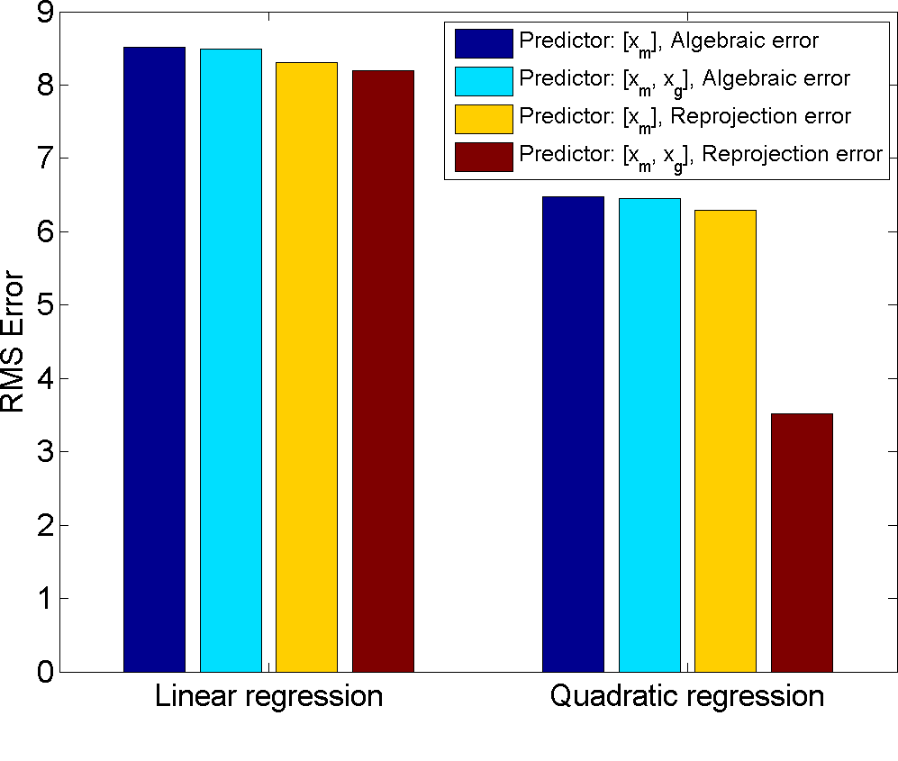
RMSE Error Comparisons Using Different Training Models
Differences are small in linear regression
Linear model is not sufficiently complex
Compensation using both predictor variables achieve the lowest errors

Slide 19

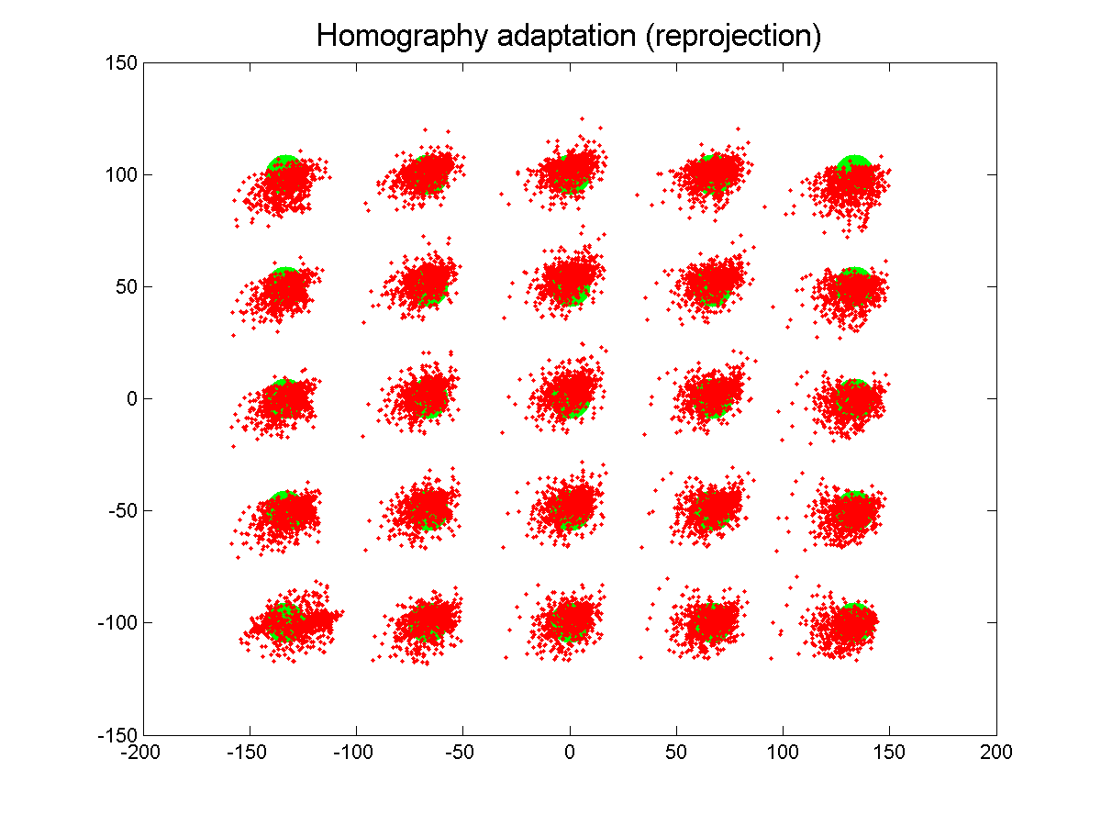
Linear Regression

Slide 20

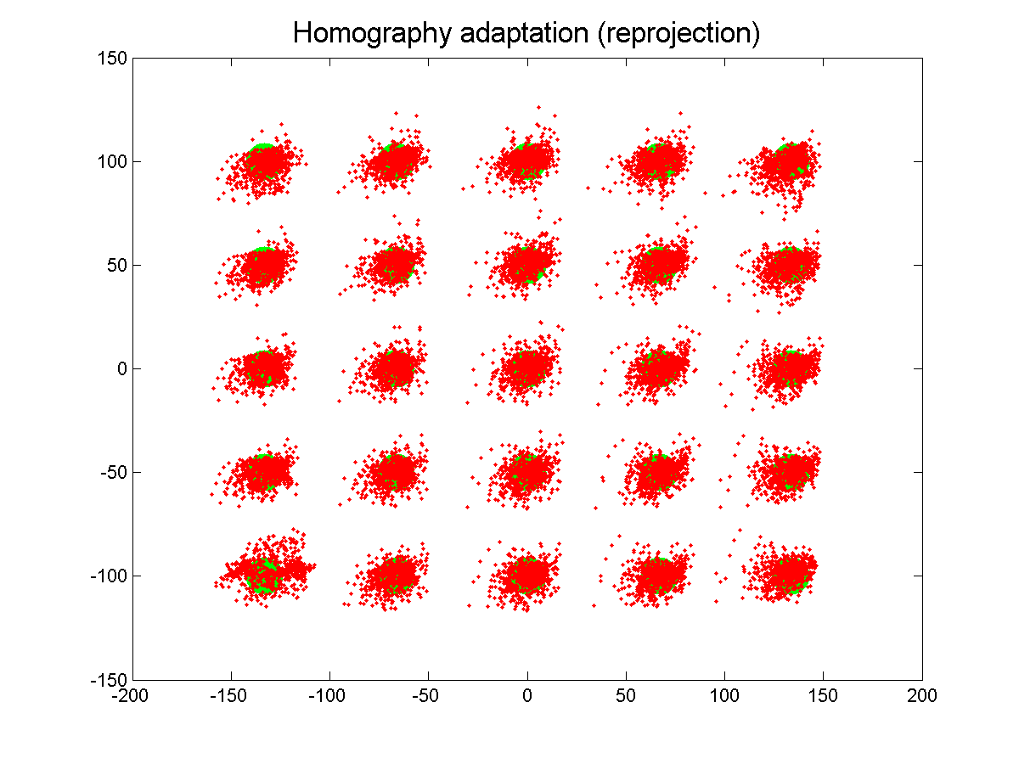
Linear Regression
Adding the normalized pupil center corrected spatially-varying errors

Slide 21
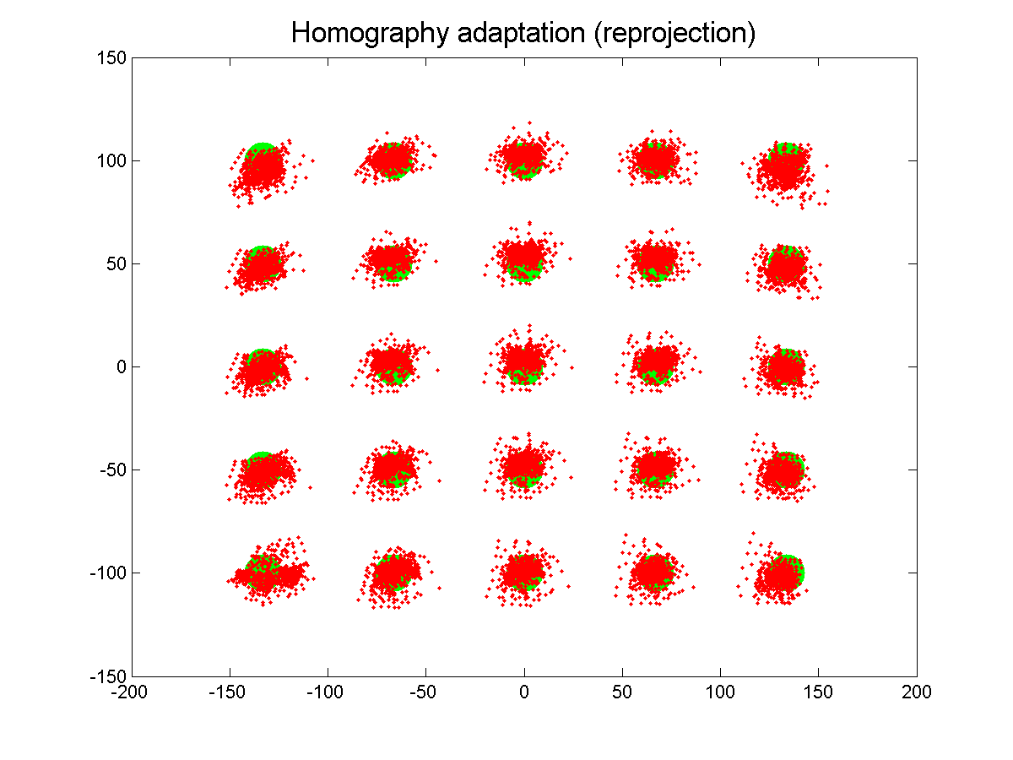
Quadratic Regression

Slide 22
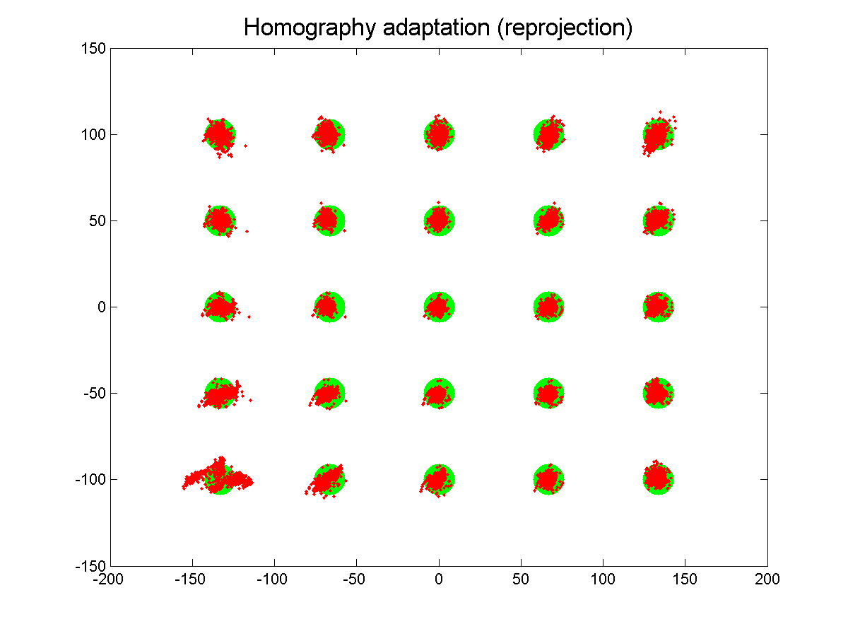
Quadratic Regression

Slide 23
Experimental Results – Synthetic data
Setup
Screen size 400mm x 300mm
Four IR lights
Camera 13mm focal length, placed slighted below the screen border (FoV~31 degree)
Calibration position and eye parameters
Eye parameters from [Guestrin and Eizenman, 2006]

Slide 24
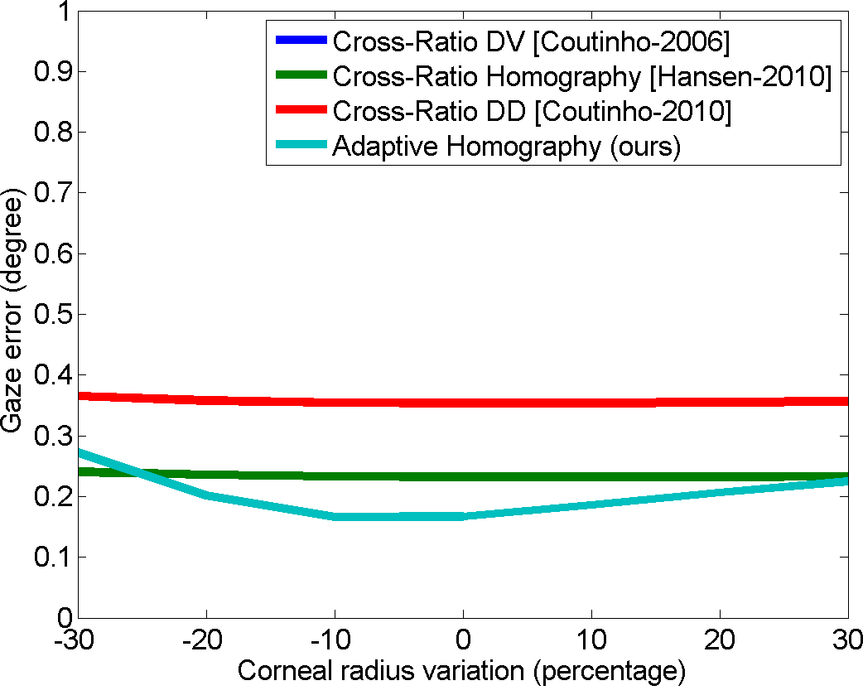
Stationary Head Varying corneal radius

Slide 25
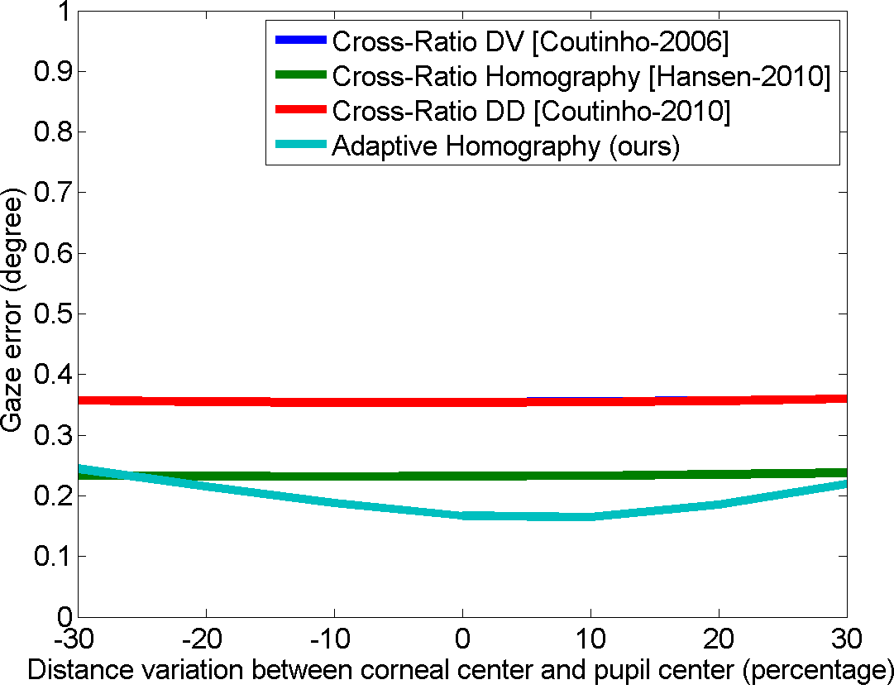
Stationary Head Varying pupil-corneal distance

Slide 26
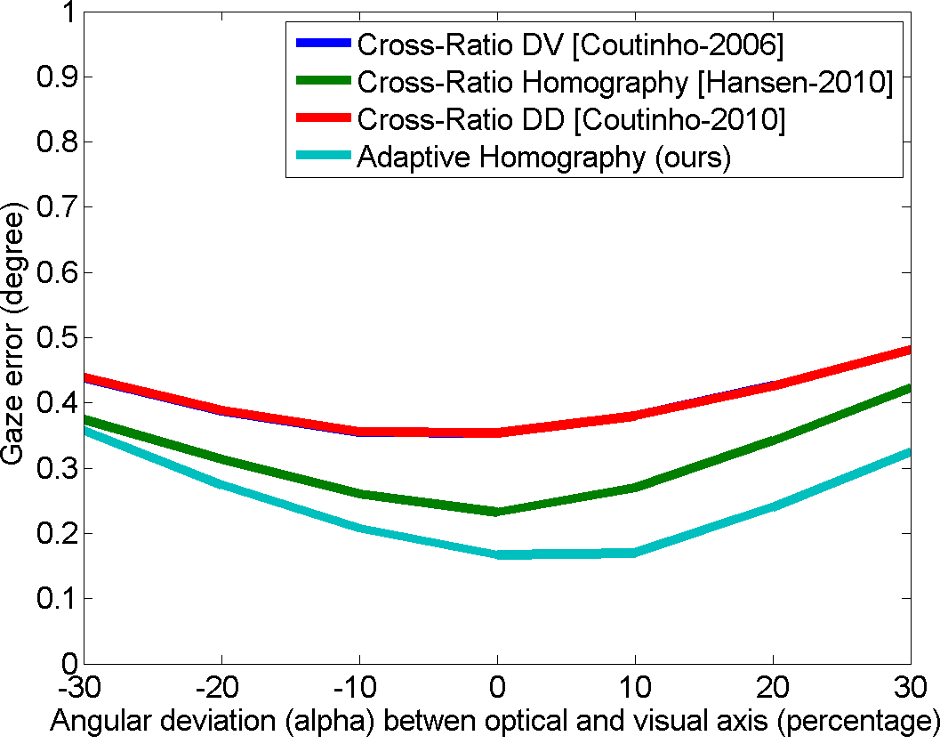
Stationary Head Varying (horizontal) angle between optical/visual axis

Slide 27
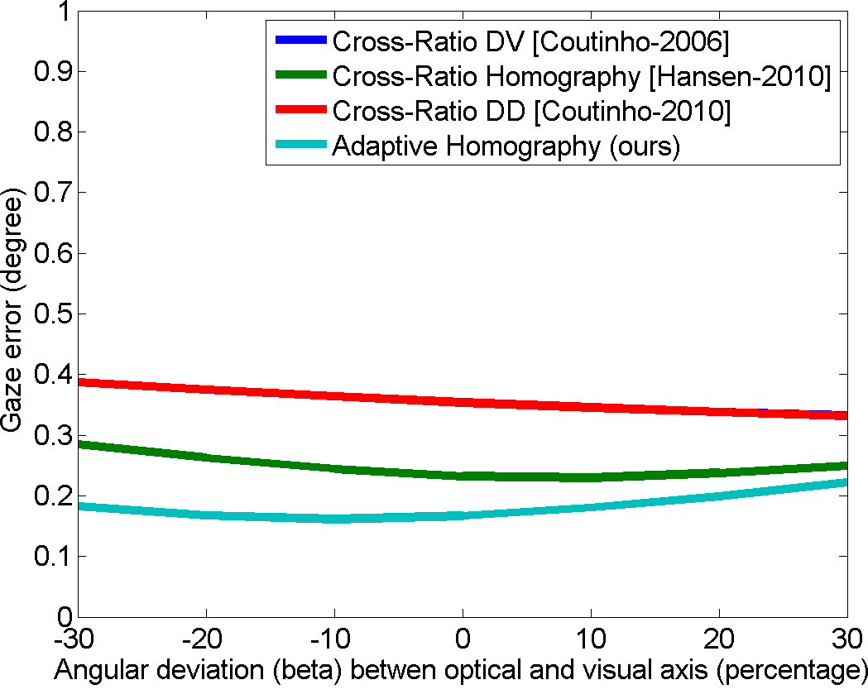
Stationary Head Varying (vertical) angle between optical/visual axis

Slide 28
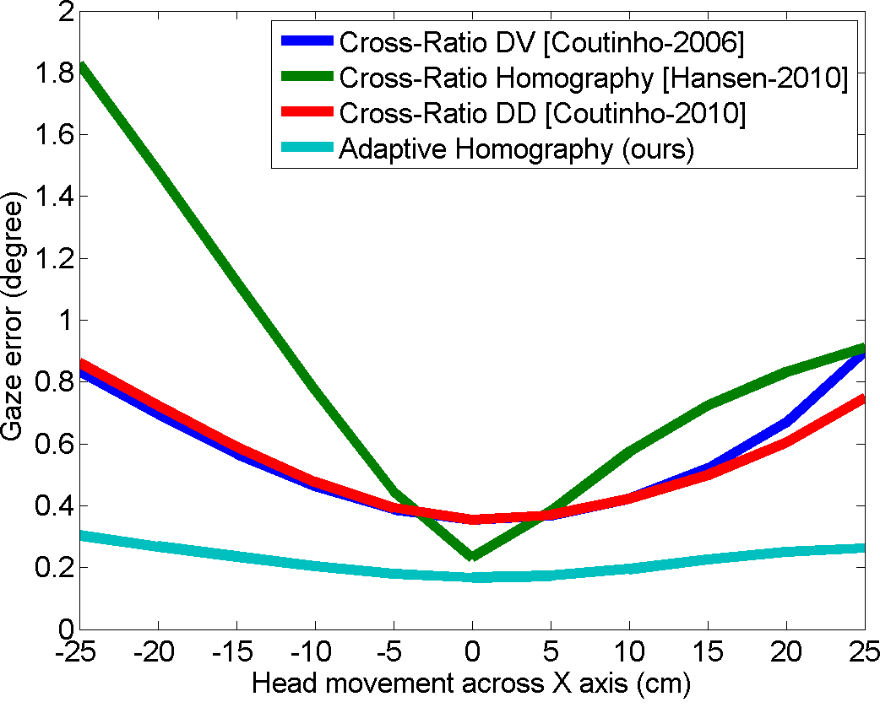
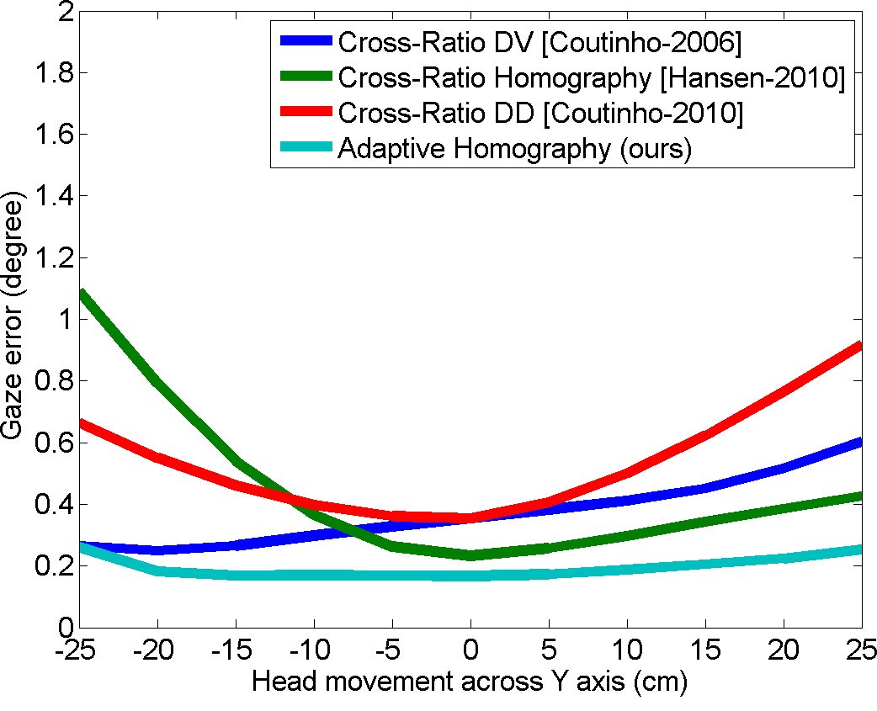
Head Movements Parallel to the Screen

Slide 29
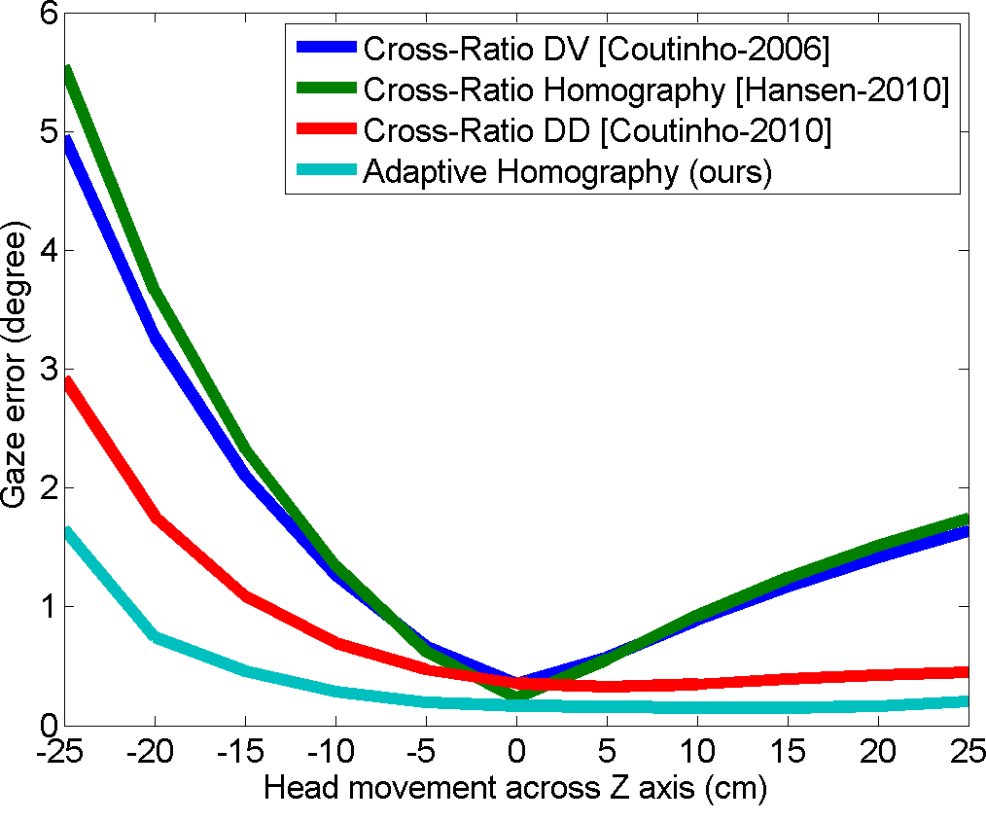
Head Movement along Depth Variation

Slide 30
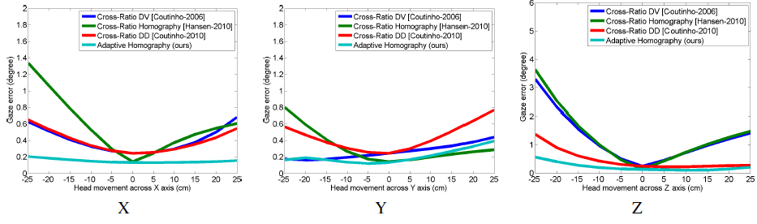
Tested at Another Head Position

Slide 31
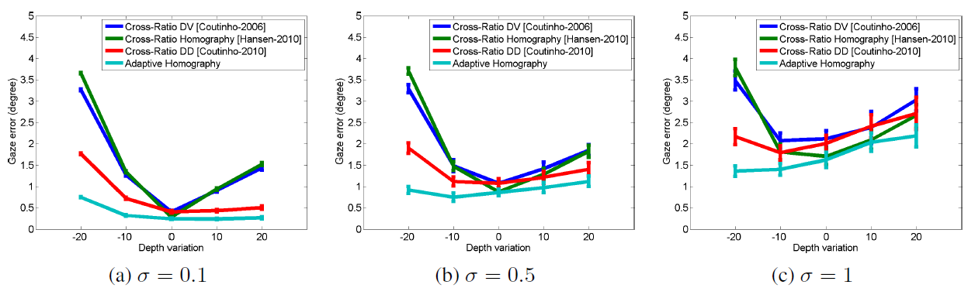
Noise Sensitivity Analysis

Slide 32
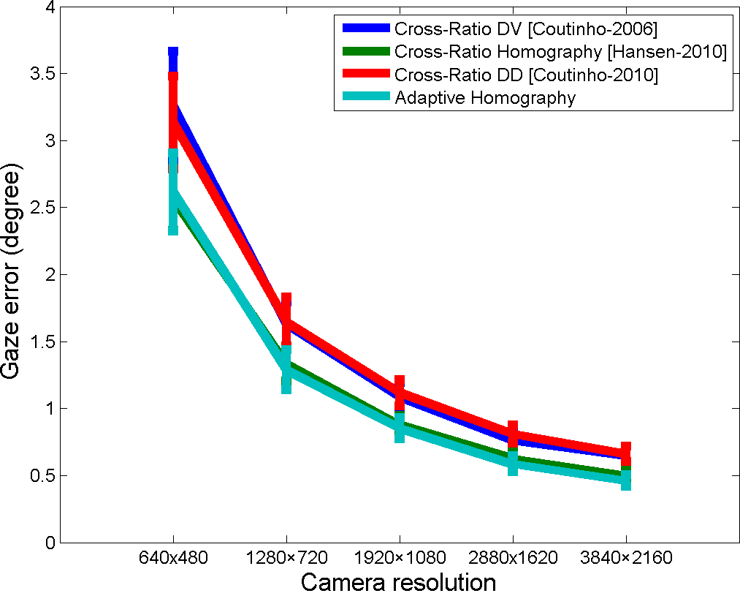
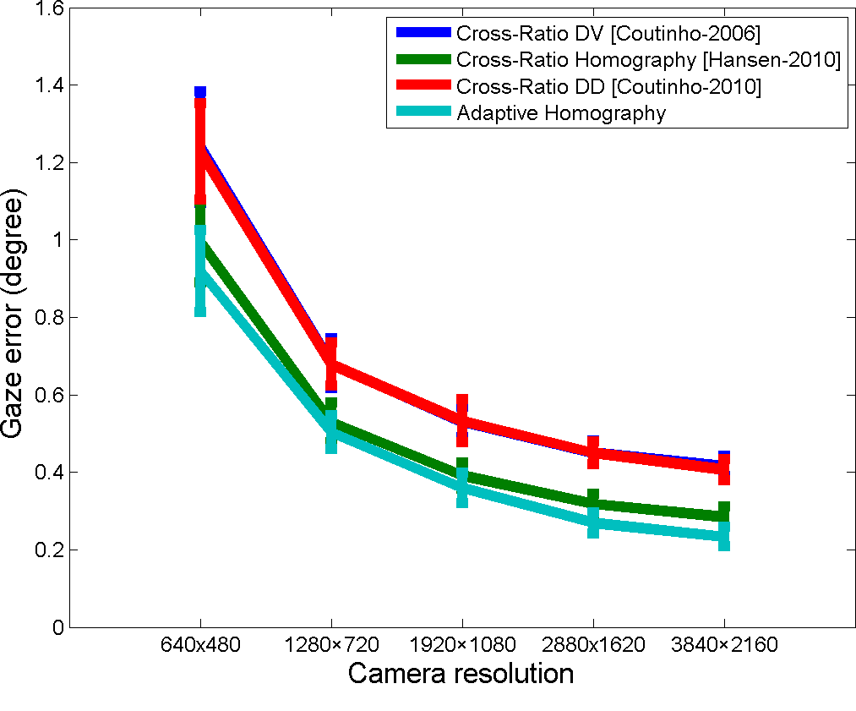
Effect of Sensor Resolution (at calibration)
Focal Length = 13 mm
Focal Length = 35 mm

Slide 33
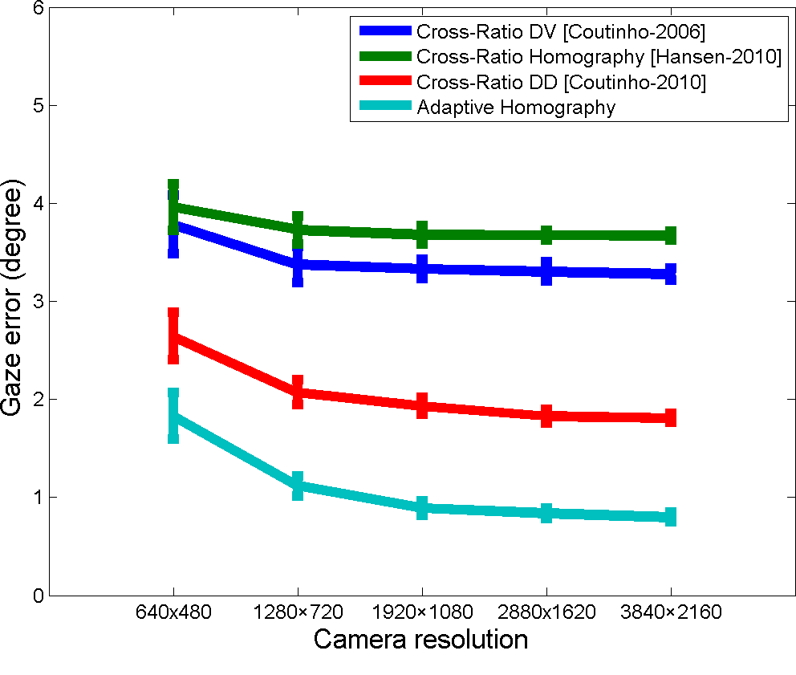
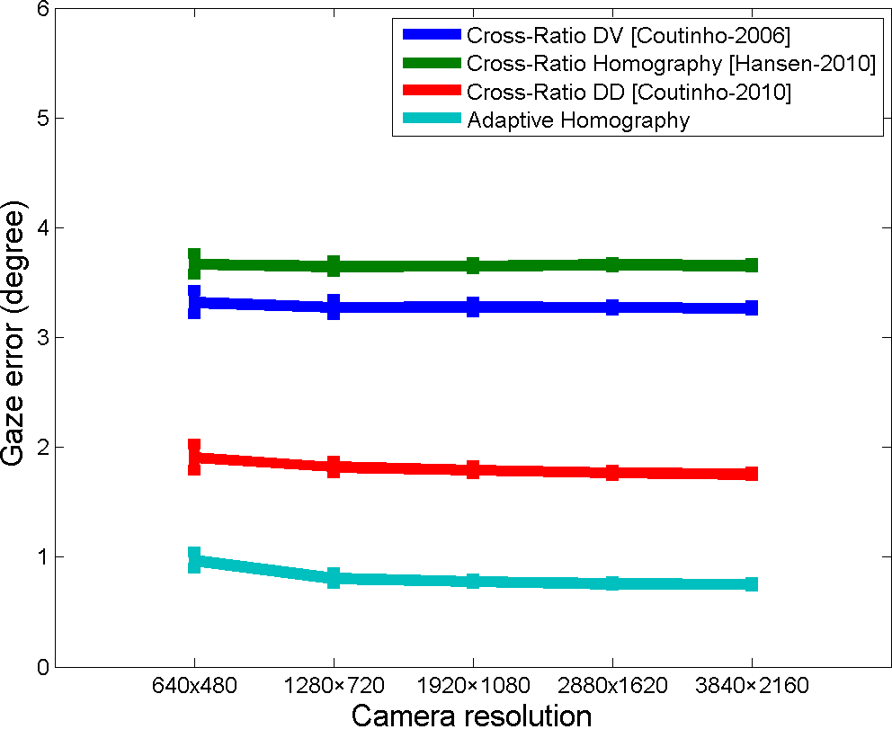
Effect of Sensor Resolution (at new position)
Focal Length = 13 mm
Focal Length = 35 mm

Slide 34
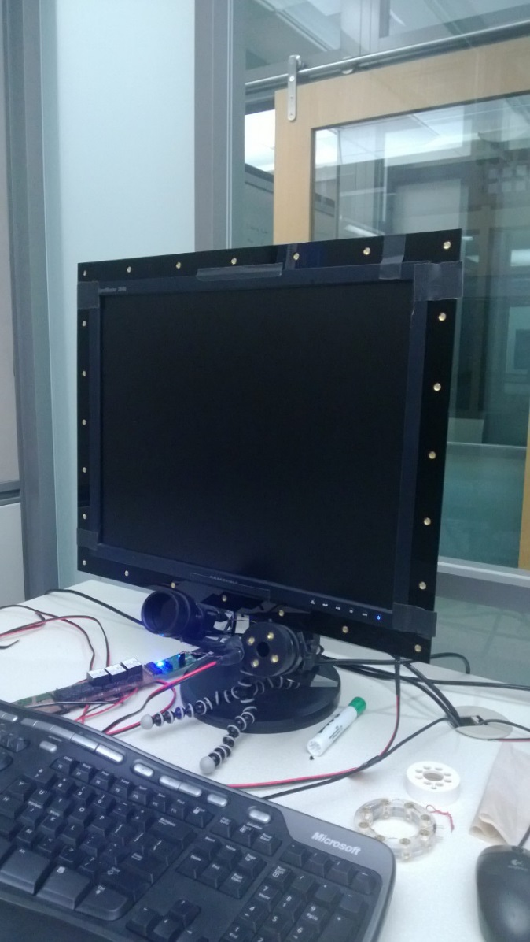
Real Data Evaluation – Programmable Hardware Setup
Off-axis IR light sources
On-axis ring light
Stereo camera (We use one only in this work)

Slide 35
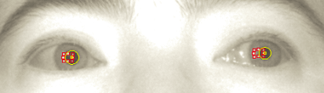
Real Data Evaluation – Feature Detection
Detecting glints and pupil center

Slide 36
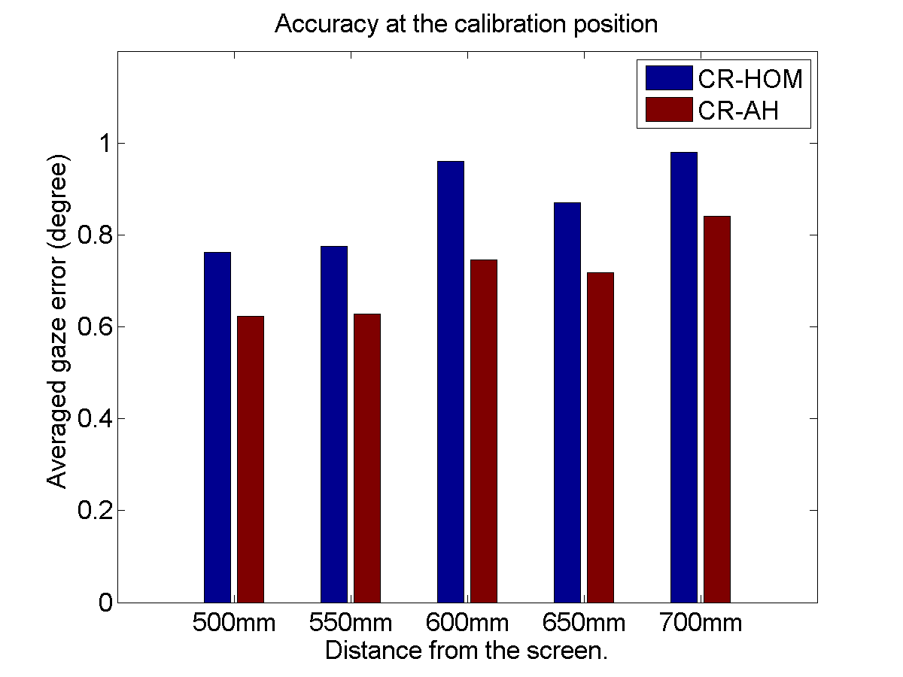
Averaged Gaze Estimation Error
at calibration position

Slide 37
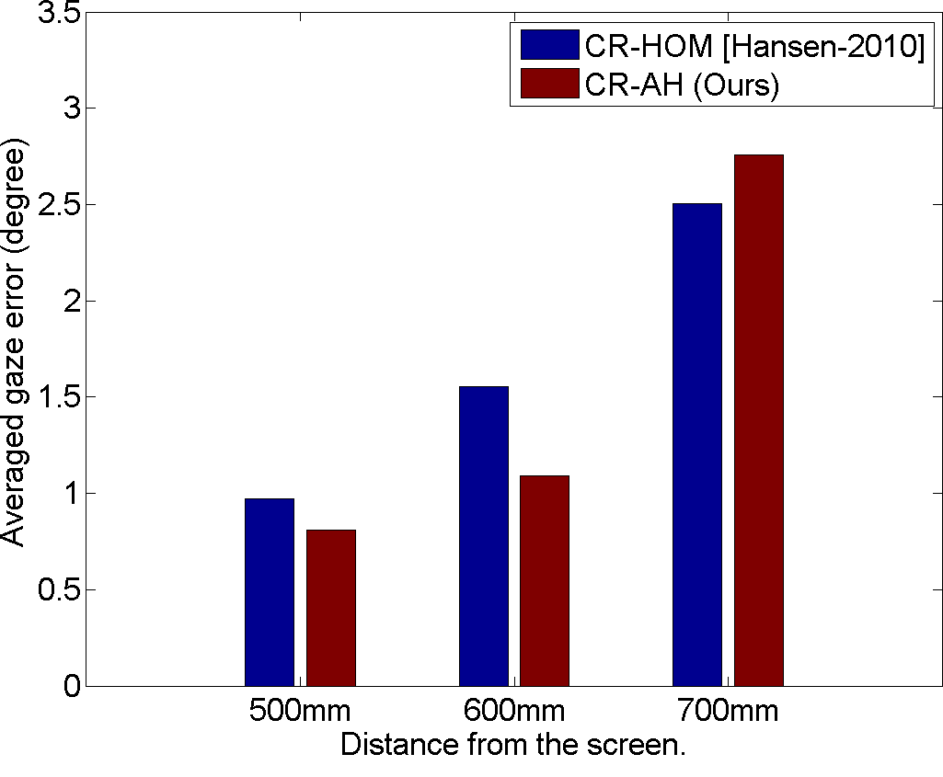
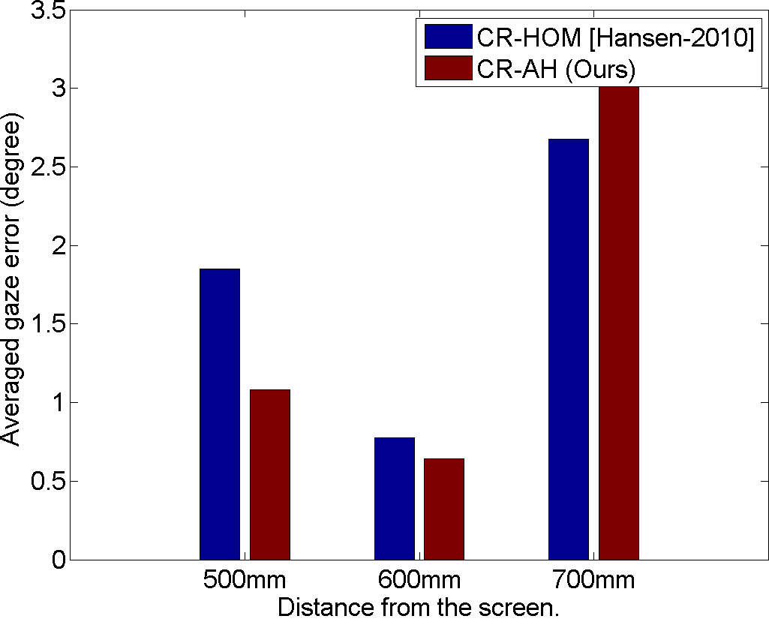
Averaged Gaze Estimation Error
Calibrated at 500mm from screen
Calibrated at 600mm from screen

Slide 38
Conclusions
A learning-based approach for simultaneously compensating (1) spatially varying errors and (2) errors induced from head movements
Generalize previous work on compensating head movements using glint geometric transformation [Cerroaza et al. 2012] [Coutinho and Morimoto 2012]
Leveraging simulated data avoid the tedious data collection

Slide 39
Future Work
Consider subject-dependent parameters in the learning and inference the adaptive homography adaptation
Integrate binocular information, please see poster Zhengyou Zhang, Qin Cai, Improving Cross-Ratio-Based Eye Tracking Techniques by Leveraging the Binocular Fixation Constraint
Extensive user study using a physical setup

Slide 40





Comments or questions?
Jia-Bin Huang jbhuang1@Illinois.edu
Qin Cai
qincai@microsoft.com
Zicheng Liu
zliu@microsoft.com
Narendra Ahuja
n-ahuja@Illinois.edu
Zhengyou Zhang
zhang@microsoft.com

