Slide 1

ngular

Slide 2
Overview
AngularJS is an open-source web application framework mainly maintained by Google and by a community of individuals and corporations to address many of the challenges encountered in developing single-page applications. It aims to simplify both the development and the testing of such applications by providing a framework for client-side architectures, along with components commonly used in rich Internet applications.

Slide 3
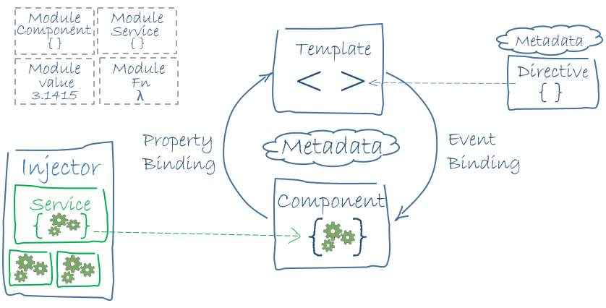
Architecture

Slide 4
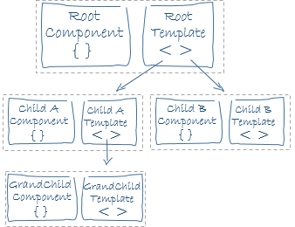
Component Hierarchy
Projects contain a single root Component
Components contain a template defined in its metadata
Templates may contain Directives, which instruct the framework to load a specific Component

Slide 5
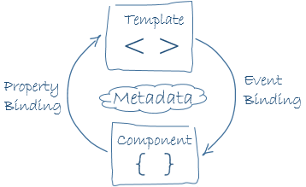
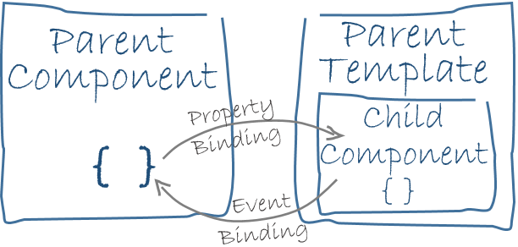
Component
Components and Templates communicate through their bindings
Property-bindings and Event-bindings are one-way
A Component can expose specific properties or methods to other Components

Slide 6
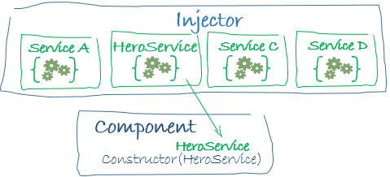
Services / Dependency Injection
Services contain your business logic and make requests to your server endpoints
Services are commonly Injected into Components
This approach increases testability across the whole application

Slide 7
Learning Curve
Fairly easy to pick
Lots of training videos already (e.g. Udemy, Youtube, Lynda.com)
Angular.io contains a thorough tutorial project
Already contains 7500+ stack overflow questions (200k+ for AngularJs)
HTML template syntax gets some getting used to
Positive changes have been made to their template API since we began

Slide 8
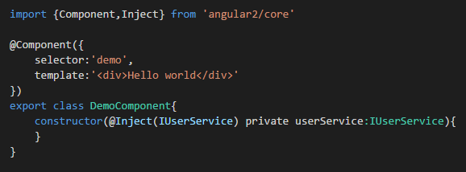
Syntax / Legibility
At-a-glance, easy to read and comprehend
Template and CSS can contain syntax highlighting when in separate files

Slide 9
Debugging
Syntax highlighting occurs for compiler errors
Runtime errors in browser console are easy to understand and well-documented
Compiled .MAP files allow for TypeScript debugging

Slide 10
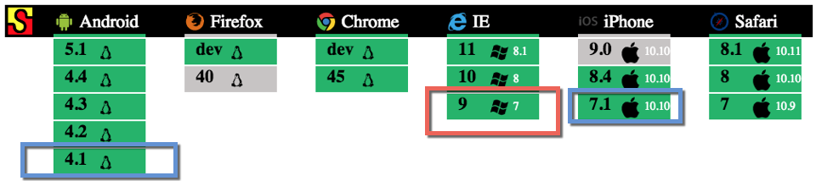
Browser Support

Slide 11
Testing Support
Most test libraries should work (Jasmine was used in the Angular.io tutorial)
Can configure to run on live-server which automatically refreshes

Slide 12
Performance

Slide 13
Extensibility

Slide 14
Developer Support

Slide 15
Size

Slide 16
Stability

Slide 17
Pros
Lots of contributors (https://angular.io/about/) and many large websites are using it!
Low decision fatigue
Opinionated documentation advocates for the use of industry best practices such as: dependency injection, unit testing, service layers, interfaces and separation of concerns.
TypeScript – consistent documentation
Reduced Churn
Web component friendly

Slide 18
Cons
No syntax highlighting within Template strings
Just came out with a release candidate
Modified parts of the API and Template format during our investigation
Some coding errors will not produce runtime or compiler errors (very uncommon)

Slide 19
Sources
https://angular.io/docs/ts/latest/guide/architecture.html
https://en.wikipedia.org/wiki/AngularJS
http://www.gurustop.net/blog/2015/10/07/angularjs2-internet-explorer-support

