Slide 1

ngular
Presenters: Justin Bicknell Colin Kirk

Slide 2
Overview
AngularJS is an open-source web application framework mainly maintained by Google and by a community of individuals and corporations to address many of the challenges encountered in developing single-page applications. It aims to simplify both the development and the testing of such applications by providing a framework for client-side architectures, along with components commonly used in rich Internet applications.

Slide 3
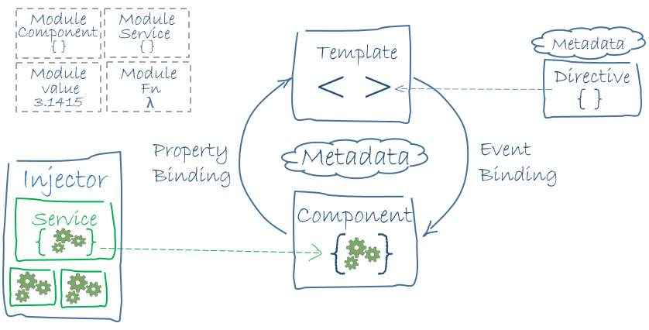
Fundamentals

Slide 4
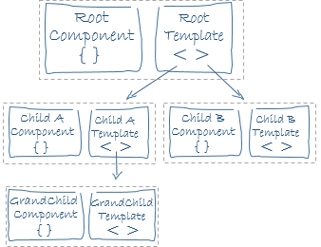
Component Hierarchy
Projects contain a single root Component
Components contain a Template defined in its metadata
Templates may contain Directives which change the behaviour or appearance of the DOM

Slide 5
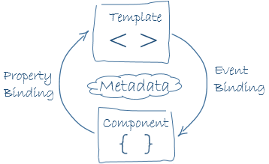
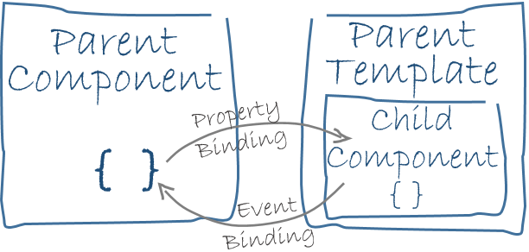
Bindings
Components and Templates communicate through their bindings
Property-bindings and Event-bindings are one-way
A Component can expose specific properties or methods to other Components
ngModel is used for form inputs and is an example of a two-way binding

Slide 6
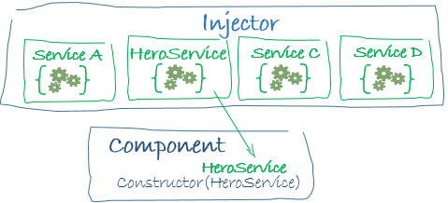
Services / Dependency Injection
Services contain your business logic and commonly make requests to your server
Services can be Injected into Components, or any class dependency
This approach increases testability across the whole application

Slide 7
Learning Curve
Fairly easy to pick, intuitive API
Has similar concepts and structure to our backend
Lots of training videos already (e.g. Udemy, Youtube, Lynda.com)
Angular.io contains a thorough tutorial project
Already contains 7500+ stack overflow questions (200k+ for AngularJs)
HTML template syntax gets some getting used to
Positive changes have been made to their Template API since we began

Slide 8
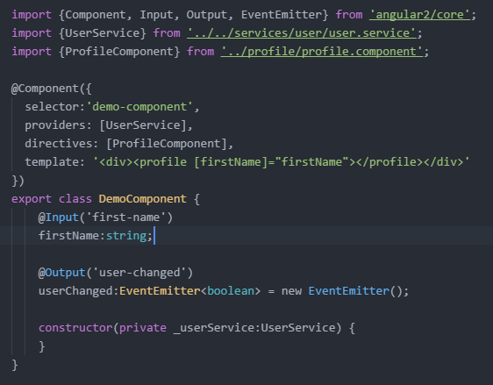
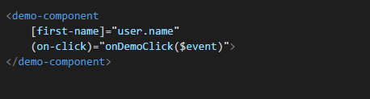
Syntax / Legibility
Template and CSS can contain syntax highlighting when in separate files
Code is easy to read and comprehend
Favors composition over inheritance

Slide 9
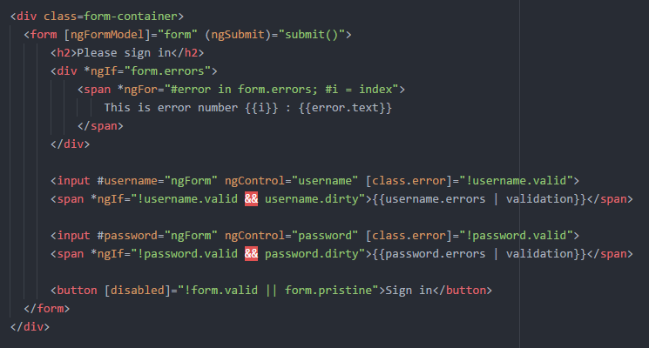
Syntax / Legibility
Template and CSS can contain syntax highlighting when in separate files
Code is easy to read and comprehend
Favors composition over inheritance

Slide 10
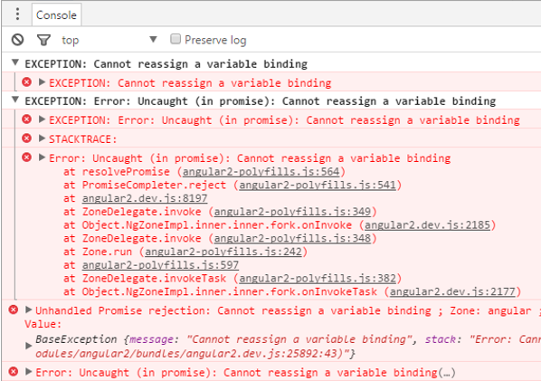
Debugging
Syntax highlighting occurs for compiler errors
Runtime errors in browser console are well-documented
Runtime errors don’t always come with line numbers
Compiled .MAP files allow for TypeScript debugging

Slide 11
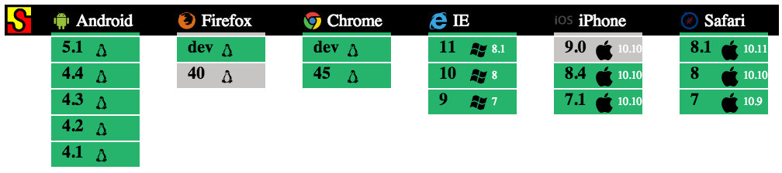
Browser Support

Slide 12
Testing Support
Most test libraries should work (Jasmine was used in the Angular.io tutorial)
Can configure to run on live-server which automatically refreshes
Dependency Injection makes objects within the application mockable
Able to test everything
Setup of test framework dependencies can be overwhelming and hard to follow (mostly because they are still under development)

Slide 13
Performance
Optimized for today's JavaScript virtual machines using an advanced change detection algorithm
RxJS Observables offer push-model data flows letting you optimize the change detection strategy
Serve the first view of your application on node.js, .NET, PHP and other servers for near-instant rendering
Component router delivers automatic code-splitting
Out of the box support for web workers

Slide 14
Developer Support
Ridiculously large community of long-time angular developers and new adopters
Built by the same people who built Angular 1
ngUpgrade and ngForward offers detailed and seamless upgrade strategies from Angular 1 to 2
Open to community, collaborating closely

Slide 15
Stability
Careful, methodical reinvention of mature, comprehensive framework
Less churn after release than other frameworks
Single team making decisions about future

Slide 16
Pros
Advocates for the use of industry best practices such as: dependency injection, unit testing, service layers, interfaces and separation of concerns (similar to our current backend)
Lots of contributors (https://angular.io/about/)
Low JavaScript fatigue / reduced Churn
Consistent documentation
Static type checking with TypeScript
Angular 2’s design embraces web component’s standard (rendering cross-platform native UI for iOS and Android)

Slide 17
Cons
Template syntax takes some getting used to
No syntax highlighting within Template or CSS strings (coming soon to editors)
Many errors are caught at runtime
Just came out with a release candidate
Modified parts of the API and Template format during our investigation
Some coding errors will not produce runtime or compiler errors (very uncommon)
Does not contain any built-in handlers for state

Slide 18
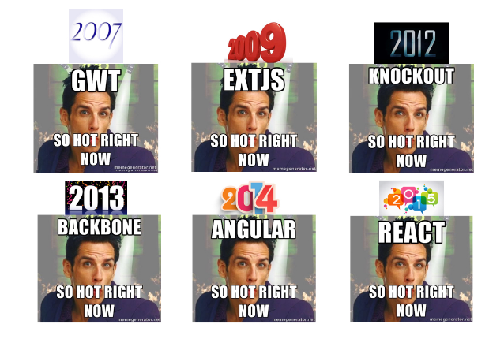
Angular 2 will be what’s “so hot right now” in 2016

Slide 19
Sources
https://angular.io/
https://en.wikipedia.org/wiki/AngularJS
http://www.gurustop.net/blog/2015/10/07/angularjs2-internet-explorer-support
https://medium.freecodecamp.com/angular-2-versus-react-there-will-be-blood-66595faafd51
http://www.syntaxsuccess.com/viewarticle/angular-2.0-unit-testing
http://developer.telerik.com/featured/will-angular-2-be-a-success-you-bet/

