Slide 1

ngular

Slide 2
Overview
AngularJS is an open-source web application framework mainly maintained by Google and by a community of individuals and corporations to address many of the challenges encountered in developing single-page applications. It aims to simplify both the development and the testing of such applications by providing a framework for client-side architectures, along with components commonly used in rich Internet applications.

Slide 3
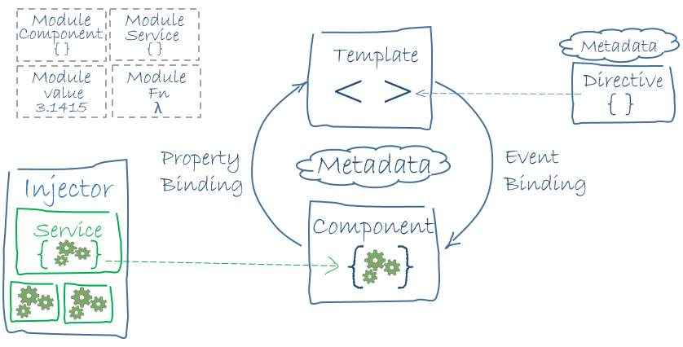
Overview

Slide 4
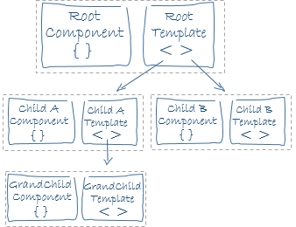
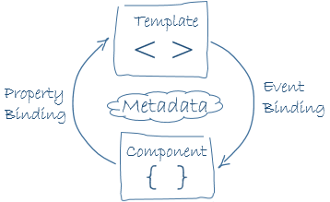
Overview

Slide 5
Learning Curve
In our own experience learning over the course of a couple of weeks, we were able to create and build a simple SPA application using only Angular 2. Features within the framework are well documented and there is an abundance of tutorials/videos to coach you along.
Angular’s documentation advocates for the use of industry best practices such as dependency injection, unit testing, service layers, interfaces, strongly typed properties, and separation of concerns.
Out of the box Angular provides tools to assist you with these practices, such as Dependency Injection, Unit testing frameworks and support for TypeScript.

Slide 6
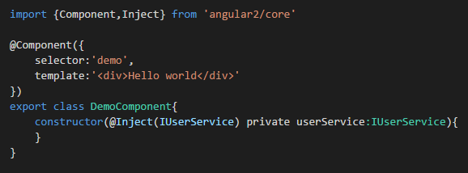

Slide 7
Syntax / Legibility

Slide 8
Longevity

Slide 9
Browser Support

Slide 10
Testing Support

Slide 11
Performance

Slide 12
Extensibility

Slide 13
Developer Support

Slide 14
Size

Slide 15
Stability

Slide 16
Pros
Lots of contributors (https://angular.io/about/)

Slide 17
Cons

Slide 18
Sources

