Slide 1
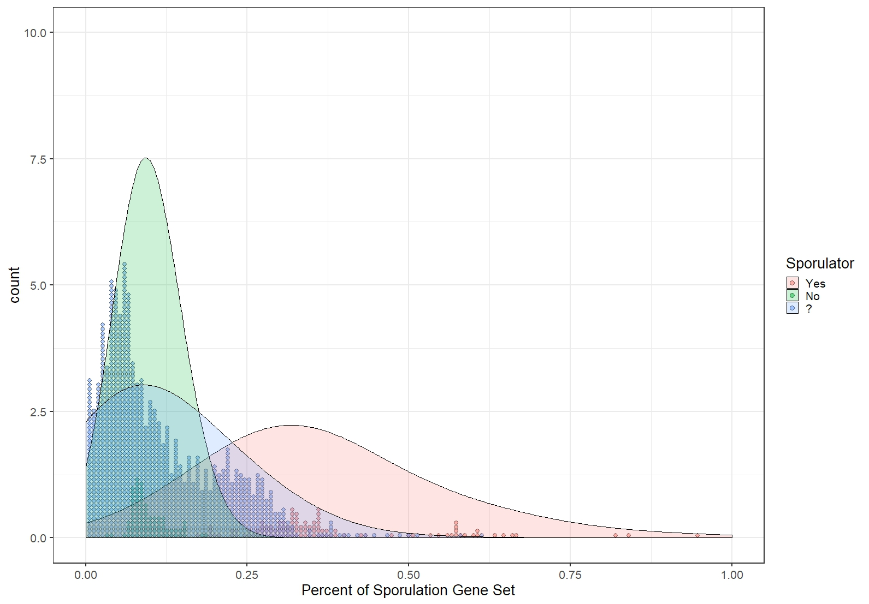

Slide 2
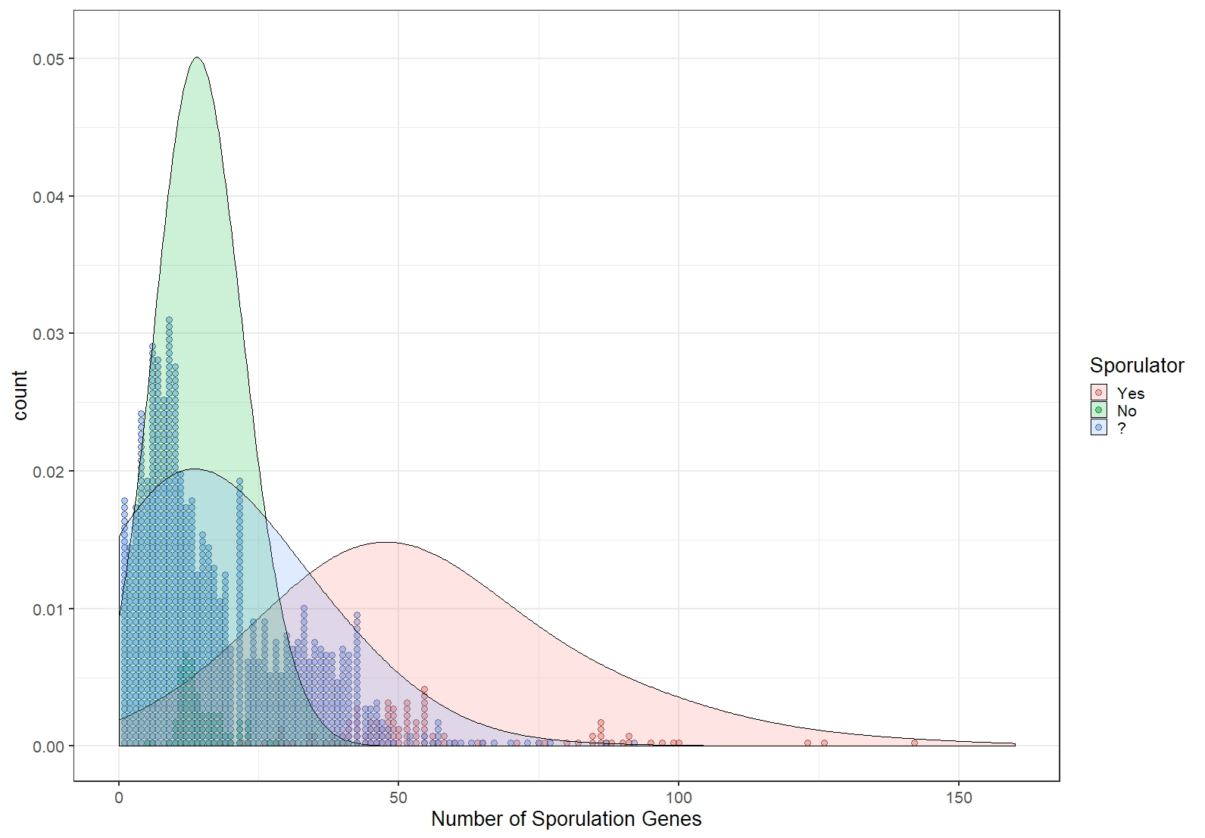

Slide 3
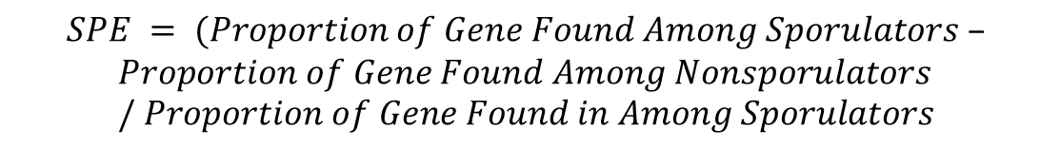

Weighted Percent
$$\left[\begin{matrix}1 & 1 \\ 0 & 1 \\ 1 & 1\end{matrix}\right]∗Sporulator Exclusivity Proportion (SPE)$$
$$SPE = (Proportion of Gene Found Among Sporulators –$$
$$Proportion of Gene Found Among Nonsporulators / Proportion of Gene Found in Among Sporulators$$

Slide 5
Mean No ≈ 14.5 genes

Slide 6
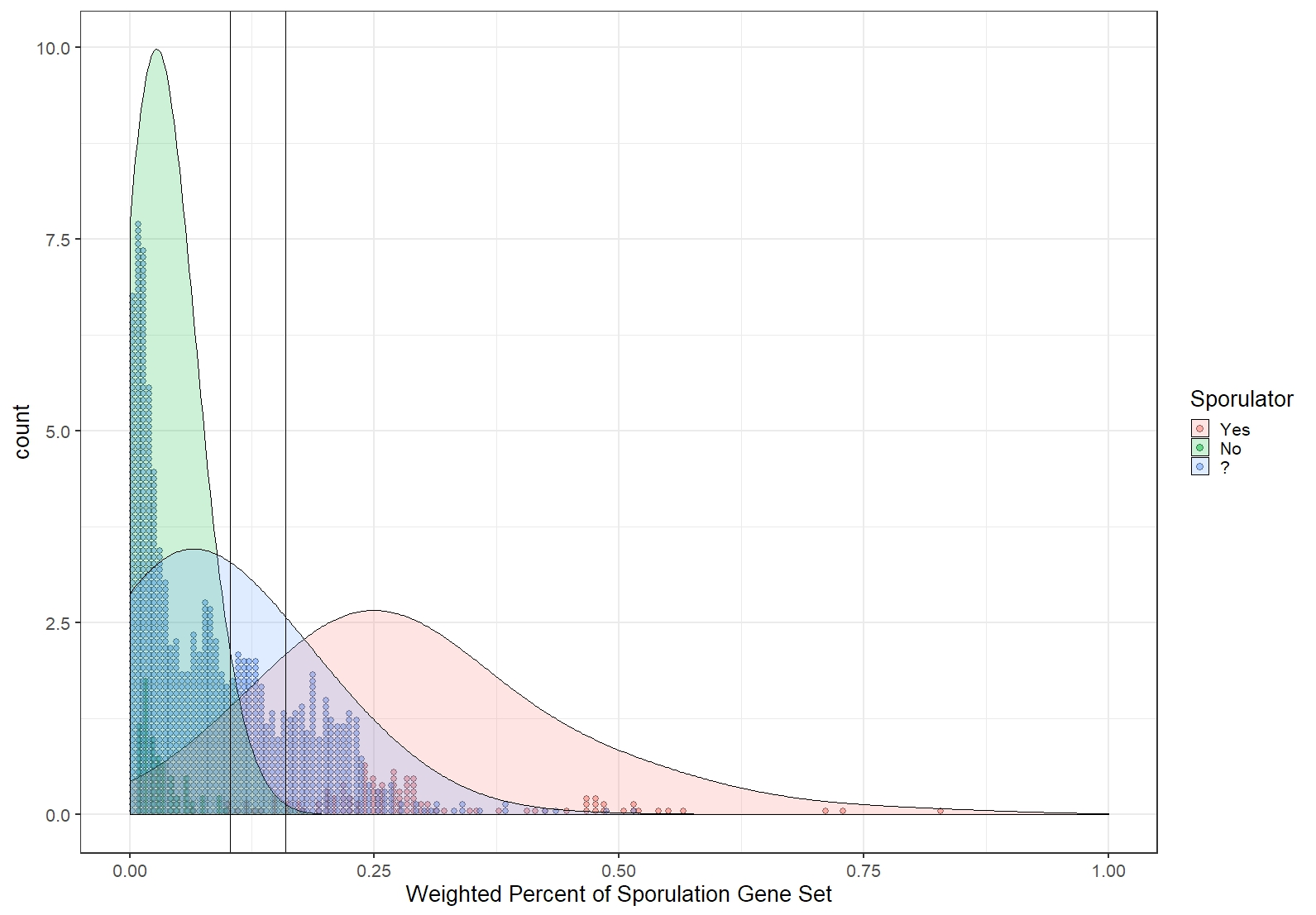
Mean No ≈ 4.75 “good” genes
Likely Sporulators
Sporulators
3.290σ No
1σ Yes

Slide 7
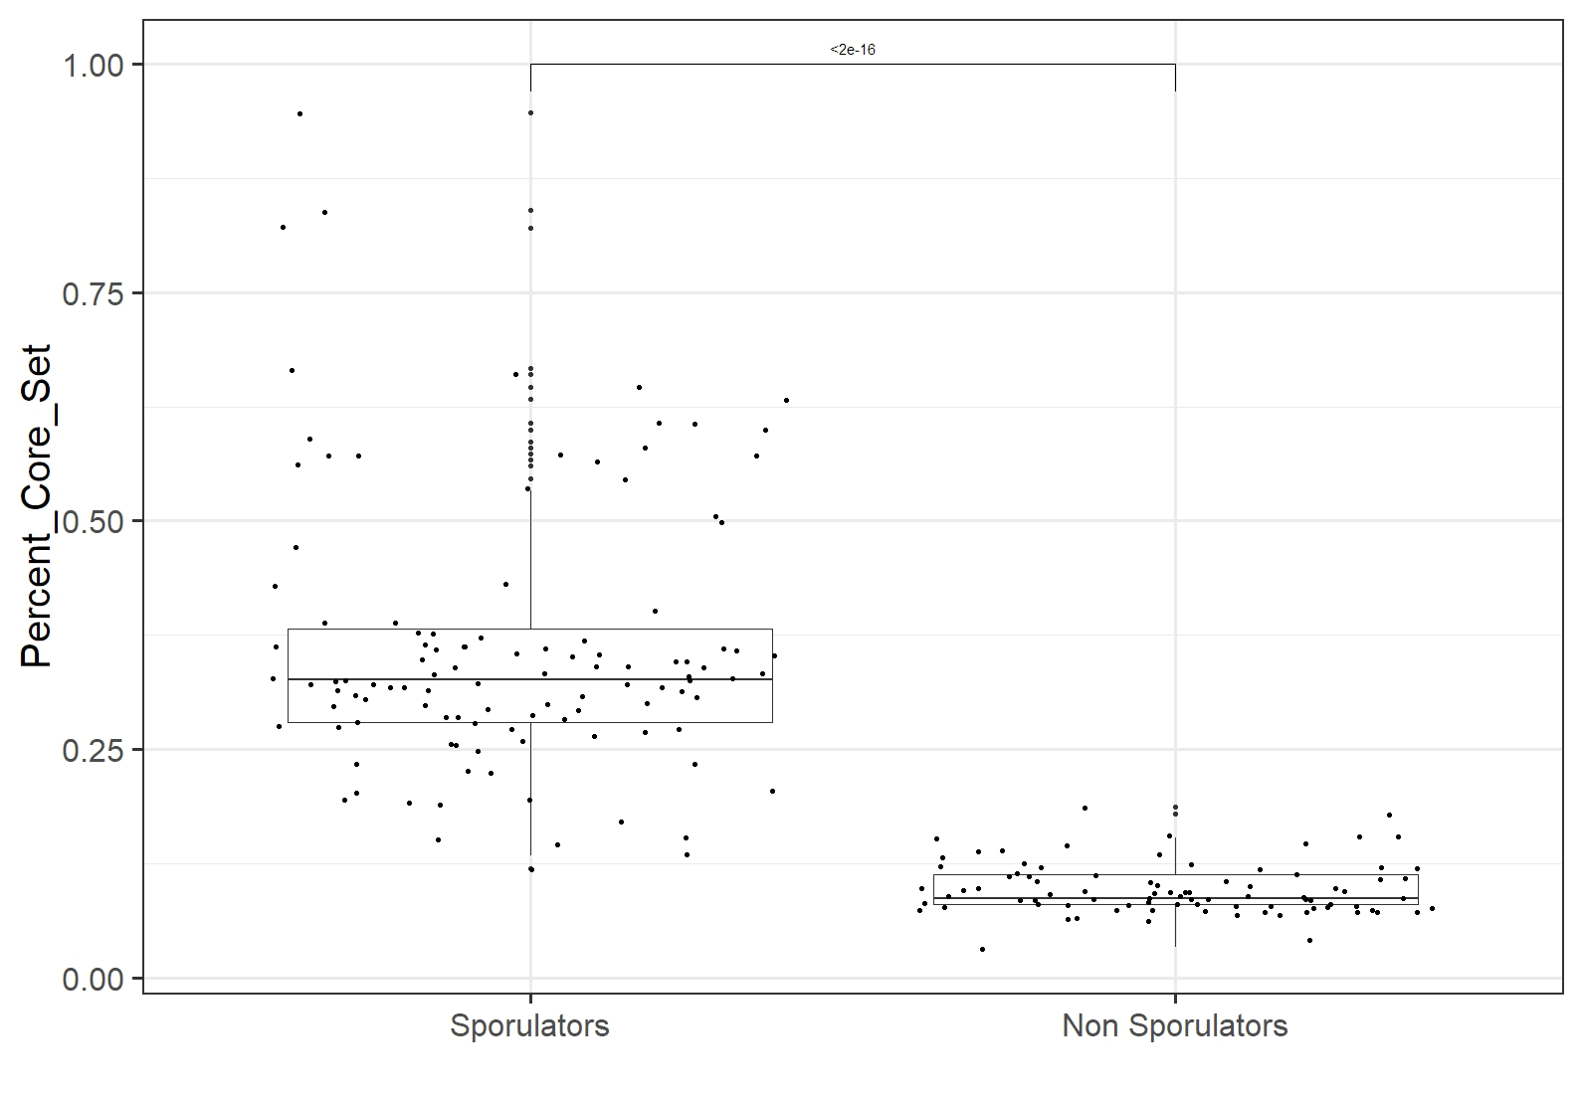

Slide 8
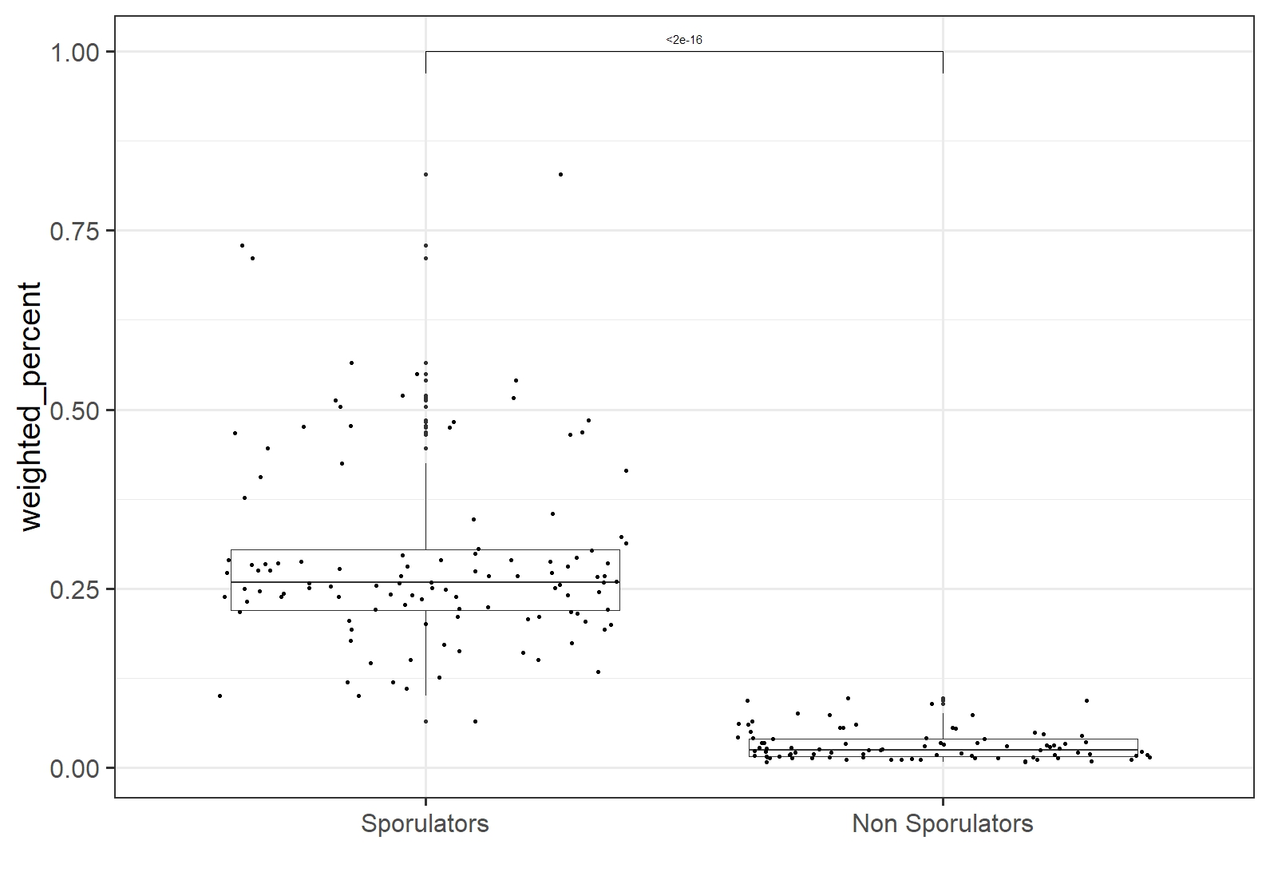

Slide 9
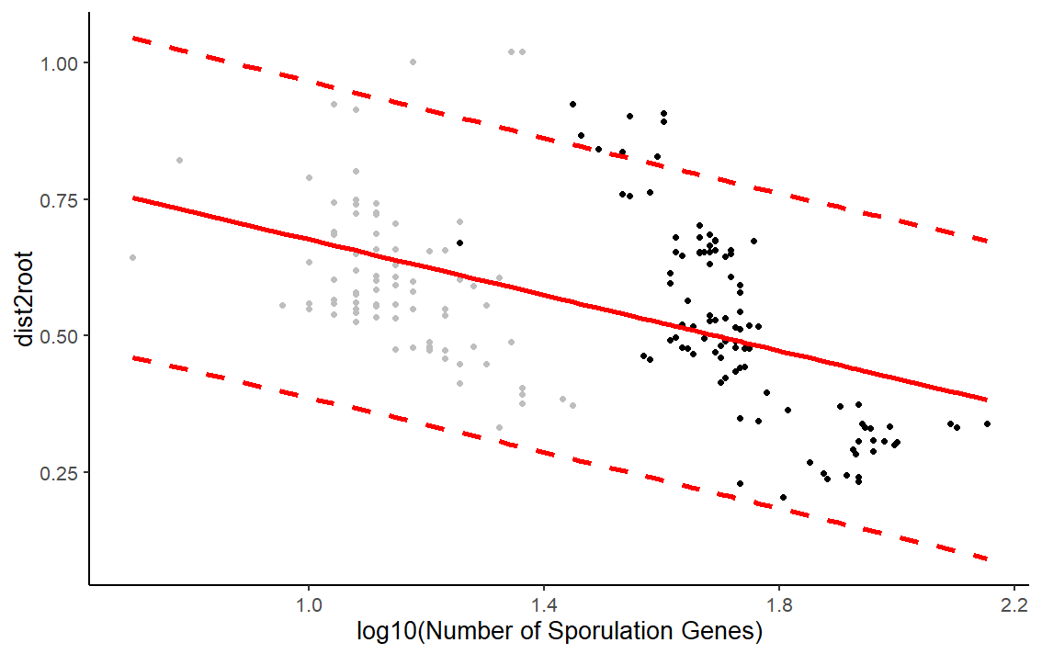

Slide 10
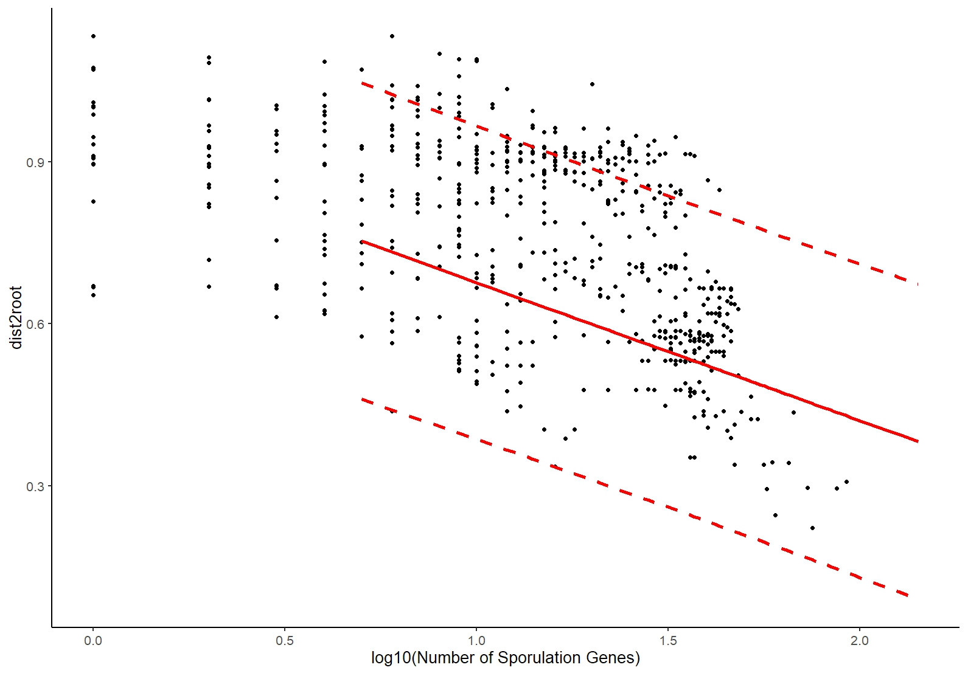

Slide 11
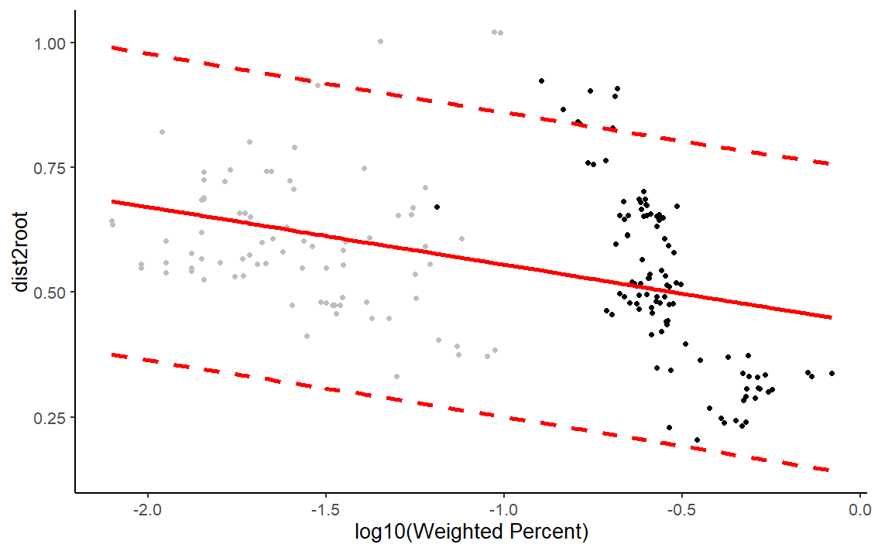

Slide 12
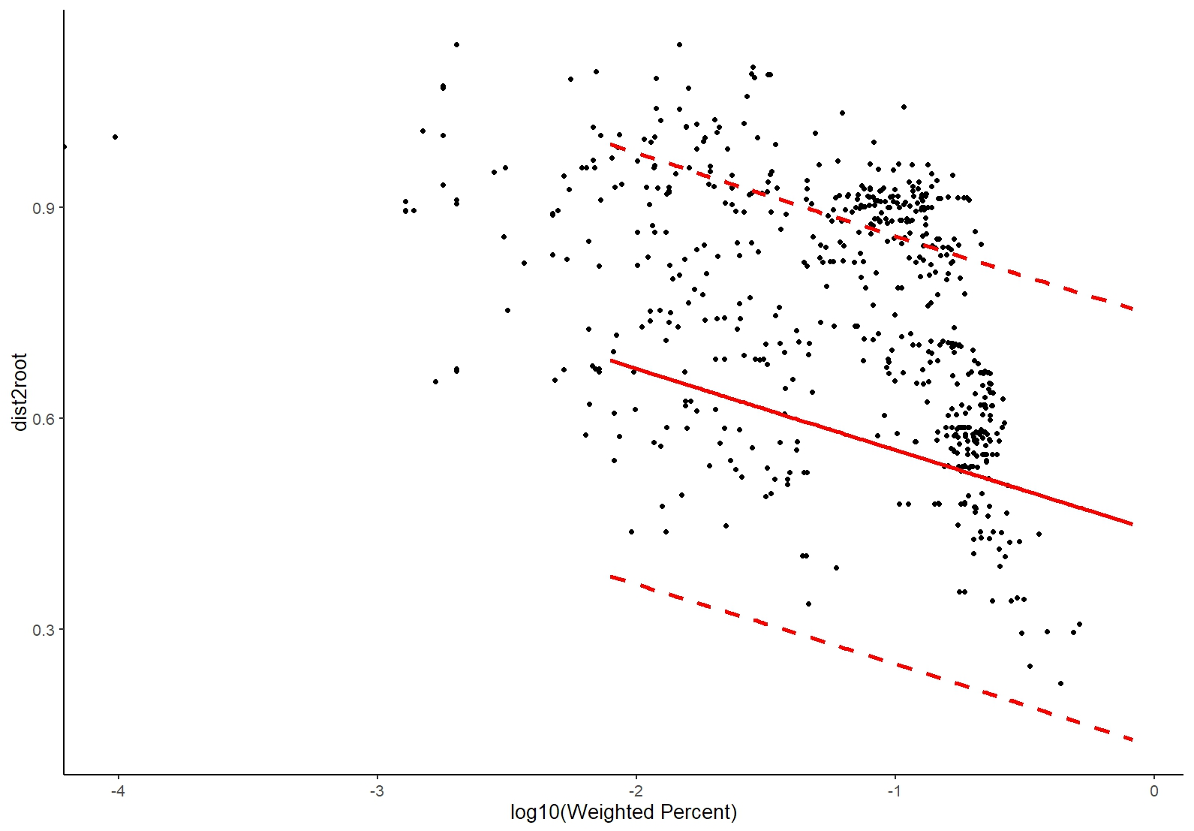

Slide 13
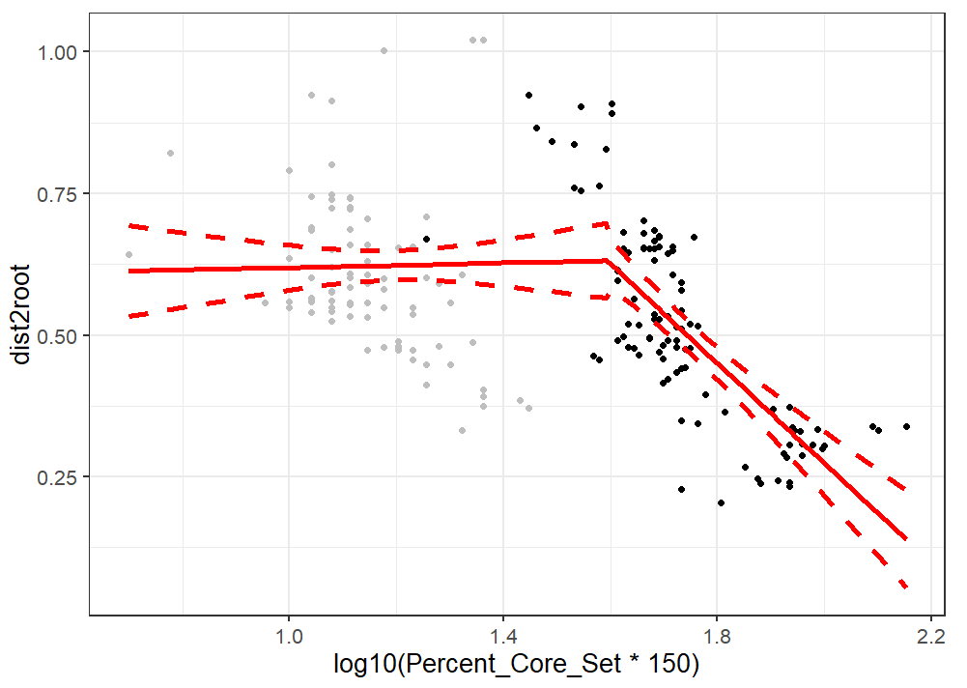

Slide 14
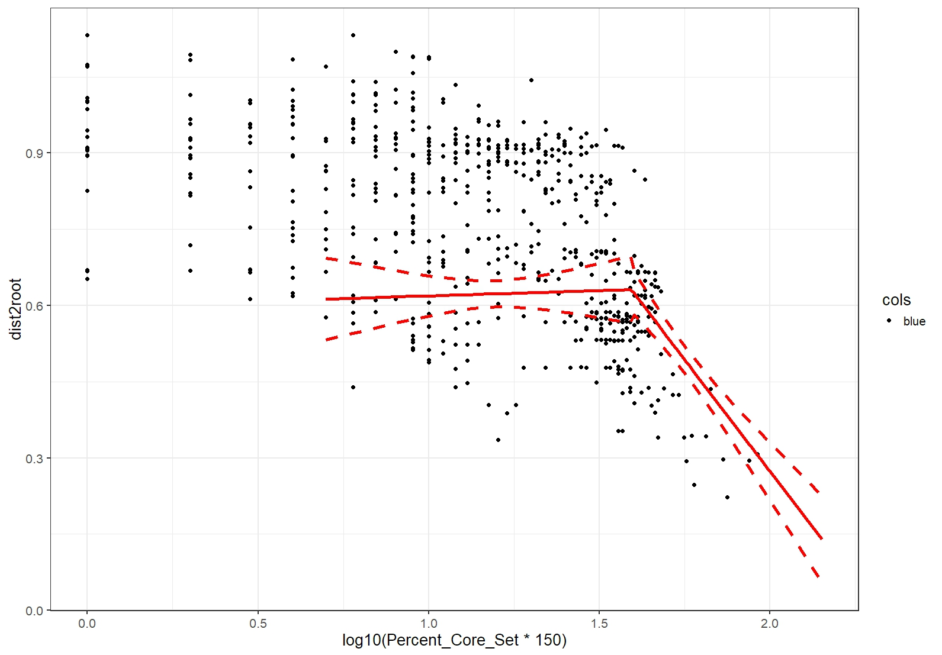

Slide 15
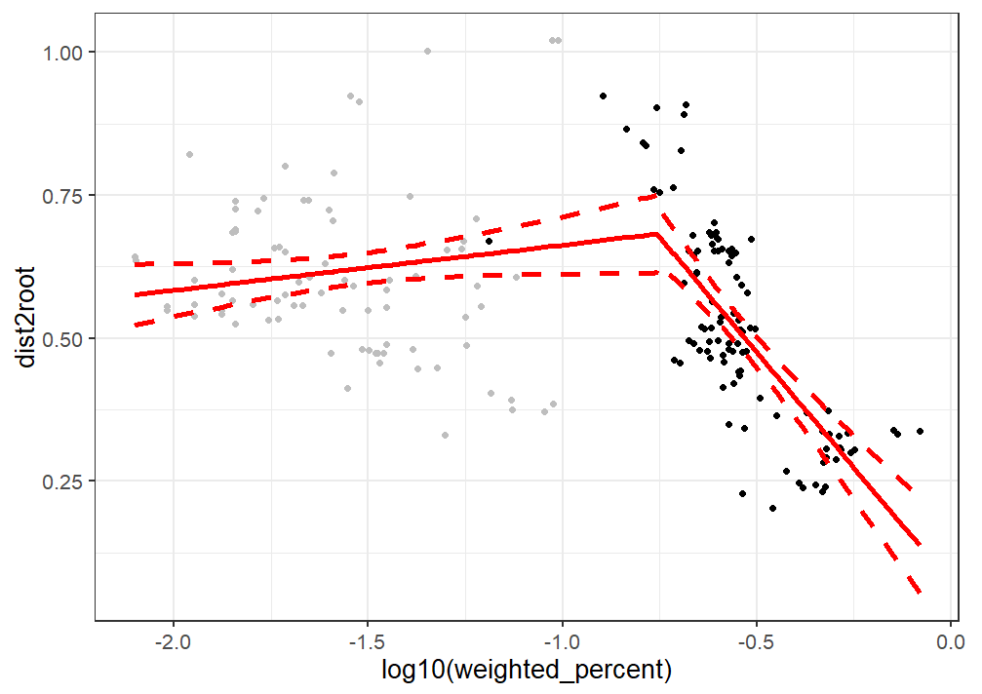

Slide 16
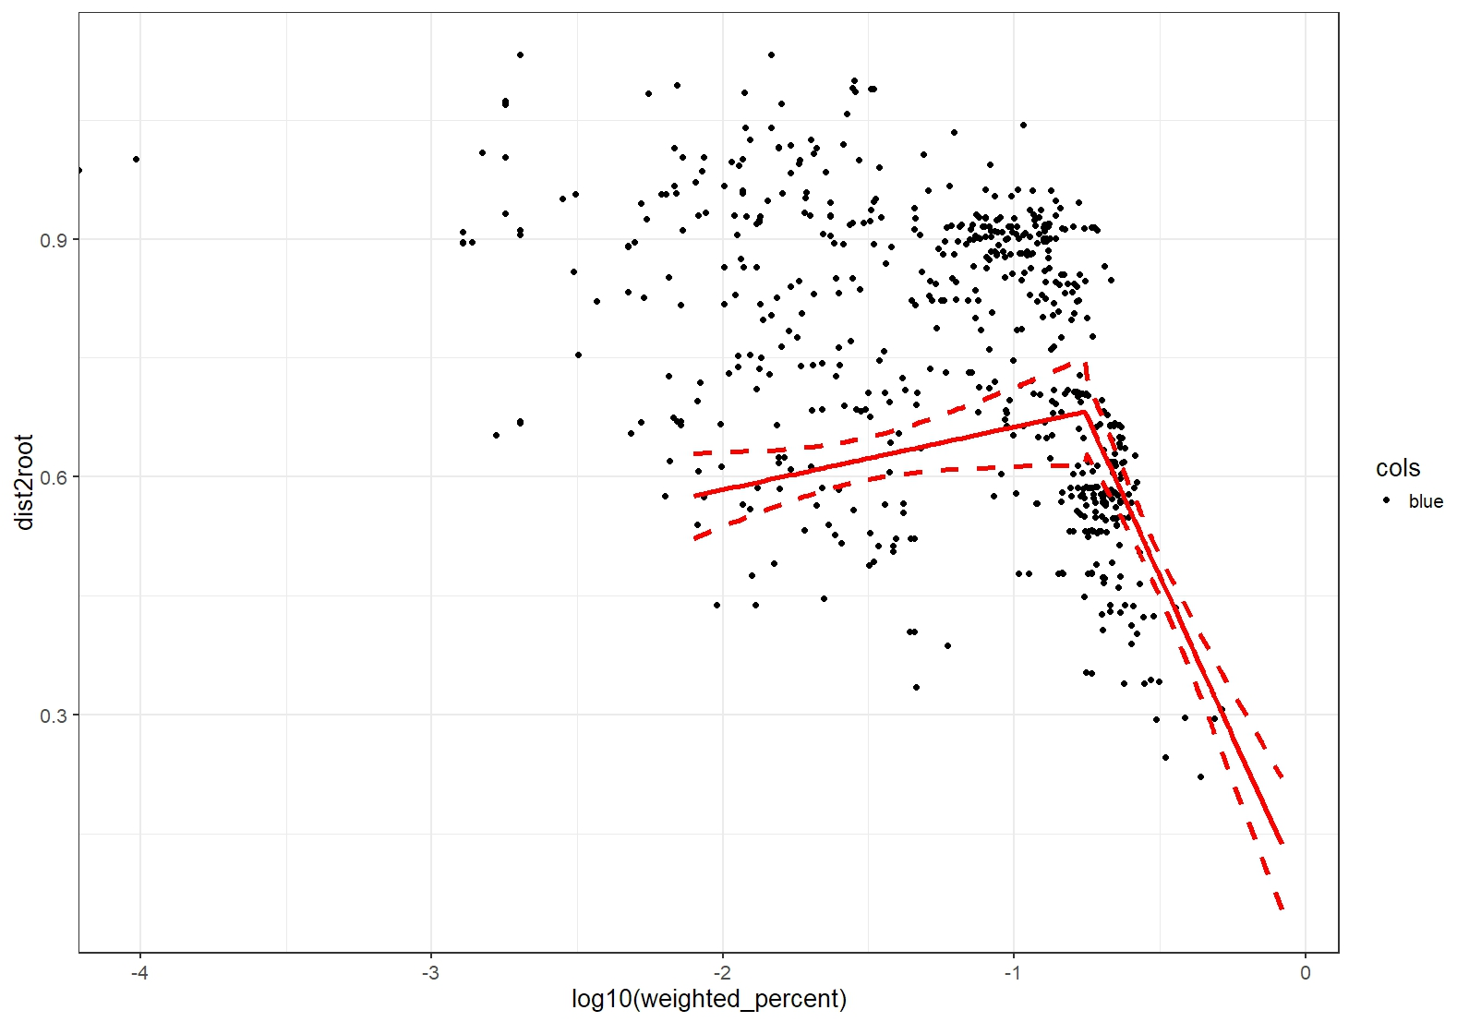

Slide 17
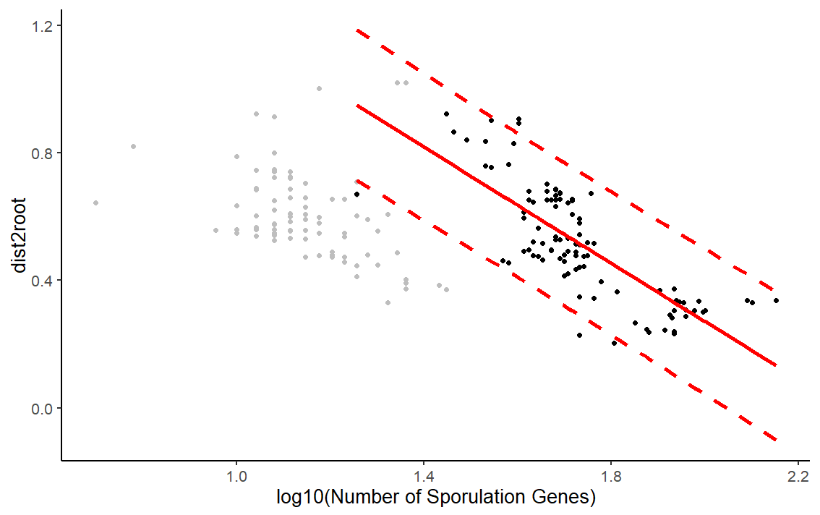

Slide 18
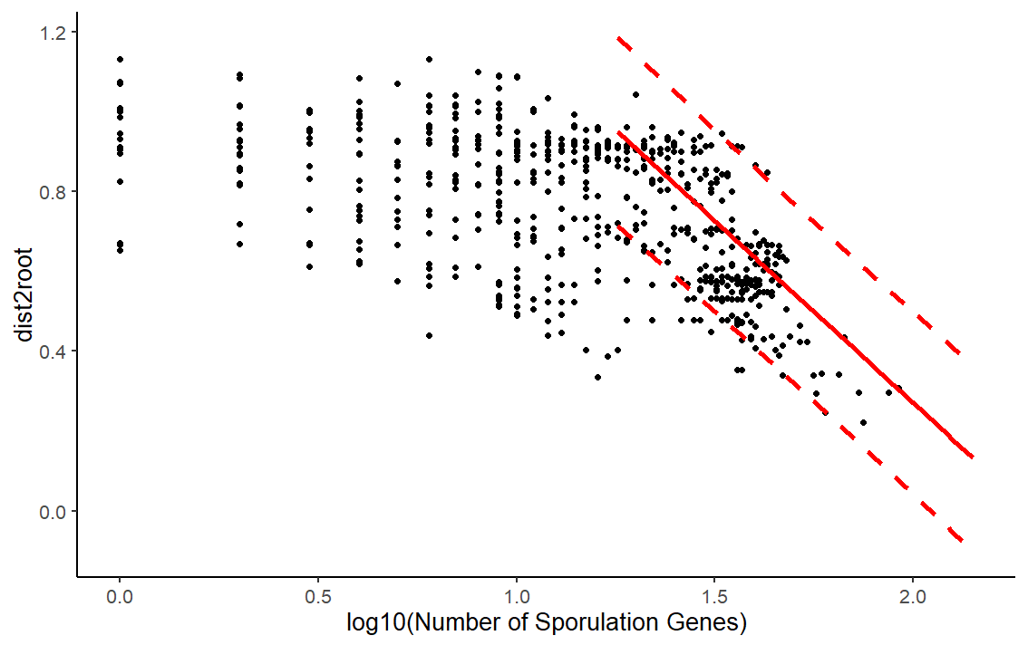

Slide 19
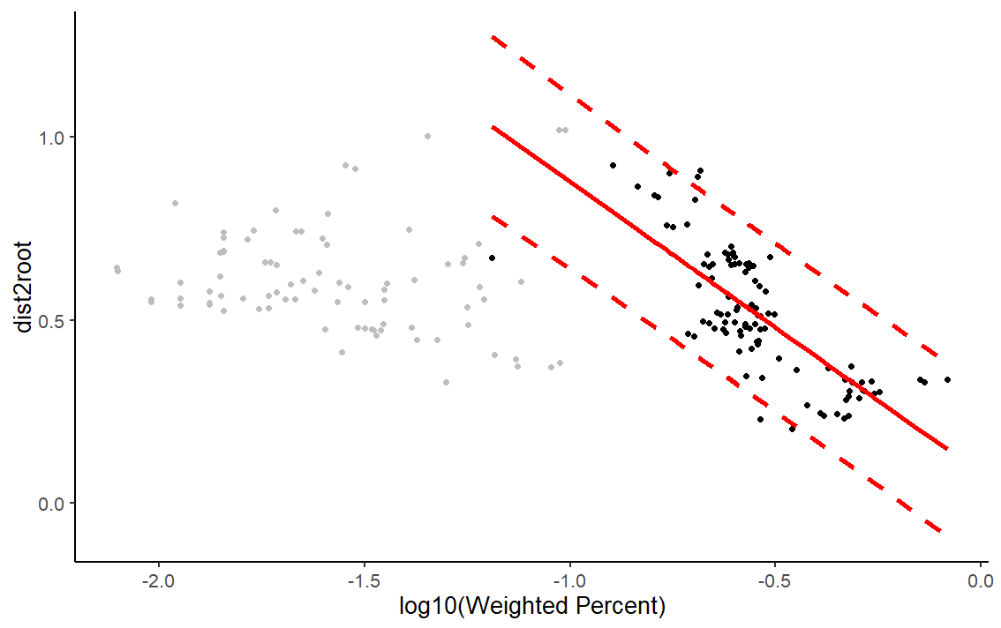

Slide 20
