Slide 1
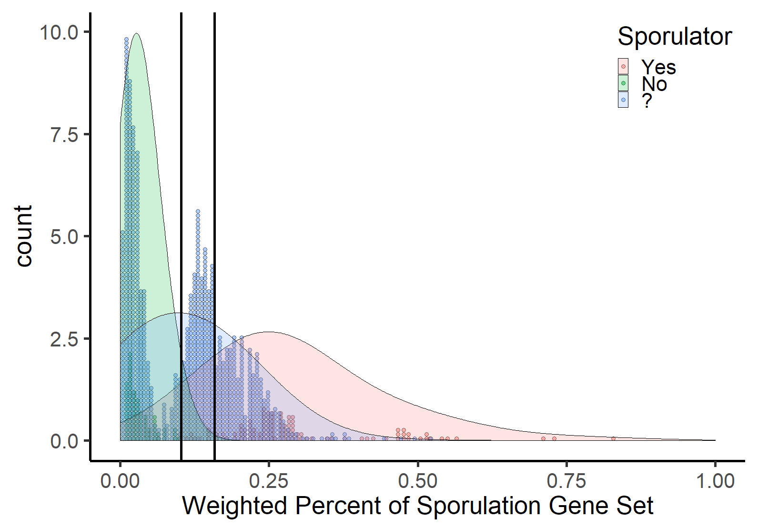
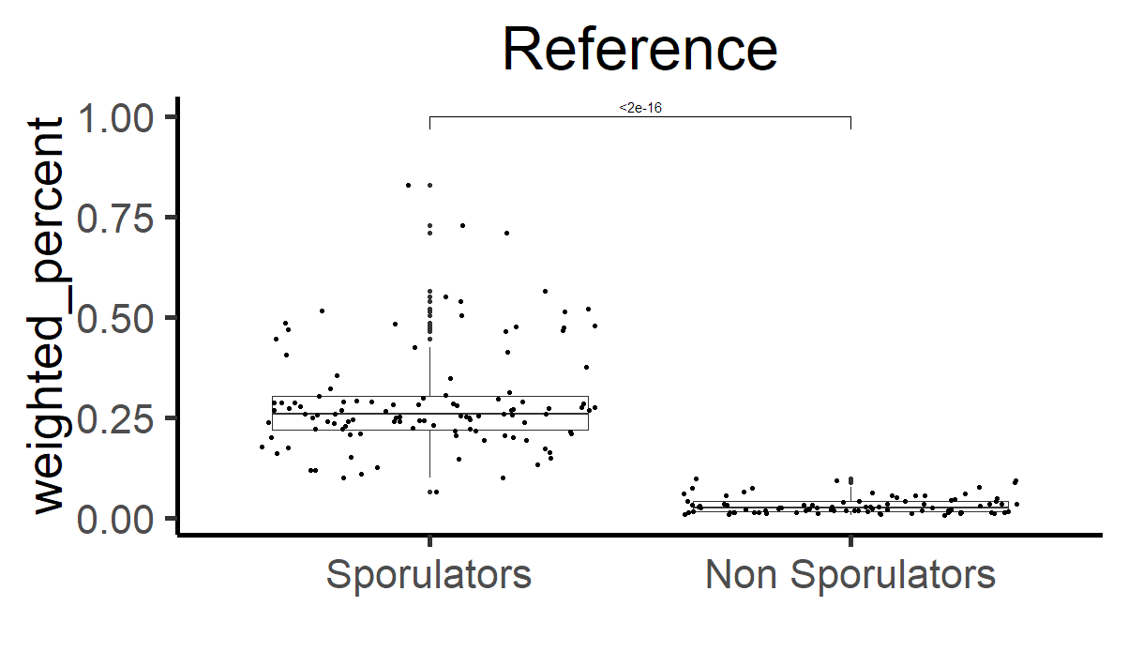
Figure 1. Distribution of weighted percent prevalence of the sporulation gene in the reference and test datasets. Weighted percent values binned at every 1/170 are represented by the height of the dots. The shape of the distributions of reference sporulators, non-sporulators, and the test dataset are represented by the density graph. Vertical lines represent cutoff values for “Likely Sporulators” and “Sporulators”, respectively. Inlayed graph show significant difference between the weighted percent of sporulators and non sporulators in the reference dataset (Student’s t-test).

