Slide 1
Notes:
Is this a table that would be good for main text? Or supplementary? Do we have other tables?

Slide 2
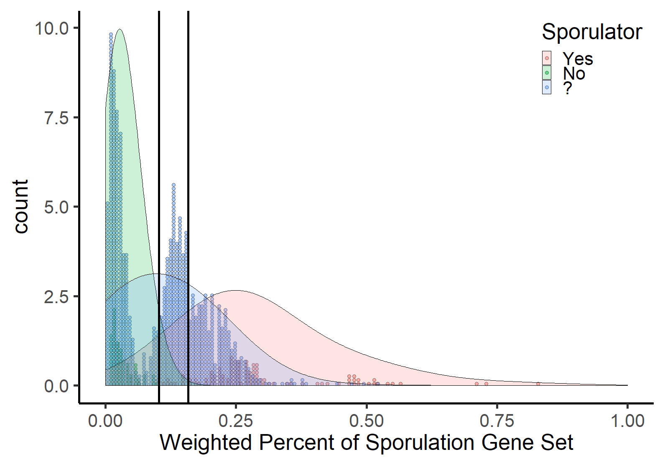
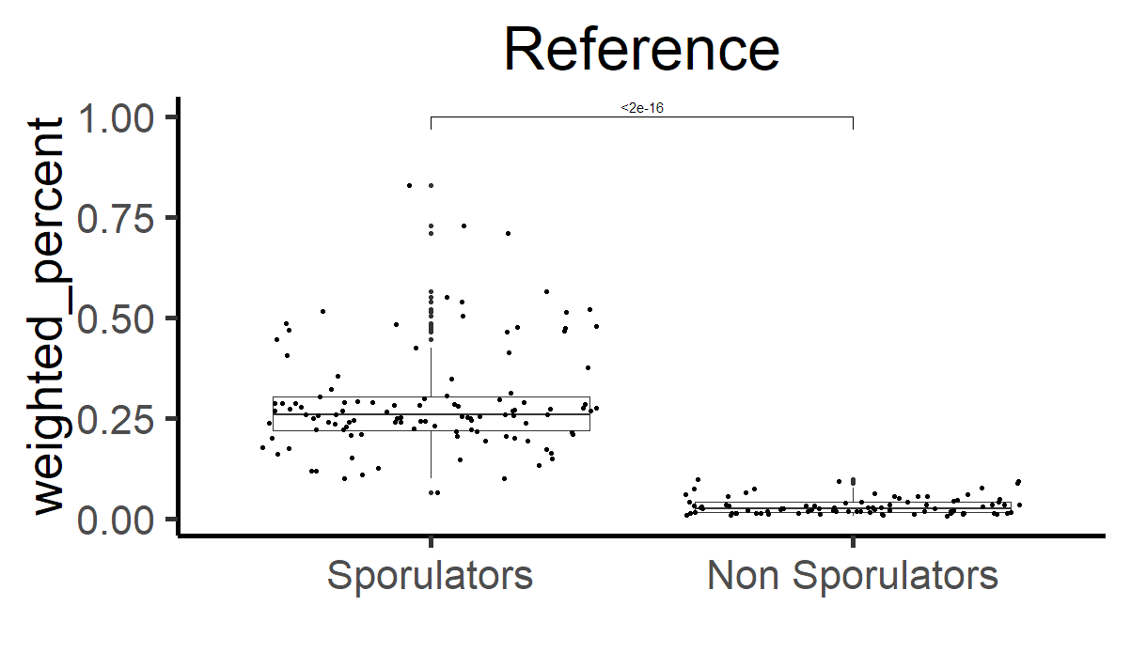
Figure 1. Distribution of weighted percent prevalence of the sporulation gene in the reference and test datasets. Weighted percent values binned at every 1/170 are represented by the height of the dots. The shape of the distributions of reference sporulators, non-sporulators, and the test dataset are represented by the density graph. Vertical lines represent cutoff values for “Likely Sporulators” and “Sporulators”, respectively. Inlayed graph show significant difference between the weighted percent of sporulators and non sporulators in the reference dataset (Student’s t-test).
Notes:
I’m wondering if there might be better ways to represent. The figure is sort of busy with histogram bars, semi-transparent distributions (I assume kernel densities?), and solid black vertical bars. The three colors are also a bit difficult to distinguish (especially for bars),
Maybe we could make remove the bars for reference sequences and just have density curves. And then put the uknowns from metagenomes as something different, like bars of in front? We should come up with different legend, too, instead of “?”
In some ways, the bot plot is easier to interpret. Could another category be created for unknowns?

Slide 3
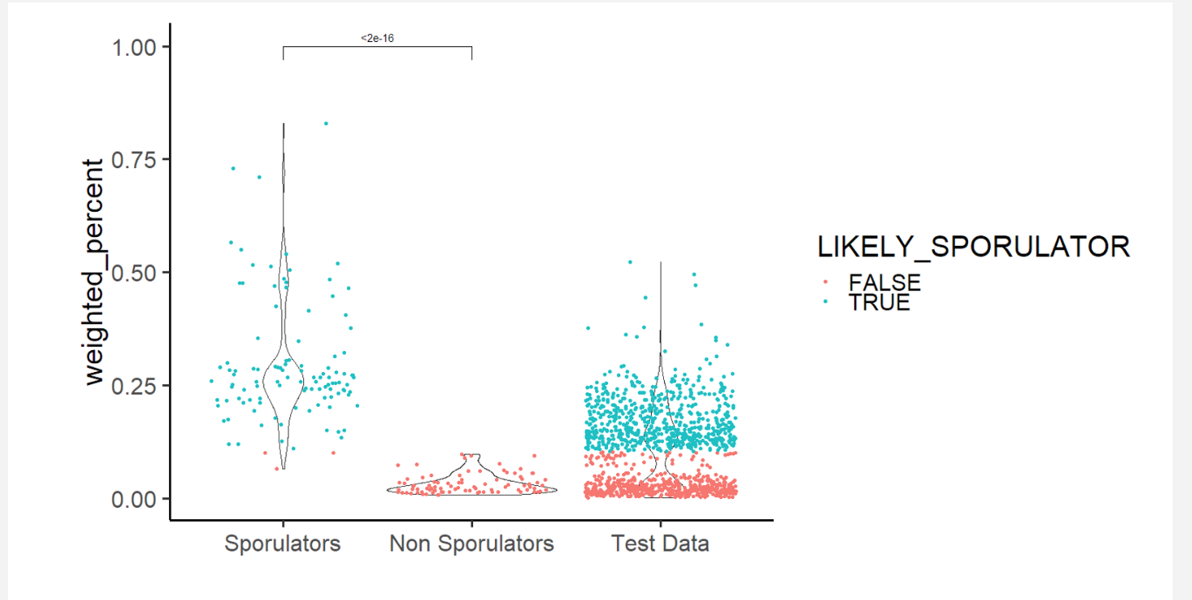
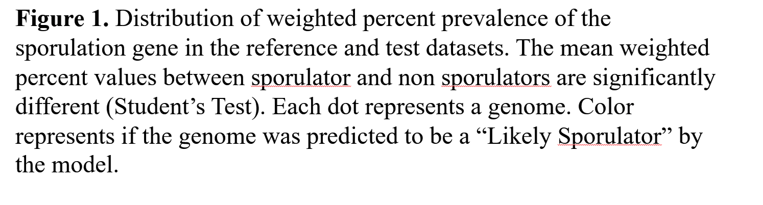
P < 0.0001
Proportion of sporulation genes
Notes:
Few thoughts in addition to changes I’ve made in by mocking things up.
-- Can we make the violin lines darker? And bring those lines to the front of symbols?
-- Do we want to stick with “test data” throughout text and in figures? Makes sense to say at least once and will make sense from statistics perspective, but perhaps it’s better to say “metagenomic data” or something.
-- Do we want to think about a color scheme for sporulators and non-sporulators and stick with it throughout ms?
-- Want to clarify colors and axis labels because this is important:
On x-axis, when we say “sporulators” and “non-sporulators”, this is what W&W predict, right? And colors correspond with our model? But our model is heavily influenced by the W&W model right? Or just W&W data?
Looks like there are only three genomes that get misclassified. Two things that we predict are sporulators are actually non-sporulators? Perhaps this is a result with would report on?
The distribution of test data is really interesting. There’s definitely a gap region. Interestingly, there’s a a set of genomes that are predicted to be non-sporulators, that group with sporulators.

Slide 4
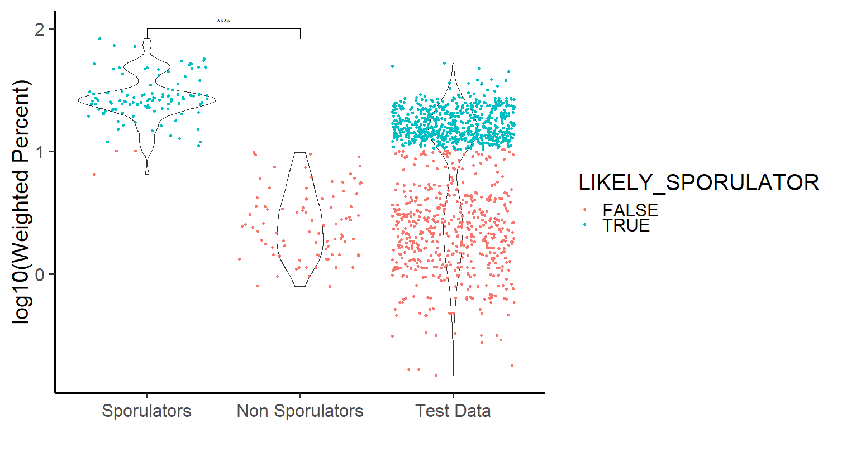

Slide 5
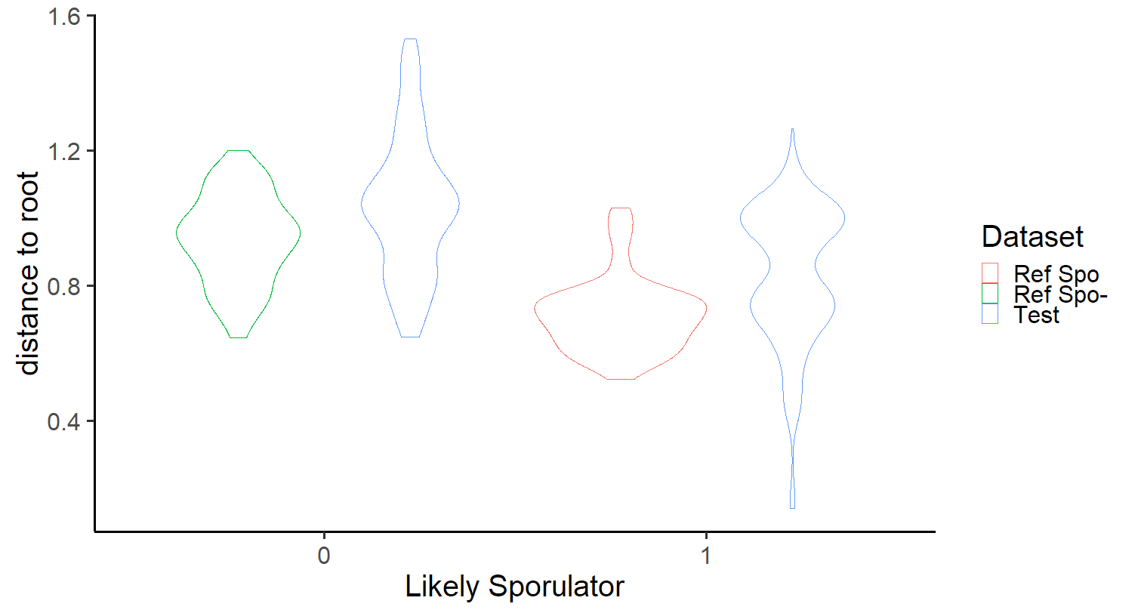
With old tree root

Slide 6
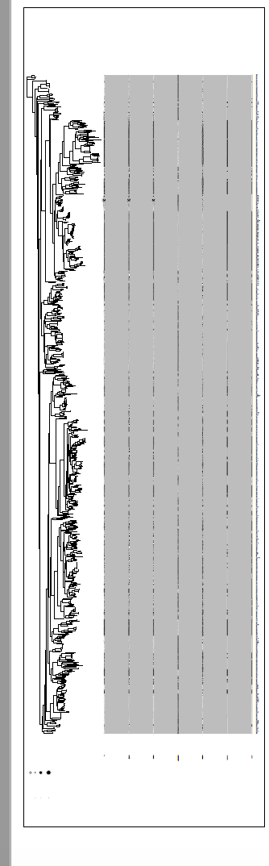
Notes:
We’ve been talking about a a tree where we can see traits mapped out. Not sure how best to represent, but hard to read pasted file here.

Slide 7
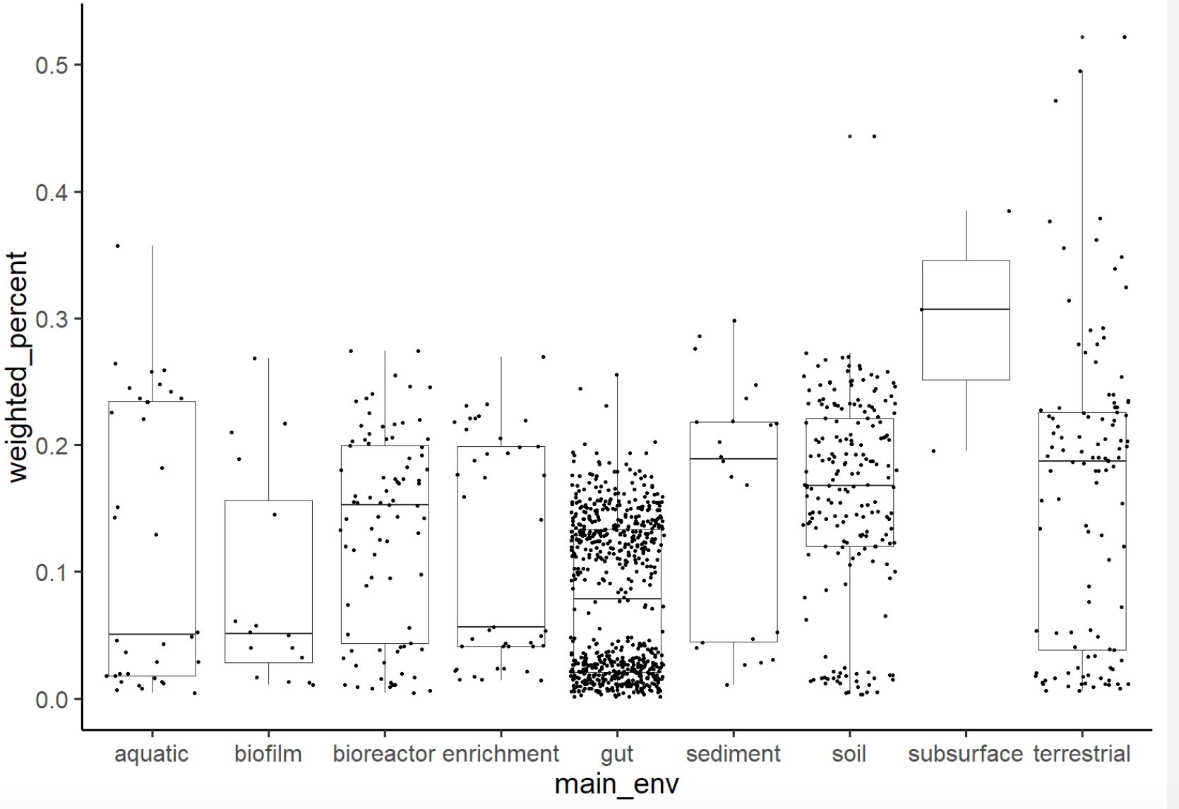
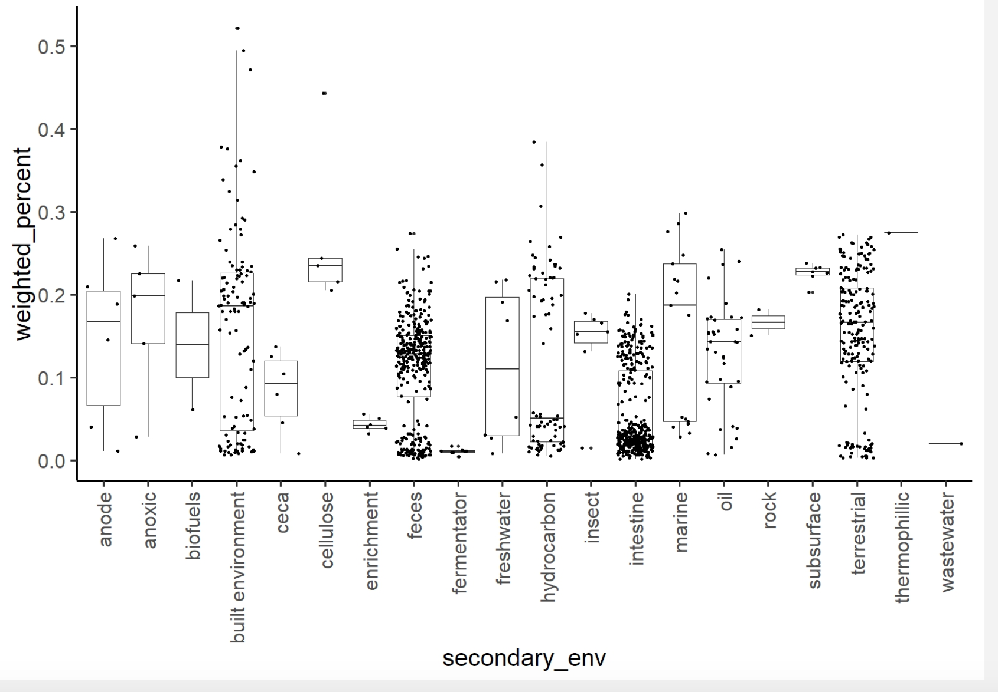
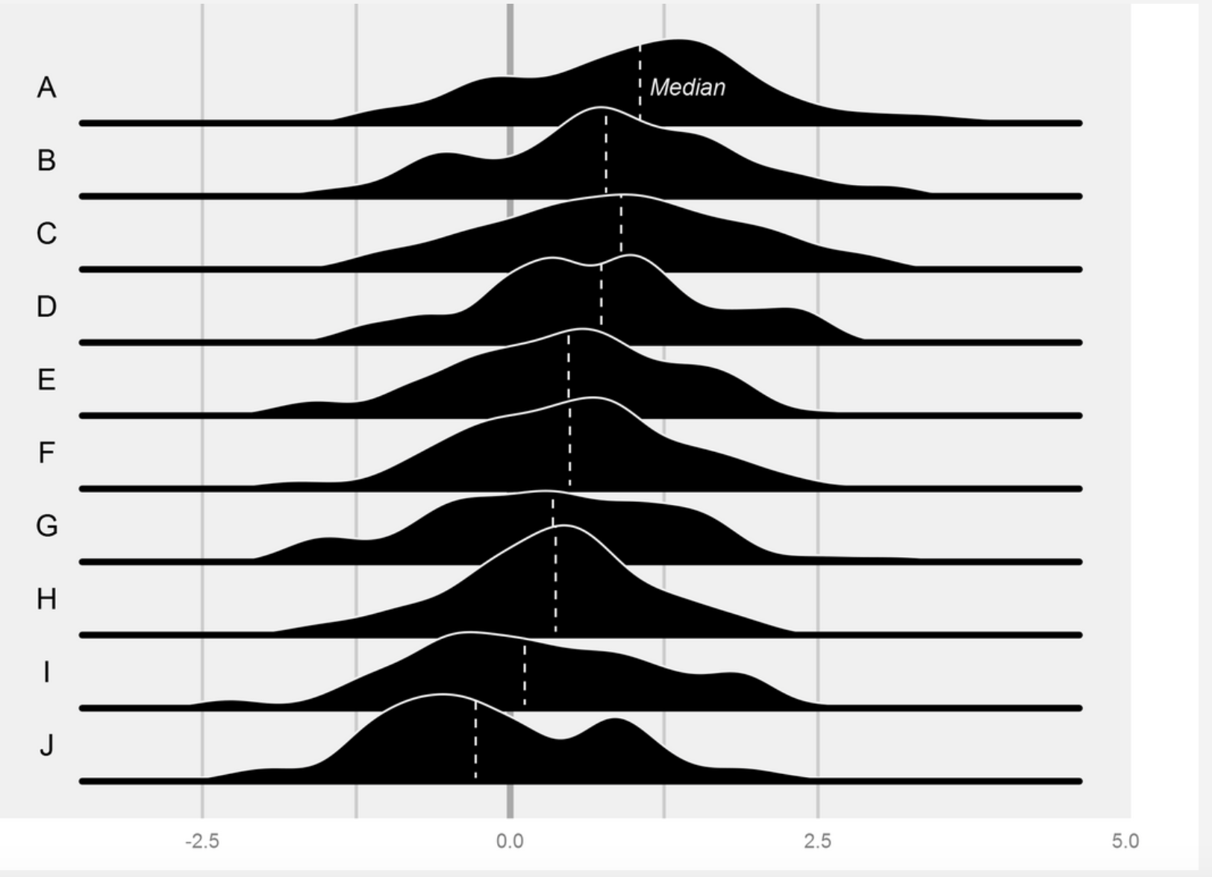
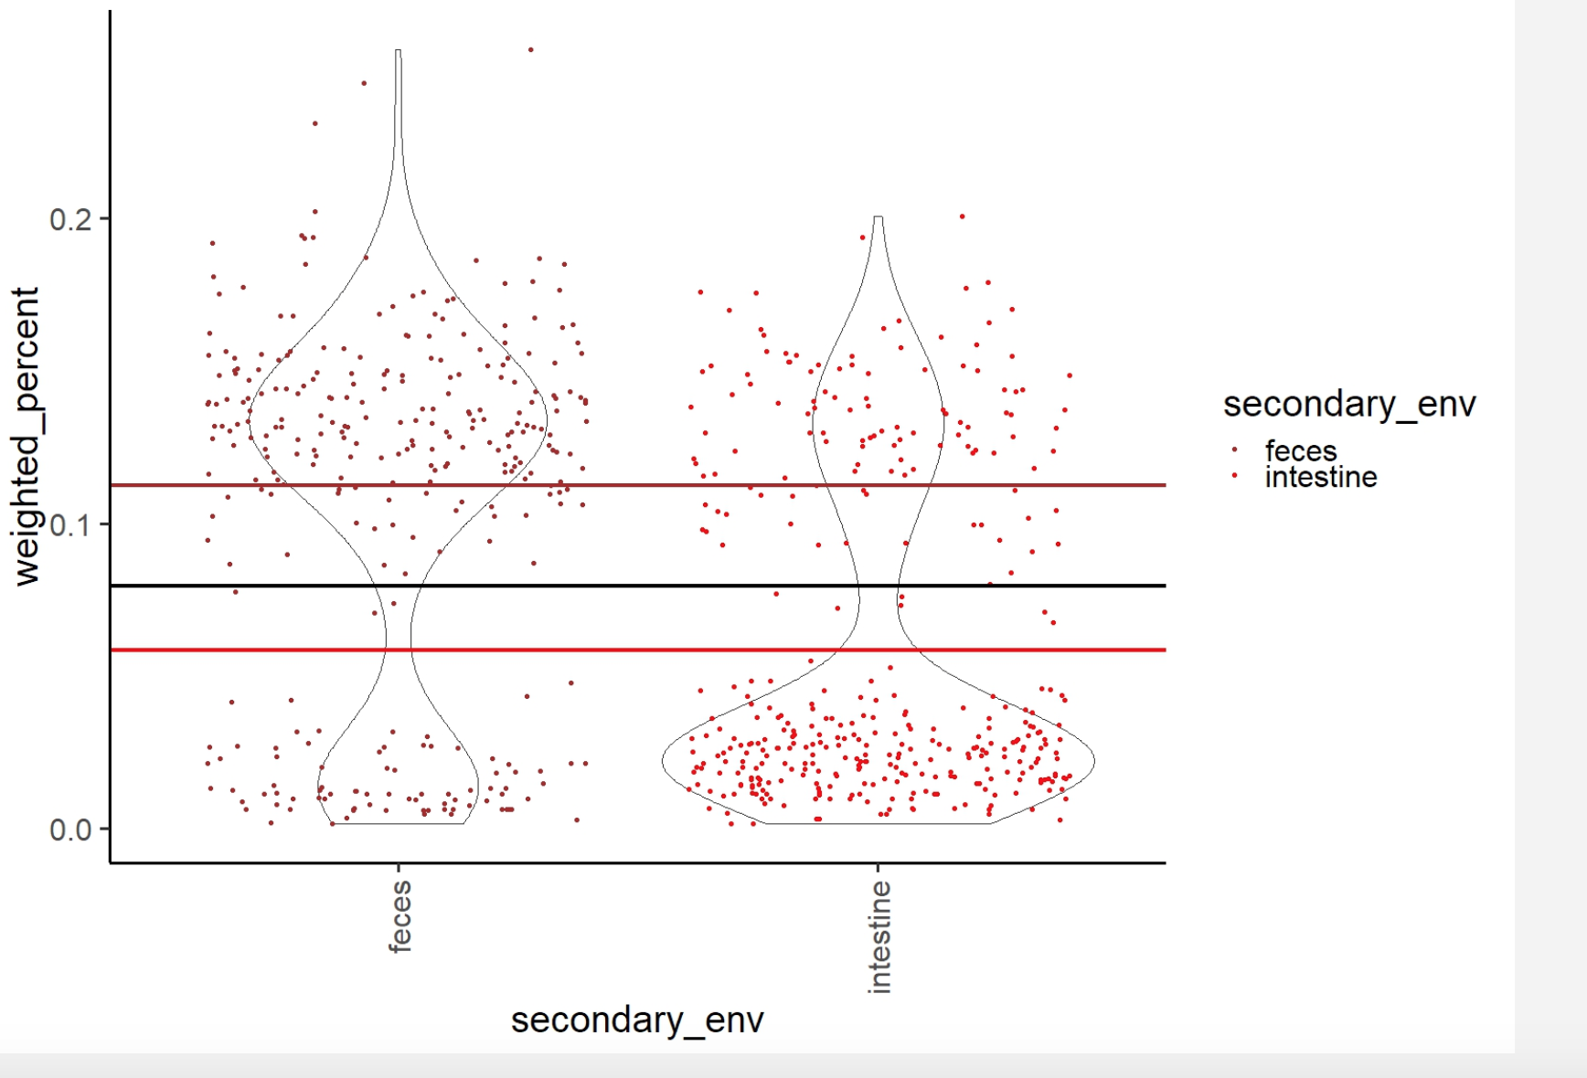
Fig 5. Proportion of sporulation genes in assembled firmicute genomes (•) from different ecosystem types based on a proposed “core set” of sporulation genes (Kawai et al. 2015).
Notes:
Some version of one of the examples on this page. We’ve considered box plots, violins, and joy plots. The latter two provide ability to visualize multimodality (should we test for this?) Also need to consider what categories we’re going to include/exclude or lump/split.
We’ve also talked about color coding genomes, perhaps based on reference info from WW. For example, if it’s a Lacto strain, we might be able to classify as non-sporulator; vice versa for Bacillus.

Slide 8
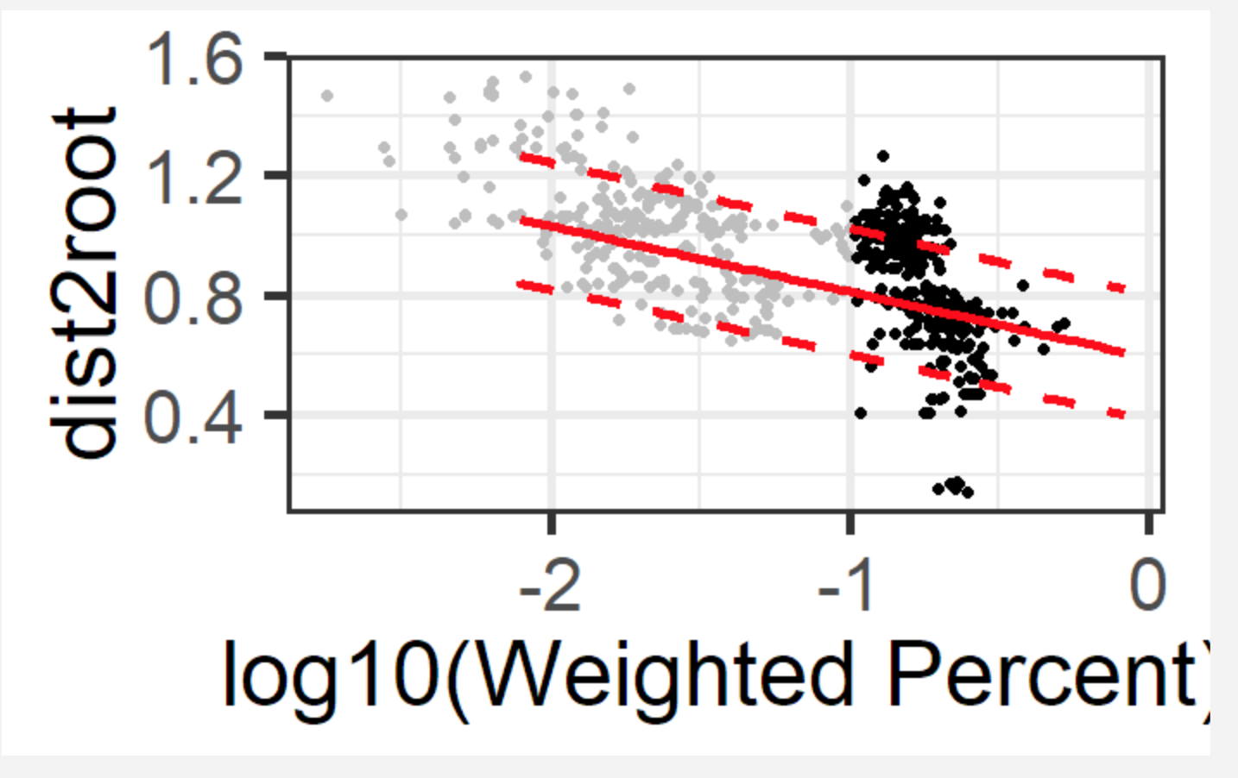
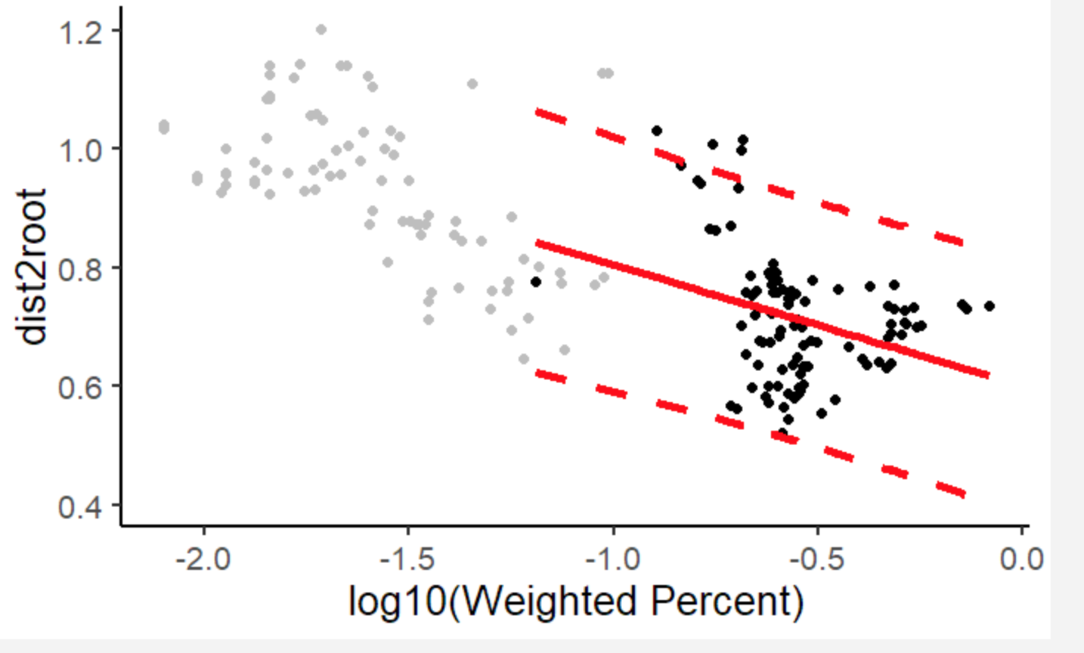
Notes:
We’ve thought about different versions of figures for this part of paper. There are the regression models depicted here.
You also took a pic of the white board where we considered t-test/binary comparison. In other words, the question came up of whether or not we want to think that sporulation is a continuous vs. binary? Or stated differently, is sporulation dependent on a continuous number of genes?
We also talked about a contingency analysis. But I don’t recall the details about looking at expected vs. observed frequencies.

Slide 9
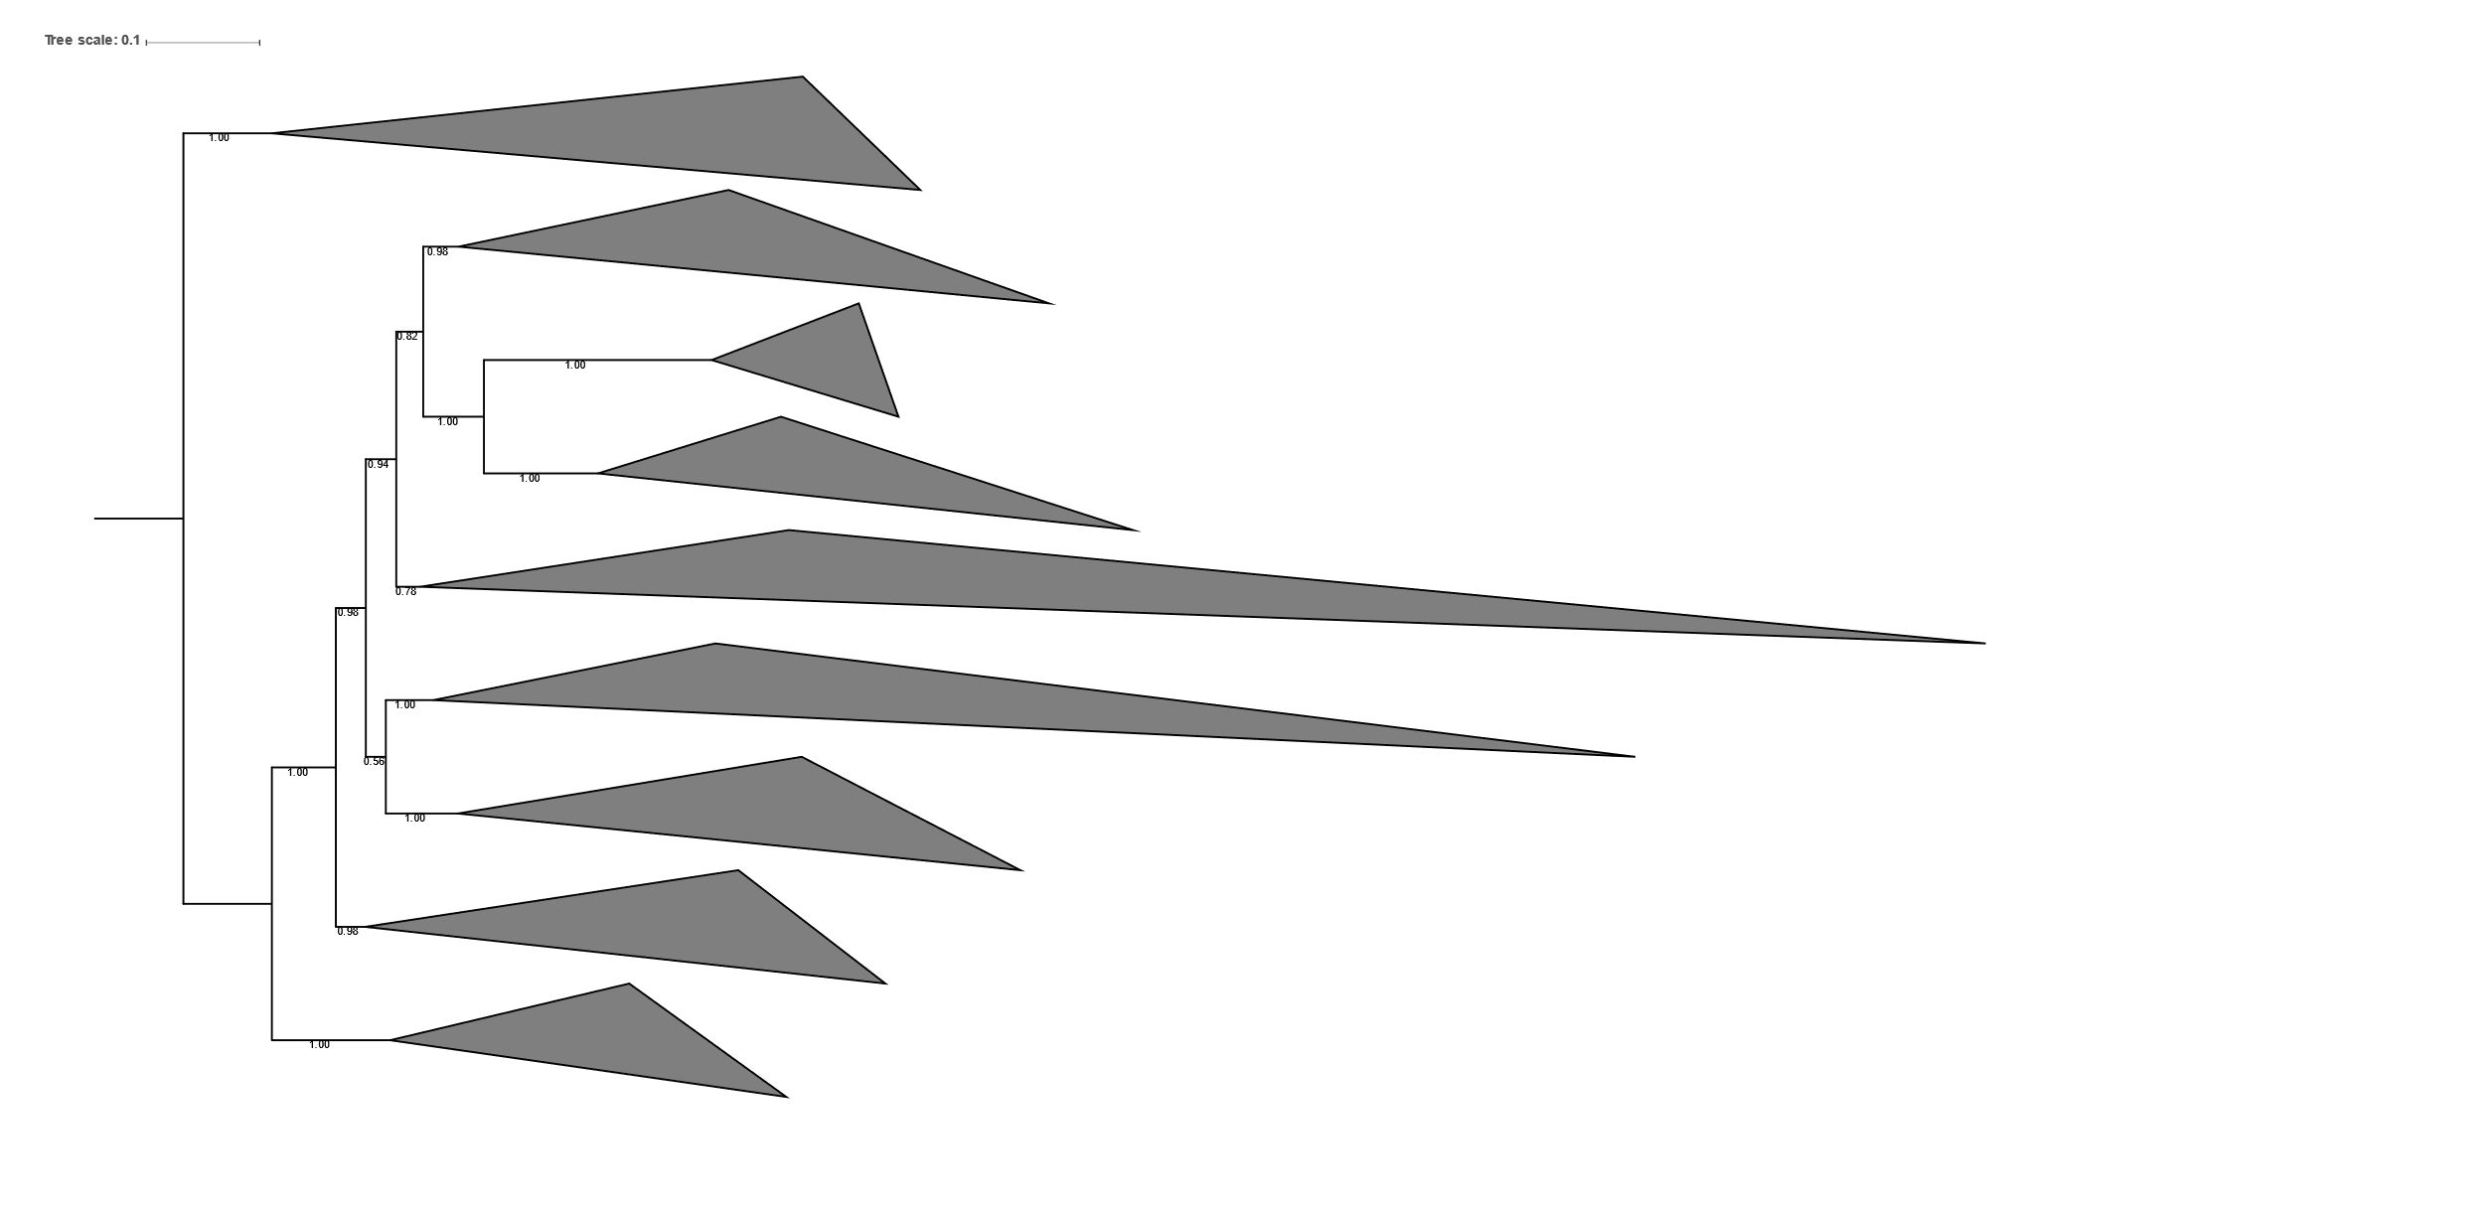
Actinobacteria
B
D
C
Firmicutes
A
E
G
F

Slide 10
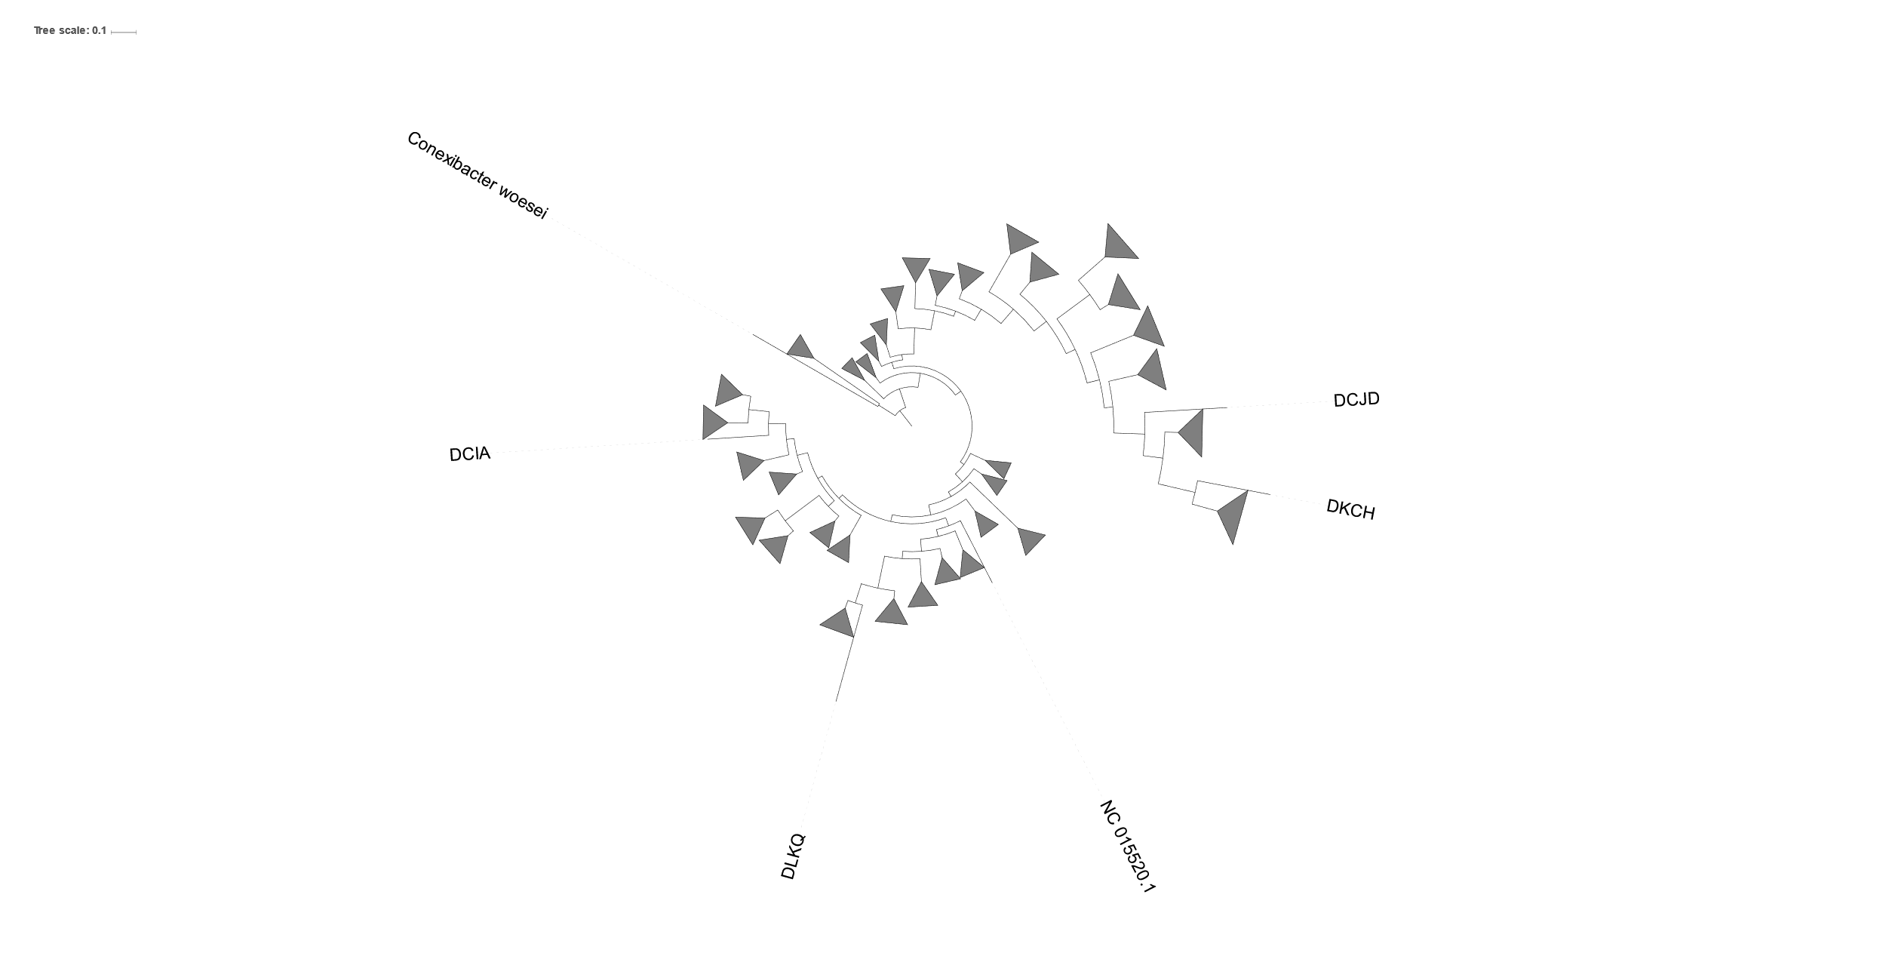
Turibacter
RF39
Notes:
Cultured representative from the Turibacter we tested to be non-spore formers despite having a number of the sporulation genes. Here we predicted two uncultured genomes were sporulators by their gene content. Members of the same order “Haloplasmatales” include non-sporulating organisms without cell walls.
DHNA is very closely related to genomes that were predicted to be sporulators.
Triangle with 8 loss could also be interpreted as “gain event”. Missing relatives likely.
FP929045 Faecalibacterium prausnitzii L2/6 makes spores but just misses the cutoff for “Likely Sporulators” at about 9% of weighted genes. Closely related genomes had a similarly percentage. I made the call to not cut any loss events in this cluster

Slide 11
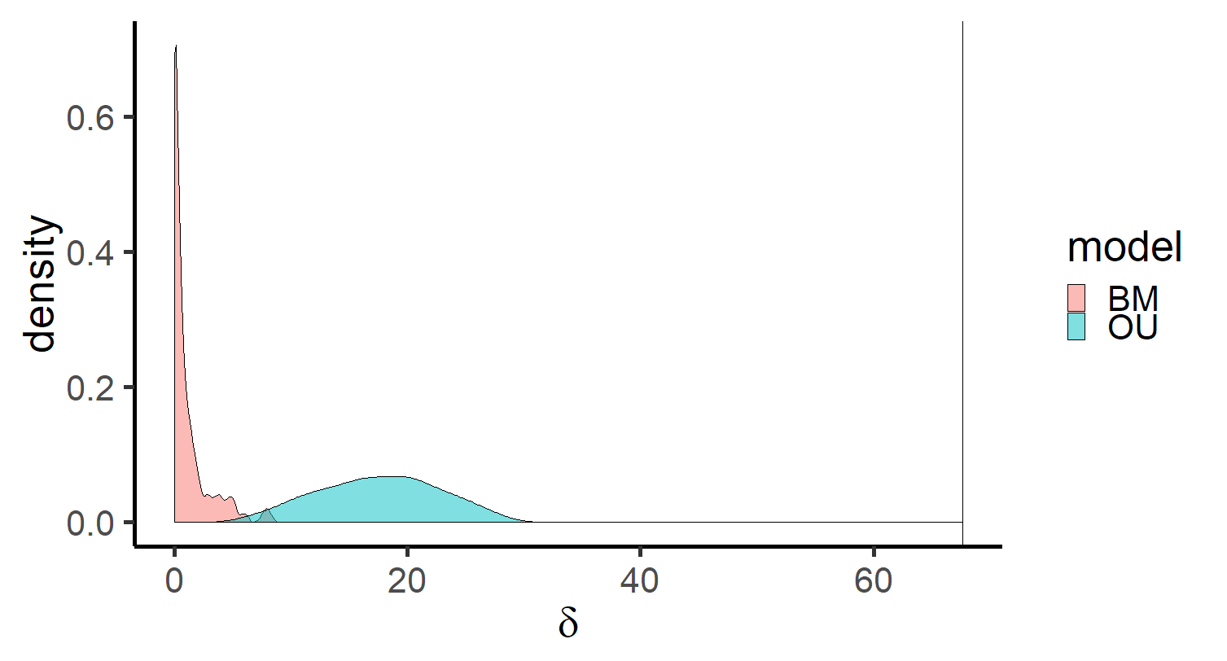
P<0.000

Slide 12
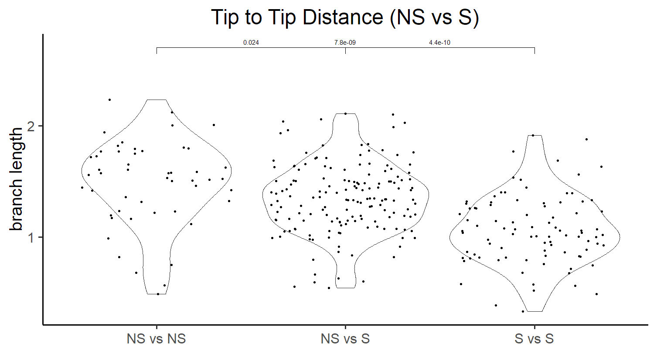

Slide 13
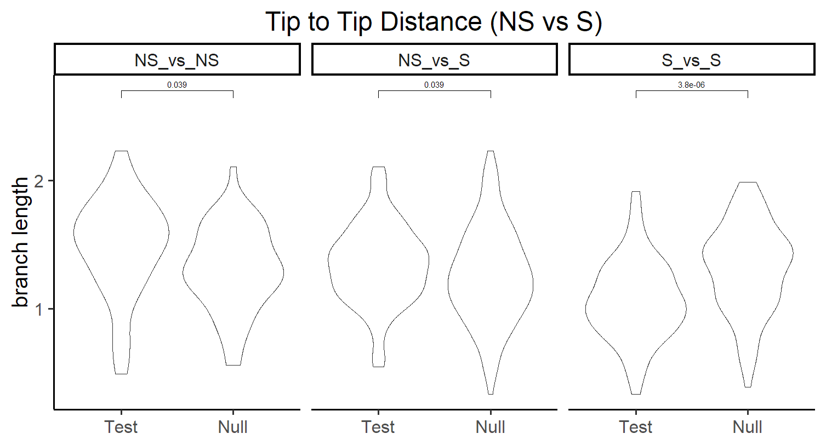

Slide 14
Figure 4. Protein evolution across the expanded Firmicutes tree appears to be slower among sporulators (S) than nonsporulators (NS). Violin plots display distribution of branch length while the significance (p values) of the difference between the means are displayed above. Branch length were subsampled (n=300) and null distribution was generated by randomly shuffling NS and S predictions at tips of tree.

