Slide 1
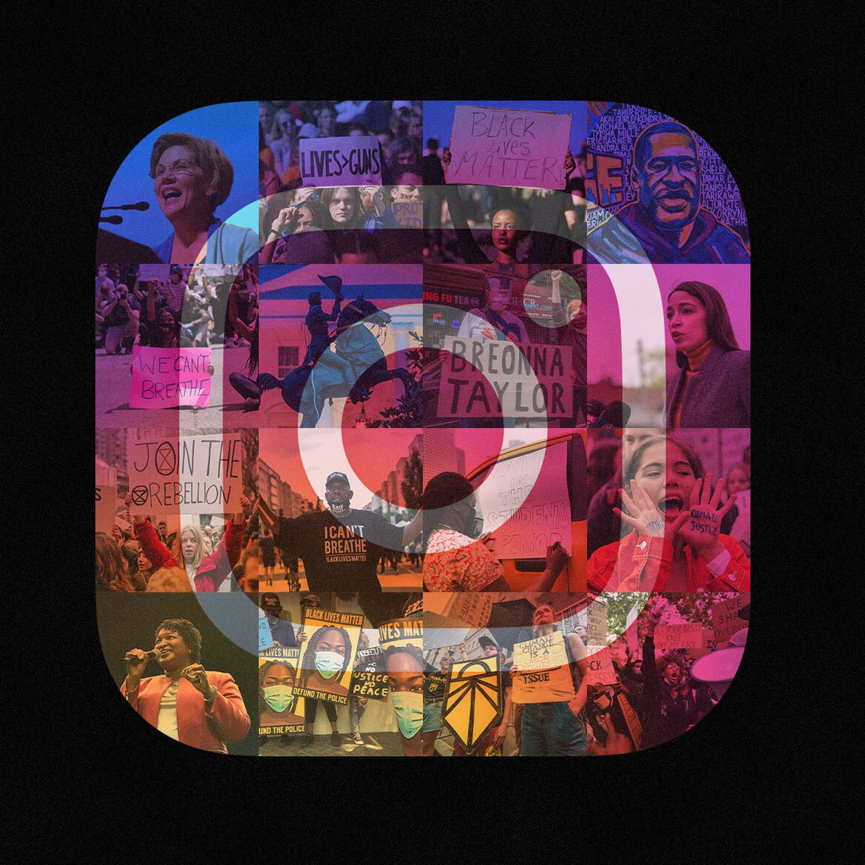
Instagram as a tool for Juniors
Does seniority affect politicians' usage of Instagram?
Hangsung Lim

Slide 2
Why Seniority?
Instagram is a tool for self-presentation
▶ Instagram is a useful tool to promote individual’s political characteristic and political image, especially in a personalized manner (Adam & Maier, 2010; Dobkiewicz, 2019; Ekman & Widholm, 2017; McGregor, 2018)
▶ Thus, Instagram is a great tool for politicians who have had relatively few opportunities to get their name out to voters as a single politician rather than as a member of a political party.
Instagram is a tool for less established actors
▶ Political parties that have less opportunity to be exposed to traditional media or have no voice in the parliament tend to use Instagram as an alternative tool for communication (Russmann & Svensson, 2017; Turnbull-Dugarte, 2019)
▶ Thus, Instagram tend to be used by politicians who are less likely to be in the spotlight than established politicians

Slide 3






Analysis Strategy
+
+
~
Frequency of
Instagram Posting
Seniority
The strength of political base that the politician has in her own party
Age

Slide 4
Data
Basic Info
▶ Number of Instagram Posts posted by 118th House of Representatives (Only official accounts)
▶ N=192 (Data is still incomplete!)
Main Variables
▶ Frequency of Instagram posting
= (Number of Posts posted between 1/3-11/27)x730/328
▶ Seniority
= Number of terms the congressman served in the House of Representatives
▶ The strength of political base that the politician has in her own party
= The difference in vote shares between the congressman and the second-runner during the primary
(Converted it into the dummy variable: 1 = Competition, 0=No Competition)
▶ Age

Slide 5
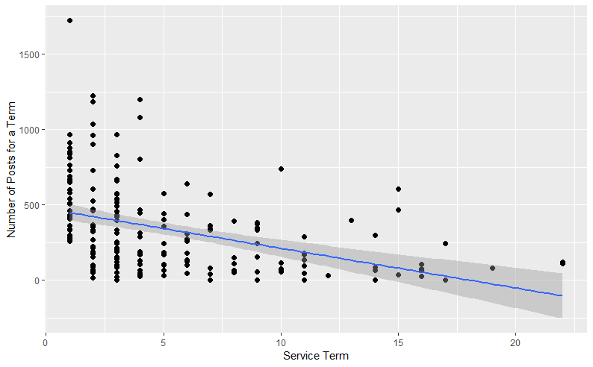
Results

Slide 6
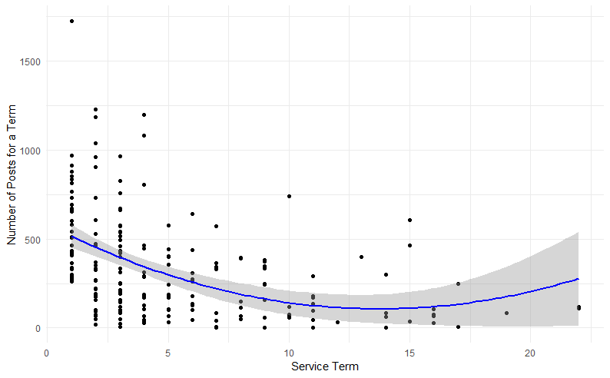
Results

Slide 7
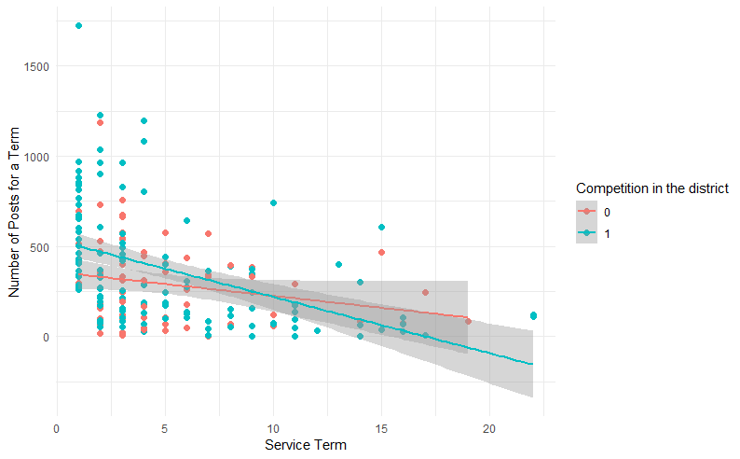
Results

Slide 8
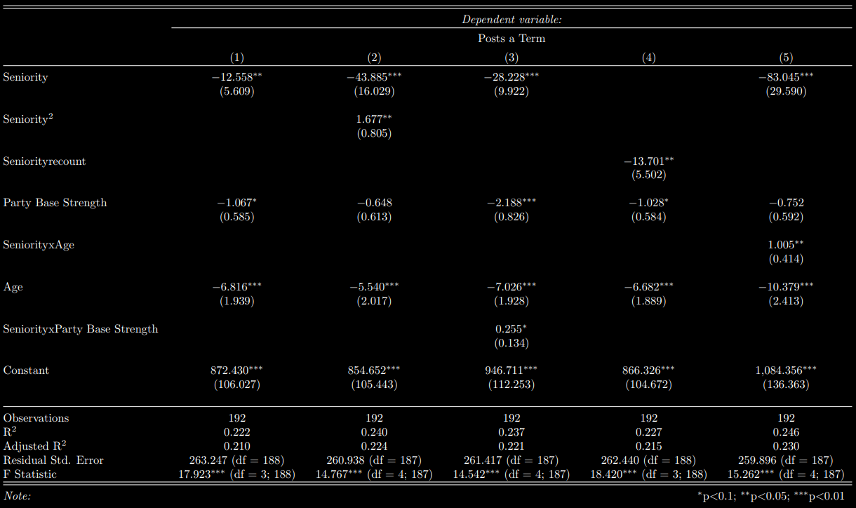

Slide 9
Limitations & Future Direction
Incomplete Data
▶ More than half of Instagram accounts are missing
▶ It is still the data collected between 1/3-11/27 (Can’t wait for 2024!)
▶ Maybe violated i.i.d
Definitely vulnerable to endogeneity
▶ Reverse causality is possible (ex. Politicians who are competent in using Instagram may have survived the modern political arena and became newbie politician even without their own political base)
▶ Perhaps, there are some potential confounding variables (ex. No influx in Gen Z population in the district)
Future Direction
▶ So, we know politicians use Instagram not because they feel like using it or just they are youngsters
▶ Proportion of Gen Z population, (especially proportion of Gen Z who are strongly affiliated with parties)?
▶ Posts content, ratio between Facebook and Instagram, change in usage pattern during election… These are all interesting topics than we can dig in!!

