Slide 1

K-Means Clustering Using OpenMp
Bittu Jaiswal
Department of Computer Science
Mahindra Universirty
Supervisor
Dr. Praveen Kumar Alapathi
Department of Computer Science
Mahindra Universirty

Slide 2
K-Means Clustering
Definition: K-Means is a popular clustering algorithm that partitions data into K clusters based on similarity.
Key Idea: Minimize the distance between data points and their respective cluster centers.
Challenges: High computational cost for large datasets.

Slide 3
How Does K-Means Work?
1. Initialization: Select K random centroids.
2. Assignment Step: Assign each data point to the nearest centroid.
3. Update Step: Recalculate centroids as the mean of all points in a cluster.
4. Repeat: Iterate until centroids no longer change significantly.

Slide 4
Applications of K-Means
Image Segmentation: Separate objects in images.
Customer Segmentation: Group customers based on behavior.
Anomaly Detection: Identify outliers in data.
Document Clustering: Organize articles or search results.

Slide 5
Advantages/Limitations
Advantages | Limitations
Simple to implement and computationally efficient | Requires predefining the number of clusters (k)
Works well with spherical-shaped, well-separated clusters | Sensitive to the initial placement of centroids
Efficient for large datasets (O(n⋅k⋅t)) | Assumes clusters are spherical and of equal size
Performs well with linearly separable data | Struggles with overlapping or non-linear clusters
Scales easily for parallel and distributed processing | Sensitive to outliers that can skew centroids

Slide 6
Objectives
Measure execution time and convergence for both approaches sequential and parallel.
Evaluate scalability with varying thread counts and cluster sizes.
Calculate Speed-Up of parallel execution with respect to sequential

Slide 7
Experimental Setup
Dataset:- 1 million 2D points, randomly generated.
Parameters:-
K: 2 to 1024 (powers of 2).
Threads: 2 to 128 (powers of 2).
Maximum iterations: 1000, tolerance: 10^-6.
Output Metrics:-
Execution time (in seconds).
Convergence iterations

Slide 8
Key Differences Between Algorithms
Feature | Parallel Approach (with OpenMP) | Sequential Approach
Execution Mode | Executes multiple tasks concurrently using multiple threads. | Executes tasks one after the other on a single thread
Performance | Achieves faster execution due to parallelization. | Slower execution due to single-threaded processing.
Scalability | Scales with the number of threads and available cores. | Limited scalability; performance is constrained by a single core.
Thread Control | Uses omp_set_num_threads to control the number of threads. | Does not involve thread management
Hardware Utilization | Utilizes multiple CPU cores for improved throughput | Utilizes only one core of the CPU
Data Partitioning | Divides data across threads for parallel processing | Processes the entire dataset sequentially.

Slide 9
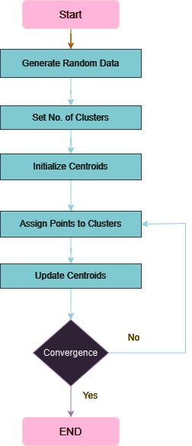
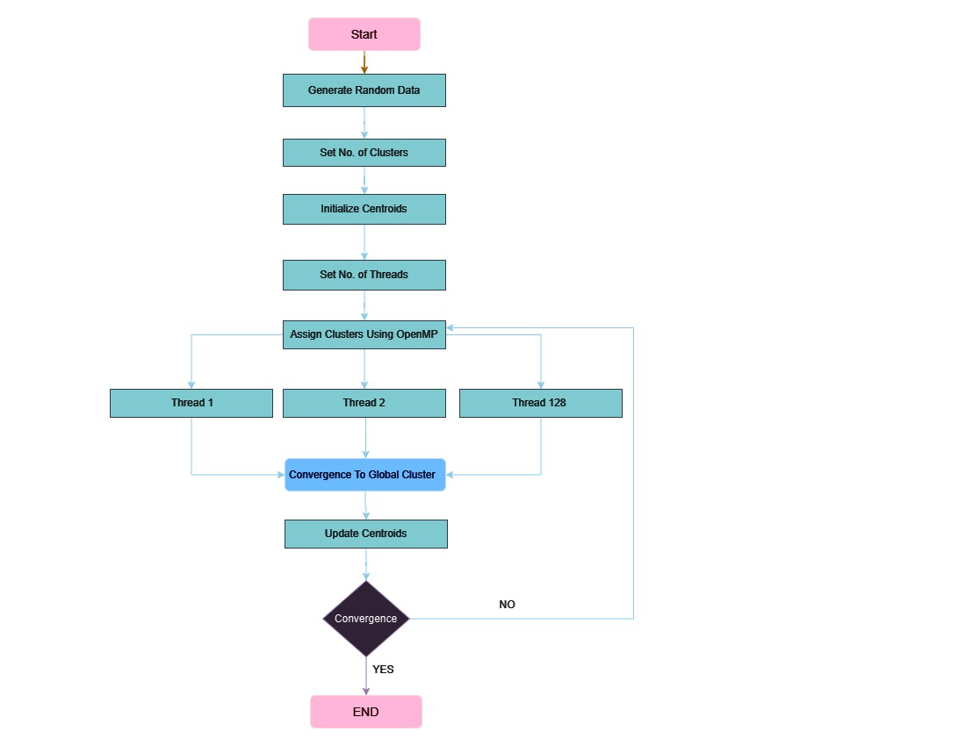
Flow Chart

Slide 10
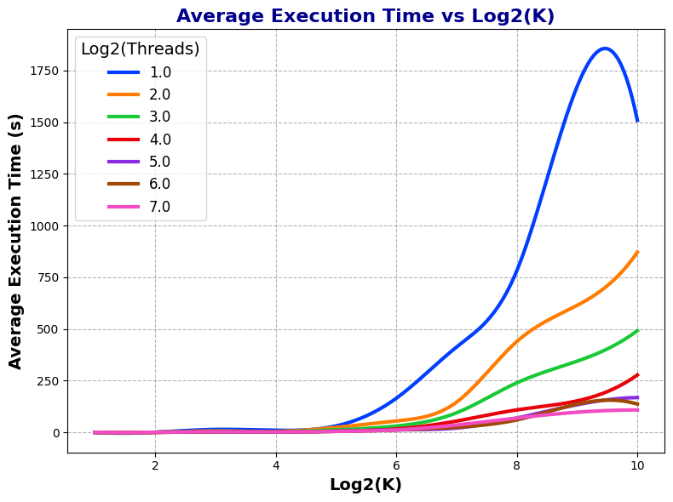
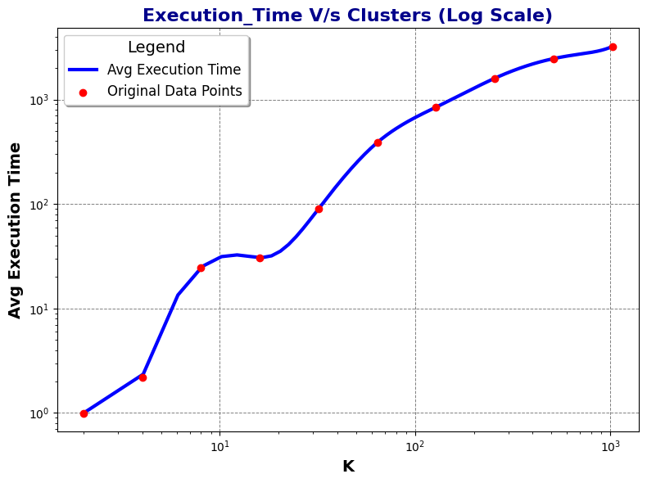
Results

Slide 11
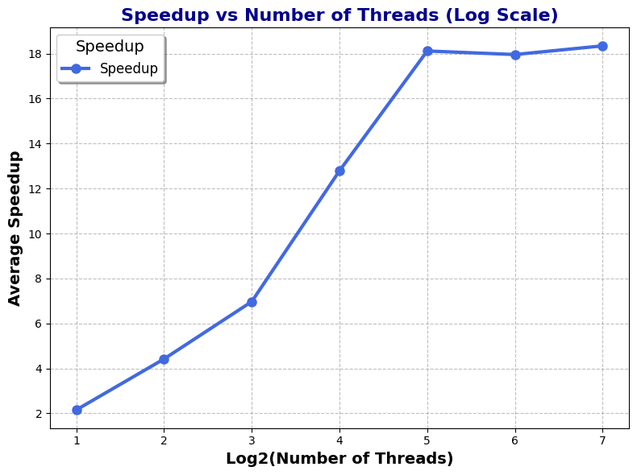
Results

Slide 12
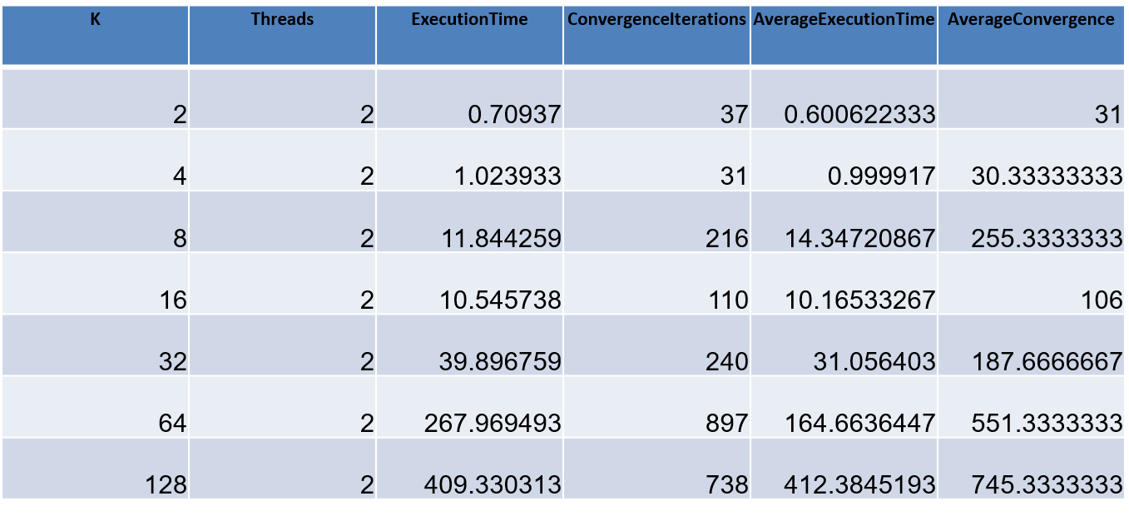
Observations
Increase in execution time as number of cluster increases for same thread

Slide 13
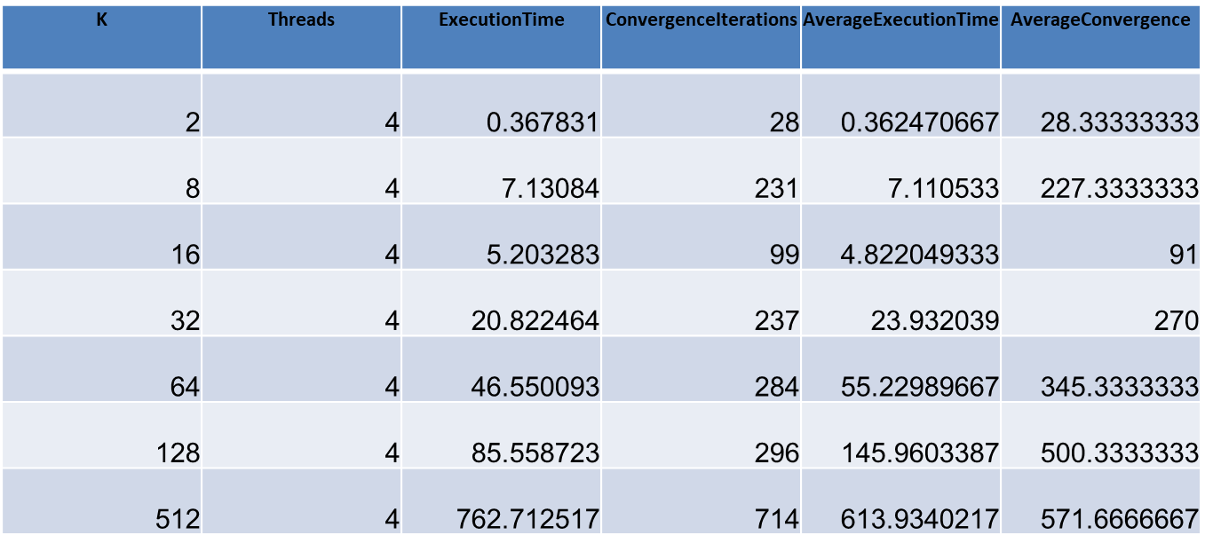
Observations
Increase in iteration number for convergence of cluster increases.

Slide 14
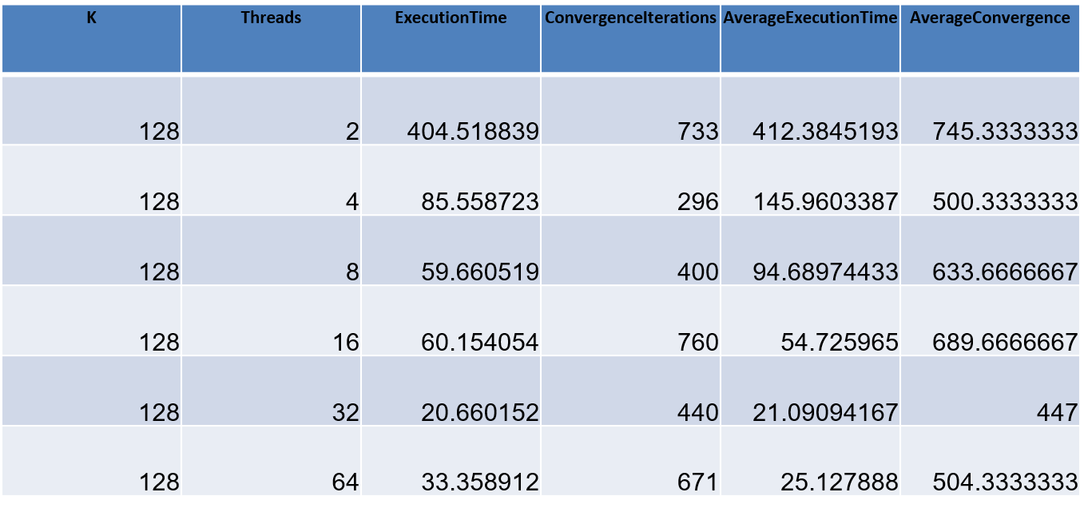
Observations
Decrease in execution time as number of thread increases.

Slide 15
Observations
Increase in Speed-Up as no. of Thread increases
Threads | Average Speedup
2 | 2.15x
4 | 4.42x
8 | 6.97x
16 | 12.79x
32 | 18.12x
64 | 17.96x
128 | 18.35x

Slide 16
Conclusion
The results show that as the number of threads increases, the speedup improves significantly, reaching a maximum of 18.35x at 128 threads. However, beyond 32 threads, the speedup starts to plateau, indicating diminishing returns due to synchronization overhead and hardware limitations. This highlights the importance of balancing thread count with the problem's parallelism and system architecture for optimal performance.

Slide 17
THANK YOU

