Slide 1
Personal Health Train ?! Decentralized And Privacy Preserving Approach To Data Sharing
Ananya Choudhury
PhD Scholar
Department of Radiation Oncology (MAASTRO)
GROW - Maastricht University Medical Centre +
Maastricht, The Netherlands

Slide 2

Barriers to sharing data
[..] the problem is not really technical […]. Rather, the problems are ethical, political, and administrative. Lancet Oncol 2011;12:933
Administrative (I don’t have the resources)
Political (I don’t want to)
Ethical (I am not allowed to)
Technical (I can’t)

Slide 3
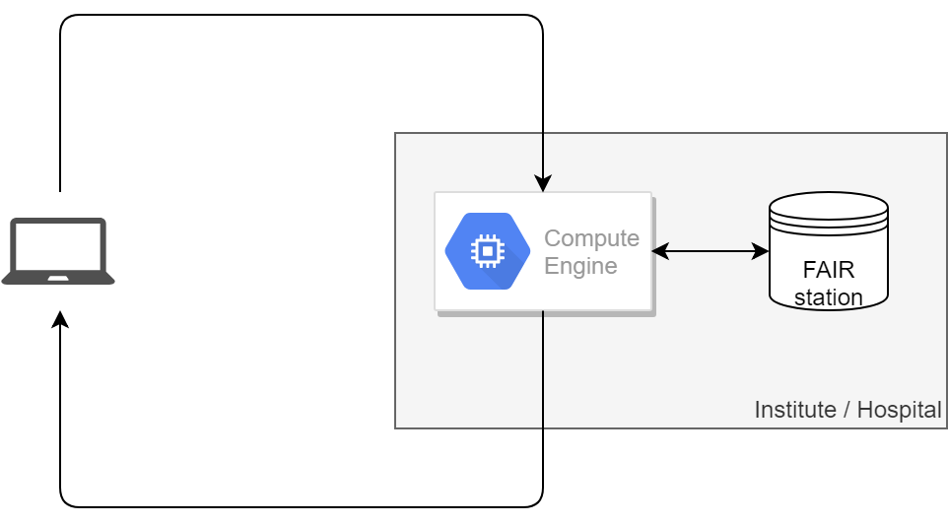
What is actually happening?
Send application
Trust this researcher?
Trust this application?
Allowed to access this data?
Send application
result
Result allowed to send back?
Sensitive result?

Slide 4

PHT: Umbrella
Statistics
Privacy-preserved learning
Distributed learning
Rare diseases registry
https://www.dtls.nl/fair-data/personal-health-train

Slide 5
What’s the problem?
ID | DoB | Gender | HbA1C | Blood glucose
1234 | … | … | … | …
1235 | … | … | … | …
1236 | … | … | … | …
Horizontal partitioning of data
ID | DoB | Gender | HbA1C | Blood glucose
1234 | … | … | … | …
1235 | … | … | … | …
1236 | … | … | … | …
Deist, Jochems, van Soest et al., Infrastructure and distributed learning methodology for privacy-preserving multi-centric rapid learning health care, ctRO. 4 (2017) 24–31

Slide 6
What’s the problem?
ID | DoB | Gender | HbA1C | Blood glucose
1234 | … | … | … | …
1235 | … | … | … | …
1236 | … | … | … | …
ID | DoB | Income | Hospital visits
1234 | … | … | …
1235 | … | … | …
1236 | … | … | …
1237 | … | … | …
1238 | … | … | …
1239 | … | … | …
1240 | … | … | …
1241 | … | … | …
Maastricht Study
Population study > 10.000 participants
Interest in Diabetes Mellitus Type 2
Statistics Netherlands
> 16 million citizens
Vertical partitioning of data

Slide 7
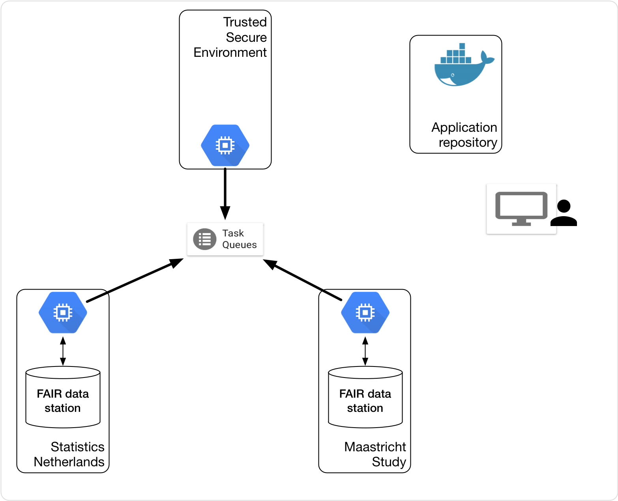
Methods
FAIR data stations
Infrastructure: Train tracks
Applications: trains

Slide 8
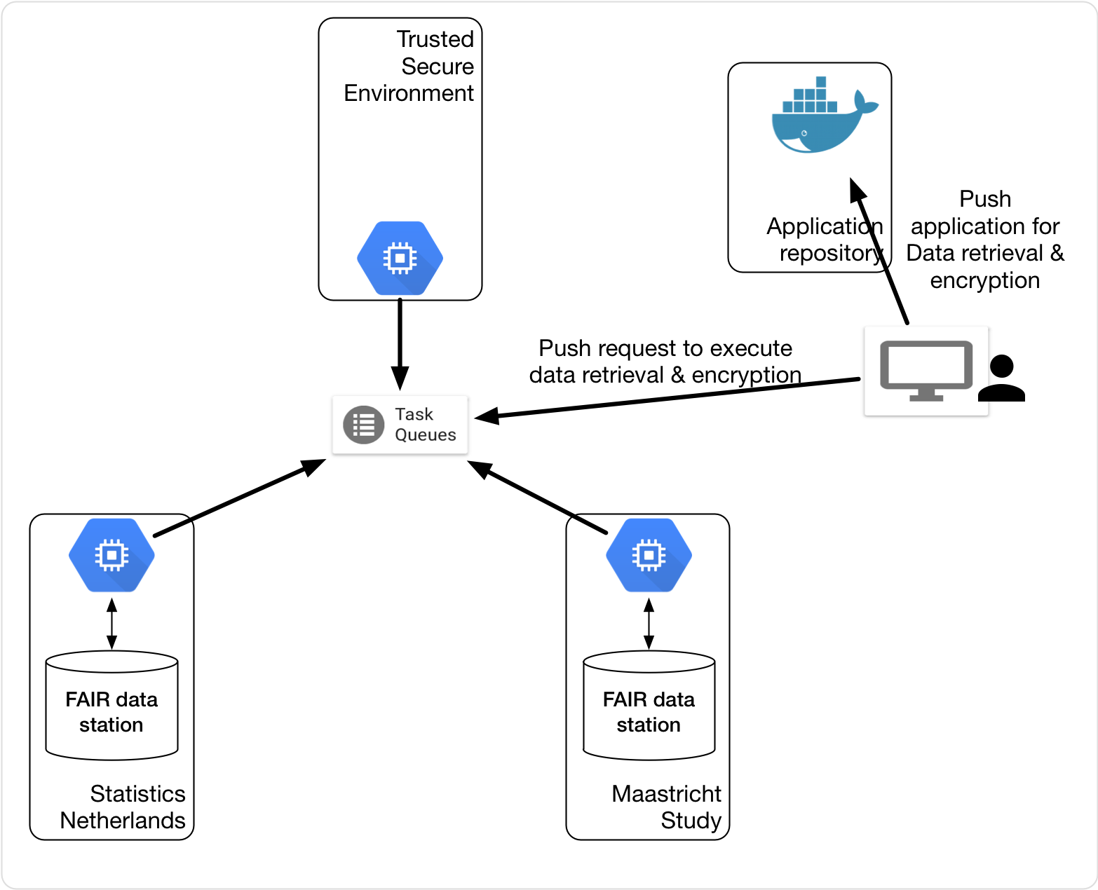
Methods

Slide 9
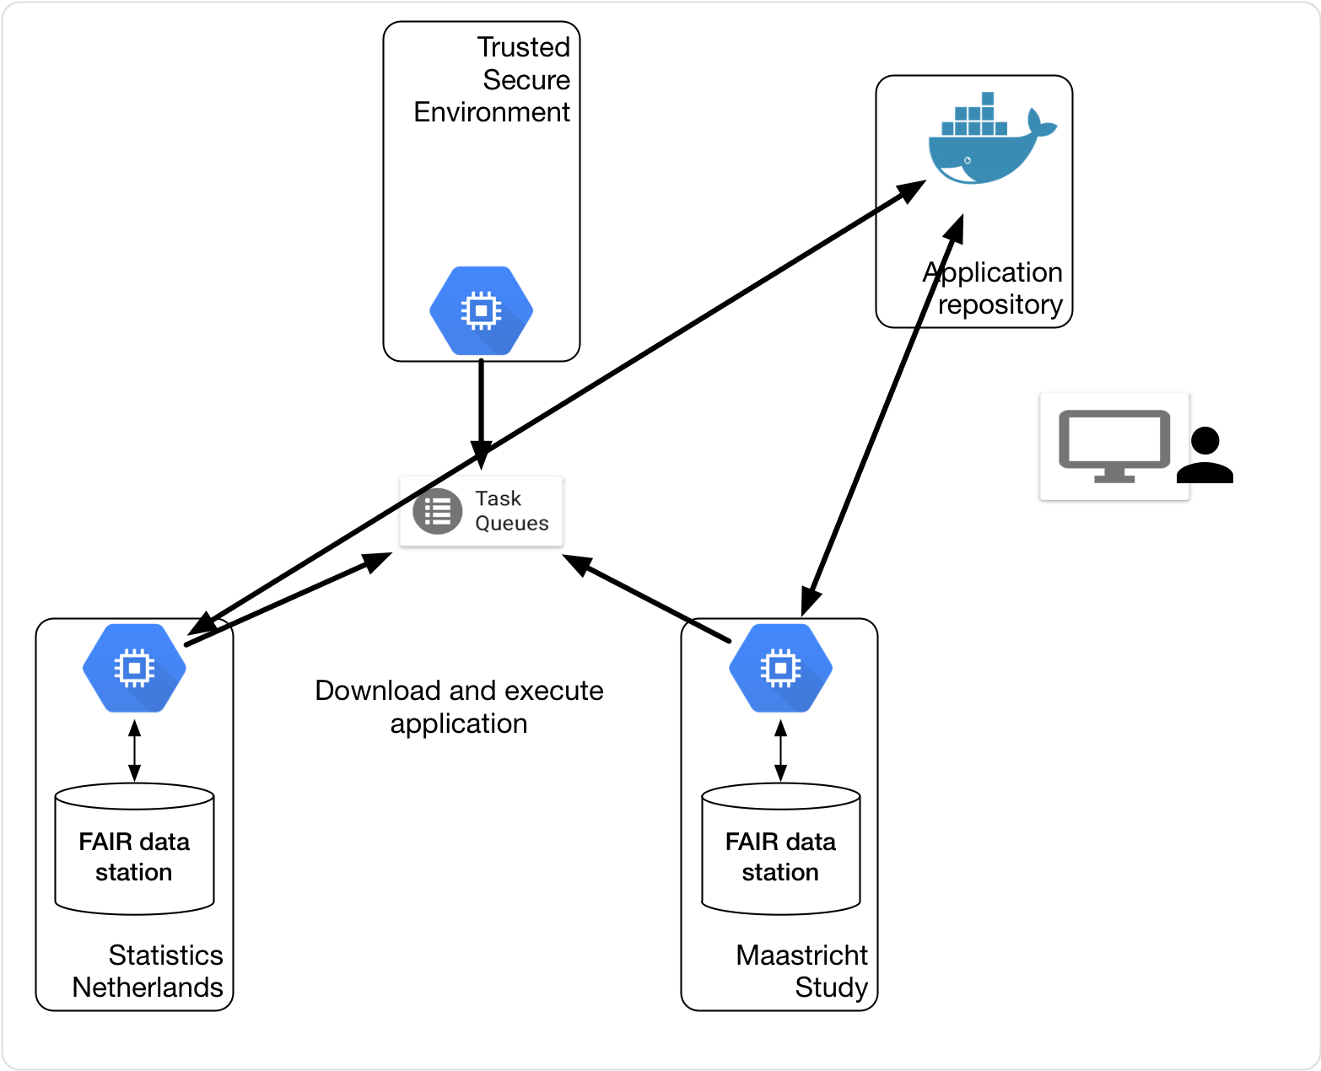
Methods

Slide 10
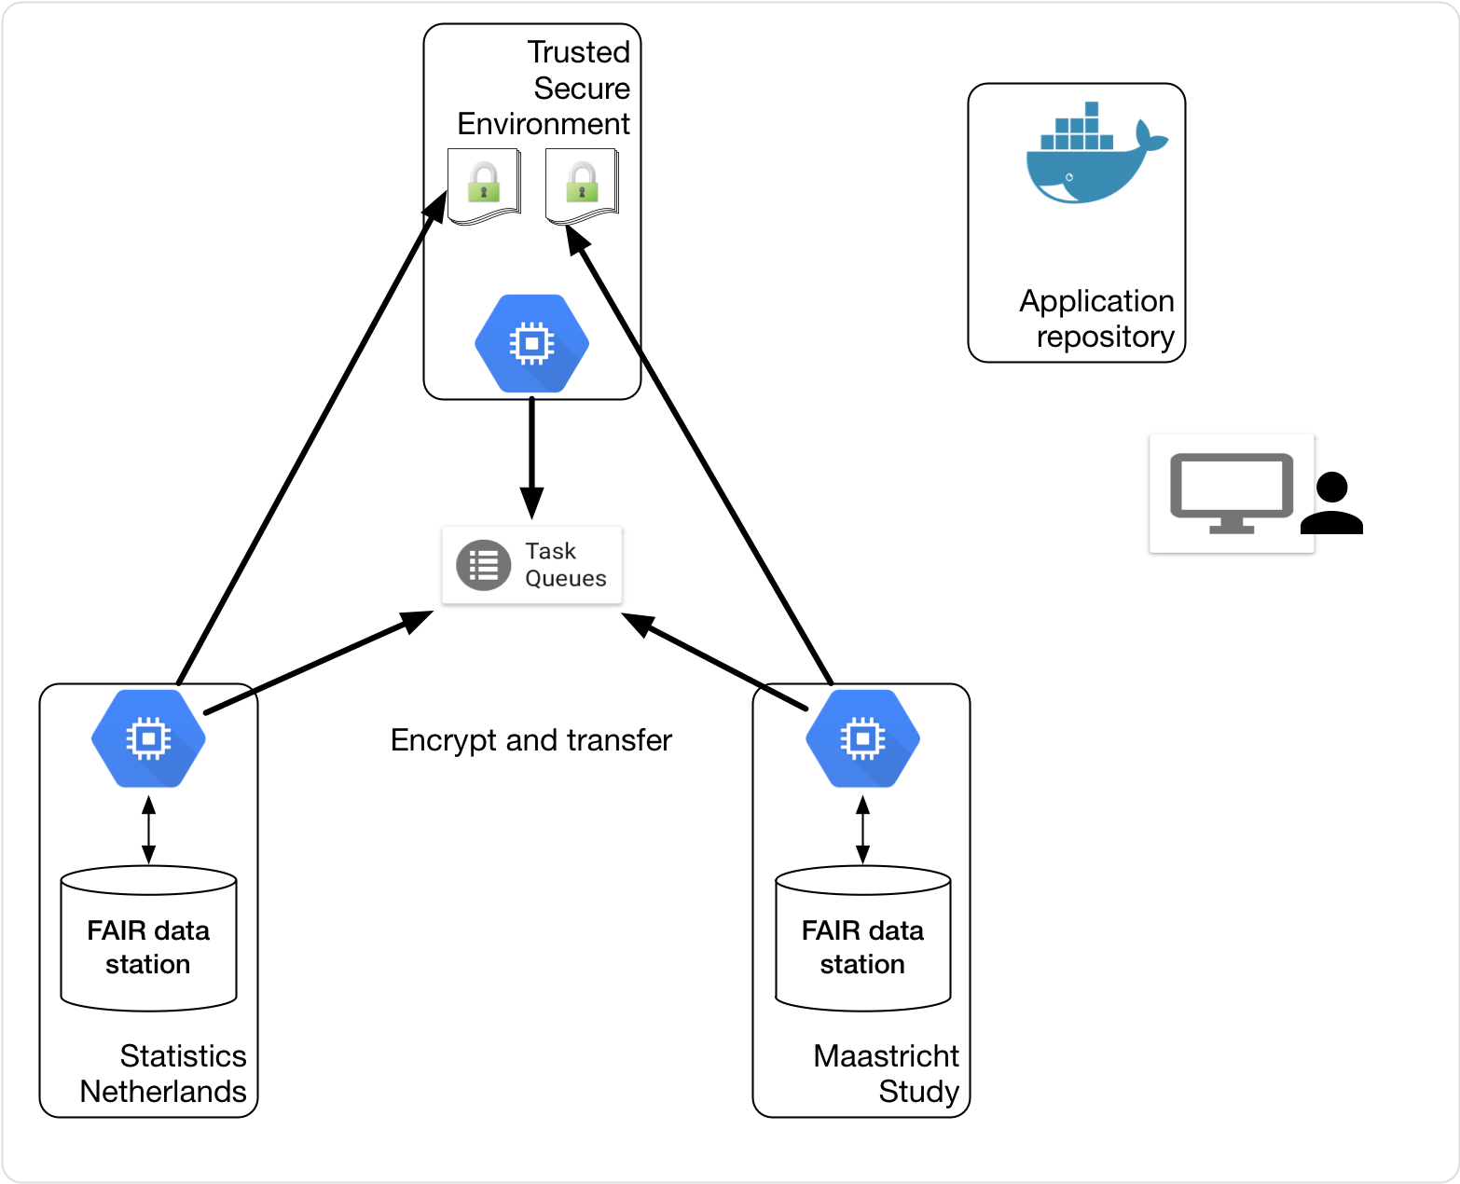
Methods

Slide 11
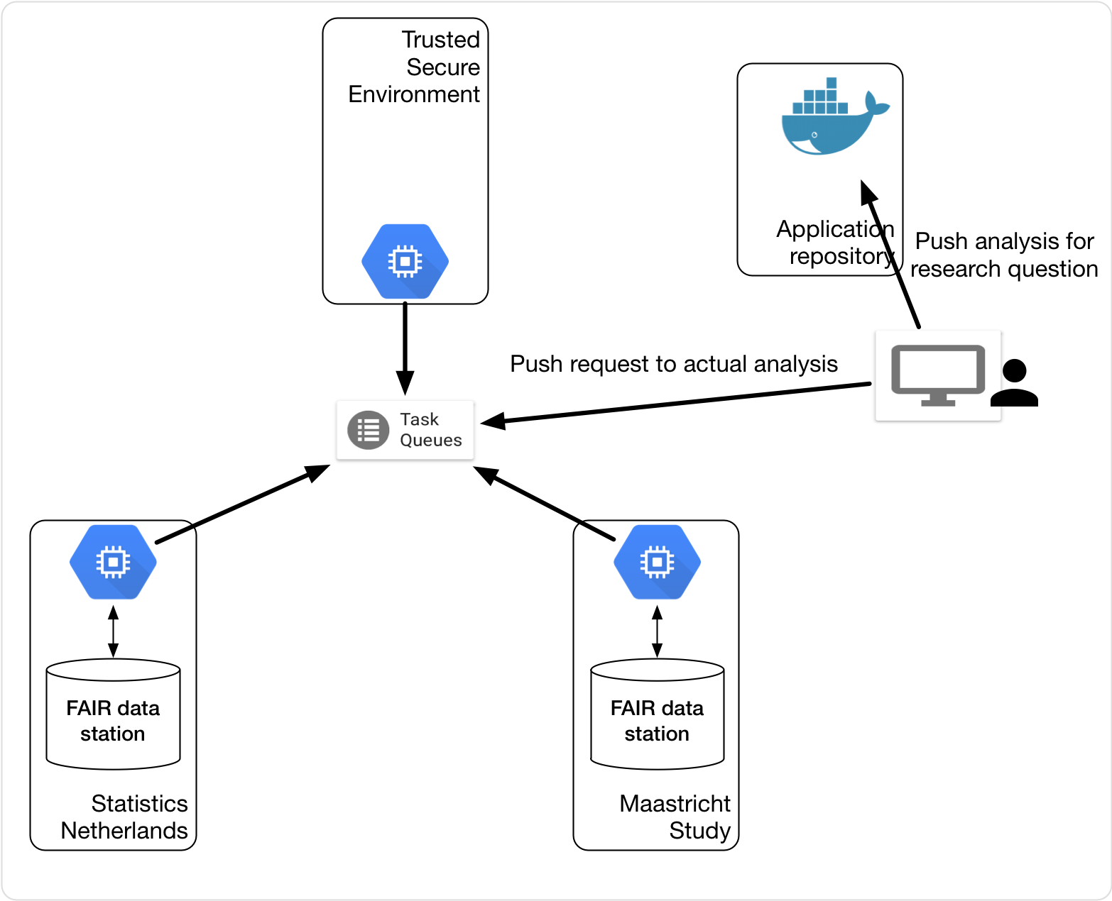
Methods

Slide 12
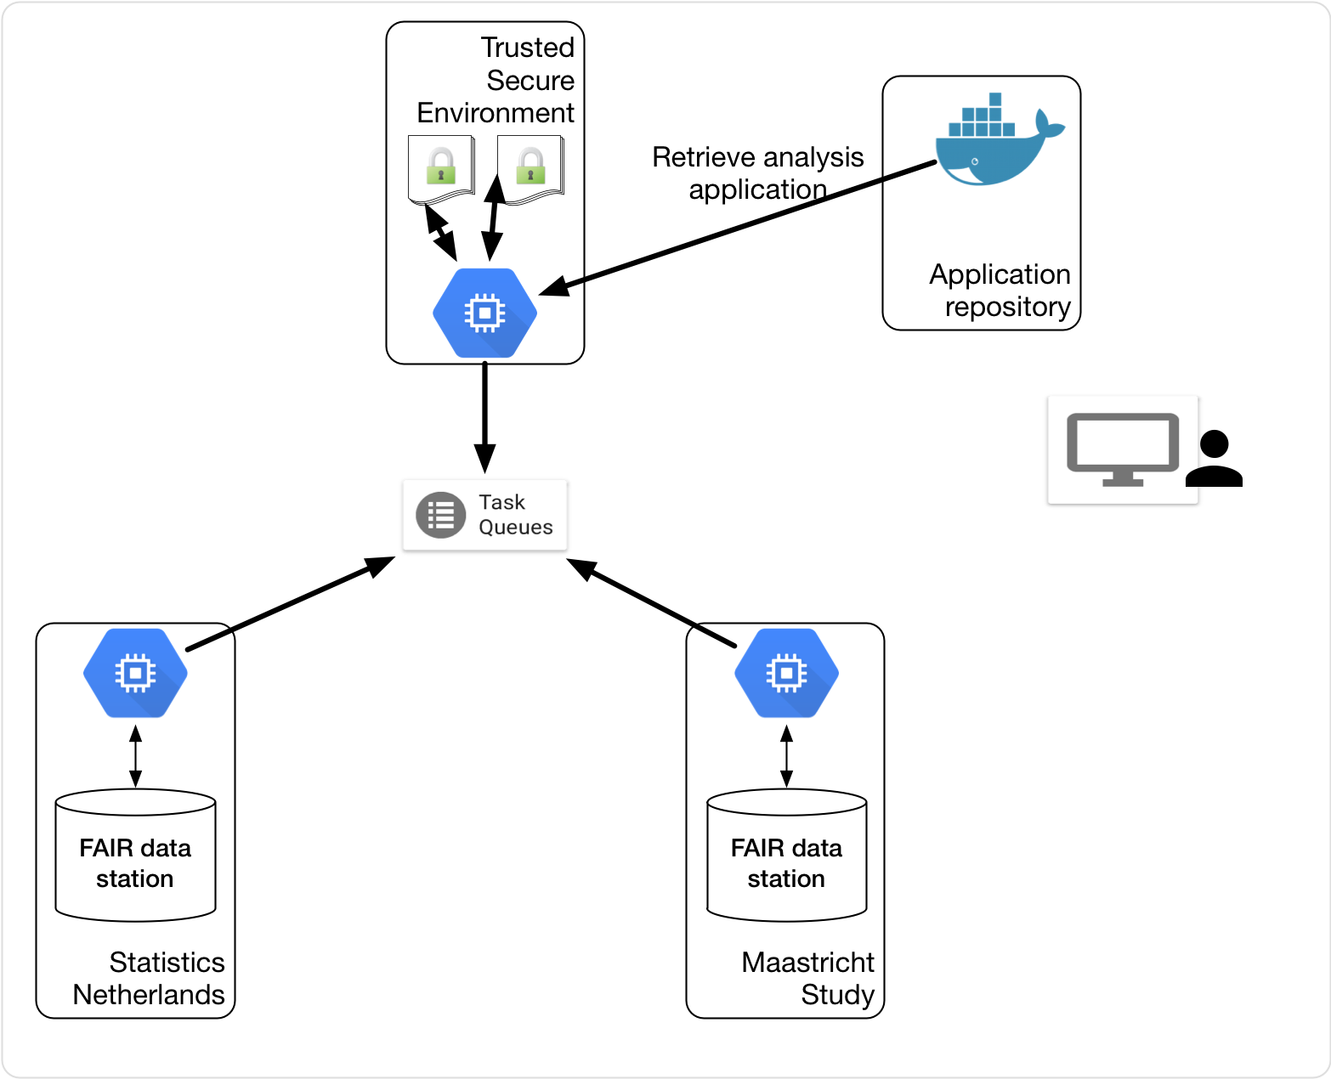
Methods

Slide 13
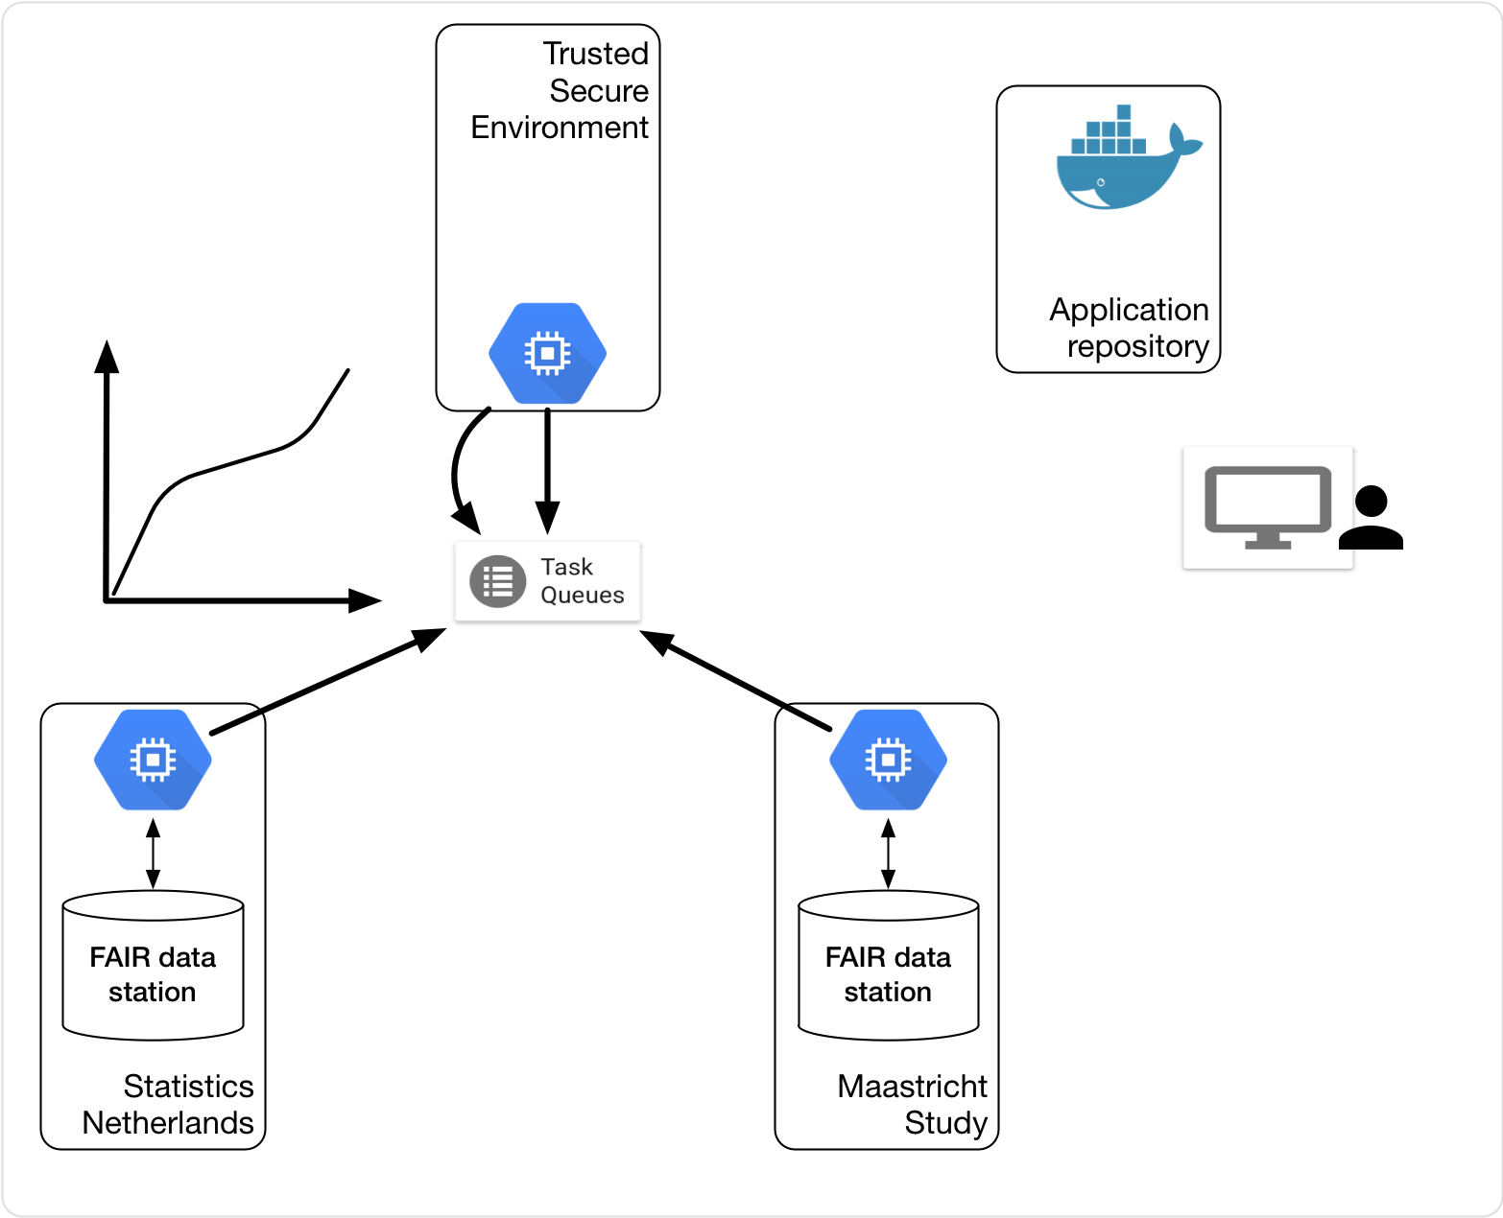
Methods

Slide 14
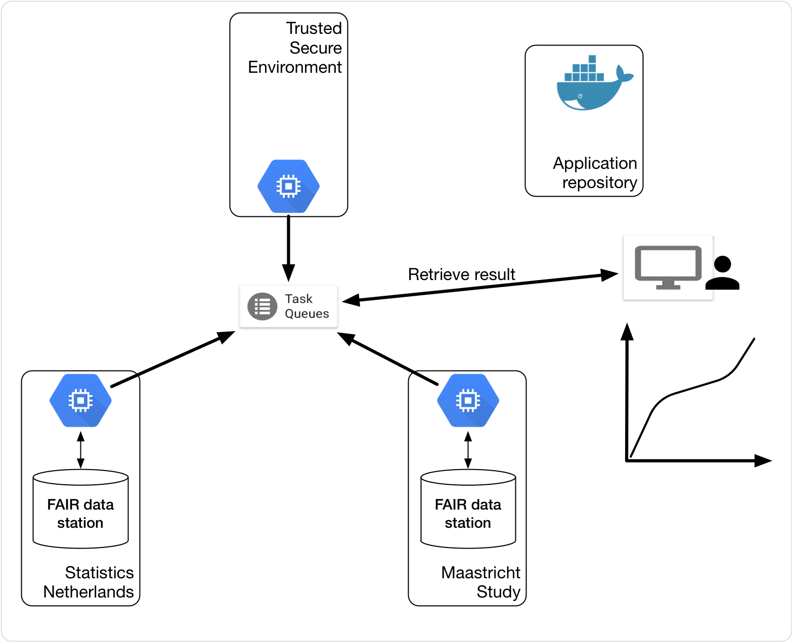
Methods

Slide 15
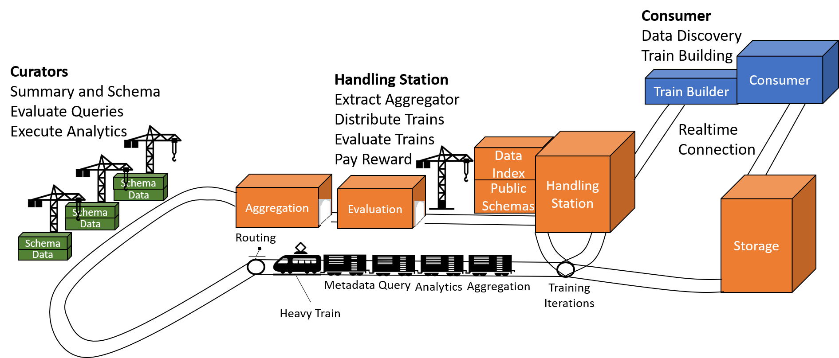
PHT Architecture

Slide 16

Prerequisites
Build
Data Stations

Slide 17
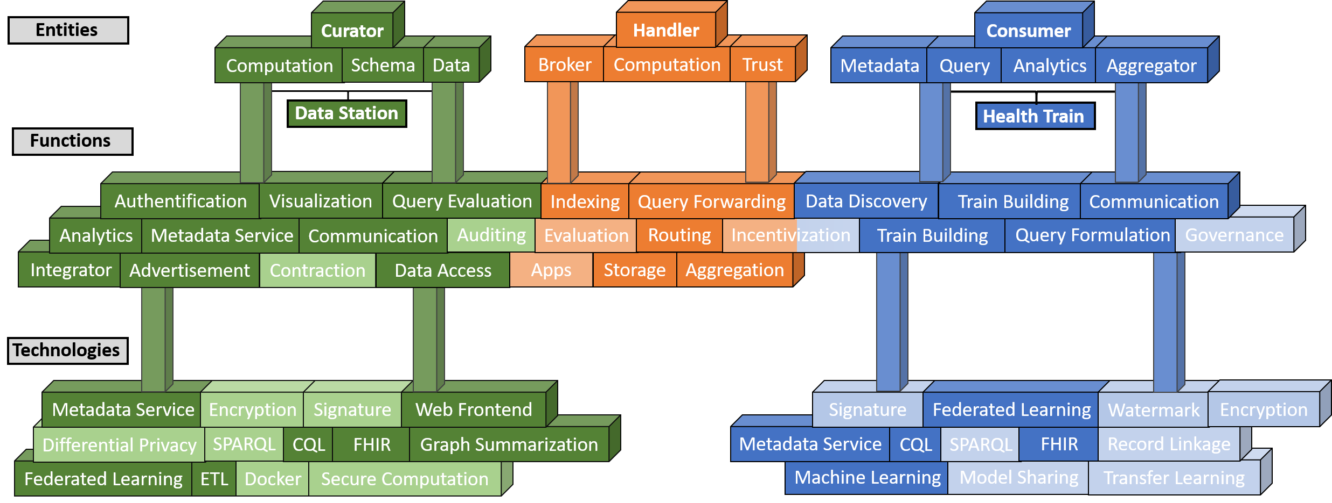
PHT Concepts

Slide 18
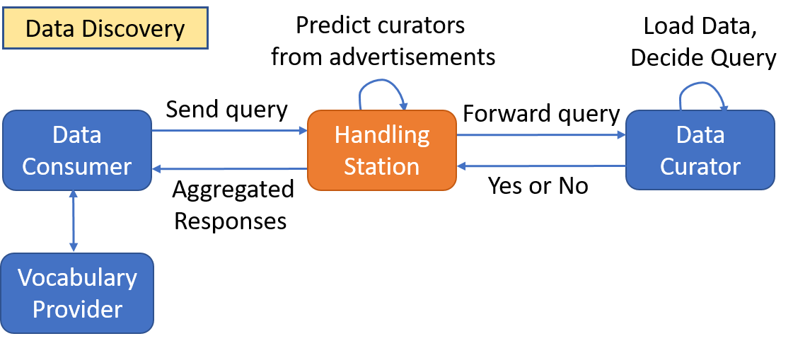

Slide 19
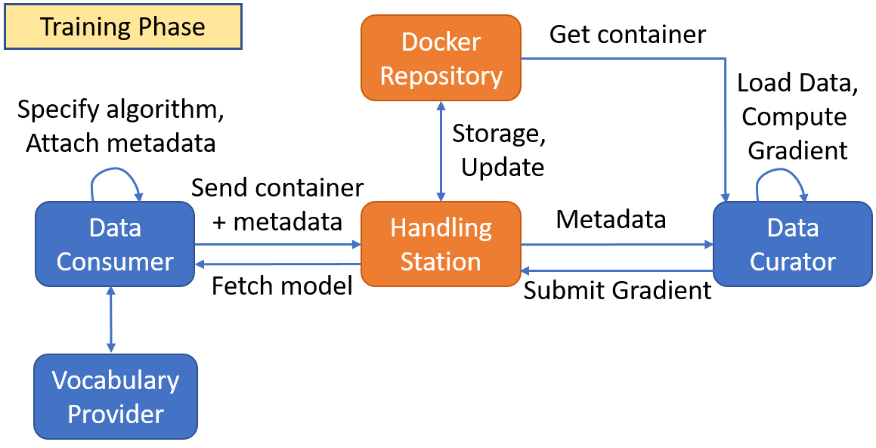
Execution Phase

Slide 20
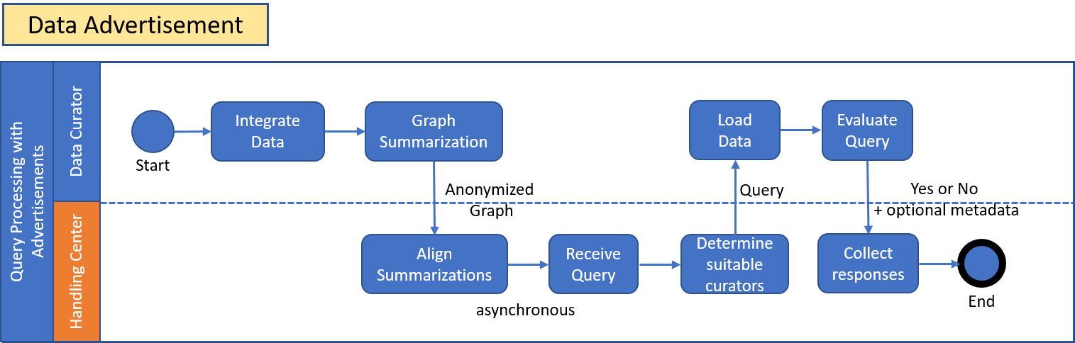

Slide 21
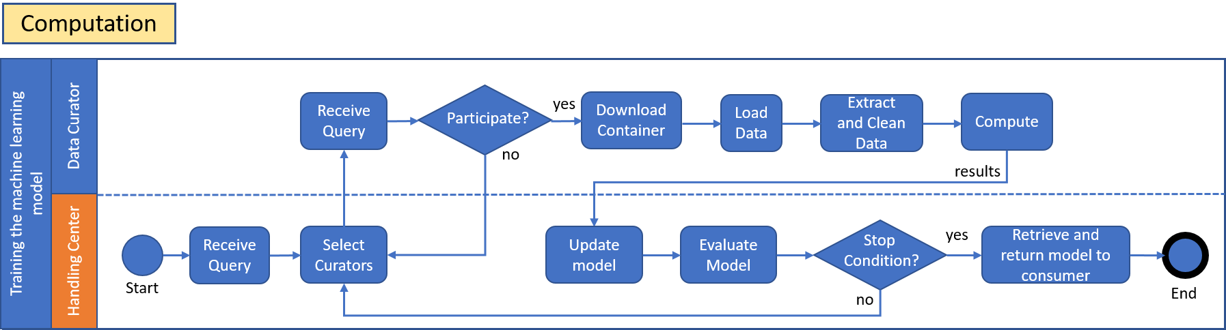

Slide 22
Few Use Cases
Primary Use:
Personal Health Record Linkage
Personal Locker for Health Data
Secondary Use
Distributed Learning without data leaving the organization
National Disease Registry
Statistical Analysis on patient data

Slide 23
Questions?

Slide 24
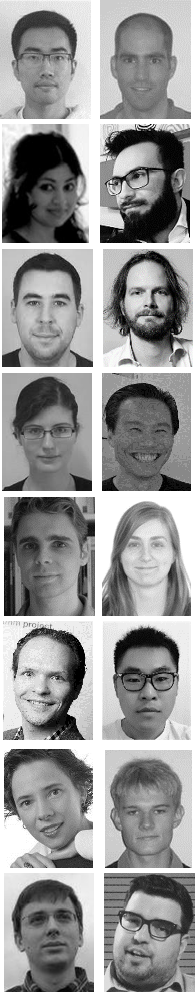
Thank you
Centraal Bureau voor de Statistiek, NL
Maastricht University, Maastricht, Netherlands
Fudan Cancer Center, Shanghai, China
Varian, Palo Alto, CA, USA
Siemens, Malvern, PA, USA
RTOG, Philadelphia, PA, USA
MAASTRO, Maastricht, Netherlands
Policlinico Gemelli, Roma, Italy
UH Ghent, Belgium
UZ Leuven, Belgium
Radboud, Nijmegen, Netherlands
University of Sydney, Australia
University of Michigan, Ann Arbor, USA
Liverpool and Macarthur CC, Australia
CHU Liege, Belgium
Uniklinikum Aachen, Germany
LOC Genk/Hasselt, Belgium
Princess Margaret CC, Canada
The Christie, Manchester, UK
UH Leuven, Belgium
State Hospital, Rovigo, Italy
ICCC, Wollongong Australia
Catharina Zkh Eindhoven, Netherlands
Philips, Eindhoven, Netherlands
Calvary Mater, Newcastle, Australia
More info on: www.predictcancer.org www.personalhealthtrain.com www.eurocat.info www.mistir.info

