Slide 1
PHT on FHIR
Johan van Soest, Ananya Choudhury
Department of Radiation Oncology (MAASTRO)
GROW - Maastricht University Medical Centre +
Maastricht, The Netherlands

Slide 2
Introductions, Practicalities, Setting-up
Johan van Soest, Ananya Choudhury
Department of Radiation Oncology (MAASTRO)
GROW - Maastricht University Medical Centre +
Maastricht, The Netherlands

Slide 3
Welcome!!
Introduce yourself
Name
Institution
Why you are here
Specific goals?

Slide 4
Overall Schedule
15 min: Introduction / what are we going to do
15 min: Explanation PHT
15 min: Q&A & small break
20 min: Demo: PHT on RDF
10 min: Demo: PHT on FHIR
15 min: round-up & Q&A
Note: We might end early but not late!

Slide 5
Demo goals
Be as practical as we can!
Have fun
Run an application on data stations, without seeing the data
Explain what RDF can (and can’t) do
Sending trains to public (FAIR) data stations
PHT != RDF && PHT != FHIR

Slide 6
Following the demo
System requirements:
Python 3.7
Jupyter notebooks (pip install jupyter notebook)
Git repository: https://github.com/jvsoest/PHT_on_FHIR_demo

Slide 7
Personal Health Train ?! Decentralized And Privacy Preserving Approach To Data Sharing
Ananya Choudhury
PhD Scholar
Department of Radiation Oncology (MAASTRO)
GROW - Maastricht University Medical Centre +
Maastricht, The Netherlands

Slide 8

Barriers to sharing data
[..] the problem is not really technical […]. Rather, the problems are ethical, political, and administrative. Lancet Oncol 2011;12:933
Administrative (I don’t have the resources)
Political (I don’t want to)
Ethical (I am not allowed to)
Technical (I can’t)

Slide 9
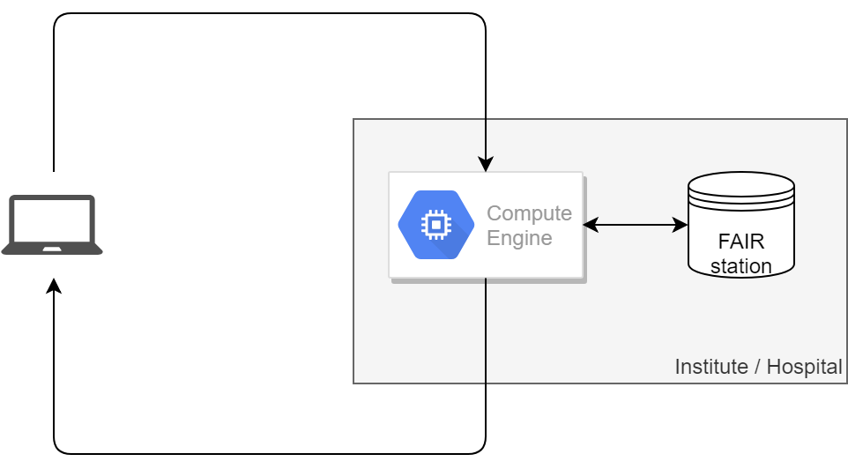
What is actually happening?
Send application
Trust this researcher?
Trust this application?
Allowed to access this data?
Send application
result
Result allowed to send back?
Sensitive result?

Slide 10

PHT: Umbrella
Statistics
Privacy-preserved learning
Distributed learning
Rare diseases registry
https://www.dtls.nl/fair-data/personal-health-train

Slide 11
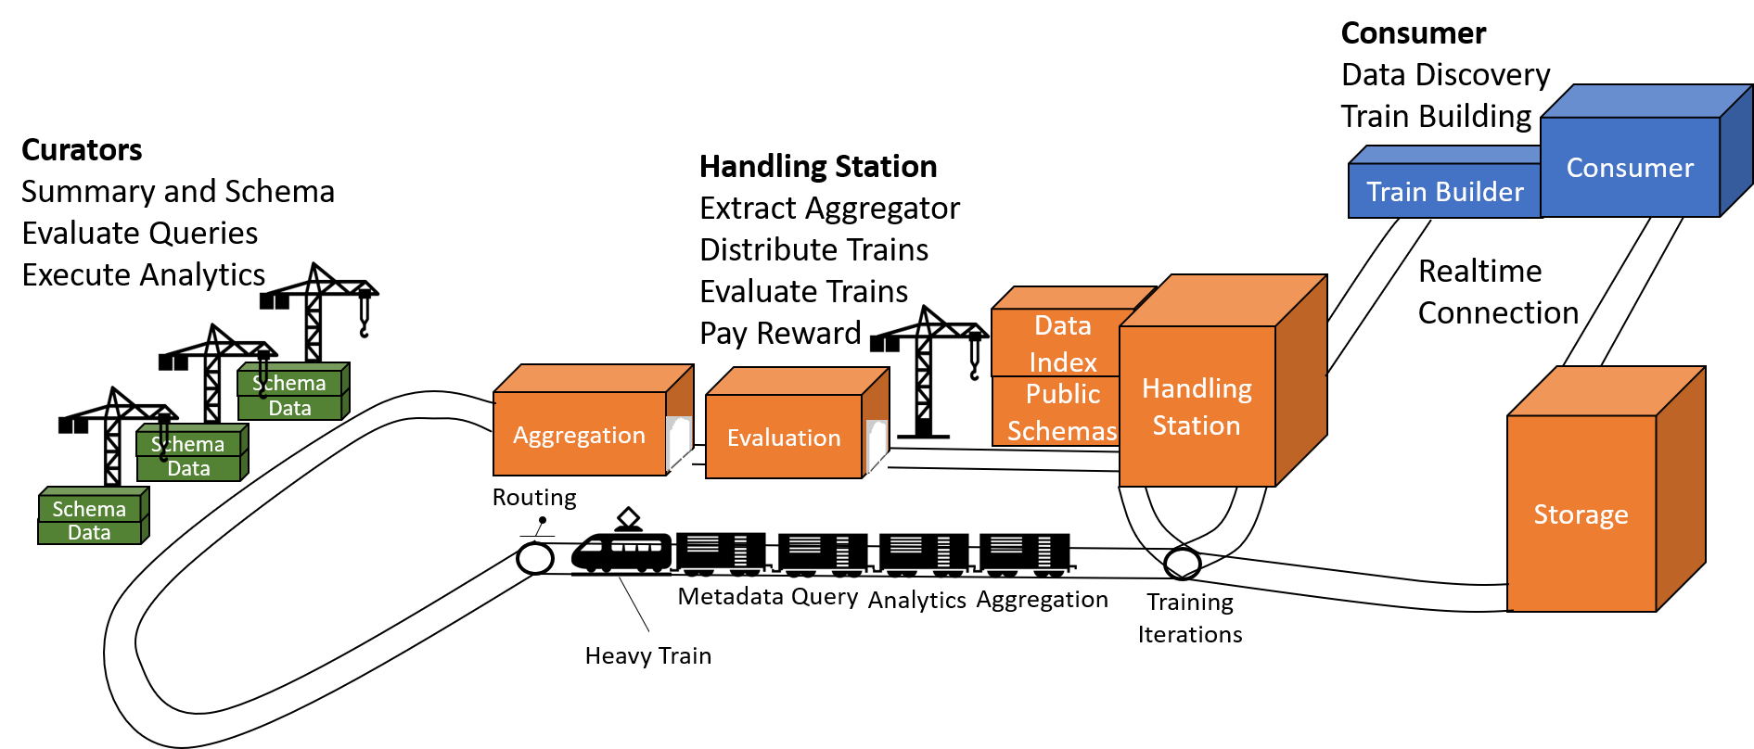
PHT Architecture

Slide 12

Prerequisites
Build
Data Stations

Slide 13
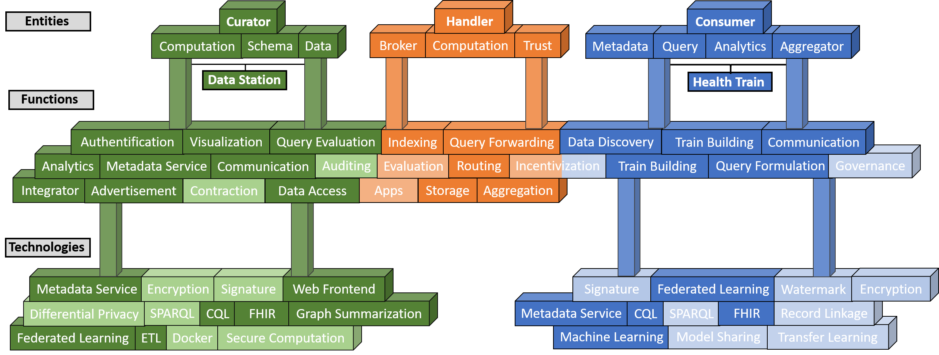
PHT Concepts

Slide 14
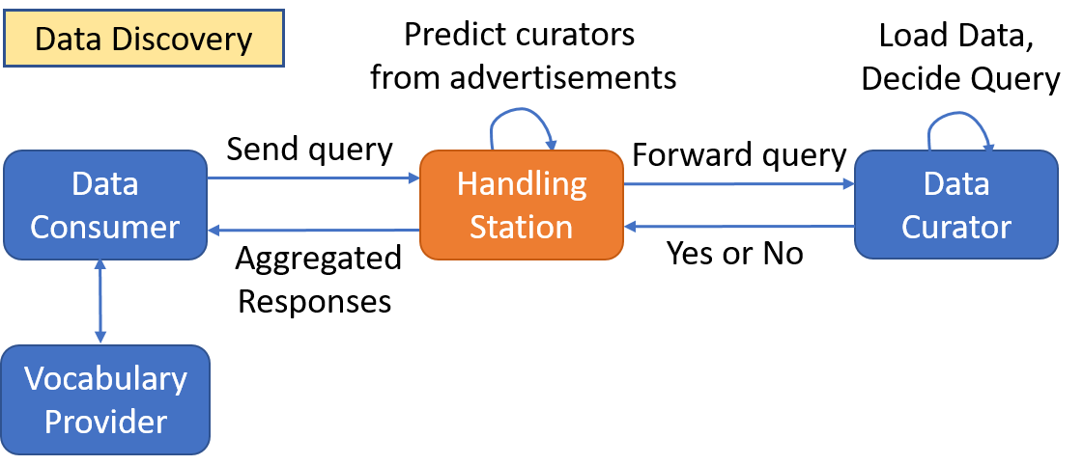

Slide 15
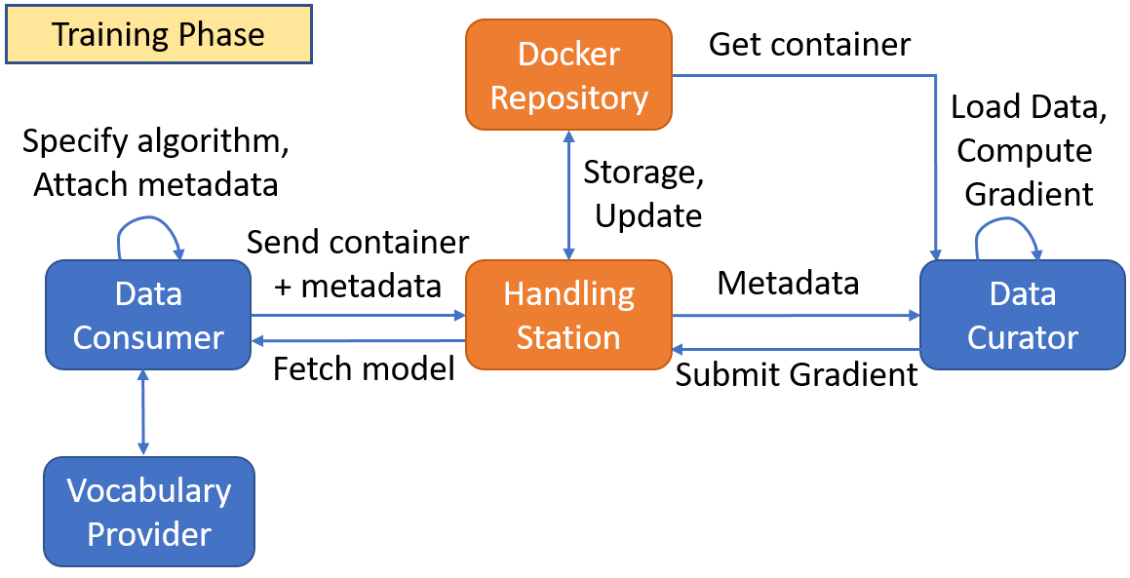
Execution Phase

Slide 16
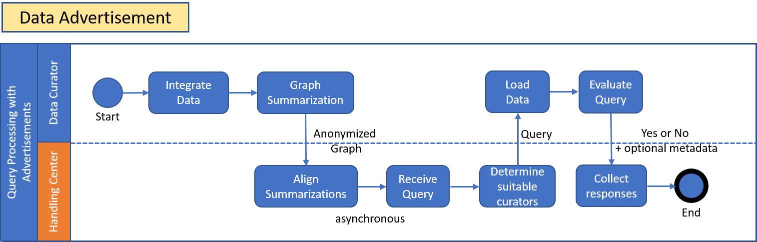

Slide 17
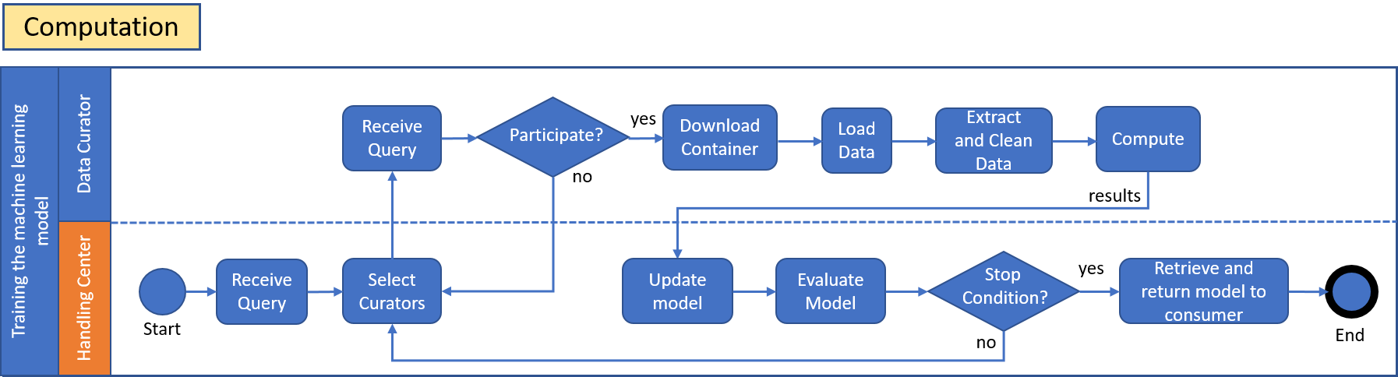

Slide 18
Few Use Cases
Primary Use:
Personal Health Record Linkage
Personal Locker for Health Data
Secondary Use
Distributed Learning without data leaving the organization
National Disease Registry
Statistical Analysis on patient data

Slide 19
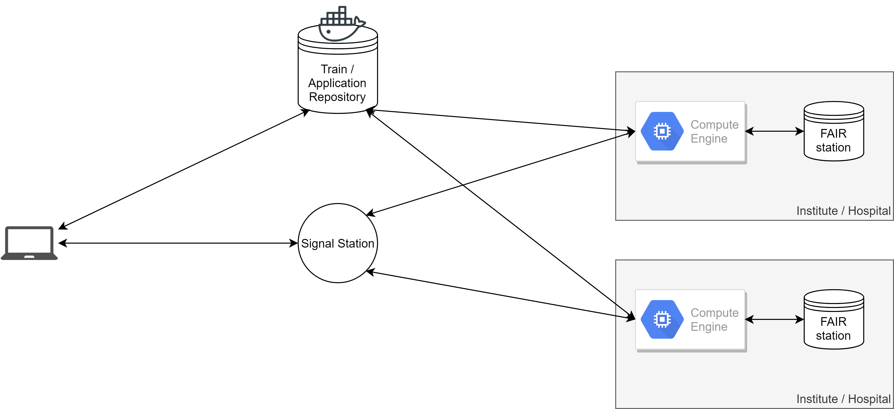
Infrastructure for today

Slide 20
Questions?

Slide 21
PHT on RDF and FHIR
Johan van Soest, Ananya Choudhury
Department of Radiation Oncology (MAASTRO)
GROW - Maastricht University Medical Centre +
Maastricht, The Netherlands

Slide 22
What data – Why FAIR data?
In hospitals, different sytems
Different structures (syntax)
Different terminologies
We can’t see the data, so we can’t do the analysis
Not true

Slide 23
Data collection & cleaning
Difference 3 and 3a?
What is 9, NA and 0?
What is empty or 0?
Lymph nodes?
Lymphocytes?
Days/Months/years?
id | cT | cN | cM | lymph | surv | survTime
1 | 3 | 1 | 1 |  | Y | 37
2 | 2 | 0 | 0 |  | N | 14
3 | 3a | 9 |  |  | N | 25
4 | 1 | NA | 0 |  | Y | 43
5 | 4 | 2 | 1 |  | Y | 9
6 | 2b | 0 | 0 |  | N | 33
Everyone develops their own standard!

Slide 24
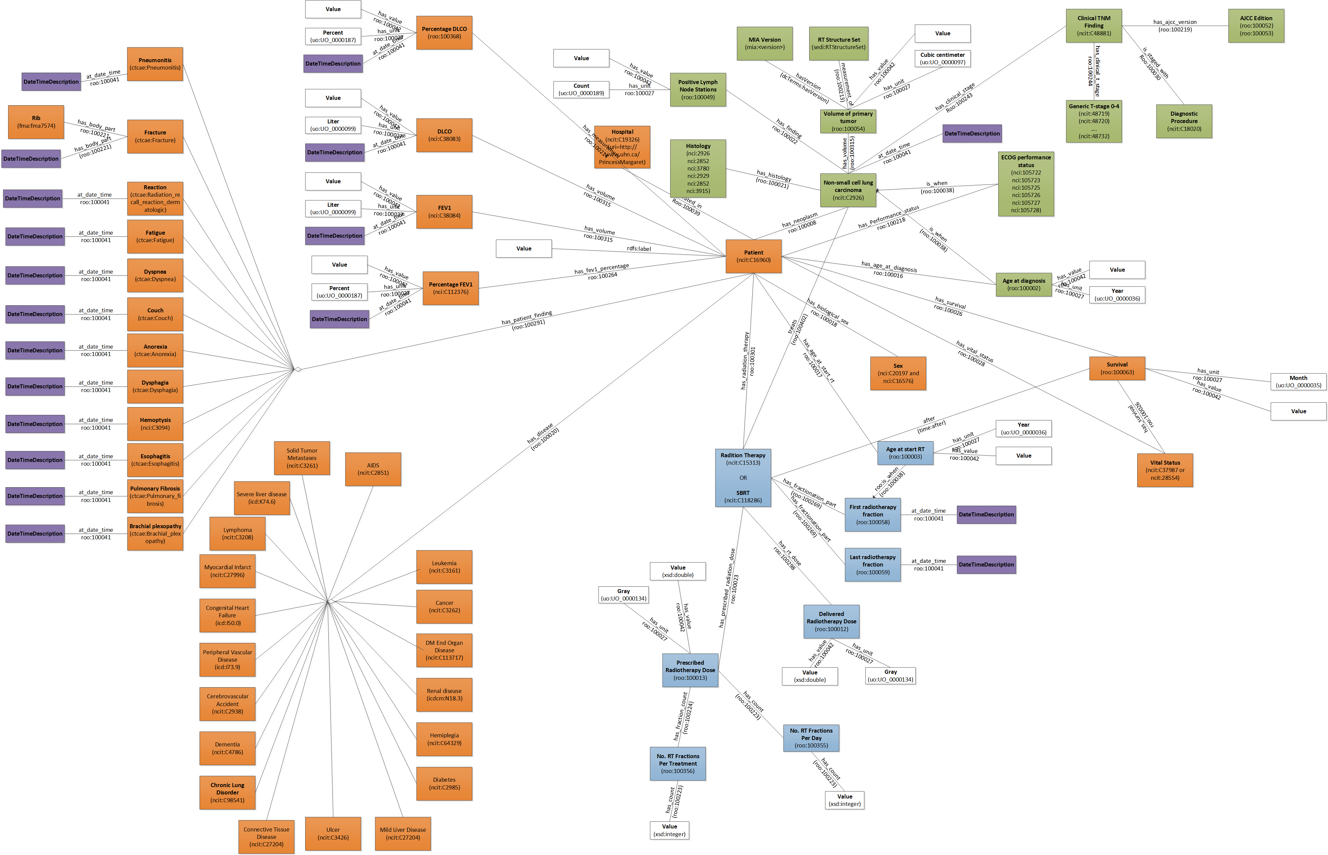

Slide 25
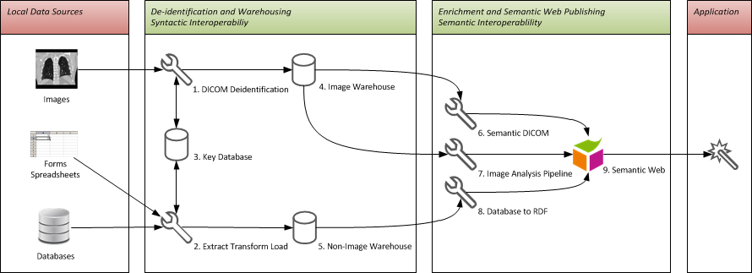
Our current workflow: primer?
https://bitbucket.org/maastroclinic/catinfrastructure_generic/wiki/high_level_infra

Slide 26
Getting data into our FAIR RDF store
Separate structure and terminology conversion
https://github.com/maastroclinic/DataFAIRifier

Slide 27
RDF query language (SPARQL)
Advantages:
(rule based) inferencing
Age 75 = elderly patient
sub/super class inferencing
NSCLC = lung cancer
linked data federation
Anyone can say Anything about Anything
Disadvantages
Anyone can say Anything about Anything
Speed

Slide 28
Demo PHT on RDF
Train / application / script?
Cohort counter
Mean age
How to trigger on a remote site?

Slide 29
Demo PHT on FHIR
Train / application / script?
Cohort counter
Mean age
How to trigger on a remote site?

Slide 30
Q&A / PHT in Practice
Johan van Soest, Ananya Choudhury
Department of Radiation Oncology (MAASTRO)
GROW - Maastricht University Medical Centre +
Maastricht, The Netherlands

Slide 31
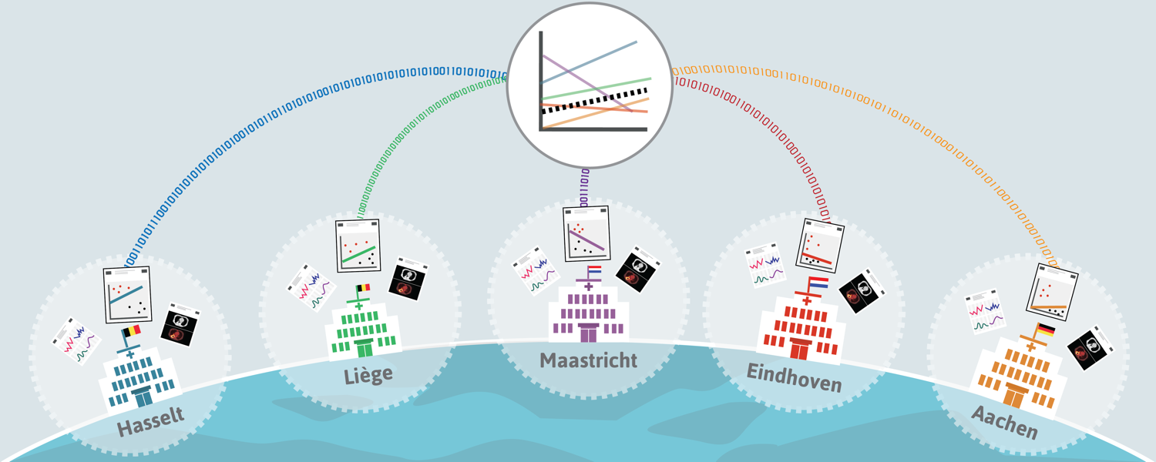
Sharing algorithms instead of data
Application of Machine Learning for Multicenter Learning, van Soest, Dekker, Roelofs, Nalbantov (2015)
Infrastructure and distributed learning methodology, Deist et al. (2017)

Slide 32
CORAL: Community in Oncology for RApid Learning
euroCAT
Lung
UK Aachen
LOC Hasselt
Catharina
MAASTRO
CHU Liege
meerCAT
Lung
U Michigan
MAASTRO
The Christie
7
sinoCAT / VATE / SAGE
Rectum
Fudan
Rome
RTOG/NRG
Starting
BCCA (Breast)
Bloemfontein (Cervix)
Odense (HN, Lung)
Aalst (Lung)
McGill (Brain)
canCAT
Sarcoma
MGH
MAASTRO
BIONIC
Radiomics
MAASTRO
Tata
ozCAT
Head&Neck, Lung
Liverpool
Illawarra
Newcastle
Westmead
MAASTRO
RTOG/NRG
duCAT
Lung, Breast
MAASTRO
Radboud
NKI
Erasmus
UMCU
ukCAT
Lung, Anal, Esophagus
Cardiff
Christie
Leeds
4
cuCAT
Esophagus
Cardiff
MAASTRO
canCAT
Lung
Princess Margaret
MAASTRO
Map © Copyright Showeet.com

Slide 33
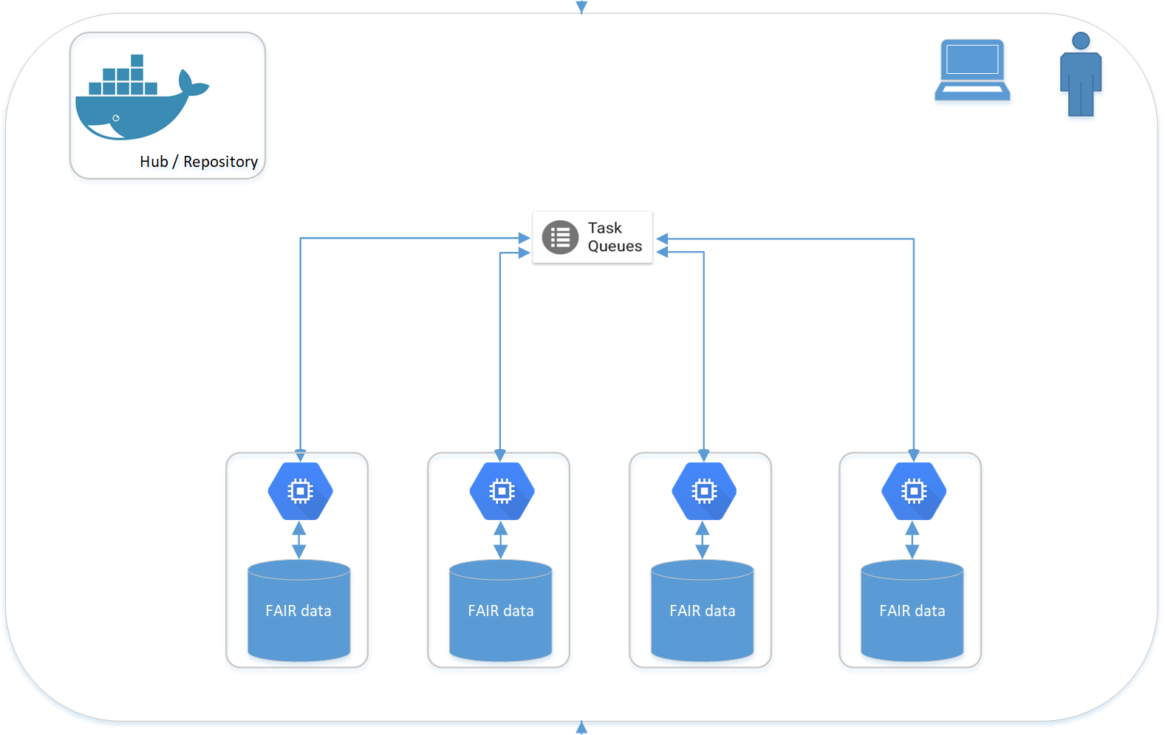
Application / IT perspective

Slide 34
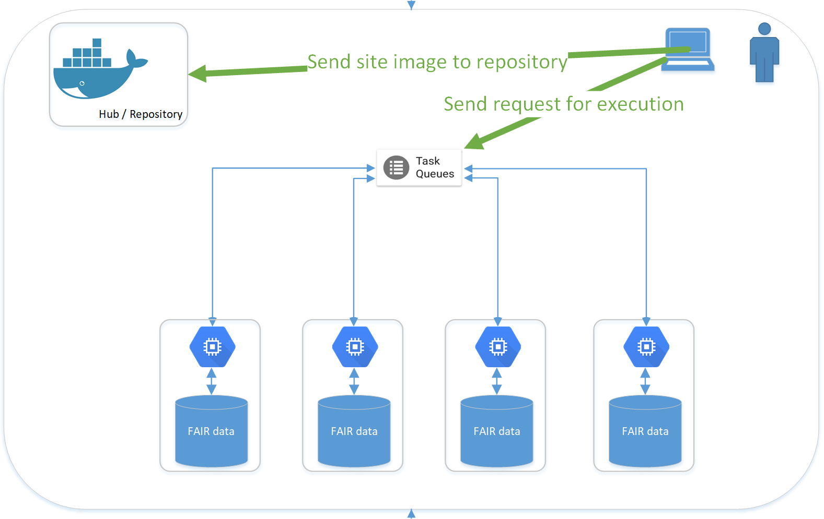
Application / IT perspective

Slide 35
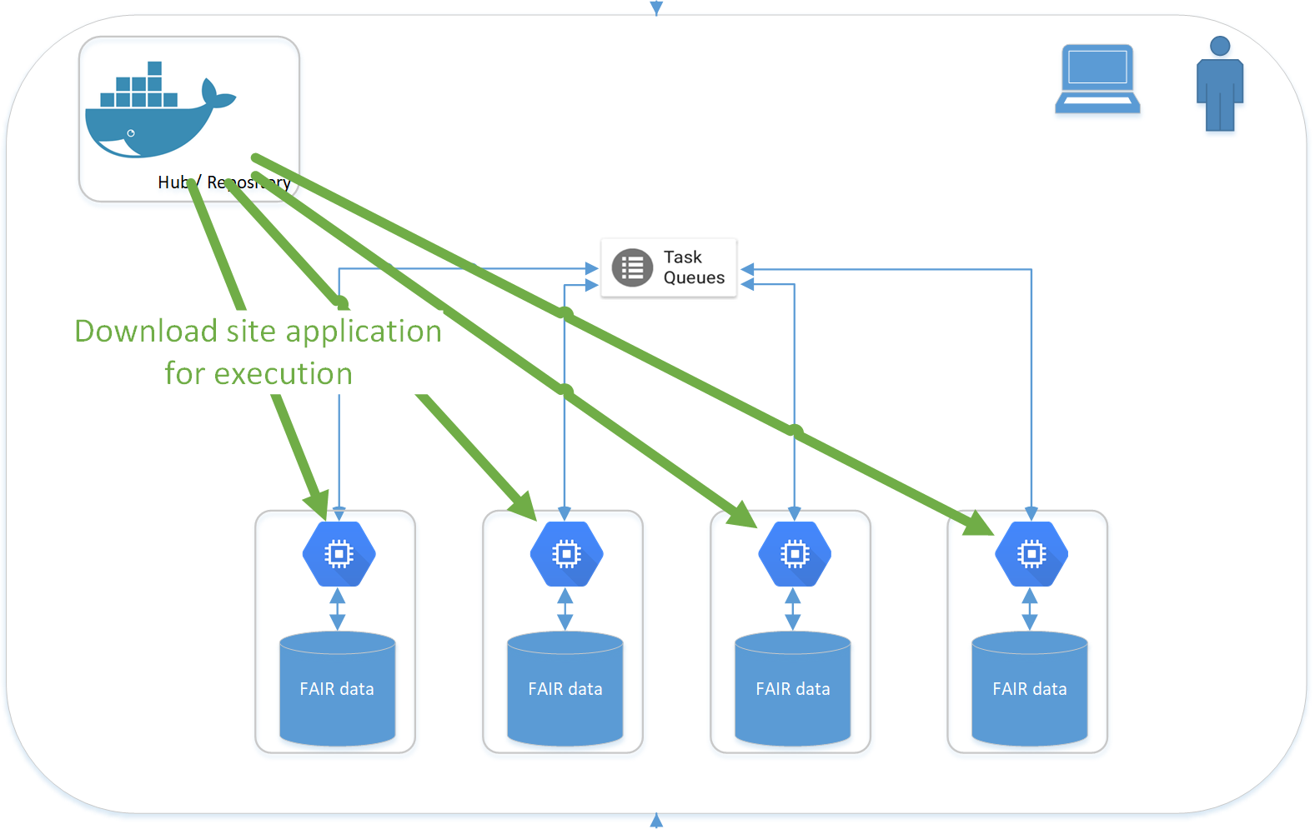
Application / IT perspective

Slide 36
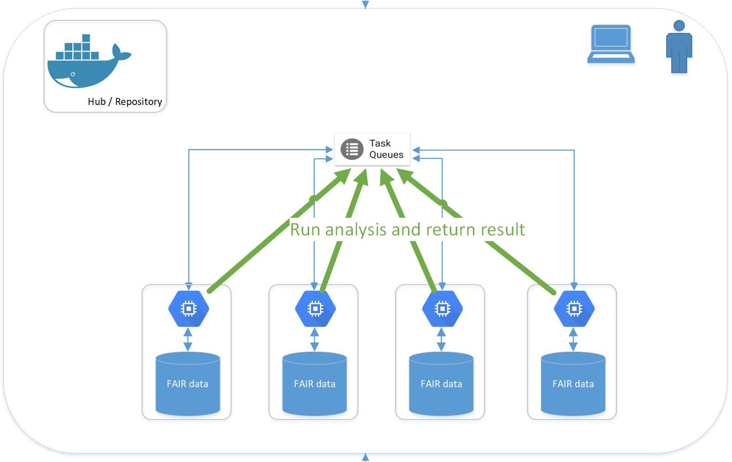
Application / IT perspective

Slide 37
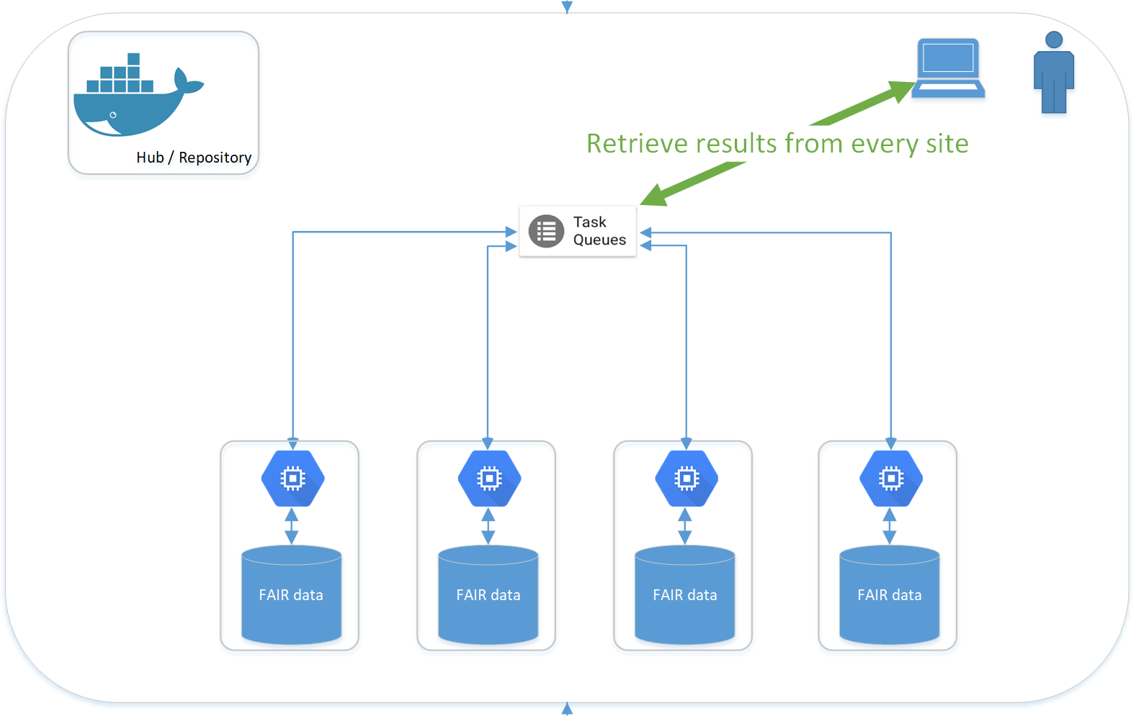
Application / IT perspective

Slide 38
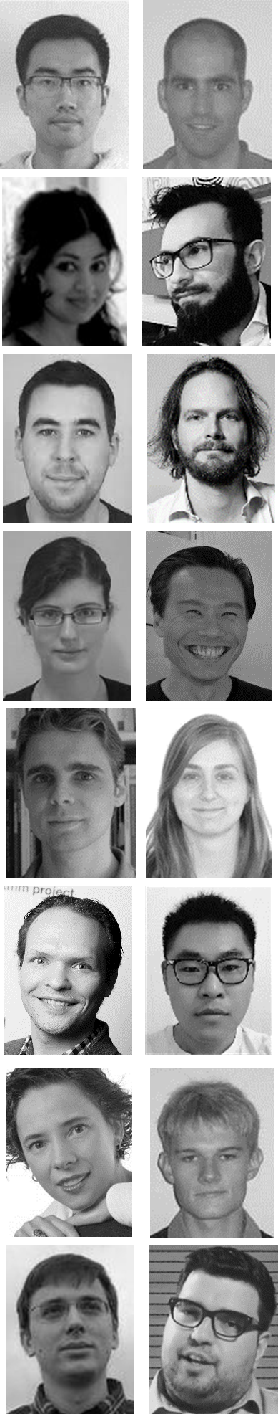
Thank you
Centraal Bureau voor de Statistiek, NL
Maastricht University, Maastricht, Netherlands
Fudan Cancer Center, Shanghai, China
Varian, Palo Alto, CA, USA
Siemens, Malvern, PA, USA
RTOG, Philadelphia, PA, USA
MAASTRO, Maastricht, Netherlands
Policlinico Gemelli, Roma, Italy
UH Ghent, Belgium
UZ Leuven, Belgium
Radboud, Nijmegen, Netherlands
University of Sydney, Australia
University of Michigan, Ann Arbor, USA
Liverpool and Macarthur CC, Australia
CHU Liege, Belgium
Uniklinikum Aachen, Germany
LOC Genk/Hasselt, Belgium
Princess Margaret CC, Canada
The Christie, Manchester, UK
UH Leuven, Belgium
State Hospital, Rovigo, Italy
ICCC, Wollongong Australia
Catharina Zkh Eindhoven, Netherlands
Philips, Eindhoven, Netherlands
Calvary Mater, Newcastle, Australia
More info on: www.predictcancer.org www.personalhealthtrain.com www.eurocat.info www.mistir.info

