Slide 1

Web开发基础
VBScript &ASP programming
赵刚

Slide 2

Outline
VBScript
ASP
ADO
essential of web development

Slide 3
What is VBScript?
VBScript is one of “Script” language
“Script” language is light-weight programming language
VBScript light-weight version of Visual Basic
VBScript in HTML document，run when document is loaded or “Trigger” by event
essential of web development

Slide 4
Where to use VBScript in HTML document?
<html>
<head>
</head>
<body>
<script type="text/vbscript">
document.write("Hello from VBScript!")
</script>
</body>
</html>
essential of web development

Slide 5
head
  VbScript function in HTML head 。Make sure functions is loaded before it is called。
body
  A piece of VBScript code.run when the page is loaded。
essential of web development

Slide 6
<html>
<head>
<script type="text/vbscript">
some statements
</script>
</head>
<body>
<script type="text/vbscript">
some statements
</script>
</body>
essential of web development

Slide 7
Variables
dim name
name=some value
or
name=some value
option explicit
dim name
name=some value
essential of web development

Slide 8
Sub type of Variant
类 型 | 描 述
Empty | 未初始化的Variant，对数值变量值为0，对字符串变量值为0长度字符串
Null | 不包含有任何有效数据的Viariant
Boolean | 值只能是true或false
Byte | 包含O～255之间的整数
Integer | 包含-32768～32767之间的整数
Currency | 包含-922 337 203 685 477～922 337 203 685 477.5807之间的数字
Long | 包含-2 147 483 648～2 147 483 647之间的整数
Single | 包含单精度浮点数，负数范围从-3.402 823 E38到-1.401 298 E～45，正数范围从1.401 298E～45到3.402 823 E38
Double | 包含双精度浮点数，负数范围从-1.797 693 134 862 32E 308到-4.940 656 458 412 47E～324，正数范围从4.940 656 458 412 47E-324到1.797 693 134 862 32E 308
Date | 包含表示日期的数字，日期范围为公元100年1月1日～公元9999年12月31日
String | 字符串，最大字符串长度为20亿个字符
Object | 对象子变量
Error | 包含错误编号
essential of web development

Slide 9
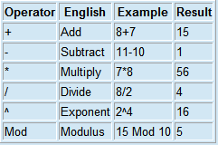
VBScript Operators: Math
essential of web development

Slide 10
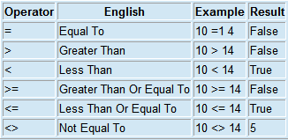
VBScript Operators: Comparison
essential of web development

Slide 11

VBScript Operators: Logic
essential of web development

Slide 12

VBScript String Concatenation Operator
essential of web development

Slide 13
Sub & function
Sub mysub(argument1,argument2)
some statements
End Sub
--------
Call MyProc(argument)
Function myfunction(argument1,argument2)
some statements
myfunction=some value
End Function
---
name = findname()
essential of web development

Slide 14
Conditional Statements
if payment="Cash" then
msgbox "You are going to pay cash!"
elseif payment="Visa" then
msgbox "You are going to pay with visa."
elseif payment="AmEx" then
msgbox "You are going to pay with American Express."
else
msgbox "Unknown method of payment."
end If
select case payment
case "Cash"
msgbox "You are going to pay cash"
case "Visa"
msgbox "You are going to pay with visa"
case "AmEx"
msgbox "You are going to pay with American Express"
case Else
msgbox "Unknown method of payment"
end select
essential of web development

Slide 15
Looping
For...Next
For i=2 To 10 Step 2
some code
Next
Do...Loop
<html>
<body>
<script type="text/vbscript">
i=0
do while i < 10
document.write(i & "<br />")
i=i+1
loop
</script>
</body>
</html>
essential of web development

Slide 16
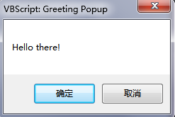
VBScript MsgBox
Button (Integer)- Allows you to set which buttons will be displayed on your popup. OK button is the default setting.
Title (String)- Sets the title of the popup window, much like the HTML title tag sets the title of the browser window.
<script type="text/vbscript"> Function myPopup_OnClick() MsgBox "Hello there!", 1, "Greeting Popup“
End Function
</script>
<form>
<input type="button" value="Click Me!" name="myPopup" />
</form>
essential of web development

Slide 17
ASP ？
ASP Active Server Pages
ASP run in IIS
ASP same as HTML
ASP may include text 、HTML、XML & Script
Script in ASP file can run on the server-side
ASP file ".asp" or “.asa”
essential of web development

Slide 18
ASP Vs. HTML ？
HTML will send to browser without any change
ASP file will send to ASP engine first ,which analysis the file , run the Script in the file ,then return the result to the browser in HTML format
essential of web development

Slide 19
What can ASP do for U？
Dynamic edit change or add any page item
Deal with the data in the form user submit
Access file or database ,and return the result to the user
Improve page usability
Improve site security because the asp code can’t read from the browser
A good asp coding can reduce the network load
essential of web development

Slide 20
Basic ASP rule
ASP file include HTML tags,like the HTML file.but,ASP include server-side script ,which with tag <% & %> .
server-side script run on the server
<%@LANGUAGE=“VBSCRIPT” CODEPAGE=“936”%>
…
<%
‘VBSCRIPT code here
%>
essential of web development

Slide 21
Hello world!
<html>
<body>
<% response.write("Hello World!") %>
</body>
</html>
<html>
<body>
<%="Hello World!"%>
</body>
</html>
essential of web development

Slide 22
VBScript & JavaScript
<html>
<body>
<% response.write("Hello World!")
%>
</body>
</html>
<%@ language="javascript"%>
<html>
<body>
<%
Response.Write("Hello World!")
%>
</body>
</html>
注意：与 VBScript 不同 - JavaScript 对大小写敏感
essential of web development

Slide 23
Lifetime of Variables
function
Session
Application
essential of web development

Slide 24
ASP form and user input
Get
http://www.test.org/simpleform.asp?fname=Bill&lname=Gates
<body>
Welcome
<%
response.write(request.querystring("fname"))
response.write(" " & request.querystring("lname"))
%>
</body>
Post
<body>
Welcome
<%
response.write(request.form("fname"))
response.write(" " & request.form("lname"))
%>
</body>
essential of web development

Slide 25
#include
#include
  Insert another asp file before asp file is run
<html>
<body>
<h2>Words of Wisdom:</h2>
<p><!--#include file="wisdom.inc"--></p>
<h2>The time is:</h2>
<p><!--#include file="time.inc"--></p>
</body>
</html>
wisdom.inc
"One should never increase, beyond what is necessary, the number of entities required to explain anything.“
time.inc
<% Response.Write(Time) %>
essential of web development

Slide 26
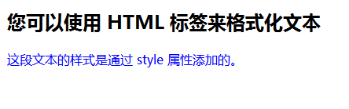
Response
ASP Response used as output to browser
<html>
<body>
<%
response.write("<h2>您可以使用 HTML 标签来格式化文本</h2>")
%>
<%
response.write("<p style='color:#0000ff'>这段文本的样式是通过 style 属性添加的。</p>")
%>
</body>
</html>
essential of web development

Slide 27
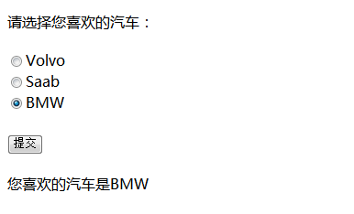
ASP Request
<html>
<%
dim cars
cars=Request.Form("cars")
%>
<body>
<form action="/example/aspe/demo_aspe_radiob.asp" method="post">
<p>请选择您喜欢的汽车：</p>
<input type="radio" name="cars"
<%if cars="Volvo" then Response.Write("checked")%>
value="Volvo">Volvo</input>
<br />
<input type="radio" name="cars"
<%if cars="Saab" then Response.Write("checked")%>
value="Saab">Saab</input>
<br />
<input type="radio" name="cars"
<%if cars="BMW" then Response.Write("checked")%>
value="BMW">BMW</input>
<br /><br />
<input type="submit" value="提交" />
</form>
<%
if cars<>"" then
Response.Write("<p>您喜欢的汽车是" & cars & "</p>")
end if
%>
</body>
</html>
essential of web development

Slide 28
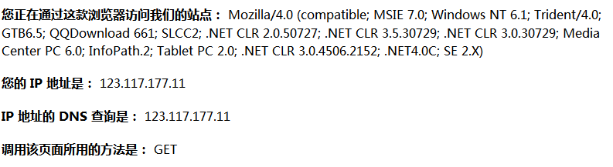
<html>
<body>
<p>
<b>您正在通过这款浏览器访问我们的站点：</b>
<%Response.Write(Request.ServerVariables("http_user_agent"))%>
</p>
<p>
<b>您的 IP 地址是：</b>
<%Response.Write(Request.ServerVariables("remote_addr"))%>
</p>
<p>
<b>IP 地址的 DNS 查询是：</b>
<%Response.Write(Request.ServerVariables("remote_host"))%>
</p>
<p>
<b>调用该页面所用的方法是：</b>
<%Response.Write(Request.ServerVariables("request_method"))%>
</p>
</body>
</html>
essential of web development

Slide 29
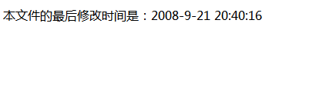
Server
ASP Server
  Access server object method and property
<html>
<body>
<%
Set fs = Server.CreateObject("Scripting.FileSystemObject")
Set rs = fs.GetFile(Server.MapPath("/example/aspe/demo_aspe_lastmodified.asp"))
modified = rs.DateLastModified
%>
本文件的最后修改时间是：<%response.write(modified)
Set rs = Nothing
Set fs = Nothing
%>
</body>
</html>
essential of web development

Slide 30
ADO
ADO?
  ADO from Microsoft
  ADO means ActiveX Data Objects
  ADO installed IIS
  ADO is the interface to access the data in database
Access database from ASP page
  Create ADO connection
  Open the connection
  Create ADO recordset
  Open the recordset
  Get the data from recordset
  Close recordset
  Close connection
essential of web development

Slide 31
ADO connection
DSN-less connection
<%
set conn=Server.CreateObject("ADODB.Connection")
conn.Provider="Microsoft.Jet.OLEDB.4.0"
conn.Open "c:/webdata/northwind.mdb"
%>
ODBC connection
<% set conn=Server.CreateObject("ADODB.Connection")
conn.Open "northwind“
%>
essential of web development

Slide 32
ADO Recordset
<%
set conn=Server.CreateObject("ADODB.Connection")
conn.Provider="Microsoft.Jet.OLEDB.4.0"
conn.Open "c:/webdata/northwind.mdb"
set rs=Server.CreateObject("ADODB.recordset")
rs.Open "Customers", conn
%>
<%
set conn=Server.CreateObject("ADODB.Connection")
conn.Provider="Microsoft.Jet.OLEDB.4.0"
conn.Open "c:/webdata/northwind.mdb"
set rs=Server.CreateObject("ADODB.recordset")
rs.Open "Select * from Customers", conn
%>
essential of web development

Slide 33
Get data from the recordset
<%
set conn=Server.CreateObject("ADODB.Connection")
conn.Provider="Microsoft.Jet.OLEDB.4.0"
conn.Open "c:/webdata/northwind.mdb"
set rs=Server.CreateObject("ADODB.recordset")
rs.Open "Select * from Customers", conn
for each x in rs.fields
response.write(x.name)
response.write(" = ")
response.write(x.value)
next
%>
essential of web development

Slide 34
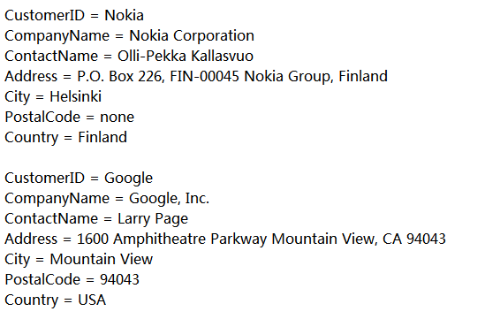
<html>
<body>
<%
set conn=Server.CreateObject("ADODB.Connection")
conn.Provider="Microsoft.Jet.OLEDB.4.0"
conn.Open(Server.Mappath("/db/northwind.mdb"))
set rs = Server.CreateObject("ADODB.recordset")
rs.Open "Select * from Customers", conn
do until rs.EOF
for each x in rs.Fields
Response.Write(x.name)
Response.Write(" = ")
Response.Write(x.value & "<br />")
next
Response.Write("<br />")
rs.MoveNext
loop
rs.close
conn.close
%>
</body>
</html>
essential of web development

Slide 35
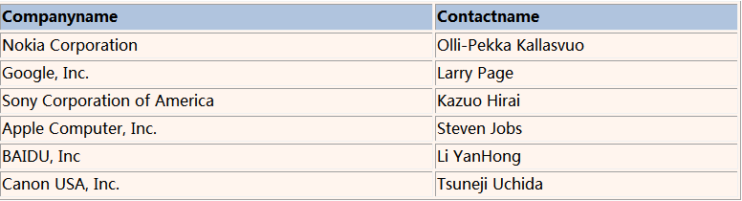
<html>
<body>
<%
set conn=Server.CreateObject("ADODB.Connection")
conn.Provider="Microsoft.Jet.OLEDB.4.0"
conn.Open(Server.Mappath("/db/northwind.mdb"))
set rs = Server.CreateObject("ADODB.recordset")
sql="SELECT Companyname, Contactname FROM Customers"
rs.Open sql, conn
%>
<table border="1" width="100%" bgcolor="#fff5ee">
<tr>
<%for each x in rs.Fields
response.write("<th align='left' bgcolor='#b0c4de'>" & x.name & "</th>")
next%>
</tr>
<%do until rs.EOF%>
<tr>
<%for each x in rs.Fields%>
<td><%Response.Write(x.value)%></td>
<%next
rs.MoveNext%>
</tr>
<%loop
rs.close
essential of web development

Slide 36
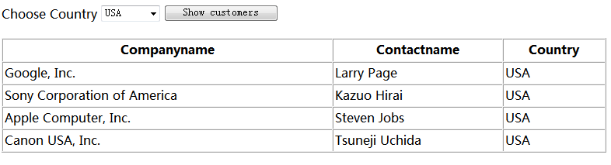
<html>
<body>
<%
set conn=Server.CreateObject("ADODB.Connection")
conn.Provider="Microsoft.Jet.OLEDB.4.0"
conn.Open(Server.Mappath("/db/northwind.mdb"))
set rs=Server.CreateObject("ADODB.recordset")
sql="SELECT DISTINCT Country FROM Customers ORDER BY Country"
rs.Open sql,conn
country=request.form("country")
%>
<form method="post">
Choose Country <select name="country">
<% do until rs.EOF
response.write("<option")
if rs.fields("country")=country then
response.write(" selected")
end if
response.write(">")
response.write(rs.fields("Country"))
rs.MoveNext
loop
rs.Close
set rs=Nothing %>
</select>
<input type="submit" value="Show customers">
</form>
<%
if country<>"" then
sql="SELECT Companyname,Contactname,Country FROM Customers WHERE country='" & country & "'"
set rs=Server.CreateObject("ADODB.Recordset")
rs.Open sql,conn
%>
<table width="100%" cellspacing="0" cellpadding="2" border="1">
<tr>
<th>Companyname</th>
<th>Contactname</th>
<th>Country</th>
</tr>
<%
do until rs.EOF
response.write("<tr>")
response.write("<td>" & rs.fields("companyname") & "</td>")
response.write("<td>" & rs.fields("contactname") & "</td>")
response.write("<td>" & rs.fields("country") & "</td>")
response.write("</tr>")
rs.MoveNext
loop
rs.close
conn.Close
set rs=Nothing
set conn=Nothing%>
</table>
<% end if %>
</body>
</html>
essential of web development

Slide 37
ADO -insert data
<html>
<body>
<form method="post" action="demo_add.asp">
<table>
<tr>
<td>CustomerID:</td>
<td><input name="custid"></td>
</tr><tr>
<td>Company Name:</td>
<td><input name="compname"></td>
</tr><tr>
<td>Contact Name:</td>
<td><input name="contname"></td>
</tr><tr>
<td>Address:</td>
<td><input name="address"></td>
</tr><tr>
<td>City:</td>
<td><input name="city"></td>
</tr><tr>
<td>Postal Code:</td>
<td><input name="postcode"></td>
</tr><tr>
<td>Country:</td>
<td><input name="country"></td>
</tr>
</table>
<br /><br />
<input type="submit" value="Add New">
<input type="reset" value="Cancel">
</form>
</body>
</html>
<body>
<%
set conn=Server.CreateObject("ADODB.Connection")
conn.Provider="Microsoft.Jet.OLEDB.4.0"
conn.Open "c:/webdata/northwind.mdb"
sql="INSERT INTO customers (customerID,companyname,"
sql=sql & "contactname,address,city,postalcode,country)"
sql=sql & " VALUES "
sql=sql & "('" & Request.Form("custid") & "',"
sql=sql & "'" & Request.Form("compname") & "',"
sql=sql & "'" & Request.Form("contname") & "',"
sql=sql & "'" & Request.Form("address") & "',"
sql=sql & "'" & Request.Form("city") & "',"
sql=sql & "'" & Request.Form("postcode") & "',"
sql=sql & "'" & Request.Form("country") & "')"
on error resume next
conn.Execute sql,recaffected
if err<>0 then
Response.Write("No update permissions!")
else
Response.Write("<h3>" & recaffected & " record added</h3>")
end if
conn.close
%>
</body>
</html>
essential of web development

Slide 38
Lab4 server side programming
Purpose
  The purpose of this lab is to practice ASP server side programming based on Lab3
Exercice 1: record user’ score in the database
  You are given an access database named score.mdb
    Table : score with field s_name,s_score
  Setting the DSN for this database on your server
  Rename and modify the test form to record the tester’s name and his/her score in the database when tester push the submit button
essential of web development

Slide 39
Exercice 2 display all the score
  Adding code to display all the score history user got on the bottom of the test form
essential of web development

Slide 40
Exercice 3
  “decorate” your “online test application” upon yourself
essential of web development

Slide 41
Exercice 4 Advanced requirement
  Sort the result by the score
  Show the score list in a table
    Hint:You may use “sort” phase of SQL
essential of web development

