Slide 1

Web开发基础
赵刚

Slide 2

本课程内容摘要
网站开发基础知识
网站环境构建
管理和配置网站
HTML &CSS
JavaScript
Asp服务端编程
数据库连结与访问
essential of web development

Slide 3
网站开发基础知识
计算机网络基础
网站的含义
网站访问的原理
网页的类型
动态网站技术
essential of web development

Slide 4
计算机网络基础
Internet Vs intranet
计算机网络的标准模型
TCP/IP 协议
服务器和客户机
域名
端口
essential of web development

Slide 5
Internet VS Intranet
The Internet is a global system of interconnected computer networks that use the standard Internet Protocol Suite (TCP/IP) to serve billions of users worldwide
  It is a network of networks
An intranet is a private computer network that uses Internet Protocol technologies to securely share any part of an organization's information or network operating system within that organization.
essential of web development

Slide 6
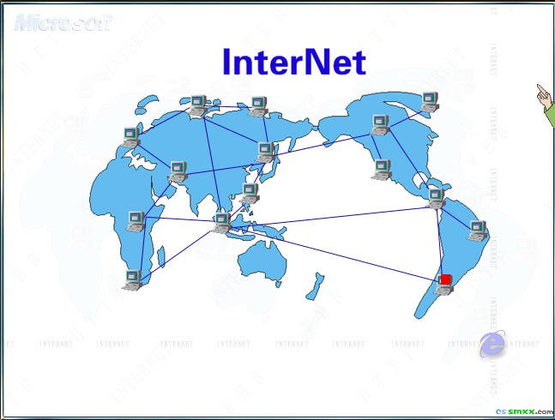
essential of web development

Slide 7
And WWW
WWW（亦作“Web”、“万维网”、“W3”，英文全称为“World Wide Web”）
  是一个由许多互相链接的超文本文档组成的系统，通过互联网访问。 万维网联盟（英语：World Wide Web Consortium，简称W3C），又称W3C理事会。1994年10月在麻省理工学院（MIT）计算机科学实验室成立。万维网联盟的创建者是万维网的发明者蒂姆·伯纳斯-李。
What's the difference between the Internet and the World Wide Web (WWW)?
  WWW = HTML* + HTTP(S)
    * including CSS, JavaScript, and other browser enabled content
  WWW 是Internet应用之一
essential of web development

Slide 8
Brief History
began as a US Department of Defense network called ARPANET (1960s-70s)
initial services: electronic mail, file transfer
opened to commercial interests in late 80s
WWW created in 1989-91 by Tim Berners-Lee
popular web browsers released: Netscape 1994, IE 1995
Amazon.com opens in 1995; Google January 1996
Chinese First Connection with Internet：Chinese Academics Net, by Computer Applying Technology Institute of Beijing1986，
First email, Sep. 14 1987, from CATIB,“Across the Great Wall we can reach every corner in the world”
Chinese First Full Internet Connection：NCFC (National Computing and Networking Facility of China) 1994
Baidu1999；Taobao 2003
essential of web development

Slide 9
Key aspects of the Internet
Internet is for freedom of information
subnetworks can stand on their own
computers can dynamically join and leave the network
built on open standards; anyone can create a new device
lack of centralized control (mostly)
everyone can use it with simple, commonly available software
essential of web development

Slide 10
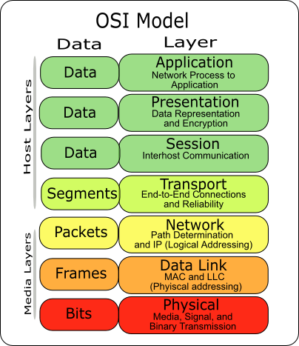
Layered architecture
The internet uses a layered hardware/software architecture (OSI model):
physical layer: devices such as coaxial cables, fiber-optic lines, modems
data link layer: basic hardware protocols (Ethernet, Wi-Fi, DSL, ATM, PPP)
network / internet layer: basic software protocol (IP)
transport layer: add reliability to network layer (TCP, UDP)
application layer: implements specific communication for each kind of program (HTTP, POP3/IMAP, SSH, FTP))
essential of web development

Slide 11
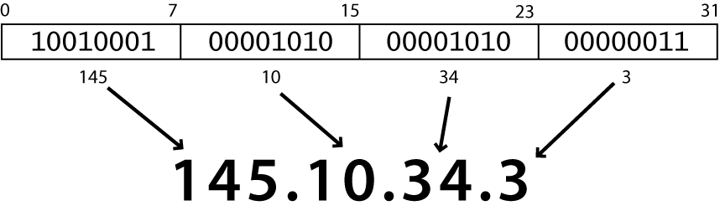
Internet Protocol (IP)
the IP is the underlying system of communication for all data (packets) sent across the internet.
each device has a 32-bit IP address as four 8-bit numbers (0-255)
find out your internet IP address: whatismyip.com
find out your local IP address:
  in a terminal, type: ipconfig (Windows) or ifconfig (Mac/Linux)
IP v4 vs. IP v6 (32-b vs. 128-b)
essential of web development

Slide 12
Transmission Control Protocol (TCP)
adds multiple, guaranteed message delivery on top of IP
multiplexing: multiple programs using the same IP address
  port: a number given to each program or service
  80: Web browser (443 for secure browsing)
  25: email
  22: ssh
  21: ftp
  more common ports
some programs (QQ, games, streaming media programs) use simpler UDP protocol instead of TCP
find out ports used:
  in a terminal, using netstat (Windows) command
  using CurrPorts
essential of web development

Slide 13
Web servers and browsers
Web server: software that listens for Web page requests
  part of Windows)
C/S Vs B/S model
Web browser: fetches/displays documents from Web servers
  Microsoft Internet Explorer (IE)
  Mozilla Firefox
  Apple Safari
  Google Chrome
  Opera
essential of web development

Slide 14
Domain Name System (DNS)
a set of servers that map written names to IP addresses
  Example: www.bit.edu.cn 219.143.204.38
  using Windows command nslookup to find out IP address
many systems maintain a local cache called a host file
  Windows: C:\Windows\system32\drivers\etc\hosts
  Mac: /private/etc/hosts
  Linux: /etc/hosts
essential of web development
Notes:
需要增补一个示意图

Slide 15
Uniform Resource Locator (URL)
an identifier for the location of a document on a web site
a basic URL:
http://www.aw-bc.com/info/regesstepp/index.html
~~~~ ~~~~~~~~~~~~~~~ ~~~~~~~~~~~~~~~~~~~~~~
protocol host path
upon entering this URL into the browser, it would:
  ask the DNS server for the IP address of www.aw-bc.com
  connect to that IP address at port 80
  ask the server to GET /info/regesstepp/index.html
  display the resulting page on the screen
essential of web development

Slide 16
More advanced URLs
anchor: jumps to a given section of a web page
http://www.textpad.com/download/index.html#downloads
  fetches index.html then jumps down to part of the page labeled downloads
port: for web servers on ports other than the default 80
http://www.bit.edu.cn:8080/
query string: a set of parameters passed to a web program
http://www.google.com/search?q=miserable+failure&start=10
  parameter q is set to "miserable+failure"
  parameter start is set to 10
essential of web development

Slide 17
Hypertext Transport Protocol (HTTP)
HTTP is the foundation of data communication for the World Wide Web.
the set of commands understood by a web server and sent from a browser
some HTTP commands (your browser sends these internally):
  GET filename : download
  POST filename : send a web form response
  PUT filename : upload
  DELETE filename : remove entity
  HEAD filename : only status information, not entire content
  …
essential of web development

Slide 18
HTTP error codes
when something goes wrong, the web server returns a special "error code" number to the browser, possibly followed by an HTML document
common error codes:
200 OK
301-303 page has moved (permanently or temporarily)
403 you are forbidden to access this page
404 page not found
500 internal server error
complete list
essential of web development

Slide 19
Terms
Internet Service Provider
  enterprises or organizations who provide Internet access to you,
  who? please identify your ISPs
Web Hosting
  provide a place for consumers to store pages designed to be consumed by the Web surfing public
  ISPs often offer Web hosting services along with their standard connectivity packages.
Client/Server vs. Browser/Server
essential of web development

Slide 20
Web 1.0 vs. Web 2.0
Web 1.0 is about publishing
  users are limited to the passive viewing of information that is provided to them
Web 2.0 is about interaction
  allows its users to interact with other users or to change website content
  information sharing, interoperability, user-centered design and collaboration
  hosted services, web applications, social-networking sites, video-sharing sites, wikis, blogs
essential of web development

Slide 21
网站的含义
网页是网站的基本单位
  用标准的HTML语言将图片、文字、多媒体信息组织起来的格式文档
一般意义上的网站
  A group of related pages?
  A dedicate server?
  A group of servers?
essential of web development

Slide 22
虚拟网站
多个网站可以同时运行在一个单一服务器上
  利用不同的端口号
  利用不同的ip地址
  利用不同的域名
essential of web development

Slide 23
网站访问的原理
网站中的两种角色-浏览器 & 服务器
网站使用的协议-HTTP
浏览器
  HTML语言解析器
  图片解析器
  声音播放器
  视频播放器
  …
网站的访问过程
  没有域名的网站
  有域名的网站
essential of web development

Slide 24
网页的类型
静态网页
  设计人员设计成什么样子，用户看到的就是什么样子
动态网页
  根据访问者当时的访问环境通过服务器端程序实时生成的网页
以数据库做为后台的动态网页
essential of web development

Slide 25
动态网站技术
Apache服务器+PHP技术
WebLogic+JSP技术
IIS服务器+ASP技术
essential of web development

Slide 26
网站环境的构建
本课程以IIS+ASP技术做为实例
典型ASP网站实现方式
  服务器操作系统平台
  IIS版本 5.0 Vs 6.0
    IIS 5.0 隔离模式
    工作进程隔离模式
essential of web development

Slide 27
IIS服务器安装演示
设置本机IP地址
安装IIS
检测服务器是否正常工作
测试asp开发环境
运行第一个ASP程序
essential of web development

Slide 28
IIS服务器的配置和管理
IIS服务器的启停
新建立网站
配置网站的基本参数
配置ASP网站网页的组织方法
配置ASP网站的访问方法
配置ASP网站的性能
虚拟目录设置方法
essential of web development

Slide 29
Lab1 实践项目
1 配置计算机的IP地址
2 查看计算机使用端口的情况
3 安装IIS服务器
4 配置IIS服务器
5 创建第一个网站
6 配置网站相应参数
7 运行你的第一个ASP程序
essential of web development

Slide 30
实践如何启停服务器
实践如何启停一个asp网站
设置网站日志，查看网站日志
熟悉匿名访问网站的设置
熟悉虚拟目录的设置
在上述基本技能基础上，设计一个你自己网站，规划网站的各项设置参数，并实现
essential of web development

