Slide 1
Hamming Codes

Slide 2
Encoder
SECSED Hamming encoder can encode up to a 27-bit message
Written entirely in ECE350 MIPS assembly and ran on my processor
Implemented additional instructions and hardware
SRL, 32-bit XOR
First wrote python script with limited use (no multiplication, division, any complex arithmetic etc.)

Slide 3
Encoder algorithm (Python version)
Determine number of parity bits
Interweave ”empty” bits into code for parity
Calculate parity of each parity bit
Or results and the code from step 2

Slide 4
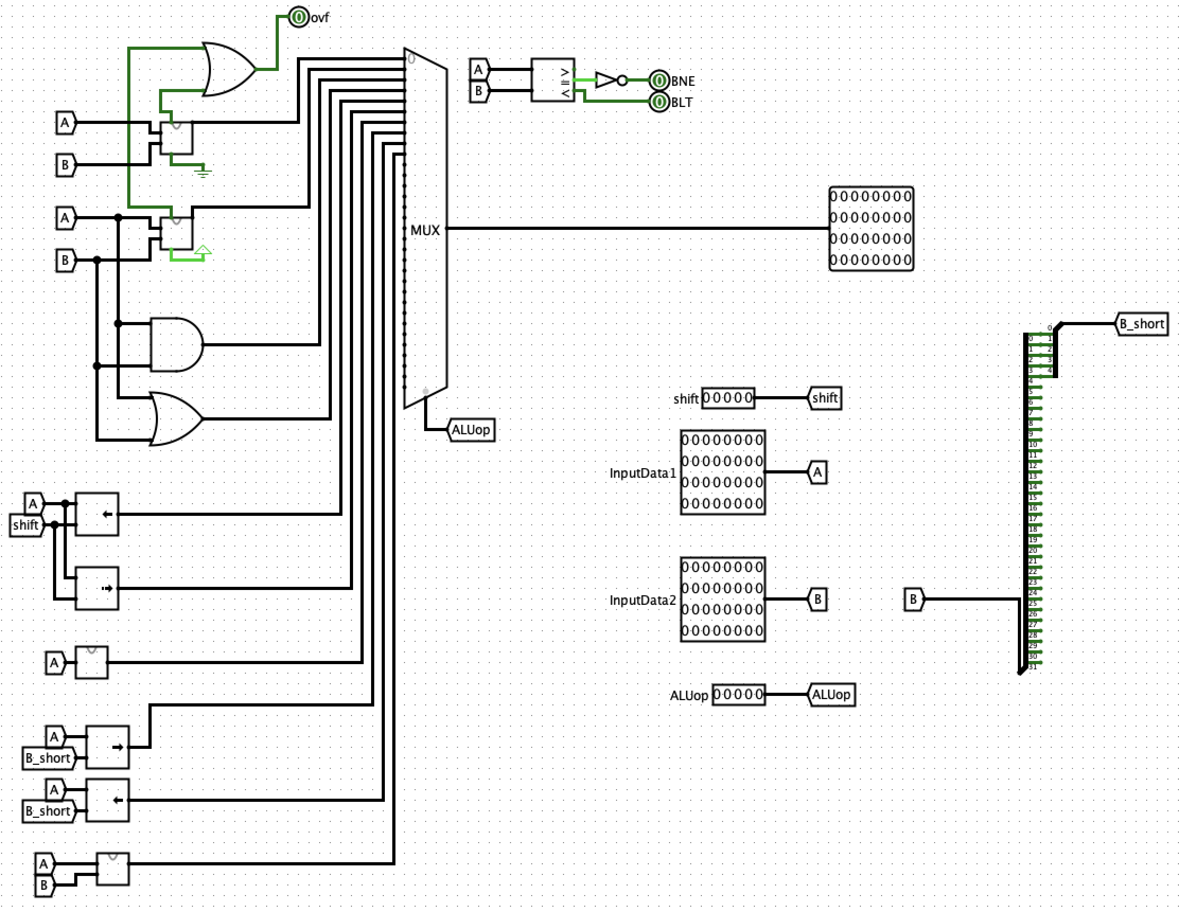

Slide 5
Decoder
SECSED decoder can correct any one-bit error in a hamming encoded message with up to 32 bits
Done mostly in hardware, some software
Calculate number of parity bits in software and rest is done in hardware

Slide 6
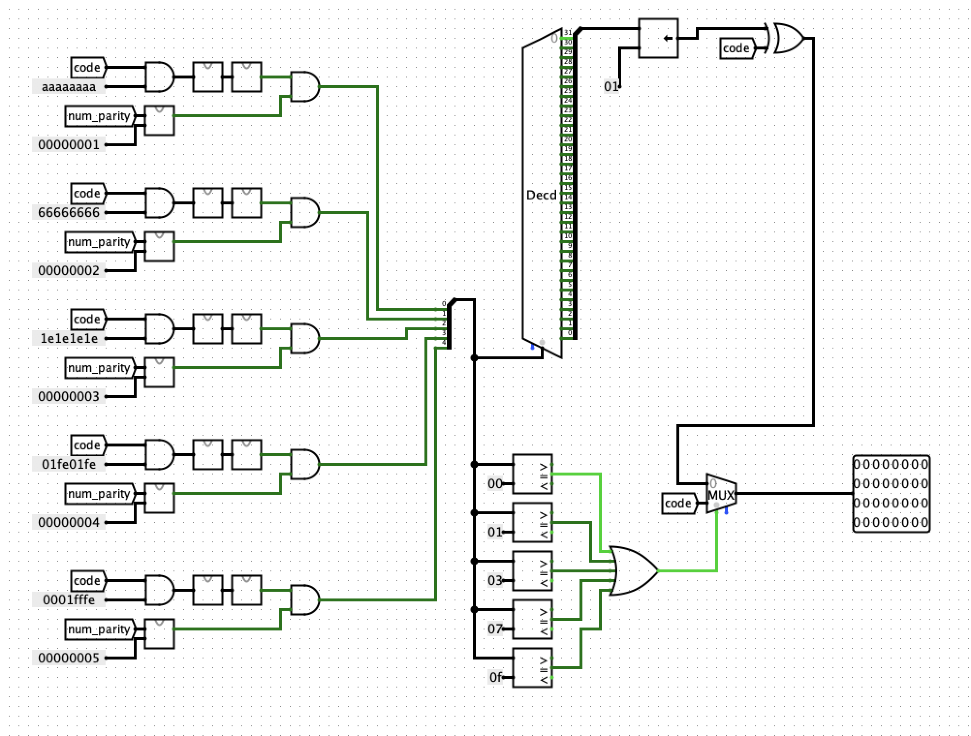

Slide 7
Software
Upload a dmem file with modified contents
Inputs are code (encoded or not), number of non-parity message bits, function type (0/1 for encode/decode)
Other important constants held in dmem
Error detection or program-done outputs to $rstatus
Non-existent function type
Input size

Slide 8
Takeaways
Hardware optimizations can seriously reduce

