Slide 1
Photo Privacy Editor
Jeremey Key

Slide 2
Overview
Problem
System Description
Experiment
Results
Discussion
Conclusions

Slide 3

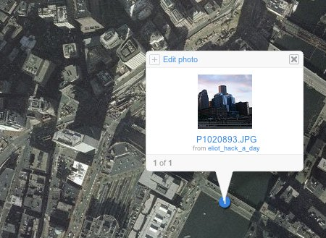
Problem
GeoTagging
Privacy
Social Media

Slide 4

System Description
Samsung Galaxy S4
Android 4.3
Google Maps
ExifInterface

Slide 5
Experiment
Participants
10 subjects (5 male, 5 female)
6 aged 20-29, 1 aged 40-49, 2 aged 50-59
Only 2 without Android experience
Various Backgrounds

Slide 6
Experiment
Training
Complete 7 Tasks
View (1)
Edit (2,3,4)
GPS, Time/Date, Both
Remove(5,6)
Single and Multiple Image Selection
Locate(7)
Questionnaire

Slide 7
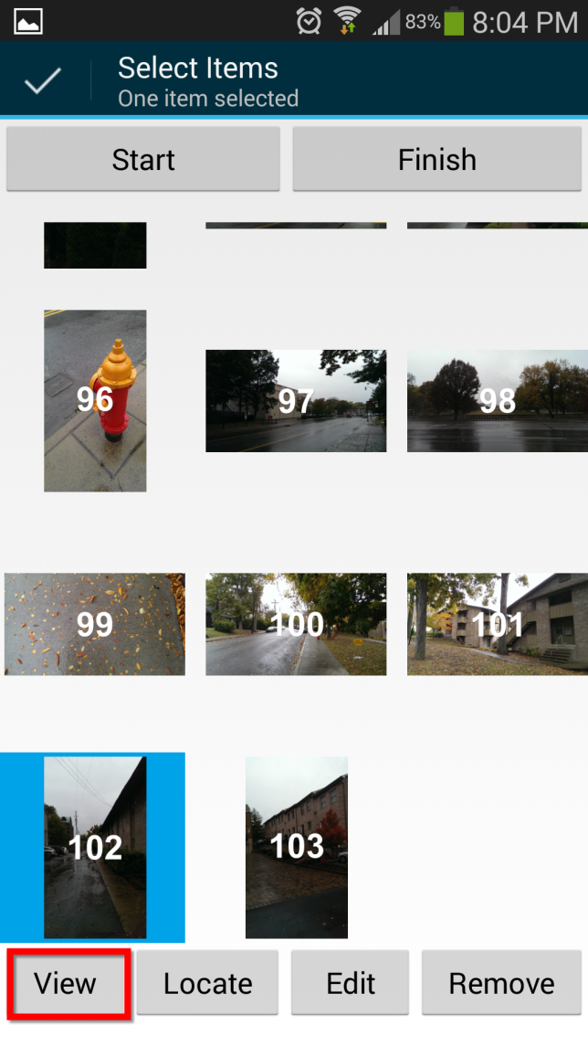
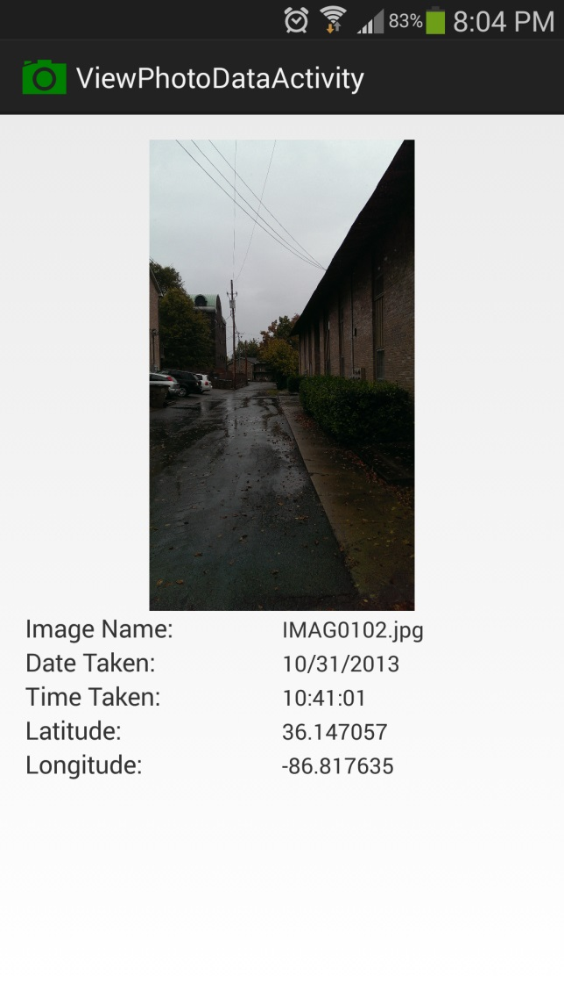
View Task

Slide 8
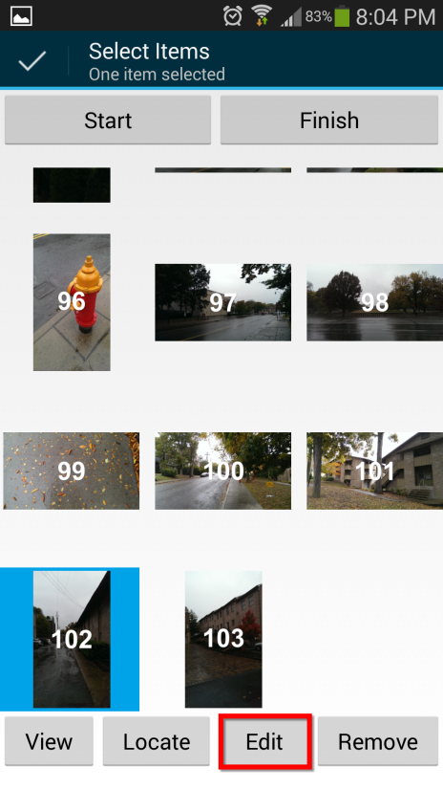
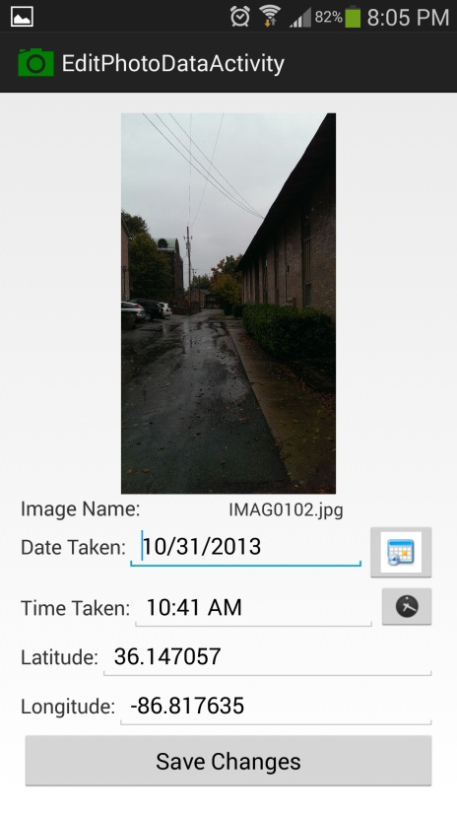
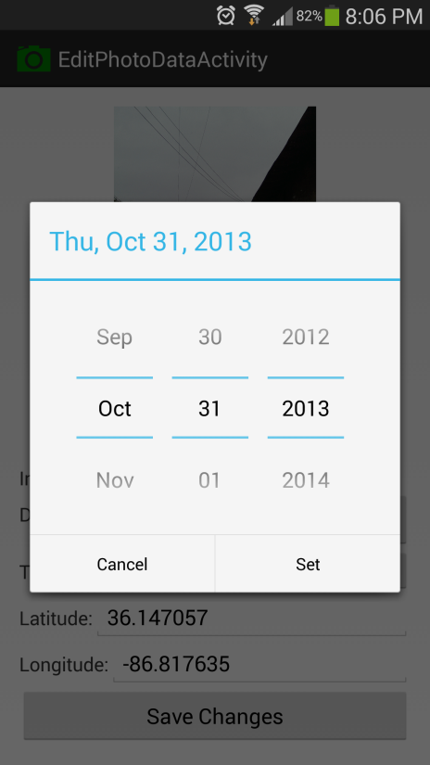
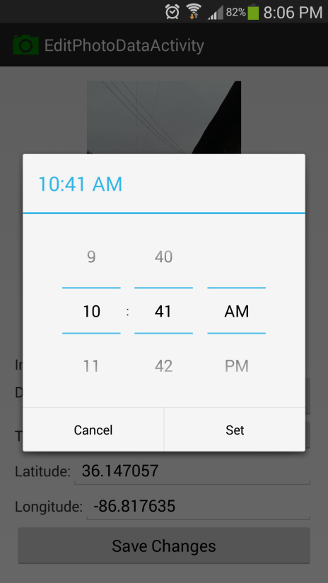
Edit Task

Slide 9
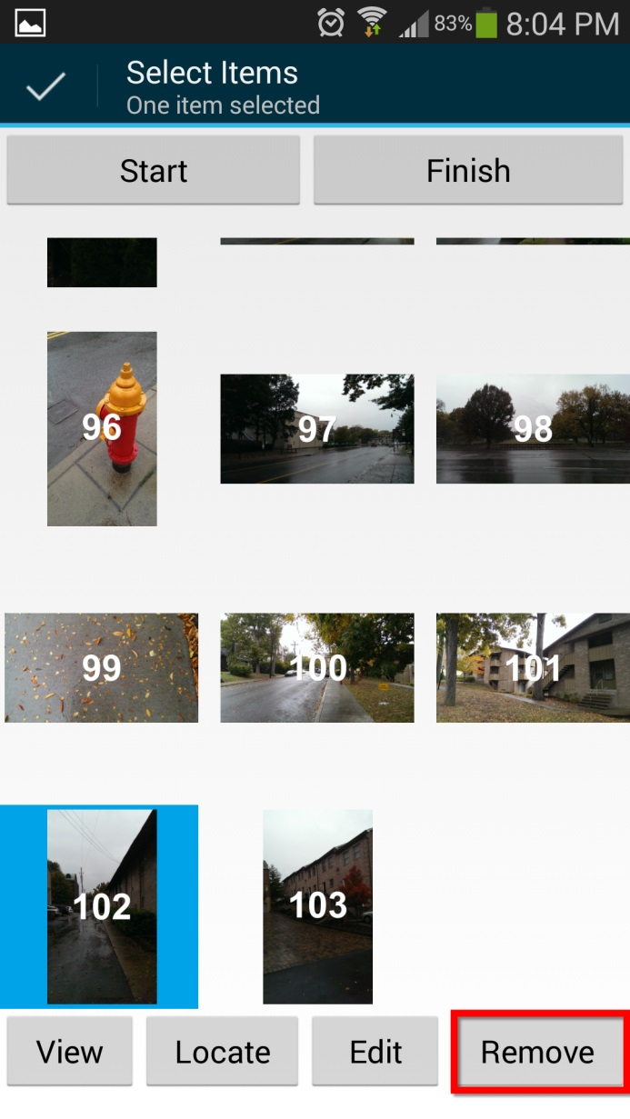
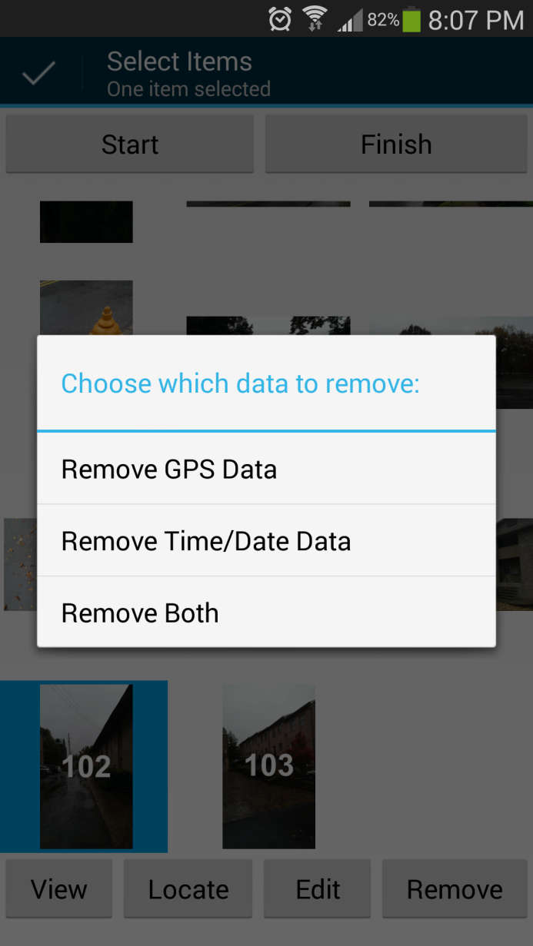
Remove Task

Slide 10
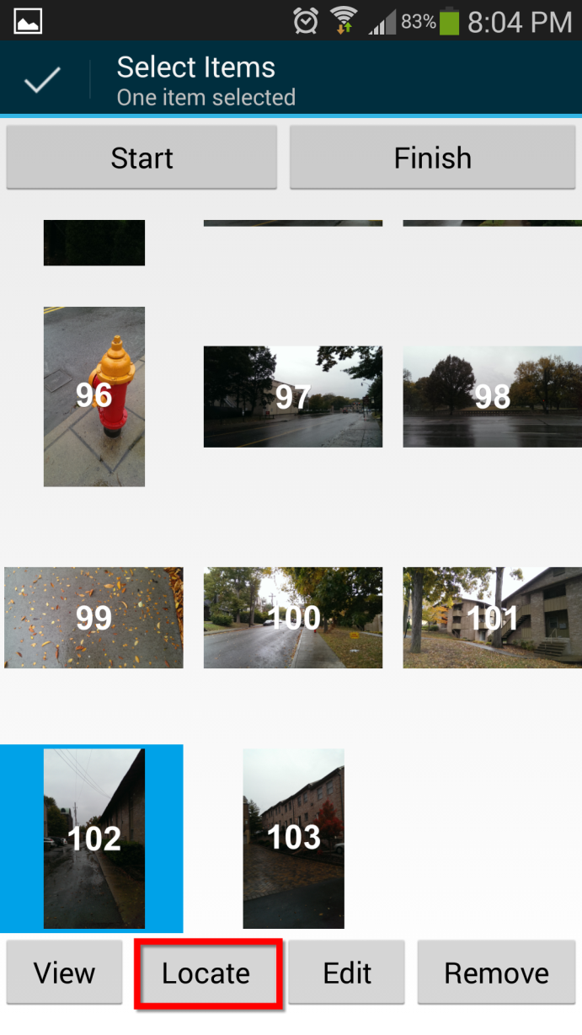
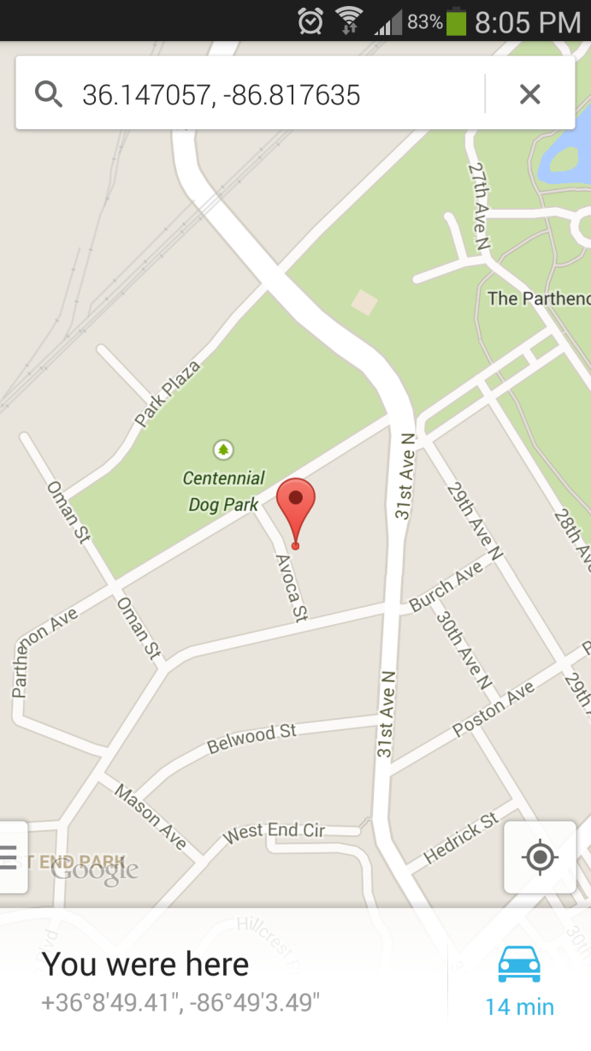
Locate Task

Slide 11
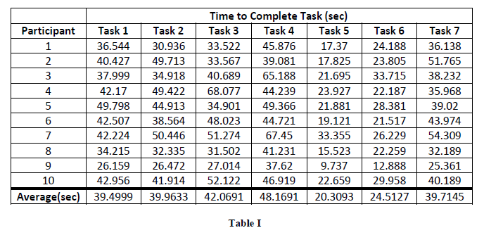
Results

Slide 12
Results
Time Data Results
Median: 41.2985; Min: 26.159; Max: 49.789
Median: 40.2390; Min: 26.472; Max: 50.446
Median: 37.7950; Min: 27.014; Max: 68.077
Median: 45.2985; Min: 37.620; Max: 67.450
Median: 20.4080; Min: 9.737; Max: 33.355
Median: 23.9965; Min: 12.888; Max: 33.715
Median: 38.6260; Min: 25.361; Max: 54.309

Slide 13
Results
Questionnaire Data Results
Likert Scale (1-Extremely Easy; 7-Extremely Difficult)
Task 1: 1.5
Task 2: 1.5
Task 3: 1.7
Task 4: 1.8
Task 5: 1.6
Task 6: 1.8
Task 7: 1.8

Slide 14
Discussion
Hypotheses
Editing metadata for both GPS and Time/Date data will be the most time consuming.
Removing metadata from multiple images will result in a higher error rate.

Slide 15
Discussion
All tasks rated below 2 on Likert scale
Other Questionnaire Data
Half of participants aware that location info embedded in photos.
All Participants want option to remove sensitive data from images.
Issues
Scrolling of images not smooth
Unfamiliar with “long press” selection

Slide 16
Conclusions
High desire for ability to remove sensitive data from photos.
Straightforward application functions
Improvements
Integration with other apps
Native camera/gallery
Prompt before sharing feature

Slide 17
Questions?

