Slide 1

Breach
Hunt Company
We make the world more secure.

Slide 2

project description
We are security company provide service for those company need to check their system if it vulnerable or have any exploit and the service is has 2 vector :
Security assurance:
We provide a vital service that assures clients of the security of their systems and data, giving them confidence in their cybersecurity measures.
Penetration Tester's :
The Penetration testers find satisfaction in conducting ethical hacking to identify vulnerabilities and contribute to enhancing cybersecurity, making a positive impact on digital security.

Slide 3
Use Case
Use Case | actor
- Login - Selecting Penetration Testing Type (Web / Network / Reverse, etc.) - Selecting Penetration Testing Plan - Payment Process | Client
- Performing tasks based on his role (Web / Network / Reverse, etc.) | Penetration tester

Slide 4


Use Case
Client domain
include
Login
Password
extend
Invalid credential error
Selecting PT Type
include
Choosing Service
include
Custom Tasks
include
Task lists
Selecting PT Plan
Customize price
include
client
Penetration tester
Payment Process
Bitcoin
Bank Transfer
PayPal

Slide 5
Formal Use Case ( Generate Test Report )
Use Case | Generate Test Report
Actor | client
Description | The client creates a task for the Penetration Tester
Preconditions | A client must be authenticated
Steps | 1- Client logs in. 2- Client selects the Penetration Testing Type (Web, Network, Reverse, etc.). 3- Client acknowledges the scope of the selected service on their provided domain. 4- Finally, the client attaches extended details as a task.

Slide 6
Formal Use Case ( Perform Penetration Test )
Use Case | Perform Penetration Test
Actor | Penetration Tester
Description | The Penetration Tester conducts security tasks on the client's systems.
Preconditions | A client has requested a penetration test (Task).
Steps | 1- Penetration Tester selects a client's domain 2- Penetration Tester performs security tasks 3- Penetration Tester documents findings. 4- Penetration Tester provides recommendations. 5- Penetration Tester marks the task as finished.

Slide 7
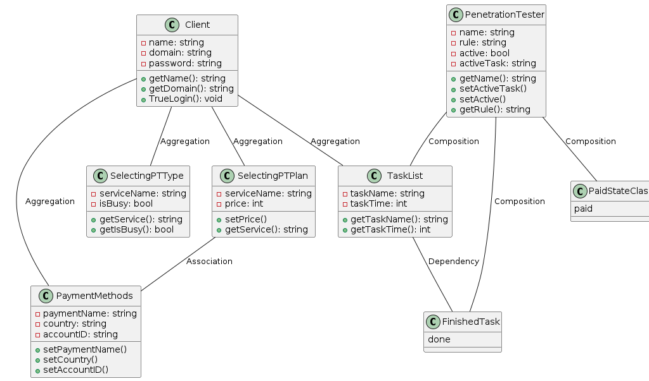





class diagram

Slide 8
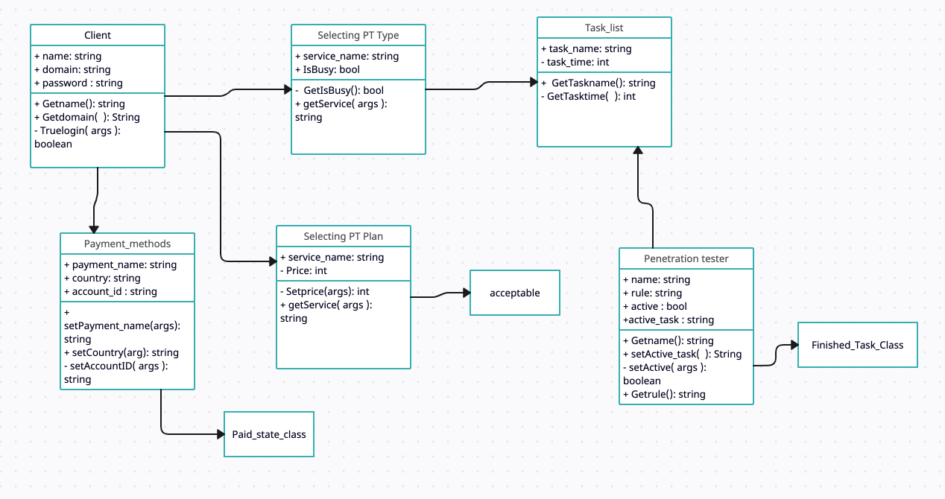
class diagram

Slide 9
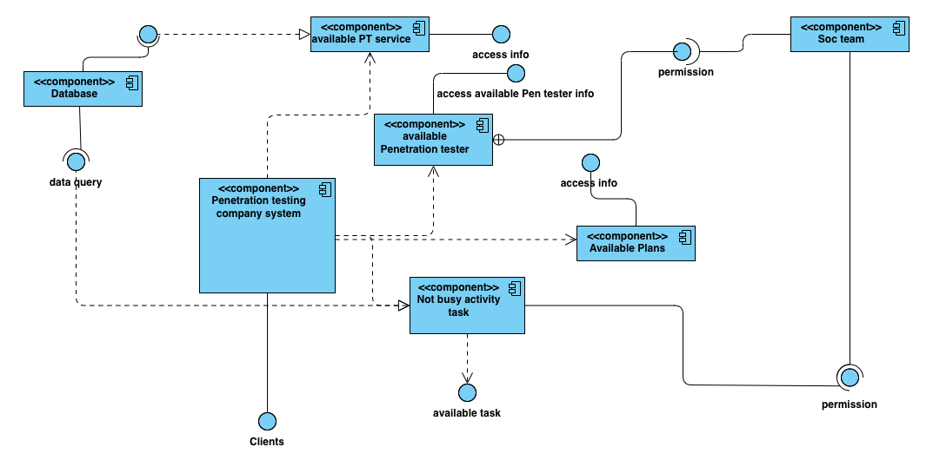
component diagram

Slide 10
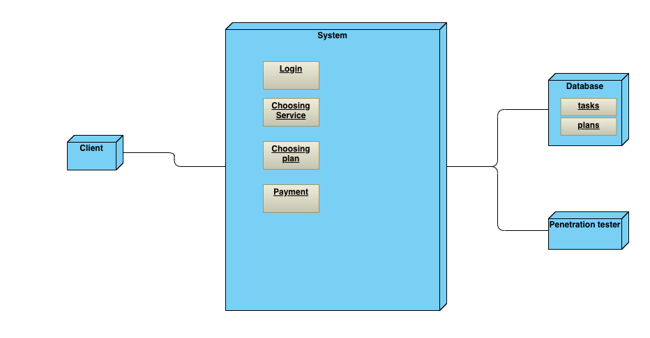
deployment diagram

Slide 11
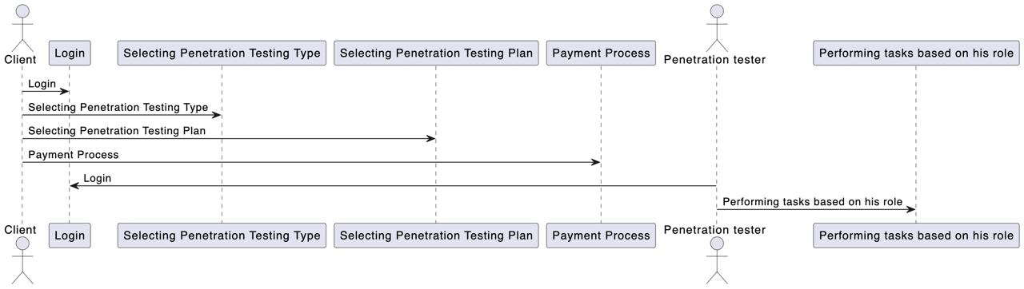
sequence diagram

Slide 12
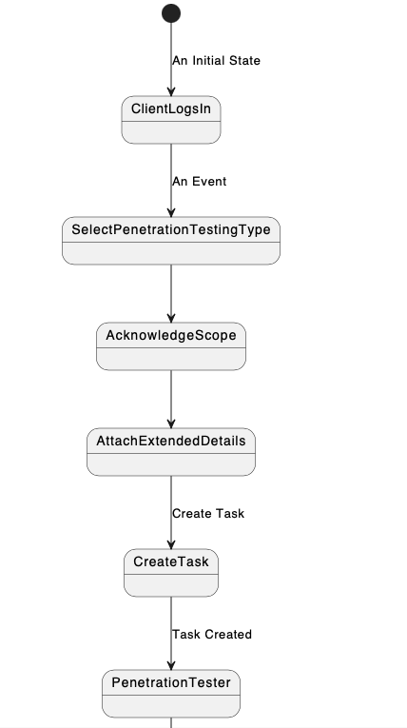
state diagram

Slide 13
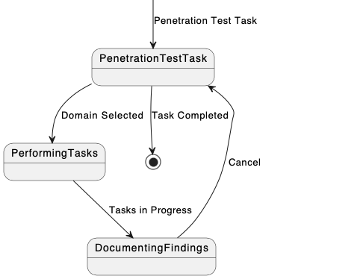
state diagram

Slide 14
End
We make the world more secure.

