Slide 1
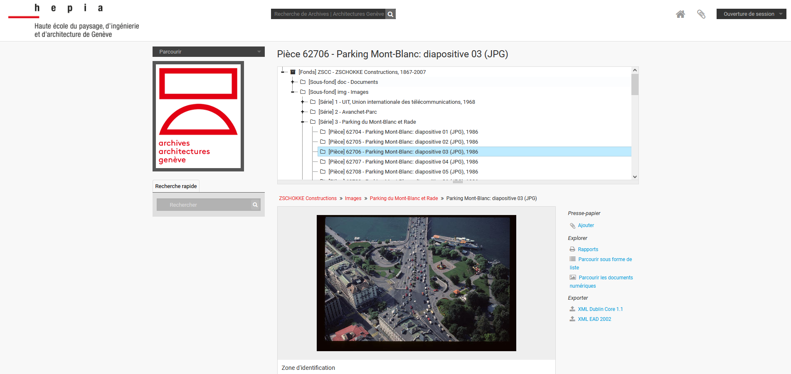
https://architrave-hesge.ch/parking-du-mont-blanc-et-rade-diapositive-3

Slide 2
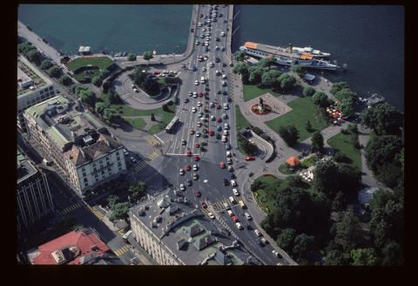
Exemple
https://architrave-hesge.ch/parking-du-mont-blanc-et-rade-diapositive-3
Namespaces/Prefixes
ldp: https://www.w3.org/ns/ldp/#
rico: https://www.ica.org/standards/RiC/ontology.html#
at: https://architrave-hesge.ch/
type: https://architrave-hesge.ch/type/
Remarque
Cet exercice, créé à des fins pédagogiques, n’est pas
formellement valide (notamment concernant l’usage de RiC).
at:zschokke-constructions
rdf:type [ ldp:Container ,
type:Fonds ] ;
rico:harOrHadTitle ‘ZSCHOKKE Constructions ‘’;
rico:hasBeginingDate ‘’1967‘’.
ldp:contains at:zscc-img
at:zscc-img
rdf:type [ ldp:Container ,
type:SubFonds ] ;
rico:harOrHadTitle ‘‘Images‘’;
rico: hasBeginingDate ‘’1967‘’.
ldp:contains at:parking-du-mont-blanc-et-rade
at:parking-du-mont-blanc-et-rade
rdf:type [ ldp:Container ,
type:Serie ] ;
rico:harOrHadTitle ‘’Parking du Mont-Blanc et Rade‘’;
rico: hasBeginingDate ‘’1967‘’.
ldp:contains at:parking-du-mont-blanc-et-rade-diapositive-3
at:parking-du-mont-blanc-et-rade-diapositive-3
rdf:type ldp:Container,
type:Piece.
rico:harOrHadTitle ‘‘Parking Mont-Blanc: diapositive 03 ‘’.
rico: hasBeginingDate ‘’1986‘’.
at:upload/…141.jpg rdf:type ldp:Ressource.

