Slide 1
latinR_22 <- function() {
latinR_2022_presentación.Rmd
untitled.R
[Cómo convertirse en DesarrolladoR en 2 pasos]
}
Joshua Kunst

Slide 2
latinR_22 <- function() {
latinR_2022_presentación.Rmd
untitled.R
[Cómo convertirse en DesarrolladoR en 2 pasos]
# quizás en 3, 4… o los que necesites!
# Consejos con ejemplos.
}
Joshua Kunst

Slide 3
01{
convertirse_desarrollador.Rmd
untitled.R
[Escribir código R]
}
Imagen del paquete https://csafe-isu.github.io/handwriter/

Slide 4

Tiene que funcionar?
Tiene que hacer el trabajo?
Tiene que ser bello/elegante?

Slide 5
convertirse_desarrollador.Rmd
untitled.R
datos<-read.table("C:/Joshua/Escritorio/Tarea 4/datos.txt")
names(datos)
attach(datos)
plot(V1,V2)
x<-datos[,2]
x
graphics.off()
Imagen del paquete https://csafe-isu.github.io/handwriter/

Slide 6
02{
[Motivación]
convertirse_desarrollador.Rmd
untitled.R
}
@jbkunst

Slide 7
02{
convertirse_desarrollador.Rmd
untitled.R
[No tiene que ser algo grande]
}
@jbkunst

Slide 8
03{
convertirse_desarrollador.Rmd
untitled.R
[No tiene por que ser algo nuevo]
}
@jbkunst

Slide 9
04{
convertirse_desarrollador.Rmd
untitled.R
[No tiene por que estar terminado]
}
@jbkunst

Slide 10
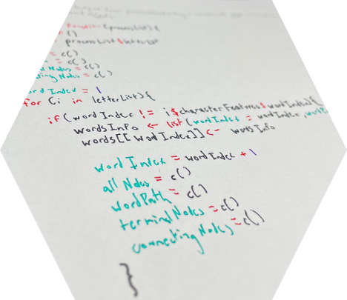
Table Of ‘Contents’ {
01
02
03
forbeginners.html
workshop.css
Theory Lesson
< You can enter a subtitle here if you need it >
Features of the Topic
< You can enter a subtitle here if you need it >
Practical Exercise
< You can enter a subtitle here if you need it >
}
Programming Language

Slide 11
Contents Of ‘This Template’;
forbeginners.html
workshop.css
Here’s what you’ll find in this Slideshow template:
A slide structure based on a Workshop presentation, which you can easily adapt to your needs. For more info on how to edit the template, please visit Slidesgo School or read our FAQs.
An assortment of graphic resources that are suitable for use in the presentation can be found in the alternative resources slide.
A thanks slide, which you must keep so that proper credits for our design are given.
A resources slide, where you’ll find links to all the elements used in the template.
Instructions for use.
Final slides with:
The fonts and colors used in the template.
A selection of illustrations. You can also customize and animate them as you wish with the online editor. Visit Storysite to find more.
More infographic resources, whose size and color can be edited.
Sets of customizable icons of the following themes: general, business, avatar, creative process, education, help & support, medical, nature, performing arts, SEO & marketing, and teamwork.
You can delete this slide when you’re done editing the presentation.
Programming Language

Slide 12
Programming ‘Language’ {
forbeginners.html
workshop.css
[For Beginners Workshop]
< Here is where your presentation begins >
}
Programming Language

Slide 13
Concepts < /1 > {
forbeginners.html
workshop.css
< Mercury is the closest planet to the Sun and the smallest one in the Solar System—it’s only a bit larger than the Moon >
}
Concepts < /2 > {
< Venus has a beautiful name and is the second planet from the Sun. It’s hot and has a poisonous atmosphere >
}
Programming Language

Slide 14
Introduction; {
forbeginners.html
workshop.css
‘Here you can give a brief description of the topic you want to talk about’
<p For example, if you want to talk about Mercury, you can say that it’s the smallest planet in the entire Solar System >
</p>
}
Programming Language

Slide 15
What Is this ‘Topic About ?’ {
forbeginners.html
workshop.css
Languages
Html
60%
Css
40%
< Mercury is the smallest planet in the entire Solar System >
< The Earth is the only one that harbors life in the Solar System >
Create a web page
Venus has a nice name
Mars is a cold place
Jupiter is a gas giant
}
Programming Language

Slide 16
Features of ‘the Topic’ {
forbeginners.html
workshop.css
Step 01
Mercury is the closest planet to the Sun and the smallest one
Step 02
Saturn is a gas giant and has several rings
Step 03
The Earth is the only planet that harbors life
Step 04
Venus has a beautiful name and is the second planet from the Sun
}
Programming Language

Slide 17
Recommendations; {
forbeginners.html
workshop.css
Mercury
< Mercury is the closest planet to the Sun and the smallest one in the Solar System >
Saturn
< It was named after the Roman god of wealth and agriculture >
Jupiter
< Jupiter is a gas giant and the biggest planet in the Solar System >
}
Programming Language

Slide 18
Examples About ‘The Topic’{
forbeginners.html
workshop.css
Mercury
Jupiter
< Mercury is the closest planet to the Sun >
< Jupiter is a gas giant and the biggest planet >
Saturn
Venus
< Saturn is a gas giant and has several rings >
< Venus has a nice name and high temperatures >
}
Programming Language

Slide 19
Practical Exercise {
< /1 >
< /2 >
forbeginners.html
workshop.css
< Saturn is the fourth-largest object by diameter in the Solar System >
Mercury is the smallest planet
The Earth is the planet we live on
Saturn is made of oxygen and helium
Jupiter is a gas giant
Venus has high temperatures
Neptune is very far away from the Sun
}
Programming Language

Slide 20
9h 55m 23s {
333,000.000
386,000 km
forbeginners.html
workshop.css
< Is Jupiter's rotation period >
< Earths fit in the Sun’s mass >
< Distance between the Moon and the Earth >
}
Programming Language

Slide 21
Awesome { Words;
forbeginners.html
workshop.css
}
Programming Language

Slide 22
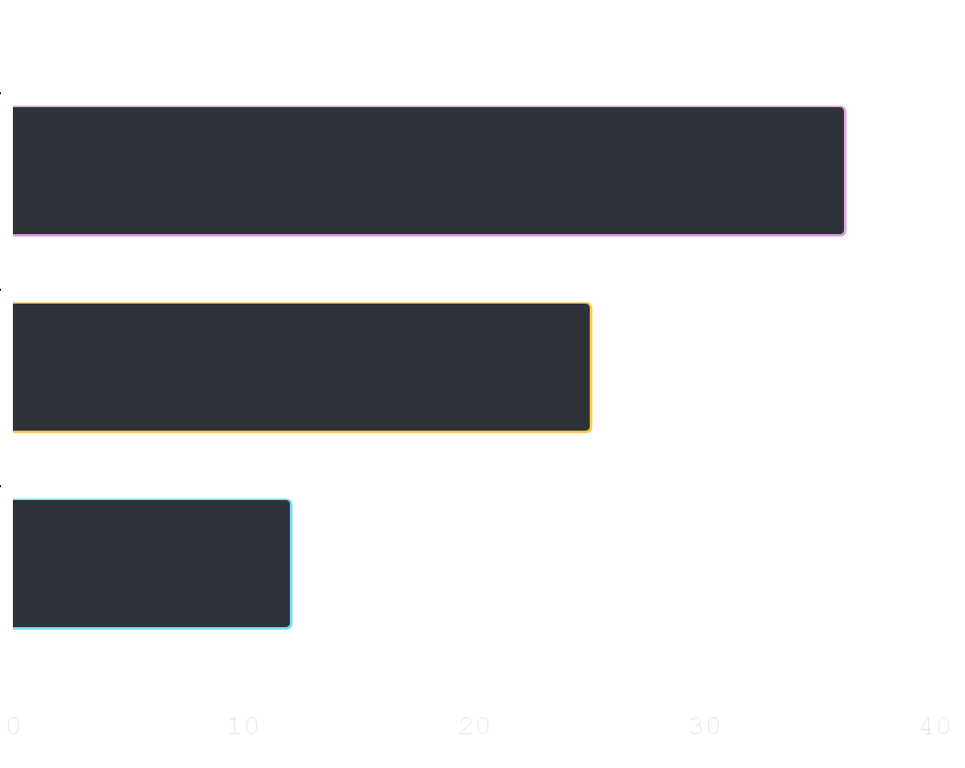
Did You Know ‘This ?’ {
forbeginners.html
workshop.css
36.00
Mercury is the smallest planet of the Solar System
25.00
Venus has a beautiful name and high temperatures
12.00
Despite being red, Mars is actually a cold place
}
Follow the link in the graph to modify its data and then paste the new one here. For more info, click here
Programming Language

Slide 23

A ‘Picture’ Always Reinforces The Concept {
forbeginners.html
workshop.css
< Images reveal large amounts of data, so remember: use an image instead of a long text. Your audience will appreciate it >
}
Programming Language

Slide 24
150,005,630 {
forbeginners.html
workshop.css
< Big numbers catch your audience’s attention >
}
Programming Language

Slide 25
— Someone ‘Famous’
forbeginners.html
workshop.css
< “This is a quote, words full of wisdom that someone important said and can make the reader get inspired.” >
Programming Language

Slide 26
Review ‘Concepts’ {
forbeginners.html
workshop.css
< Mercury is the closest planet to the Sun and the smallest one in the Solar System >
Venus
Ceres
Saturn
}
Programming Language

