Slide 1
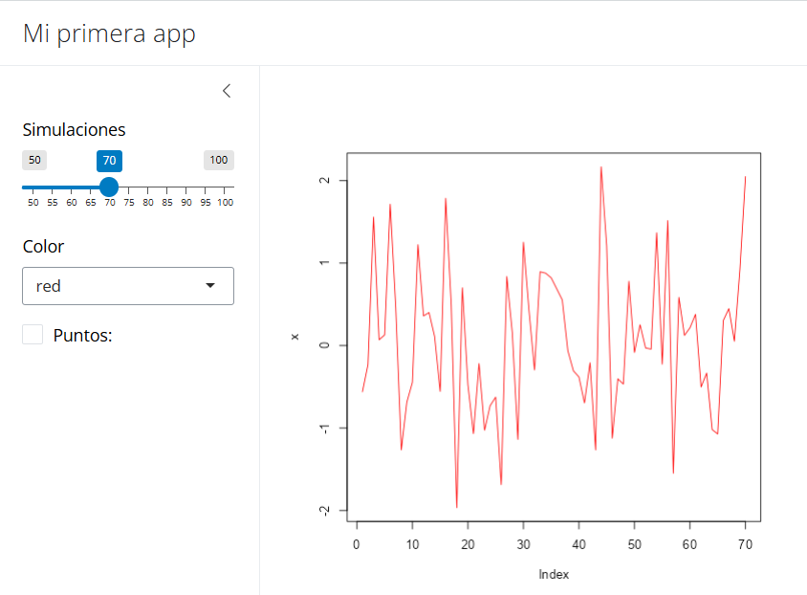
ui <- page_sidebar(
title = "Mi primer app",
sidebar = sidebar(
sliderInput("nrand", "Simulaciones", min = 50, max = 100, value = 70),
selectInput("col", "Color", c("red", "blue", "black")),
checkboxInput("punto", "Puntos:", value = FALSE)
),
plotOutput("grafico")
)
server <- function(input, output) {
output$grafico <- renderPlot({
set.seed(123)
x <- rnorm(input$nrand)
t <- ifelse(input$punto, "b", "l")
plot(x, type = t, col = input$col)
})
}

Slide 2
ui <- page_sidebar(
title = "Mi primer app",
sidebar = sidebar(
sliderInput("nrand", "Simulaciones", min = 50, max = 100, value = 70),
selectInput("col", "Color", c("red", "blue", "black")),
checkboxInput("punto", "Puntos:", value = FALSE)
),
plotOutput("grafico")
)
server <- function(input, output) {
output$grafico <- renderPlot({
set.seed(123)
x <- rnorm(input$nrand)
t <- ifelse(input$punto, "b", "l")
plot(x, type = t, col = input$col)
})
}

Slide 3
ui <- page_sidebar(
title = "Mi primer app",
sidebar = sidebar(
sliderInput("nrand", "Simulaciones", min = 50, max = 100, value = 70),
selectInput("col", "Color", c("red", "blue", "black")),
checkboxInput("punto", "Puntos:", value = FALSE)
),
plotOutput("grafico")
)
server <- function(input, output) {
output$grafico <- renderPlot({
set.seed(123)
x <- rnorm(input$nrand)
t <- ifelse(input$punto, "b", "l")
plot(x, type = t, col = input$col)
})
}

Slide 4
ui <- page_sidebar(
title = "Mi primer app",
sidebar = sidebar(
sliderInput("nrand", "Simulaciones", min = 50, max = 100, value = 70),
selectInput("col", "Color", c("red", "blue", "black")),
checkboxInput("punto", "Puntos:", value = FALSE)
),
plotOutput("grafico")
)
server <- function(input, output) {
output$grafico <- renderPlot({
set.seed(123)
x <- rnorm(input$nrand)
t <- ifelse(input$punto, "b", "l")
plot(x, type = t, col = input$col)
})
}

Slide 5
ui <- page_sidebar(
title = "Mi primer app",
sidebar = sidebar(
sliderInput("nrand", "Simulaciones", min = 50, max = 100, value = 70),
selectInput("col", "Color", c("red", "blue", "black")),
checkboxInput("punto", "Puntos:", value = FALSE)
),
plotOutput("grafico")
)
server <- function(input, output) {
output$grafico <- renderPlot({
set.seed(123)
x <- rnorm(input$nrand)
t <- ifelse(input$punto, "b", "l")
plot(x, type = t, col = input$col)
})
}

Slide 6
ui <- page_sidebar(
title = "Mi primer app",
sidebar = sidebar(
sliderInput("nrand", "Simulaciones", min = 50, max = 100, value = 70),
selectInput("col", "Color", c("red", "blue", "black")),
checkboxInput("punto", "Puntos:", value = FALSE)
),
plotOutput("grafico")
)
server <- function(input, output) {
output$grafico <- renderPlot({
set.seed(123)
x <- rnorm(input$nrand)
t <- ifelse(input$punto, "b", "l")
plot(x, type = t, col = input$col)
})
}

Slide 7
ui <- page_sidebar(
title = "Mi primer app",
sidebar = sidebar(
sliderInput("nrand", "Simulaciones", min = 50, max = 100, value = 70),
selectInput("col", "Color", c("red", "blue", "black")),
checkboxInput("punto", "Puntos:", value = FALSE)
),
plotOutput("grafico")
)
server <- function(input, output) {
output$grafico <- renderPlot({
set.seed(123)
x <- rnorm(input$nrand)
t <- ifelse(input$punto, "b", "l")
plot(x, type = t, col = input$col)
})
}

