Slide 1
HTML5 and Local Storage

Slide 2
Topics
HTML5 Storage
Key-value pairs
localStorage Object

Slide 3
Cookies Before HTML5
Websites could store only small amounts of text-based information on a user’s computer using cookies.

Slide 4
How Cookies Worked
A website might use a cookie to record user preferences or other information that it can retrieve during the client’s subsequent visits.
When a user visits a website, the browser locates any cookies written by that website and sends them to the server.

Slide 5
Developing with Cookies
Cookies may be accessed only by the web server and scripts of the website from which the cookies originated .
The browser sends these cookies with every request to the server.

Slide 6
Drawbacks with Cookies
Cookies have a number of problems associated with them.
Offline access is not often performed very well.
memory is limited.

Slide 7
Is there a solution to Cookies?
HTML5 Storage

Slide 8
HTML5 Storage
HTML5 Storage is also known as:
Local Storage
Web Storage
DOM Storage

Slide 9
How does HTML5 Storage work?
HTML5 Storage allows web applications to store persistent data locally in web browsers.
Persistent data stored does not expire with a session.
If you browse away from the site that saved the data or close the browser, you will notice that the data is still there when you open it again or check for it locally.
The storage option is supported by all modern browsers, even mobile ones.

Slide 10
HTML5 Client-Side Storage Overview
There are several ways to store data on a user’s computer:
Web Storage: Single file that uses key-values.
Indexed Database: Key-value Indexed table.
Web SQL: Structured Database.

Slide 11
Web Storage Options
Web storage is always local. Values can be set and retrieved even when the browser has been closed and re-opened.
Web storage can also be used for sessions.
A storage session can be cleared when a window closes.

Slide 12
Examining Website Storage
It is easy to find out if a website uses Storage.
Google Chrome Developer Tools
Examine Storage in Applications.

Slide 13
Working with HTML5 Web Storage
The mechanism for storage is key-value pairs.
Web applications can use the window object’s localStorage property to store up to several megabytes of key-value-pair string data on the user’s computer.
localStorage can access that data across browsing sessions.

Slide 14
HTML5 Web Storage vs Cookies
Unlike cookies, data in the localStorage object is not sent to the web server with each request.
Websites often use both cookies and localStorage.

Slide 15
HTML5 Web Storage TIPS
Each website domain has a separate localStorage object.
All the pages from a given domain share one localStorage object.
Typically 5BM are reserved for each localStorage object.
If web storage is full, the browser can ask the user if more space should be allocated.

Slide 16
Key Value Pairs
A key value pair is a key with a corresponding value.
The key and value are both strings.
For example
Key: “address”
Value: “1200 E Colton Ave”

Slide 17
localStorage Object Methods
length() to get the number of key-value pairs stored in local storage.
key(i) to collect the key at index i.
getItem() and setItem() to set and get a key item.
removeItem() to remove a key-value pair from local storage

Slide 18
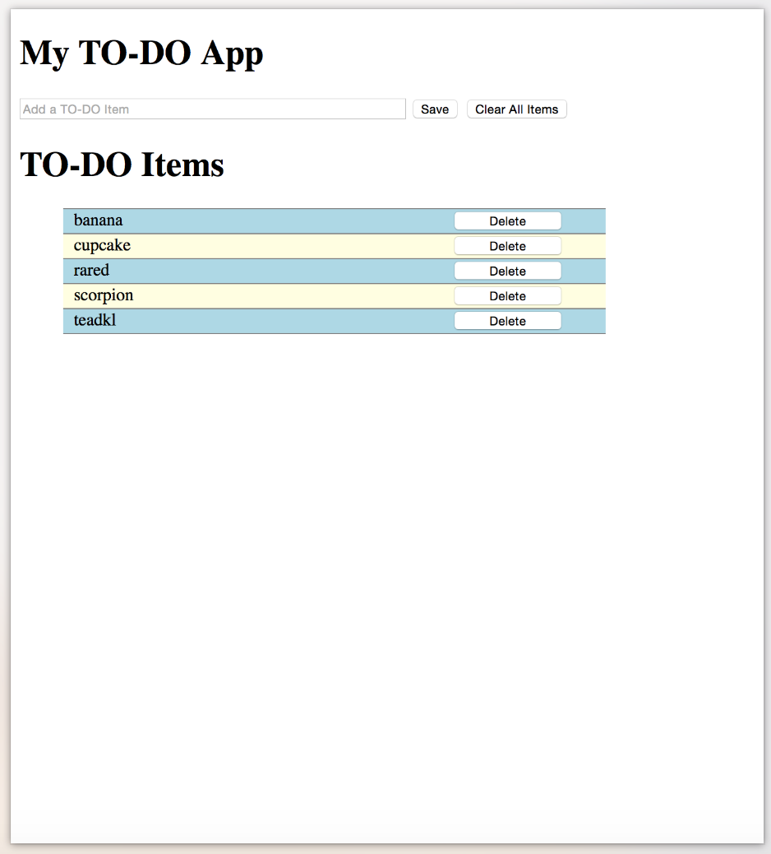
Practice

Slide 19
Task 1: Determine the Divisions
<!DOCTYPE html>
<html>
<head>
<title>To Do List</title>
<link rel = "stylesheet“
type = "text/css"
href = "css/style.css">
<script src = "js/todo.js"></script>
</head>
<body onload='initialize()'>
</body>
</html>

Slide 20
Inside <body>
<div>
<div>
<h1>My TO-DO App</h1>
</div>
<div>
<p>
<input id = "todoTag" type = "text" placeholder = "Add a TO-DO Item">
<button onclick="saveSearch();"> Save </button>
<button onclick="clearAllItems();"> Clear All Items </button>
</p>
<h1>TO-DO Items</h1>
<div id = "searchList"></div>
</div>
</div>

Slide 21
CSS Formatting
Use nth-child to style even/odd elements.
Use span to create elements on a line with other elements.

Slide 22
p {
margin: 0px;
}
#welcomeMessage {
margin-bottom: 10px;
font-weight: bold;
}
input[type = "text"] {
width: 350px;
}
input[type = "button"]{
width: 100px;
}
/* list item styles */
span {
margin-left: 10px;
display: inline-block;
width: 350px;
}
li {
list-style-type: none;
width: 500px;
}
li:first-child {
border-top: 1px solid grey;
}
li:nth-child(even) {
background-color: lightyellow;
border-bottom: 1px solid grey;
}
li:nth-child(odd) {
background-color: lightblue;
border-bottom: 1px solid grey;
}
CSS

Slide 23
Write the JavaScript

