Slide 1
PHP –Regular Expressions
What is the history of regex
Quick demo
Regular Expressions Lab 10 Exercise 4
Reading contents of a file
PHP Language constructs

Slide 2
Regular Expressions
A rational expression is referred to as a regular expression.
A regular expression is a sequence of characters that can be defined by a pattern.
Pattern matching with strings is an important of computer science, but especially with the web.
Data is often passed as a string –it must be parsed and dissembled into meaningful objects.

Slide 3
Regex History
Regex was invented by mathematician (and theoretical computer scientist) Stephen Kleene.
He explored recursive parsing during the 50’s at the RAND institute looking.
Parsing is the process of analyzing and interpreting a string of symbols.
Kleene wrote a very important paper on finite automata and regular expressions.
CS340 Programming Languages discusses this topic extensively.

Slide 4
PHP and Regular Expressions
PHP relies on a method called preg_split() for processing regular expressions.
preg_split() is used to split a string into an array of variables based on a pattern of characters.
preg means Pcre REGexp". "PCRE" means "Perl Compatible Regexp", which is functionality for processing a “regular expression”.
The main rule for processing a regular expression is the consistent escaping rule.
PCRE has consistent escaping rules: any non-alpha-numeric character may be escaped to mean its literal value by prefixing a \ (backslash) before the character, and vice versa.

Slide 5
Demo using PHP Sandbox
Create a variable to hold the following sentence:
$mywords = “bobo likes cake, cookies, and carrots.”;
Use preg_split to collect each word and place it in an array, $mywords.
$mywords = preg_split("/[\s,.]+/", $mysentence);
foreach ($mywords as &$value) {
print $value." ";
}

Slide 6
Explanation
Splits will occur on any part of the string that is at least one whitespace character, a comma, or a period.
Pattern: "/[\s,\.]+/"
/ start or end of pattern string
[ ... ] group of characters to look for
\s Any whitespace character (space, tab).
, the literal comma character
\. the period character must be escaped.
+ delimitor is one or more of the group characters

Slide 7
More Explanations
--------------------------------------------------------------------------------
\w word characters (a-z, A-Z, 0-9, _)
--------------------------------------------------------------------------------
) end of look-behind
--------------------------------------------------------------------------------
\b the boundary between a word char (\w) and
something that is not a word char
--------------------------------------------------------------------------------
\s* whitespace (\n, \r, \t, \f, and " ") (0 or
more times (matching the most amount
possible))
--------------------------------------------------------------------------------
[!?.]* any character of: '!', '?', '.' (0 or more
times (matching the most amount possible))

Slide 8
Regex Practice Lab 10 Exercise 4
Use Atom to search for patterns.
Choose Find. Then select Find in Buffer.
Activate the Regex by Selecting the .*

Slide 9
Reading the contents of a file
Option 1: file_get_contents() Using this function will return the contents of a given file as a single string.
Option 2: file() Reads an entire file into an array. Each cell contains a string of text (paragraph).

Slide 10
Language Constructs
"Language constructs" are operations that are supported by special features in the language. In PHP, mostly anything that isn't a variable or a function is a language construct. These can be found at the PHP documentation page:
http://php.net/manual/en/reserved.keywords.php
TIP: list() function is used to assign a list of variables in one operation.
<?php
$my_array = array("Dog","Cat","Horse");
list($a, $b, $c) = $my_array;
echo "I have several animals, a $a, a $b and a $c.";
?>
Output: I have several animals, a Dog, a Cat and a Horse.

Slide 11
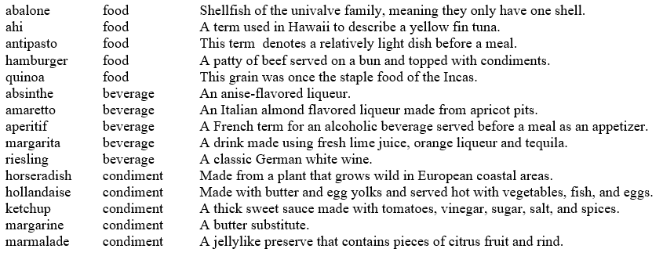
Example:
Pattern
Each line contains a food object.
For each line, tabs separate three elements:
Word
food type
definition

Slide 12
Code Tasks: a. Open the file and copy the contents to an array variable. b. Shuffle the array. c. Select a random line from the array.
$lines = file(“dataFile.txt”);
Shuffle($lines);
$aLine = trim($lines[array_rand($lines)]);

Slide 13
Code Task: For a given line, create three variables, one for each element.
list($food, $foodType, $description) = preg_split(“/[t]+/”, $aLine);
Explanation : "/[\t]+/“
/ = start or end of pattern string
[ ... ] = grouping of characters
+ = one or more of the preceding character or group
\t = A tab character.

