Slide 1
International Demand for Bourbon and it’s Affect on the Kentucky Economy

Slide 2
Objective
Gauge economic impact of recent surge in popularity of Bourbon on Kentucky.
Focus specifically on international exports.

Slide 3
What is Bourbon?
Recognized under US statutory law as a distinct product.
Title 27 (Alcohol, Tobacco Products, and Firearms) of the Code of Federal Regulations, Section 5.22
Made from a fermented mash with a minimum of 51% and a maximum of 79% corn
Distilled at less than 80% alcohol/volume (160 proof)
Stored in a new, charred, white oak barrel at a maximum of 62.5% alcohol/volume (125 proof) for at least 2 years
The original color and flavor of the whiskey can not be filtered or altered in any way
Must be produced and stored (for at least one year of the aging) in Kentucky to be called Kentucky Bourbon

Slide 4
International Trade
NAFTA
Chapter 3, Annex 313: "Distinctive Products”
Canada and Mexico shall recognize both Bourbon Whiskey and Tennessee Whiskey as products of the US and enforce the standards of US law (title 27 CFR 5.22).
NAFTA agreement effectively transplants US law through a treaty to Canada and Mexico
Mexico eliminated its 20% tariff on bourbon immediately following NAFTA's creation.
June 6, 2003 trade agreement with Chile
Distinctive products
June 1994 US-EU EEC Council Regulation EEC 1267/94
EU recognized Bourbon and Tennessee Whiskey as products that must be produced in the US under the standards of US law
In exchange US recognizes European products under title 27 CFR 5.22
February 2004, US-AU
Bourbon and Tennessee Whiskey make up 80% of US distilled spirit exports to Australia in 2003

Slide 5
WTO
Trade Related Aspects of Intellectual Property Rights (TRIPS)
"Each member shall provide the legal means for interested parties to prevent use of a geographic indication identifying wines for wines not originating in the place indicated by the geographical indication in question, even where the true origin of the goods is indicated or the geographical indication is used in translation or accompanied by expressions such as 'kind, 'type', 'style', 'imitation', or the like."

Slide 6
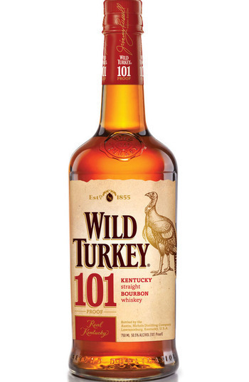
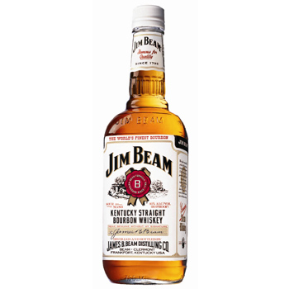
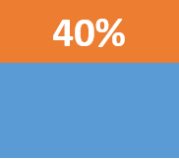
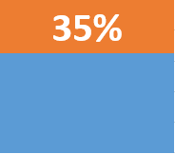
2003

Slide 7
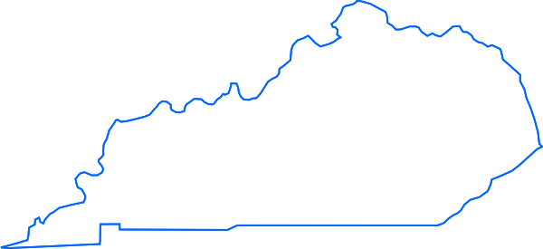
2003

Slide 8
Bourbon Importing Countries
Notes:
Total Sales $331,886,195

Slide 9
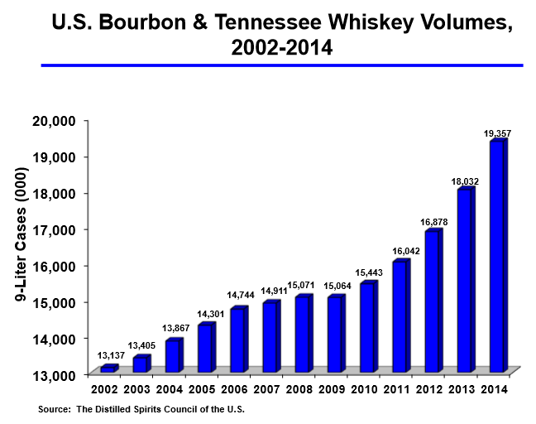
Growth
Notes:
Nearly 150% increase

Slide 10
Growth
In 2013 exports of Kentucky Bourbon and Tennessee Whiskey surpassed 1 billion.
2014: American spirits exports = 1.56 billion
Notes:
KY Bourbon and TN Whiskey = 1.02 bn
56% of American spirits

Slide 11
Growth

Slide 12
Challenges
Establish “year zero” (2010?)
“Before Boom” (BB)
“After Boom” (AB)
What was normal yearly sales and growth before the boom?
What is growth now?
Gather data
Separate Kentucky Bourbon from other whiskey and spirits.

Slide 13
Sources
http://www.fas.usda.gov/
http://www1.american.edu/TED/kentuckybourbon.htm
http://sice.oas.org/trade/nafta/chap-031.asp#A313
https://www.wto.org/english/docs_e/legal_e/27-trips_04b_e.htm#3
http://www.seattletimes.com/business/bourbon-tennessee-whiskey-sales-soar-in-us-exports-top-1b/
http://www.discus.org/assets/1/7/Bourbon_and_Tennessee_Whiskey_2014.pdf
http://kybourbon.com/wp-content/uploads/2014/08/economic_impact_2014.pdf

