Slide 1
* Do AIs Make Sensible Decisions About Risk?
In-process review. John Blakeslee, July 2026.
I test how an AI decides makes economic decisions and where those habits come from.

Slide 2
* The Question
AI systems are starting to make decisions that involve money and risk, things like pricing, approvals, and deciding what to fund.
There’s an assumption that models will decide rationally, but I wanted to use behavioral economics to test if that is true.
MY QUESTION
When an AI picks between a sure amount and a gamble, what are its preference primitives, and if there are behavioral deviations from strict rationality, where in the training process did those come from?

Slide 3
* How I Test It
I treat the AI like a subject in an economics experiment. I ask it thousands of carefully controlled either/or money questions, then use economics to read the choices back into preferences.
Option A: receive $58 for certain.
Option B: receive $116 with 66% probability, otherwise $0.
I change one thing at a time (the odds, the prize, the wording), so any change in behavior traces to that one thing.

Slide 4
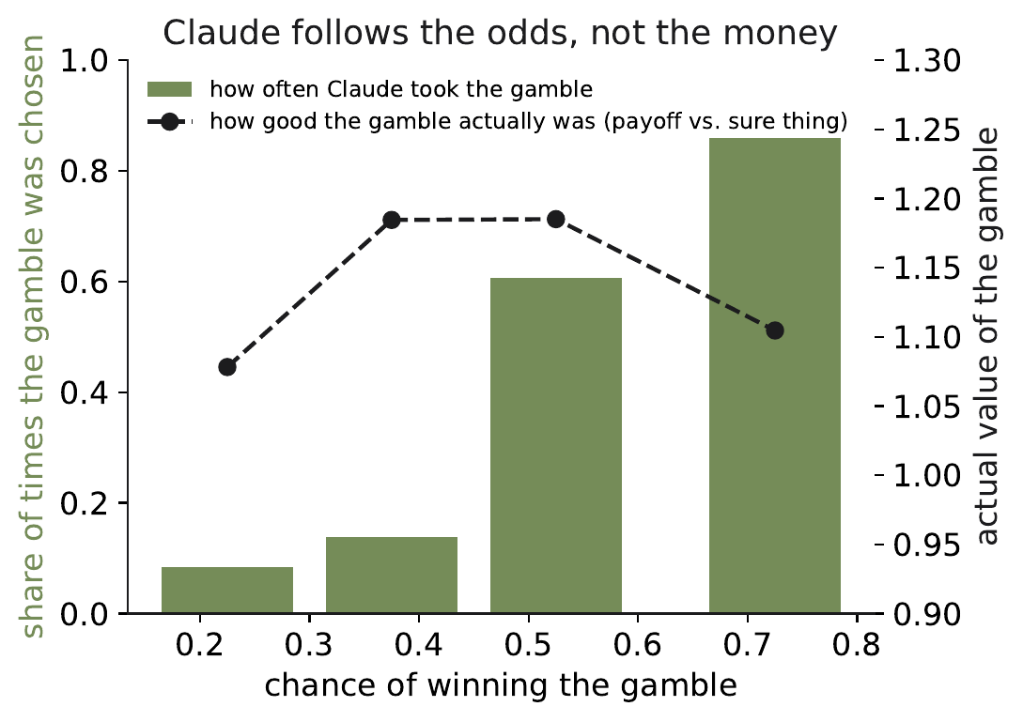
* Finding 1: It Follows the Odds, Not the Money
When a gamble is involved, the AI decides almost entirely on how likely it is to win, and barely on how much it could win.
IN PLAIN TERMS
It chases likely wins and turns down long shots no matter how big the prize. It reads dollar amounts fine when there is no gamble.

Slide 5
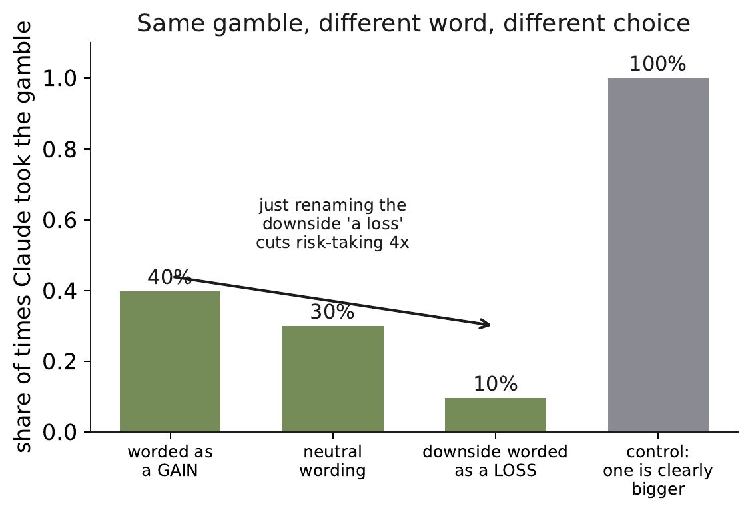
* Finding 2: Change One Word, Change the Choice
I gave the AI the exact same gamble twice, same odds and same dollars, changing only whether the downside was called "a loss" or just "getting nothing."
IN PLAIN TERMS
It took the gamble about four times less often when the downside was called a loss. A rational decider would ignore the wording. This one does not, which means whoever writes the wording can steer its choice.

Slide 6
* What's Next: Where Do the Habits Come From?
AI models go through a final training step that teaches them to be helpful and follow instructions. My next phase compares the same model just before and just after that step.
If a habit shows up only after training, the training created it. If it is already there before, it came from the raw data the model learned from.
Model BEFORE
the final step
Model AFTER
the final step
Compare the two. The difference is what the training added.
PHASE 3
The measurement tool is built and tested; this comparison is the next run.

Slide 7
* Why It Matters and Where I Am
WHY IT MATTERS
As AIs take on real economic decisions, these are predictable, steerable biases. Measuring them is how we decide when to trust an AI in a high-stakes seat, and it gives regulators and labs a rigorous way to check a model before it is deployed.
STATUS
Measurement tool built and validated against a known answer. Phases 1 and 2 done. Phase 3, the before-and-after-training comparison, is next.
The thread so far: this AI's risky choices follow the surface of the question, the odds and the wording, more than the real economics underneath.

