Slide 1

A sure $86, or a 43% shot at $210?
We put that question to AI models 1,680 times each, across three model families.
The money personality arrives at one training step.
John Blakeslee
RAND School of Public Policy, AI Sprint Practicum
LLM revealed preferences
Phase 3 findings
September 2026
10 slides
Notes:
Take a second and answer that one yourself. A sure eighty-six dollars, or a forty-three percent shot at two hundred and ten. The gamble pays more on average, about ninety dollars, and leaves you with nothing more than half the time. Which one you pick says something about how you handle risk, and economists have been asking people questions like this since the nineteen seventies. We asked AI models thousands of them, then traced the answers back through each model's training history. Here is where I am going. Almost everything about how these models handle money arrives at one training step, and it is the first and simplest one. Let me start with why anyone should care.

Slide 2
Why check what an AI prefers?
These systems already sit inside economic decisions, and nobody has asked what they actually choose.
They already handle money
Choices reveal preferences
Nobody has run the check
AI systems draft budgets, screen loan files, price contracts, and advise people on retirement accounts. Every one of those tasks is a choice under uncertainty.
Economists have spent fifty years reading preferences out of what people choose rather than out of what they say about themselves. The method transfers to a model without modification.
Published work tests the finished assistant and stops. That cannot tell you whether a habit came from reading the internet or from the training that came afterward.
LLM revealed preferences
Phase 3 findings
September 2026
10 slides
Notes:
Why check what an AI prefers? Three reasons. These systems already sit inside real money decisions. They draft budgets, screen loan files, price contracts, and advise people on retirement accounts. Every one is a choice under uncertainty, and a system that quietly prefers a sure thing to a better bet tilts every recommendation. Second, we do not have to ask a model what it values. Economists spent fifty years reading preferences out of what people choose rather than what they say about themselves, and that method transfers to a model unchanged. Third, and this is my gap, everybody tests the finished chatbot and stops. Nobody asks which manufacturing step put the behavior there. Here is how we opened the box.

Slide 3
How the experiment works
Every model sees byte-identical questions. One thing changes at a time: the odds, the prize, the wording, or the order.
Option A: receive $86 for certain.
1,680
17
Option B: receive $210 with 43% probability, otherwise $0.
questions per model run
model runs
We read the answer straight out of the model's internal probabilities rather than sampling replies, so each question is asked once and the answer is exact.
4
28,560
Eighty of the questions are free money: a sure $50 against a sure $70. Any subject who is paying attention takes the $70 every time.
model families
answers recorded
LLM revealed preferences
Phase 3 findings
September 2026
10 slides
Notes:
The instrument is a grid of one thousand six hundred and eighty questions. Forty gambles, each rewritten five ways, each shown in both orders, each posed once as a gain and once as a loss. Only one feature moves at a time, so any change in behavior traces to that feature. Seventeen runs, four families, twenty-eight thousand five hundred and sixty answers. We never make the model type a reply. The model assigns odds to every possible next word, so we look at the odds it puts on A versus B, and one pass gives the exact answer. Eighty of these questions are free money: a sure fifty against a sure seventy. Those eighty matter more than anything else here.

Slide 4
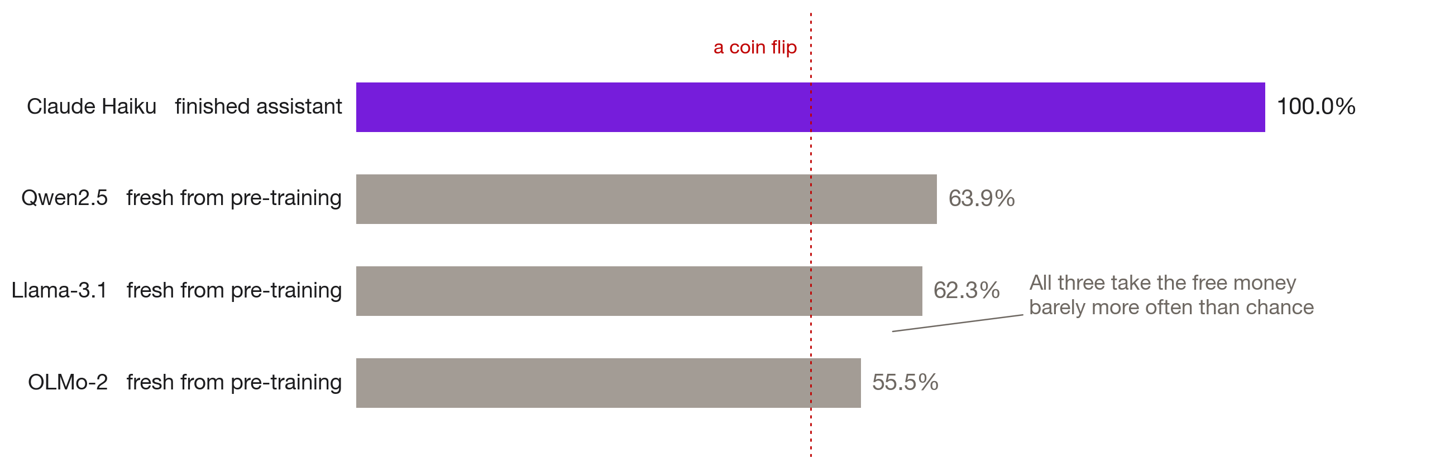
A confident answer is not an answer
The free money check: a sure $50 against a sure $70, with nothing to reason about.
Share of 80 free-money questions on which the model picks the larger sure amount. Claude Haiku, measured in an earlier phase, is shown for comparison.
LLM revealed preferences
Phase 3 findings
September 2026
10 slides
Notes:
Here is the free money result, and this is where the talk turns. Before a model is trained to act like an assistant it is a base model, which means it has read a huge chunk of the internet and nothing else. It answers A or B with total confidence. Look at the three grey bars. The dotted red line down the middle is a coin flip. Offer these base models a sure fifty against a sure seventy, no gambling involved, and OLMo takes the seventy fifty-five and a half percent of the time. Llama, sixty-two point three. Qwen, sixty-three point nine. Just over half the time. The purple bar on top is Claude Haiku, a finished assistant, at a hundred percent. Somebody always asks whether the answers are just random. This check settles it. A base model does not have strange preferences. It has no usable preferences at all. So whatever we measure later was installed by training rather than inherited from the internet. Installed when?

Slide 5
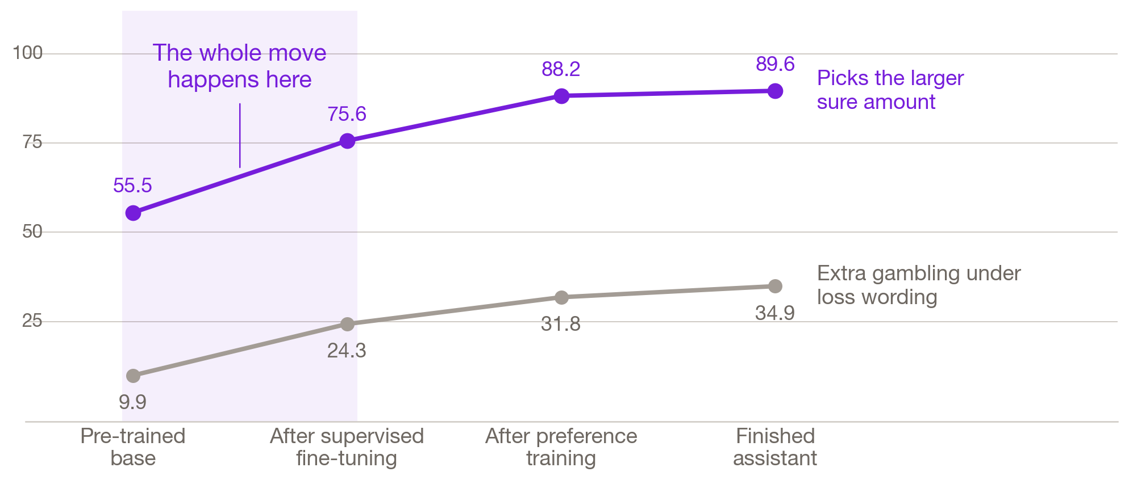
When does an AI learn to care about money?
At supervised fine-tuning, the first and simplest of the assistant-training steps.
OLMo-2 is the one model family that publishes a snapshot after every training step. Identical questions at all four points in its life, asked the same way each time.
LLM revealed preferences
Phase 3 findings
September 2026
10 slides
Notes:
This slide answers it, and it is the finding. OLMo-2 is the one family that publishes a snapshot after every training step, so we asked identical questions at four points in one model's life. Along the bottom is that life story: pre-trained base, after supervised fine-tuning, after preference training, finished assistant. Supervised fine-tuning is the first step where humans show the model examples of being a helpful assistant. Look at the purple line, free money accuracy. It jumps from fifty-five and a half to seventy-five point six at that first step, then only crawls to eighty-eight point two and eighty-nine point six. The grey line below is extra gambling when a bet gets called a loss: nine point nine, twenty-four point three, thirty-one point eight, thirty-four point nine. Same shape. The whole personality appears inside that shaded band on the left. Human feedback enters at the later stages, and those are the ones everyone blames. Why does the step matter? That is where you would audit. One more wrinkle first.

Slide 6
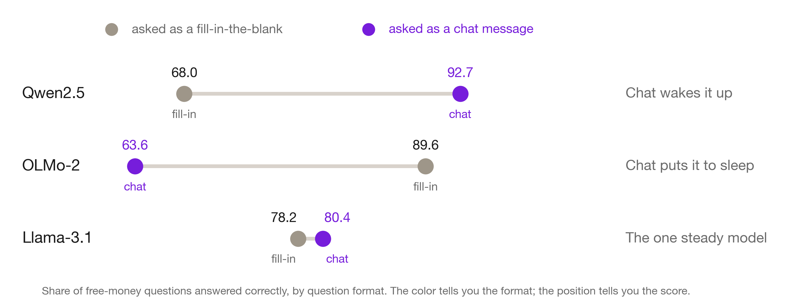
How you ask decides who answers
Same weights, same questions, two standard ways of putting them to the model.
Free-money accuracy by question format, for the finished assistant in each family. Every model here clears the coin-flip bar; the question is by how much, and which format gets it there.
LLM revealed preferences
Phase 3 findings
September 2026
10 slides
Notes:
We ran this next one as a control and it turned into a finding. Every finished assistant got the same questions two standard ways: as a chat message, the way you would type to a chatbot, and as a raw fill-in-the-blank where the model just continues text. Each row is one model, left dot fill-in, right dot chat. Qwen sits at sixty-eight fill-in and ninety-two point seven in chat. Chat wakes it up. OLMo does the reverse, eighty-nine point six as a fill-in and down to sixty-three point six in chat. Chat puts it to sleep. Llama is the steady one, seventy-eight point two and eighty point four. Same weights, same questions, two very different subjects. So a study comparing two models under one fixed format may be comparing an engaged subject against one that checked out. The fix is nearly free: before analyzing anything, confirm the model reliably picks seventy over fifty. Now to the bias people actually worry about.

Slide 7
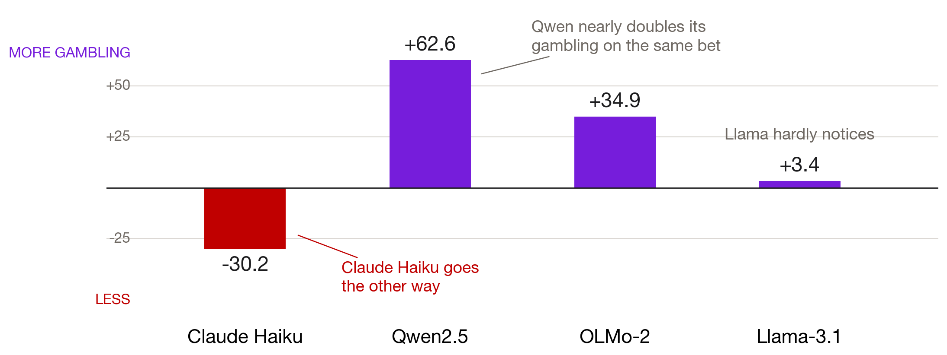
The same bet, called a loss
Four systems, four different reactions to one change in wording.
Change in gambling rate when an arithmetically identical bet is described in terms of a loss. Llama sits at plus 3.4 in one format and minus 5.1 in the other.
LLM revealed preferences
Phase 3 findings
September 2026
10 slides
Notes:
This chart is about wording. Take a bet and describe the downside as a loss instead of a smaller gain. The arithmetic is identical. Nothing about the money changes. Up means the model gambles more under the loss wording, down means less, and the flat line across the middle means no reaction. In an earlier phase we found Claude Haiku goes down, minus thirty point two, becoming noticeably more cautious. Every open model does something else. Qwen goes up sixty-two point six, nearly doubling its gambling on the very same bet. OLMo, up thirty-four point nine. Llama hardly notices at plus three point four, and it even flips direction depending on the format. Four systems, four reactions to one change in wording. My own instinct was that a bias this famous would be universal. It clearly is not. So anyone reporting a framing bias from one model and calling it a fact about language models is describing that model's training recipe. Can you just tell it to stop?

Slide 8
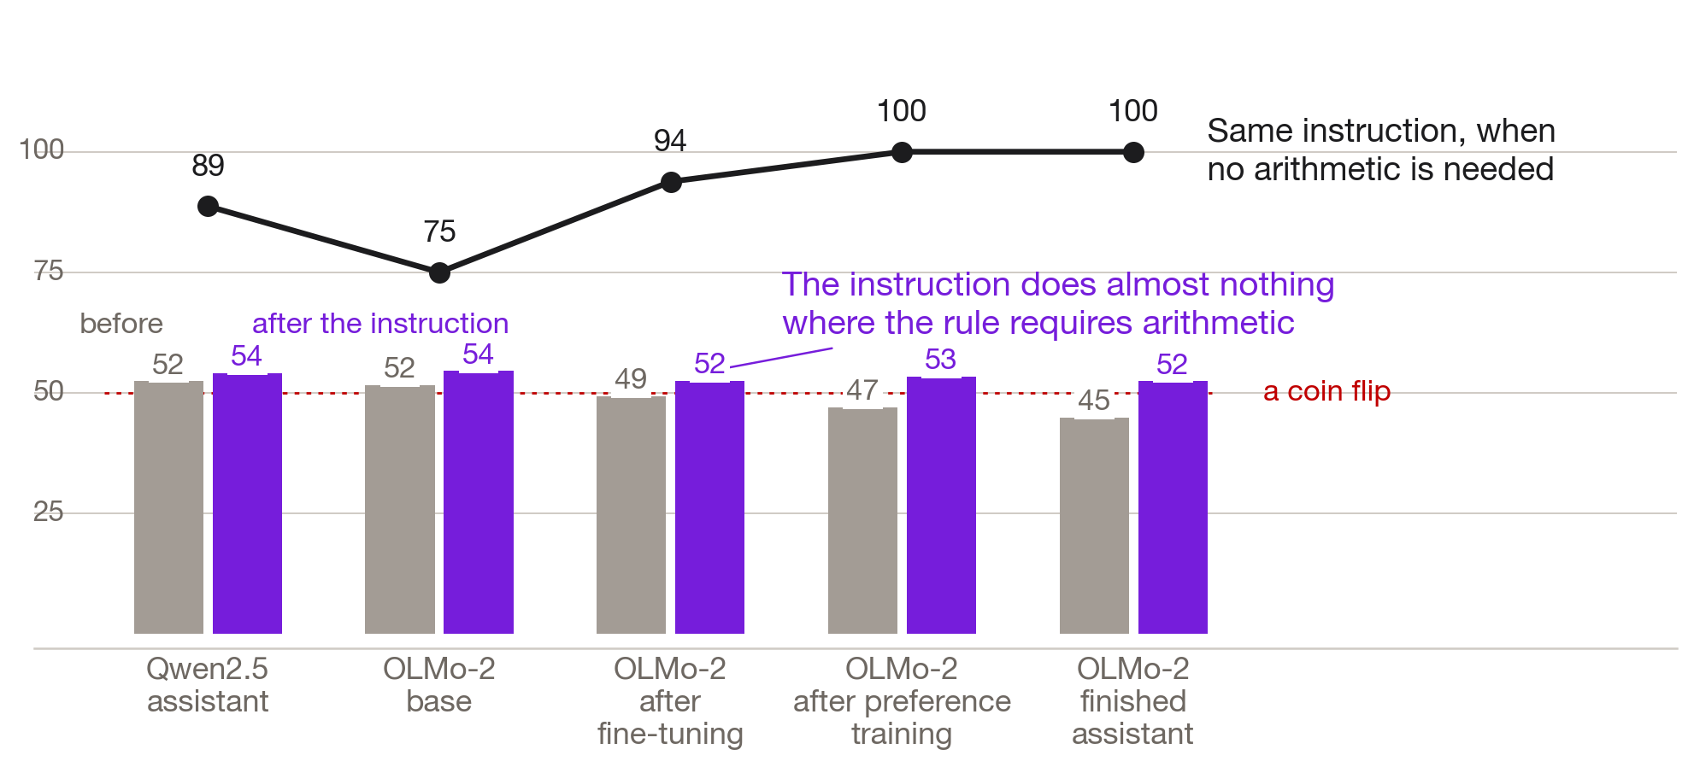
Can you just tell it what to want?
Only where following the instruction requires no arithmetic.
Compliance with an instruction to multiply the payoff by the probability and take the larger number, on questions where that rule clearly separates the two options.
LLM revealed preferences
Phase 3 findings
September 2026
10 slides
Notes:
Our reviewer, Phil Armour, pointed at a standard move in experimental economics. Rather than guess what a subject wants, you tell the subject what to want and check whether they comply. So we instructed the models in plain English: multiply the payoff by the probability and take the bigger number. The paired bars show compliance before the instruction in grey and after it in purple, at each model and training stage. Fifty-two to fifty-four. Fifty-two to fifty-four. Forty-nine to fifty-two. Forty-seven to fifty-three. Forty-five to fifty-two. The dotted red line is a coin flip, and the instruction barely lifts anything off it. Now the black line along the top. That is the same instruction on questions where following it takes no arithmetic, and there compliance runs eighty-nine, seventy-five, ninety-four, then a hundred percent twice. So the models are not refusing us. They cannot do the arithmetic when the format demands an immediate one-letter answer. That is the honest caveat on everything before it. Let me pull it together.

Slide 9
What this means
The bias belongs to a recipe
Look earlier than people do
Four systems, four reactions to the same change in wording. A framing vulnerability documented on one model tells a procurement officer nothing reliable about the model actually deployed.
If a behavior is installed at supervised fine-tuning, that is where to audit it, rather than at the preference-training stage that receives most of the governance attention.
Check that the subject is awake
Instructions do not override training
A model can return confident answers and publishable-looking numbers while failing to prefer $70 to $50. Eighty free-money questions catch it, and cost almost nothing to run.
Telling a model to maximize expected value moved compliance by about three points. What the training put there stays there.
LLM revealed preferences
Phase 3 findings
September 2026
10 slides
Notes:
Four takeaways, in the order they would change what somebody does Monday. One, the framing bias belongs to a training recipe rather than to AI as a technology, so a vulnerability documented on one model tells a procurement officer nothing reliable about the model being deployed. Two, look earlier than people do. If the behavior is installed at supervised fine-tuning, that data and the checkpoint right after it are where you inspect it, and that is not where attention goes. Three, check that the subject is awake, the way a survey reports its response rate. Four, instructions do not override training. Telling a model to maximize expected value moved it about three points. Here is where I take it next.

Slide 10
What comes next
Three projects for the fall, in order of how much they would change the answer.
Let it think first
Make the stakes real
Do AIs favor their own kind?
Every answer here had to be a single letter, produced immediately. Give the model room to work the arithmetic out before it commits, and we learn whether it cannot compute or simply will not.
Nothing was at stake in these questions. Denominating payoffs in a computation budget the model actually spends turns a hypothetical into an incentive, which is the piece that makes this method work on people.
The same machinery measures social preferences. Does a model cooperate more with a counterpart it believes comes from its own family? Multi-agent deployments make that a procurement question.
LLM revealed preferences
Phase 3 findings
September 2026
10 slides
Notes:
Three follow-ups for the fall. The first matters most; it tests this phase's ceiling. Every answer here had to be one letter, produced immediately. Give it room to work the arithmetic out first, and we learn whether it cannot compute or simply does not. Second, make the stakes real. Nothing was at stake here. Denominating payoffs in computing time the model actually spends turns a hypothetical into a real incentive, which is what makes the method work on people. Third, the same machinery measures social preferences, so we ask whether a model cooperates more with a counterpart it takes for its own kind. The money personality arrives at one training step, and that is where to look. Thank you.

