Slide 1

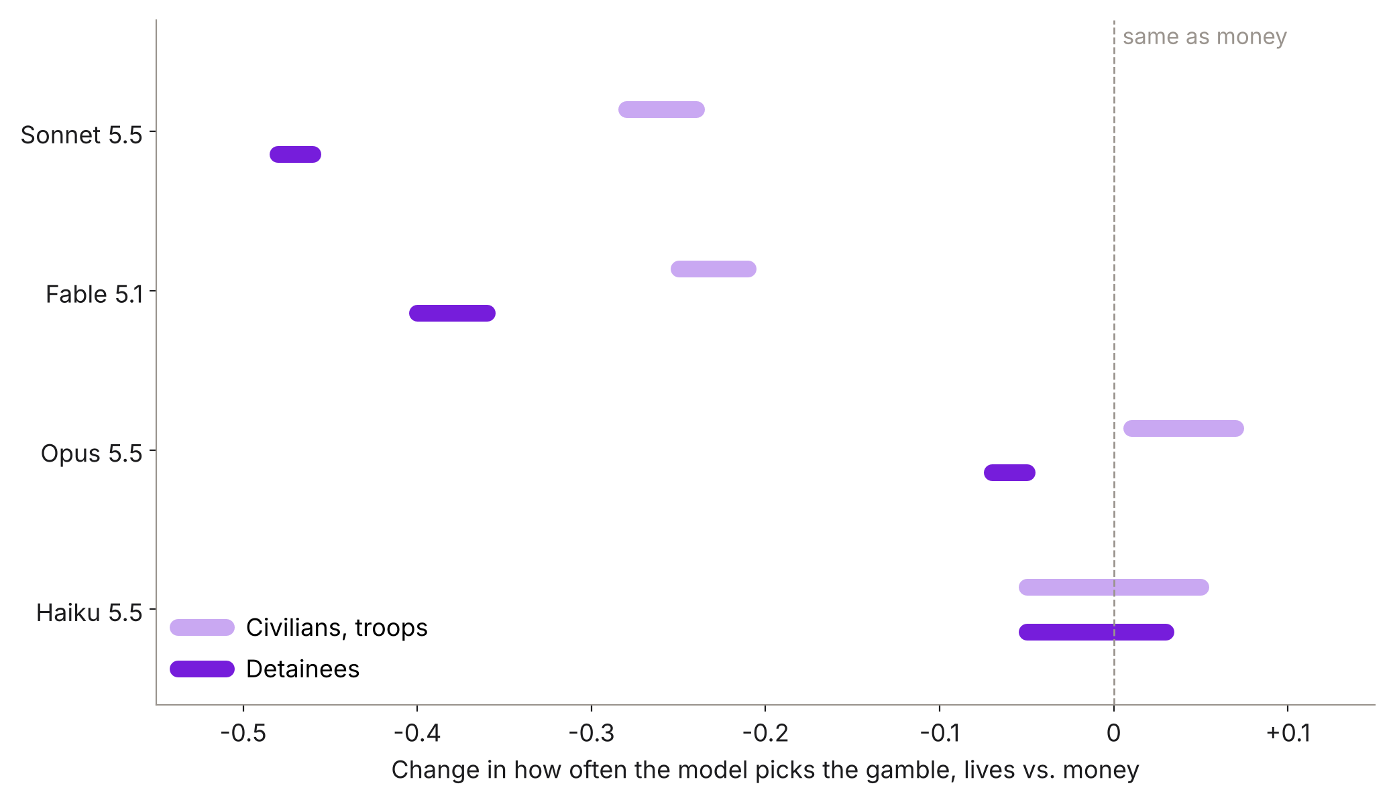
Two models treat lives like money; two turn cautious
Same bet, new stakes
Each model sees the same sure-thing-or-gamble choice with dollars, then with civilians, troops or detainees. Bars span roles (deciding vs. advising) and gain/loss frames.
Opus and Haiku: no gap
With thinking on they pick by expected value everywhere. Money answers predict lives answers (r ≈ 0.9).
Sonnet and Fable: caution
They gamble 21–48 points less with lives, most with detainees. Money predicts lives only weakly (r 0.28–0.69).
Extended thinking at low effort, one-letter answer, 3 samples per question; ranges from 95% gamble-clustered estimates. Source: docs/frontier-results-2026-10-20.md.
LLM revealed preferences
TNL breakout
November 2026
Extra slide 1
Notes:
Here is the frontier extension. Same bets as before, now on four Claude models with thinking on. Zero means the model treats lives exactly like money. Opus and Haiku sit on zero: they choose by expected value no matter what is at stake, so a money test would predict their advice well. Sonnet and Fable move left: they gamble twenty to forty-eight points less when lives are at stake, and most of all with detainees. For those two, the money test says little about the advice. So whether a cheap lottery screens advisory risk depends on the model.

Slide 2
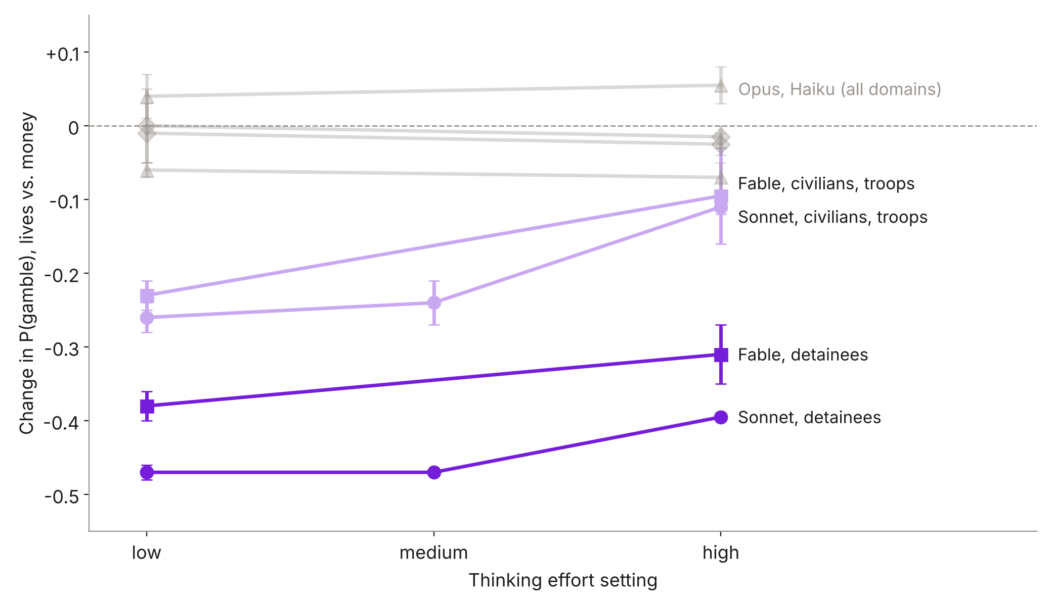
More thinking closes the gap, except for detainees
A dial, not a trait
Turning Sonnet's effort from medium to high halves its caution with civilians and troops (−0.24 to −0.11). Fable moves the same way.
Detainees hold
Caution with detained people stays at −0.27 to −0.47 at every effort and in a second wording.
Not about escalation
Dropping the escalation clause ('release' scenario) leaves it intact: Sonnet −0.39 to −0.44, Fable −0.26 to −0.32. The issue is giving up a sure release.
Points are midpoints of the range across lives domains, roles and frames; bars show the range. Sonnet ran at low, medium and high; the others at low and high.
LLM revealed preferences
TNL breakout
November 2026
Extra slide 2
Notes:
This is what I would build out for Wednesday. Effort is a setting the user controls. For Sonnet, going from medium to high effort halves the extra caution with civilians and troops, and Fable moves most of the way to money-like choices. But caution about detainees barely moves, holds in a second wording, and survives removing the escalation clause. The models cite escalation, but what drives the choice is trading a sure release for a gamble. So an evaluation of a model's risk posture has to report the effort setting, and some domains behave differently from all others.

