Slide 1

A sure $86, or a 43% shot at $210?
We put that question to nine AI models from four families, 42,505 times in all.
Their choices have a structure, it is mostly set at one training step, and it changes when they think first.
John Blakeslee
RAND School of Public Policy, AI Sprint Practicum
LLM revealed preferences
Project overview
October 2026
7 slides
Notes:
A sure eighty-six dollars, or a forty-three percent shot at two hundred and ten? Economists use choices like this to measure how people handle risk. Since July I have asked AI models the same kind of question, more than forty-two thousand times, across nine models from four families. Three things came out of it. The models' choices have a measurable structure. Most of that structure is set at one early training step. And it changes when the model is allowed to think before it answers.

Slide 2
How the experiment works
Every model sees byte-identical questions. One thing changes at a time: the odds, the prize, the wording, or the order.
Option A: receive $86 for certain.
1,680
9
Option B: receive $210 with 43% probability, otherwise $0.
questions per model run
models
We read each answer straight out of the model's internal probabilities. Since September, the models may also reason in writing before they answer.
4
42,505
Eighty of the questions are free money: a sure $50 against a sure $70. Any subject who is paying attention takes the $70 every time.
model families
answers recorded
LLM revealed preferences
Project overview
October 2026
7 slides
Notes:
The method is simple. Every model sees the same sixteen hundred and eighty questions, and only one thing changes at a time: the odds, the prize, the wording, or the order of the options. We read the answer from the model's internal probabilities, so each question is asked once and the answer is exact. Eighty questions are free money, a sure fifty against a sure seventy, to check the model is paying attention. Since September we also let the models write out their reasoning first.

Slide 3
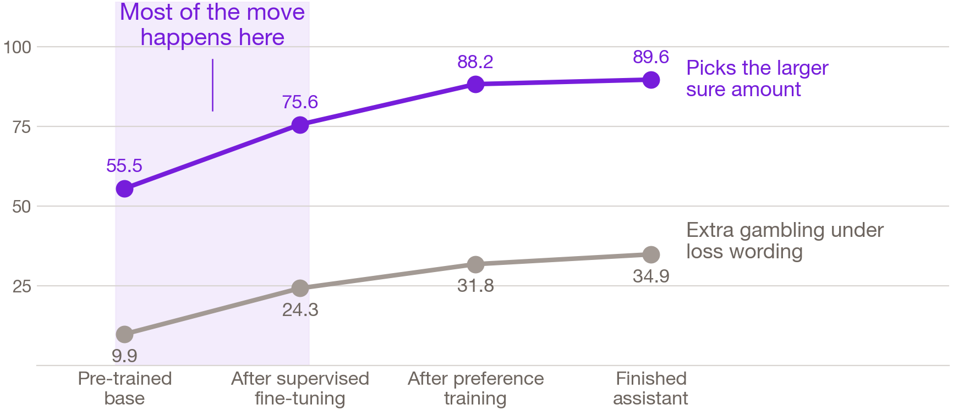
When does an AI learn to care about money?
Mostly at supervised fine-tuning, the first and simplest of the assistant-training steps.
OLMo-2 is the one model family that publishes a snapshot after every training step. Identical questions at all four points in its life, asked the same way each time.
LLM revealed preferences
Project overview
October 2026
7 slides
Notes:
OLMo publishes a snapshot after every training step, so we could ask the same questions at four points in one model's life. Most of the change happens at supervised fine-tuning, the first and simplest step, where the model learns from examples of helpful answers. Free-money accuracy jumps from fifty-six to seventy-six percent there, the largest single step, and the preferences we estimate stop moving after it. Preference training, the step usually blamed for human-like biases, finds the profile already in place. When a model answers at once, its money personality is mostly set early.

Slide 4
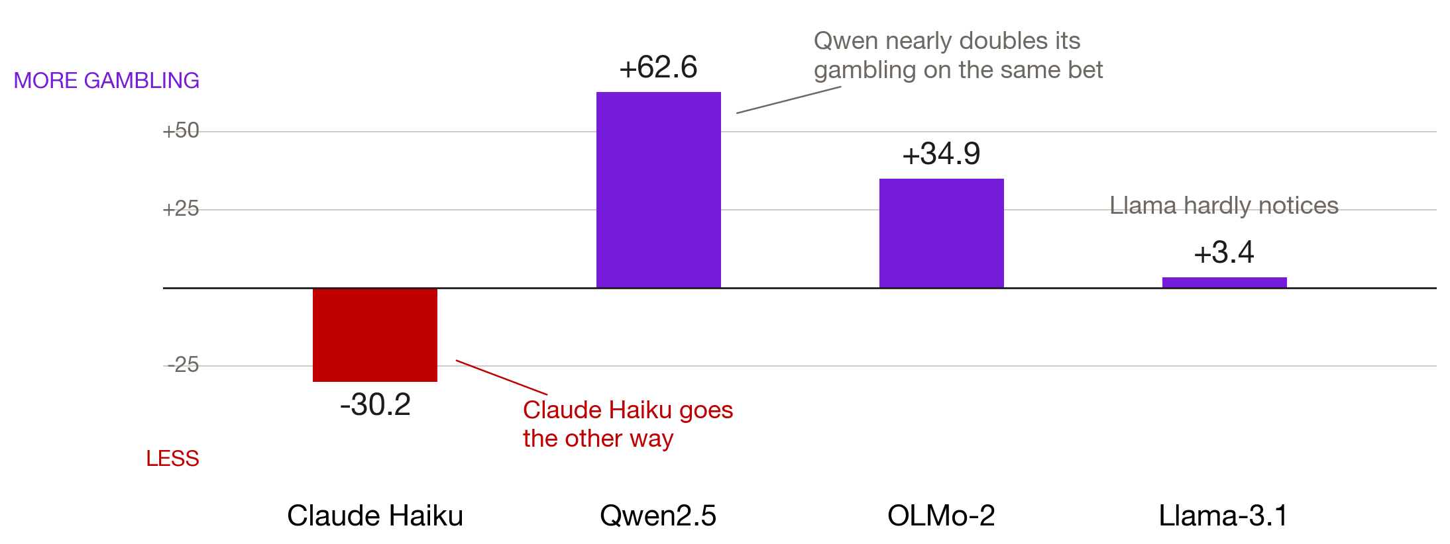
The same bet, called a loss
Four systems, four different reactions to one change in wording.
Change in gambling rate when an arithmetically identical bet is described in terms of a loss. Llama sits at plus 3.4 in one format and minus 5.1 in the other.
LLM revealed preferences
Project overview
October 2026
7 slides
Notes:
The second finding is that the bias belongs to the training recipe. Describe the same bet as a loss instead of a smaller gain, with identical arithmetic. Claude Haiku gambles less, Qwen gambles far more, OLMo somewhat more, and Llama barely reacts. Four systems, four reactions. A framing weakness documented on one model says little about another.

Slide 5
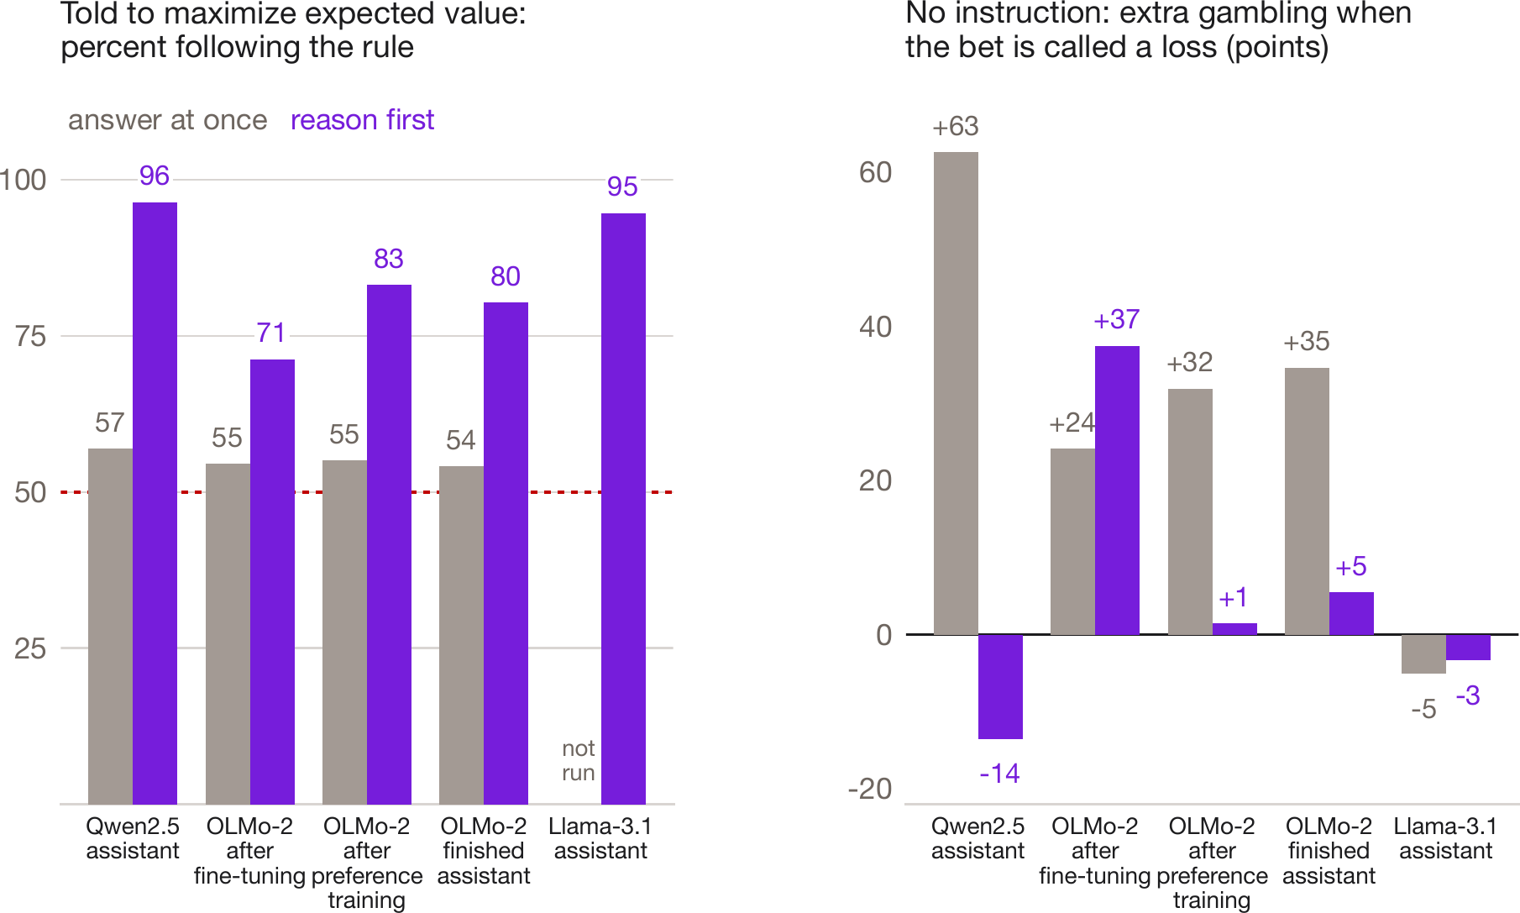
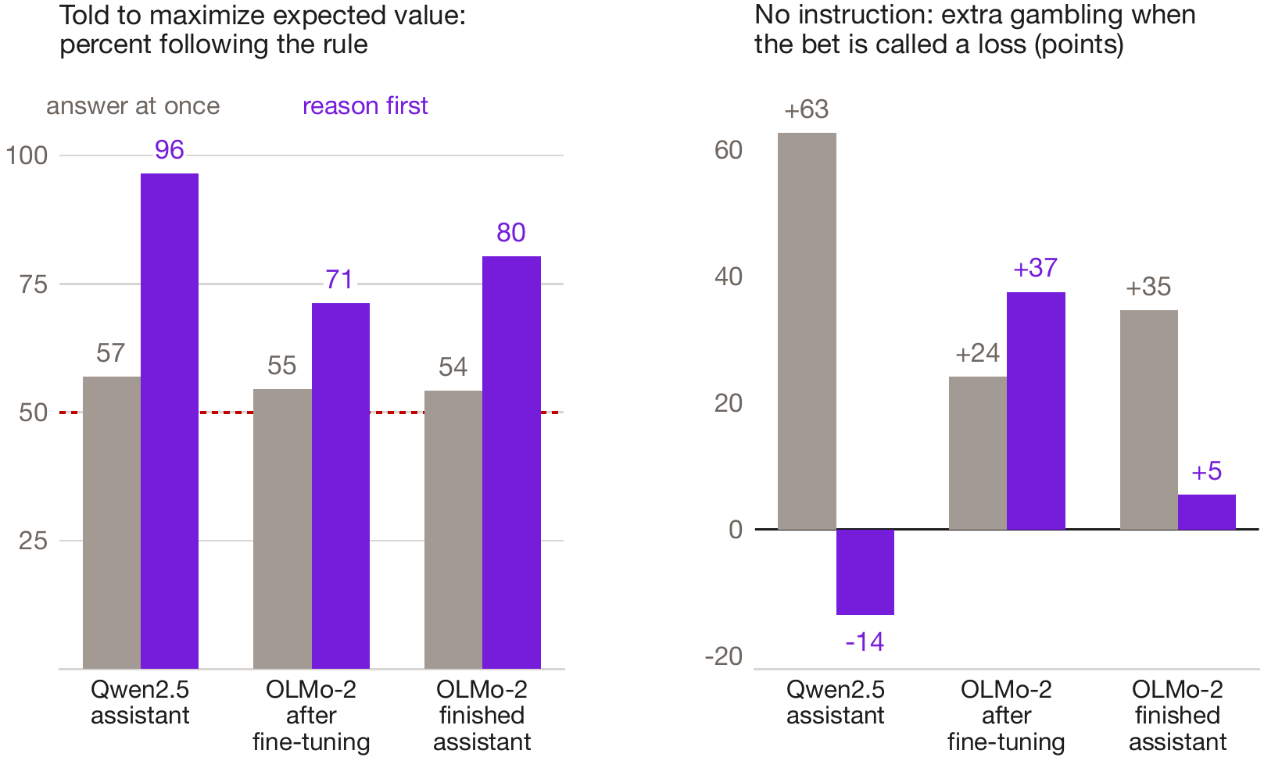
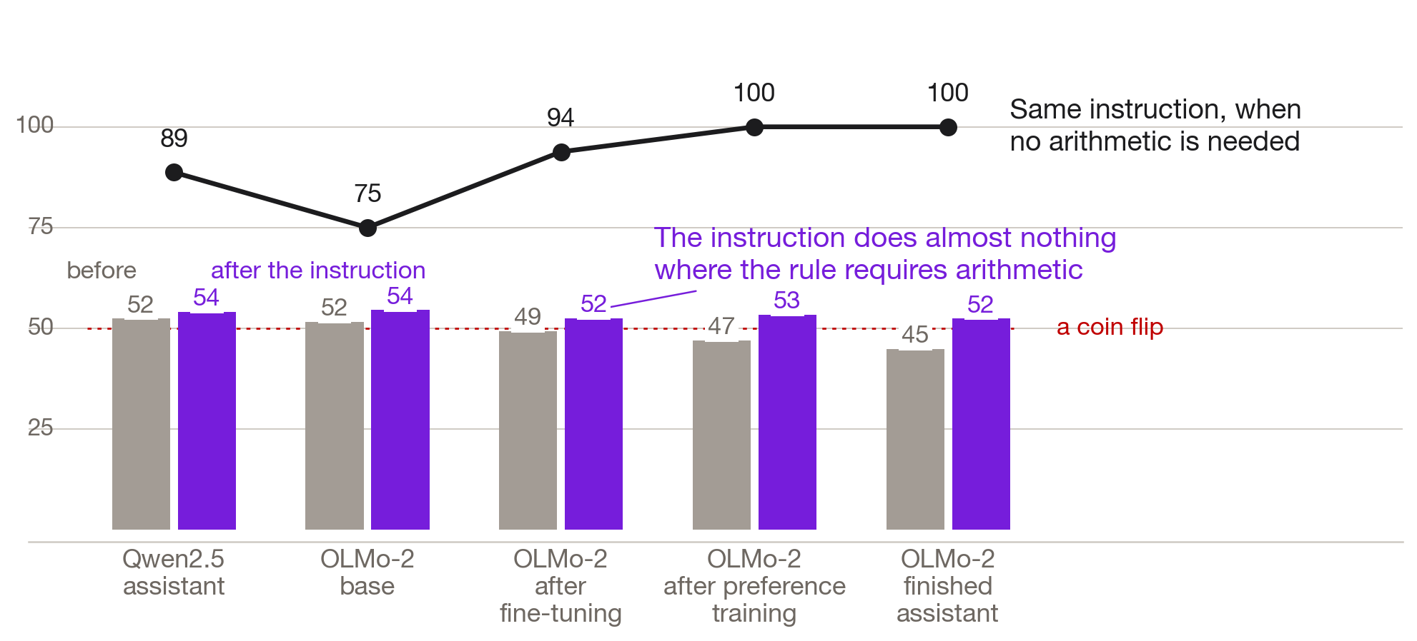
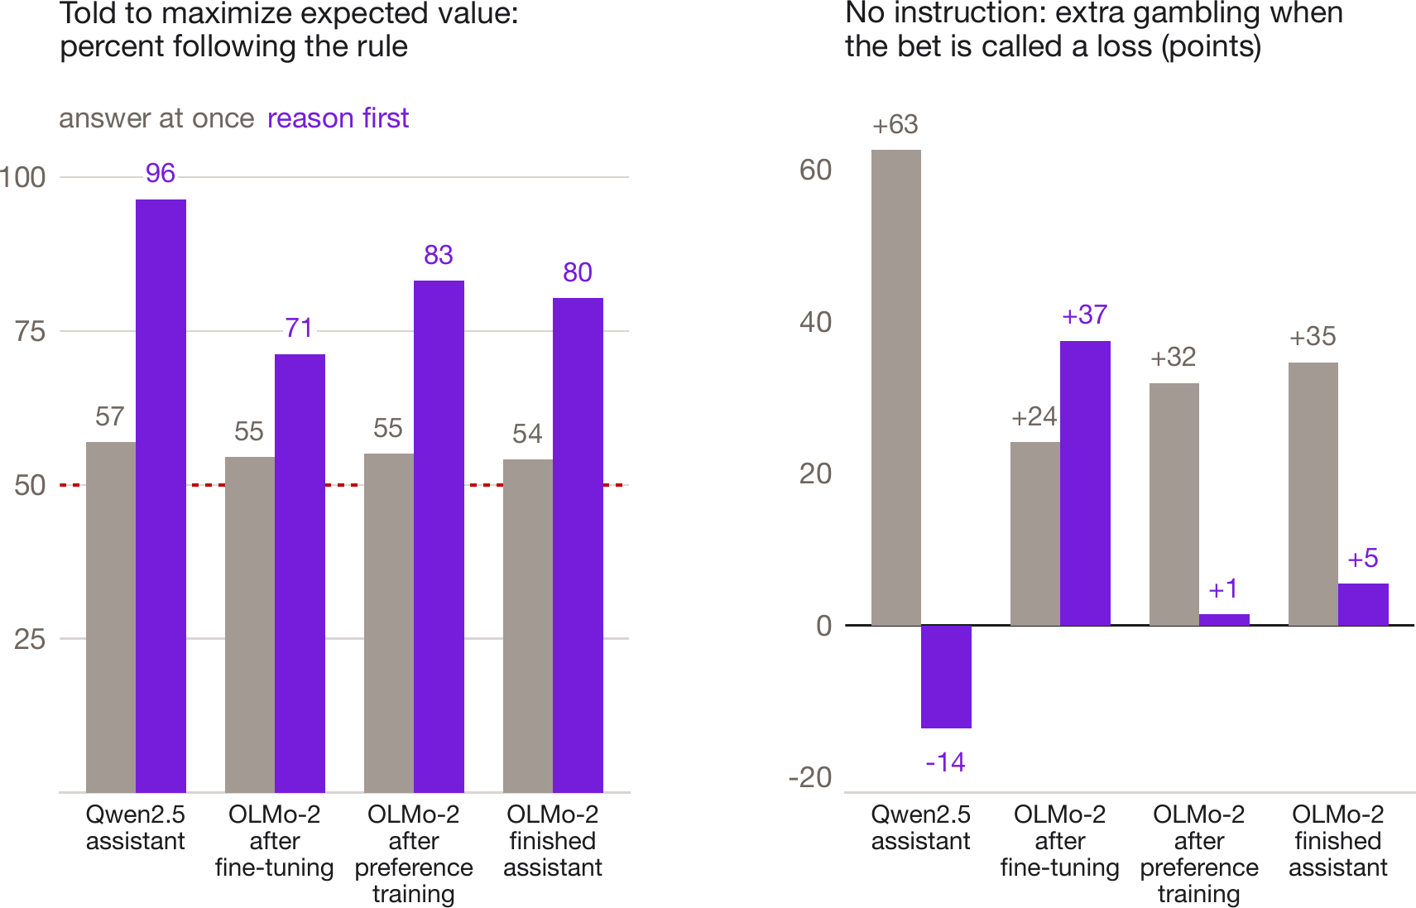
Give it room to work, and it complies
Told to maximize expected value and allowed to reason first, the models follow the rule 71 to 96 percent of the time.
Gray: answering at once. Purple: reasoning first. Left, with the expected-value instruction; right, extra gambling under loss wording, no instruction.
LLM revealed preferences
Project overview
October 2026
7 slides
Notes:
Third, all of that describes snap answers. Told to maximize expected value and answering at once, the models we tested sit near a coin flip. Allowed to reason first, they follow the rule seventy-one to ninety-six percent of the time, and the loss-wording effect shrinks, vanishes, or reverses. In OLMo this change happens at preference training: the step that left the snap answers alone is the one that changes how the model reasons.

Slide 6
The written verdict can contradict the arithmetic
Right sums, wrong verdict
Qwen leans safe
Most of Qwen’s remaining errors compute the expected value correctly and then write “$152.04, which is less than the guaranteed $117.”
Its backward verdicts all favor the sure amount and follow one stock phrase. Handed the right number, after “which is” it says “less” 89% of the time.
Llama leans the other way
Telling works, paying did not
Llama writes “Since $115.72 is greater than $149,” mostly when the gamble is listed first. Each family has its own habit.
Told the rule, Qwen stops writing backward verdicts. Paid through training for snap answers, a model learned one fixed answer, never the arithmetic.
LLM revealed preferences
Project overview
October 2026
7 slides
Notes:
Reading the reasoning brought a surprise. Most remaining errors get the arithmetic right and then state the comparison backward. Qwen's backward verdicts always favor the sure amount and follow one phrase, which is less than the guaranteed amount. Llama's go the other way and favor whichever option it read first. Telling the model the rule removes Qwen's errors. Paying a model through training for its snap answers taught it a fixed answer and nothing else.

Slide 7
What this means
Look at fine-tuning
Say which mode you measured
Most of the snap-answer profile is in place after supervised fine-tuning, the first assistant-training step. An audit that starts at preference training starts late.
Preference training reshapes how a model reasons and leaves its snap-answer preferences where they were. A bias found in one mode can vanish or reverse in the other.
Check that the subject is awake
What comes next
A model can return confident answers while failing to prefer $70 to $50. Eighty free-money questions catch it, and cost almost nothing to run.
Pay the model while it reasons. Ask whether models favor their own family, and whether these risk habits carry into the advice they give commanders and officials.
LLM revealed preferences
Project overview
October 2026
7 slides
Notes:
Four takeaways. Audit at the fine-tuning checkpoint, because that is where most of the snap-answer profile appears. Say whether you measured snap answers or reasoning, because the two can disagree. Check that the subject is paying attention before trusting any estimate. And read reasoning traces knowing each family has its own habits. Next, we pay the model while it reasons, use the same machinery to ask whether AI agents favor their own kind, and then ask whether the risk habits we measured show up in the advice a model gives a commander or an official, with the same numbers as our bets. Thank you.

