Slide 1

A sure $86, or a 43% shot at $210?
We put that question to AI models 1,680 times each, across three model families.
Most of the money personality arrives at one training step.
John Blakeslee
RAND School of Public Policy, AI Sprint Practicum
LLM revealed preferences
Phase 3 findings
September 2026
12 slides
Notes:
Take a second and answer that one yourself. A sure eighty-six dollars, or a forty-three percent shot at two hundred and ten. The gamble pays more on average, about ninety dollars, and leaves you with nothing more than half the time. Which one you pick says something about how you handle risk, and economists have been asking people questions like this since the nineteen seventies. We asked AI models thousands of them, then traced the answers back through each model's training history. Here is where I am going. Most of how these models handle money arrives at one training step, and it is the first and simplest one. Let me start with why anyone should care.

Slide 2
Why check what an AI prefers?
These systems already sit inside economic decisions, and nobody has asked what they actually choose.
They already handle money
Choices reveal preferences
No one checks each step
AI systems draft budgets, screen loan files, price contracts, and advise people on retirement accounts. Every one of those tasks is a choice under uncertainty.
Economists have spent fifty years reading preferences out of what people choose rather than out of what they say about themselves. The method transfers to a model without modification.
Published work tests the finished assistant, or compares it with the raw model. Neither can tell you which training step put a habit there.
LLM revealed preferences
Phase 3 findings
September 2026
12 slides
Notes:
Why check what an AI prefers? Three reasons. These systems already sit inside real money decisions. They draft budgets, screen loan files, price contracts, and advise people on retirement accounts. Every one is a choice under uncertainty, and a system that quietly prefers a sure thing to a better bet tilts every recommendation. Second, we do not have to ask a model what it values. Economists spent fifty years reading preferences out of what people choose rather than what they say about themselves, and that method transfers to a model unchanged. Third, and this is my gap, most work tests the finished chatbot, and the few studies that compare it with the raw model skip every step in between. Nobody asks which manufacturing step put the behavior there. Here is how we opened the box.

Slide 3
How the experiment works
Every model sees byte-identical questions. One thing changes at a time: the odds, the prize, the wording, or the order.
Option A: receive $86 for certain.
1,680
17
Option B: receive $210 with 43% probability, otherwise $0.
questions per model run
model runs
We read the answer straight out of the model's internal probabilities rather than sampling replies, so each question is asked once and the answer is exact.
4
28,560
Eighty of the questions are free money: a sure $50 against a sure $70. Any subject who is paying attention takes the $70 every time.
model families
answers recorded
LLM revealed preferences
Phase 3 findings
September 2026
12 slides
Notes:
The instrument is a grid of one thousand six hundred and eighty questions. Forty gambles, each rewritten five ways, each shown in both orders, each posed once as a gain and once as a loss. Only one feature moves at a time, so any change in behavior traces to that feature. Seventeen runs, four families, twenty-eight thousand five hundred and sixty answers. We never make the model type a reply. The model assigns odds to every possible next word, so we look at the odds it puts on A versus B, and one pass gives the exact answer. Eighty of these questions are free money: a sure fifty against a sure seventy. Those eighty matter more than anything else here.

Slide 4
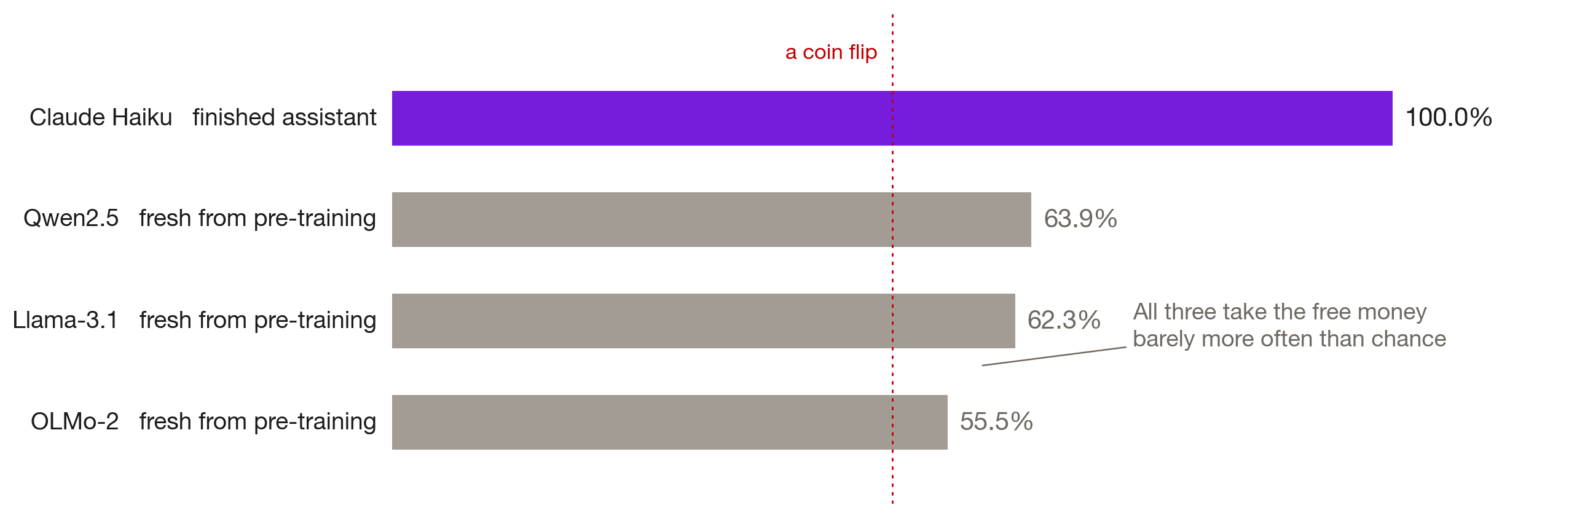
A confident answer is not an answer
The free money check: a sure $50 against a sure $70, with nothing to reason about.
Share of 80 free-money questions on which the model picks the larger sure amount. Claude Haiku, measured in an earlier phase, is shown for comparison.
LLM revealed preferences
Phase 3 findings
September 2026
12 slides
Notes:
Here is the free money result, and this is where the talk turns. Before a model is trained to act like an assistant it is a base model, which means it has read a huge chunk of the internet and nothing else. It answers A or B with total confidence. Look at the three grey bars. The dotted red line down the middle is a coin flip. Offer these base models a sure fifty against a sure seventy, no gambling involved, and OLMo takes the seventy fifty-five and a half percent of the time. Llama, sixty-two point three. Qwen, sixty-three point nine. Just over half the time. The purple bar on top is Claude Haiku, a finished assistant, at a hundred percent. Somebody always asks whether the answers are just random. This check settles it. A base model does not have strange preferences. It has no usable preferences at all. So whatever we measure later only becomes visible through training. Whether training builds it or brings out something the model absorbed from the internet, these answers cannot tell us. What we can ask is when it shows up.

Slide 5
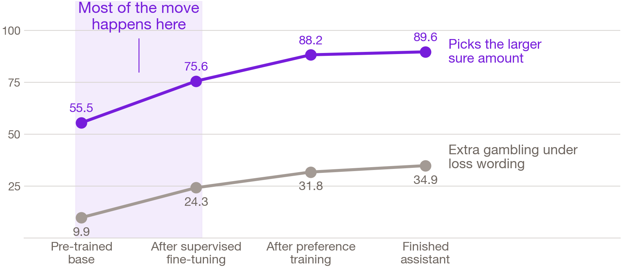
When does an AI learn to care about money?
Mostly at supervised fine-tuning, the first and simplest of the assistant-training steps.
OLMo-2 is the one model family that publishes a snapshot after every training step. Identical questions at all four points in its life, asked the same way each time.
LLM revealed preferences
Phase 3 findings
September 2026
12 slides
Notes:
This slide answers it, and it is the finding. OLMo-2 is the one family that publishes a snapshot after every training step, so we asked identical questions at four points in one model's life. Along the bottom is that life story: pre-trained base, after supervised fine-tuning, after preference training, finished assistant. Supervised fine-tuning is the first step where humans show the model examples of being a helpful assistant. Look at the purple line, free money accuracy. It jumps from fifty-five and a half to seventy-five point six at that first step, then keeps climbing more slowly, to eighty-eight point two and eighty-nine point six. The grey line below is extra gambling when a bet gets called a loss: nine point nine, twenty-four point three, thirty-one point eight, thirty-four point nine. Same shape. About three fifths of the change on both lines happens inside that shaded band on the left, and it is the only step where our estimate of the model’s preferences moves. Human feedback enters at the later stages, and those are the ones everyone blames. They keep pushing in the same direction, but they arrive to find the pattern already there. Why does the step matter? That is where you would audit. One more wrinkle first.

Slide 6
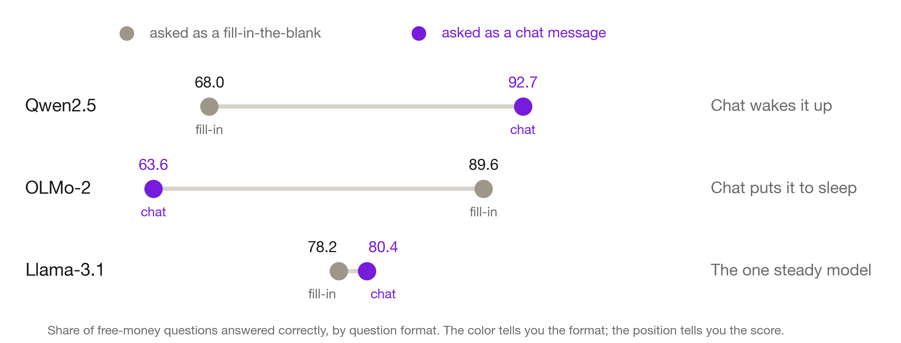
How you ask decides who answers
Same weights, same questions, two standard ways of putting them to the model.
Free-money accuracy by question format, for the finished assistant in each family. Every model here clears the coin-flip bar; the question is by how much, and which format gets it there.
LLM revealed preferences
Phase 3 findings
September 2026
12 slides
Notes:
We ran this next one as a control and it turned into a finding. Every finished assistant got the same questions two standard ways: as a chat message, the way you would type to a chatbot, and as a raw fill-in-the-blank where the model just continues text. Each row is one model, left dot fill-in, right dot chat. Qwen sits at sixty-eight fill-in and ninety-two point seven in chat. Chat wakes it up. OLMo does the reverse, eighty-nine point six as a fill-in and down to sixty-three point six in chat. Chat puts it to sleep. Llama is the steady one, seventy-eight point two and eighty point four. Same weights, same questions, two very different subjects. So a study comparing two models under one fixed format may be comparing an engaged subject against one that checked out. The fix is nearly free: before analyzing anything, confirm the model reliably picks seventy over fifty. Now to the bias people actually worry about.

Slide 7
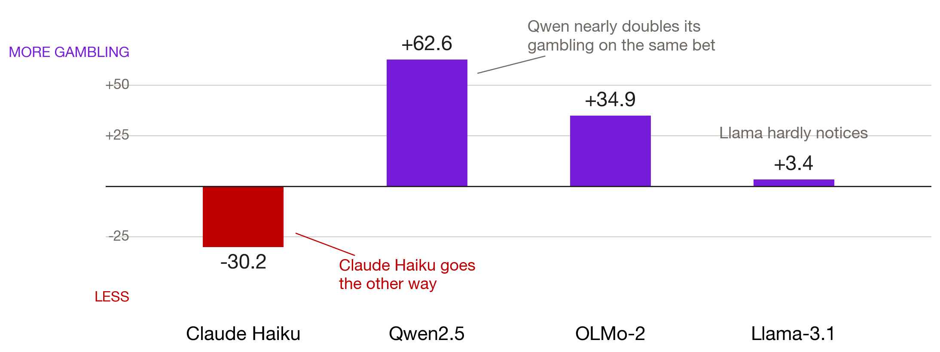
The same bet, called a loss
Four systems, four different reactions to one change in wording.
Change in gambling rate when an arithmetically identical bet is described in terms of a loss. Llama sits at plus 3.4 in one format and minus 5.1 in the other.
LLM revealed preferences
Phase 3 findings
September 2026
12 slides
Notes:
This chart is about wording. Take a bet and describe the downside as a loss instead of a smaller gain. The arithmetic is identical. Nothing about the money changes. Up means the model gambles more under the loss wording, down means less, and the flat line across the middle means no reaction. In an earlier phase we found Claude Haiku goes down, minus thirty point two, becoming noticeably more cautious. Every open model does something else. Qwen goes up sixty-two point six, nearly doubling its gambling on the very same bet. OLMo, up thirty-four point nine. Llama hardly notices at plus three point four, and it even flips direction depending on the format. Four systems, four reactions to one change in wording. My own instinct was that a bias this famous would be universal. It clearly is not. So anyone reporting a framing bias from one model and calling it a fact about language models is describing that model's training recipe. Can you just tell it to stop?

Slide 8
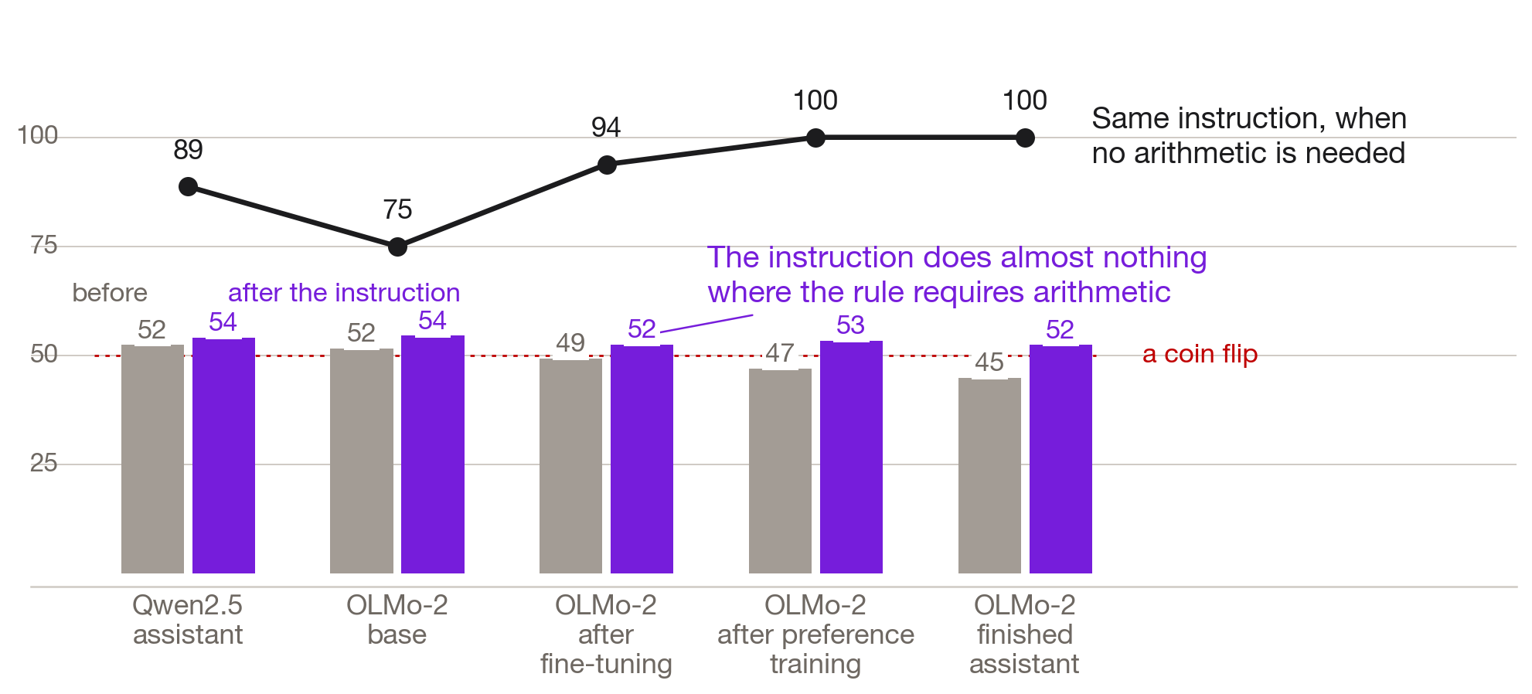
Can you just tell it what to want?
Only where following the instruction requires no arithmetic.
Compliance with an instruction to multiply the payoff by the probability and take the larger number, on questions where that rule clearly separates the two options.
LLM revealed preferences
Phase 3 findings
September 2026
12 slides
Notes:
Our reviewer, Phil Armour, pointed at a standard move in experimental economics. Rather than guess what a subject wants, you tell the subject what to want and check whether they comply. So we instructed the models in plain English: multiply the payoff by the probability and take the bigger number. The paired bars show compliance before the instruction in grey and after it in purple, at each model and training stage. Fifty-two to fifty-four. Fifty-two to fifty-four. Forty-nine to fifty-two. Forty-seven to fifty-three. Forty-five to fifty-two. The dotted red line is a coin flip, and the instruction barely lifts anything off it. Now the black line along the top. That is the same instruction on questions where following it takes no arithmetic, and there compliance runs eighty-nine, seventy-five, ninety-four, then a hundred percent twice. So the models are not refusing us. They cannot do the arithmetic when the format demands an immediate one-letter answer. That would be the honest caveat on everything before it, if the format were the whole story.

Slide 9
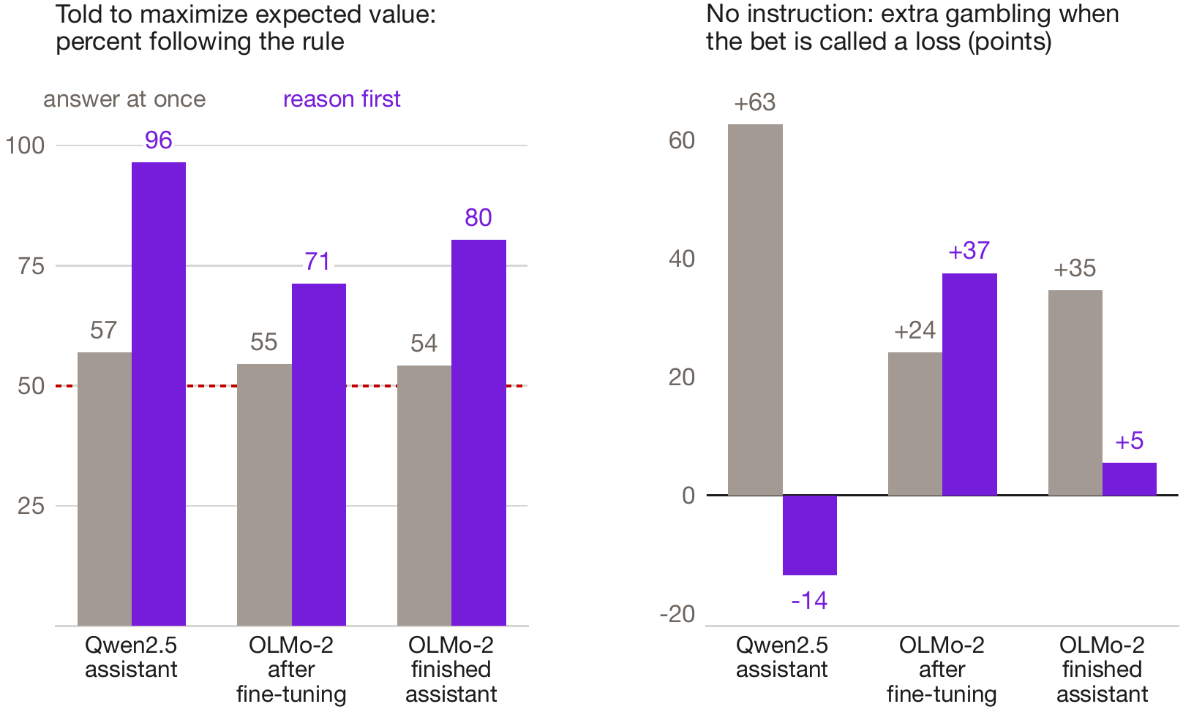
Give it room to work, and it complies
Told to maximize expected value and allowed to reason first, the models follow the rule 71 to 96 percent of the time.
Gray: answering at once. Purple: reasoning first. Left, with the expected-value instruction; right, extra gambling under loss wording, no instruction.
LLM revealed preferences
Phase 3 findings
September 2026
12 slides
Notes:
So we tested that directly. We let the models write out their reasoning before giving the letter, and asked the same questions. On the left, told to maximize expected value: answering at once, compliance sits in the fifties, a coin flip. Reasoning first, the finished Qwen assistant follows the rule ninety-six percent of the time, and OLMo eighty. The ceiling was the format, not the model. On the right is the wording effect with no instruction at all. Answering at once, Qwen gambles sixty-three points more when a bet is called a loss. Reasoning first, it gambles fourteen points less, the direction Claude Haiku took in our earlier phase. So the same model reverses its reaction to loss wording depending on whether it thinks first. The written reasoning tells us why.

Slide 10
The loss-wording effect is a bookkeeping habit
The mistake
One sentence fixes it
Reasoning through a loss-worded bet, Qwen counts the gamble as a change in its money and the sure option as a total. All 21 of its errors went toward the safe choice.
Add “compare the final dollar amounts” to the instruction and the errors fall from 21 to zero. The gap between gain and loss wording goes to exactly zero.
Paying it does not teach it
Habit, not preference
We also paid the model through training for its snap answers. In all six versions we tried, it learned one fixed answer, never the arithmetic.
None of the remaining mistakes mentions risk or safety. The model can do the arithmetic; it needs room to work and a clear rule.
LLM revealed preferences
Phase 3 findings
September 2026
12 slides
Notes:
Here is what the reasoning showed. Given a loss-worded bet, Qwen treats the gamble as a change in its money, say an average gain of eight dollars, and the sure option as a total, ninety-eight dollars, and of course the total wins. Every one of its twenty-one errors went toward the safe choice. So we added one sentence: compare the final dollar amounts. The errors fell from twenty-one to zero, and the wording effect disappeared. We also tried the economist's other lever, payment. We paid the model through training for its snap answers, and in all six versions it learned to give one fixed answer, never the arithmetic. None of the leftover mistakes mentions risk. This is a habit of arithmetic, not a preference. Let me pull it together.

Slide 11
What this means
The bias belongs to a recipe
Look earlier than people do
Four systems, four reactions to the same change in wording. A framing vulnerability documented on one model tells a procurement officer nothing reliable about the model actually deployed.
The checkpoint after supervised fine-tuning is the earliest place a behavior can be measured, and where most of it appears. An audit that starts at preference training starts late.
Check that the subject is awake
Give it room to compute
A model can return confident answers and publishable-looking numbers while failing to prefer $70 to $50. Eighty free-money questions catch it, and cost almost nothing to run.
Answering in one letter, a model told to maximize expected value barely moves. Let it reason first and it follows the rule up to 96 percent of the time. Measure the mode that is deployed.
LLM revealed preferences
Phase 3 findings
September 2026
12 slides
Notes:
Four takeaways, in the order they would change what somebody does Monday. One, the framing bias belongs to a training recipe rather than to AI as a technology, so a vulnerability documented on one model tells a procurement officer nothing reliable about the model being deployed. Two, look earlier than people do. The checkpoint right after supervised fine-tuning is the earliest place the behavior can be measured, and most of it is already there. Governance attention goes to the later preference stage, which starts late. Three, check that the subject is awake, the way a survey reports its response rate. Four, give it room to compute. A snap answer and a reasoned answer from the same model can point in opposite directions, so an evaluation has to say which one it measured. Here is where I take it next.

Slide 12
What comes next
Three projects for the fall, in order of how much they would change the answer.
Pay it while it reasons
Finish the staircase
Do AIs favor their own kind?
Payment did not teach arithmetic to snap answers, but the model already computes when it reasons. Pay it there: can payment install a risk-averse utility, and does it carry over to snap answers?
Run the checkpoint after preference training with reasoning, to see which of the two later training stages removes the loss-wording effect.
The same machinery measures social preferences. Does a model cooperate more with a counterpart it believes comes from its own family? Multi-agent deployments make that a procurement question.
LLM revealed preferences
Phase 3 findings
September 2026
12 slides
Notes:
Three follow-ups for the fall. First, pay the model while it reasons. Payment through training could not teach arithmetic to snap answers, but the model already does the arithmetic when it thinks first, so that is where payment can test what instructions cannot: whether you can install a specific risk-averse utility, and whether paid reasoning carries over to snap answers. Second, finish the staircase. With reasoning, the later training stages remove most of the loss-wording effect, and one more checkpoint tells us which stage does it. Third, the same machinery measures social preferences, so we ask whether a model cooperates more with a counterpart it takes for its own kind. Most of the money personality arrives at one training step, and that is where to start looking. Thank you.

