Slide 1
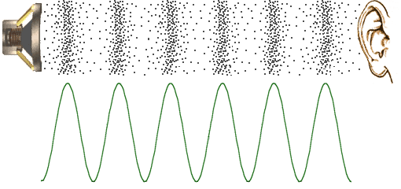
Sound Theory
Sound is made up of “pressure waves”
Higher pressure
Lower pressure
Pressure
Atmospheric pressure
https://astronomy.swin.edu.au/~smaddiso/astro/SiS/NPS/sound1.html

Slide 2

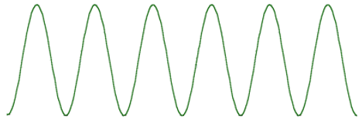
Microphone
Microphone converts sound pressure to voltage
Mic Output
Voltage
Pressure
https://astronomy.swin.edu.au/~smaddiso/astro/SiS/NPS/sound1.html

Slide 3
Amplifier and A/D
Our mic includes an amplifier
converts weak voltage to much larger voltage
A/D converts voltage to integer between 0 and 1023
Amplifier Output
AnalogRead Output
1023
Mic Output
Voltage
Arduino A/D
Voltage
Amp
511
Gain = 60 dB
Output = 1,000,000 x Input
0

Slide 4
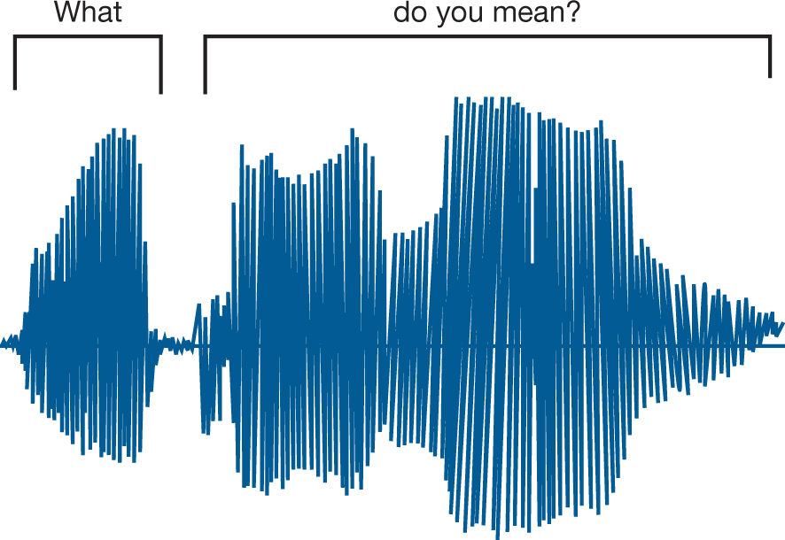
Measuring the “Envelope”
Human Speech
1023
:
:
387
:
0
Average amplitude is called the “envelope”
Amplitude
Time
Some applications (e.g., speech recognition)
Need the raw speech waveform (blue)
For other applications (e.g., the “Clapper”)
We are only interested in the “volume”, AKA “envelope” (red)

Slide 5
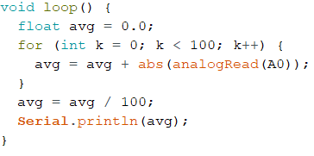
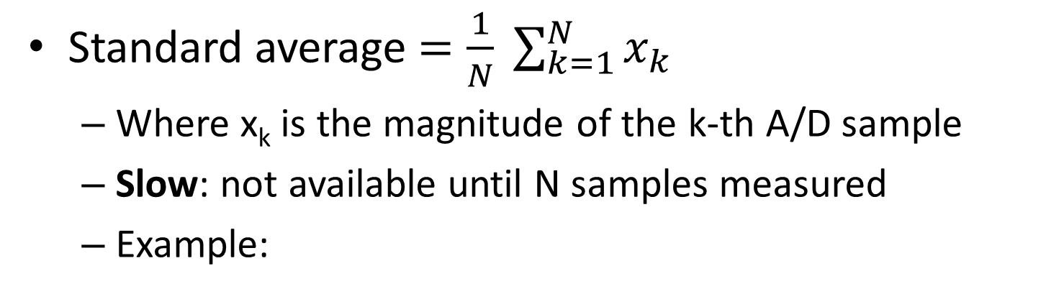
Standard Averaging
Standard average $=\frac{1}{N} \sum_{k=1}^{N}{x_{k}}$
Where x_{k} is the magnitude of the k-th A/D sample
Slow: not available until N samples measured
Example:

Slide 6
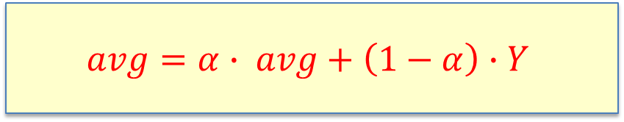
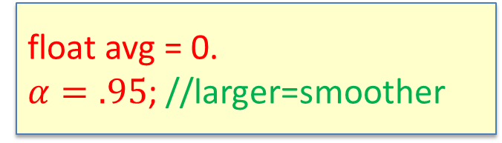
Running Average
Also known as the “exponential average”
float avg = 0.
$α=.95$; //larger=smoother
X = analogRead(A0)
Y = |X| //magnitude
New value of avg consists of:
95% is previous average
5% is new measurement
loop()
$$avg=α∙ avg+\left(1−α\right)∙Y$$

Slide 7
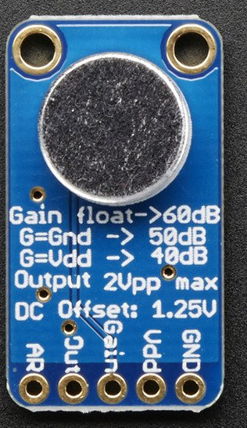
Adafruit: “Electret Microphone Amplifier - MAX9814 with Auto Gain Control”
Gain is automatic (not adjustable)
Very sensitive! Gain = 60 dB = 10⁶ = 1,000,000

Slide 8
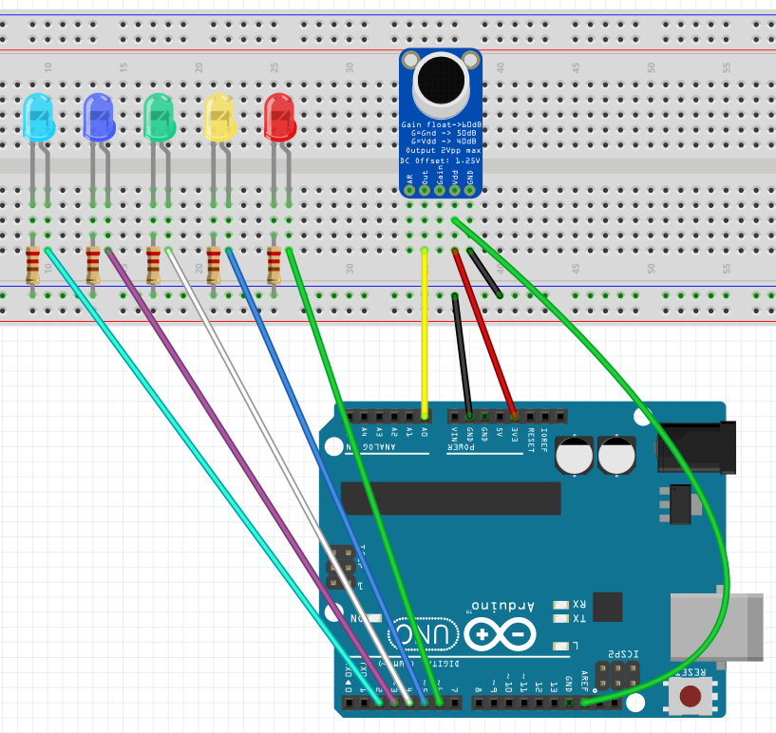
Build This
Louder
Note that we’ll power the microphone using 3.3V rather than 5 V
(less noisy)
220
A0
3.3
Note: AREF pin is connected to 3.3V via the breadboard
23456 AREF

Slide 9
Purpose of AREF Pin
Improves A/D resolution for low-voltage microphone signal
A/D Converter error is proportional to Δ
Default:
Aref = 5 Volts
analogReference(EXTERNAL) causes the voltage on the AREF pin to be associated with the largest digital value (1032)
5 Volts
111
110
Δ
101
analogReference:
Aref = 3.3 Volts
3.3 Volts
100
3.3 Volts
111
011
110
Δ
101
010
100
011
001
010
001
0 Volts
000
0 Volts
000
A/D Output:
000 011 000 001 010
A/D Output:
000 101 001 001 100

Slide 10
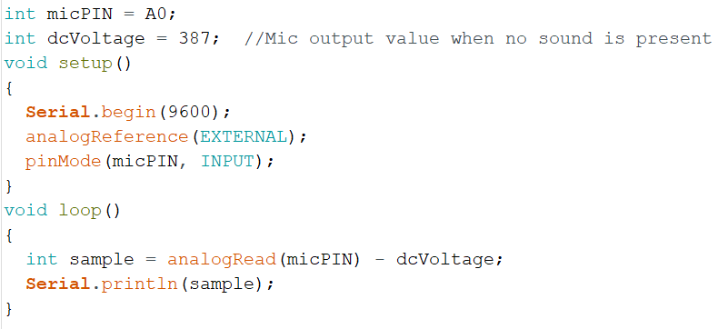
Experiment 1 - Enter this code:
Use this when AREF pin used
Otherwise, default is 5V
Use Serial Plotter to plot amplitudes
LEDs not used in this sketch

Slide 11
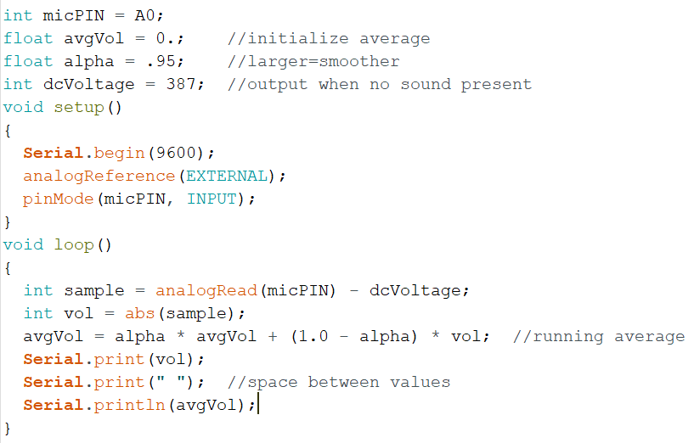
Experiment 2: Average Volume
Try these experiments:
Change ‘alpha’ to 0.99
Change ‘alpha’ to 0.15
Watch Serial Plotter
Understand output

Slide 12
Make an LED Light Gauge
Add logic to make the LEDs change with volume
Higher sound lights up more LEDs
You already have the circuit
Changes required
Define volume threshold to light up each LED
Add pinMode statements to setup()
Add digitalWrite statements to loop()

Slide 13
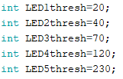
LED Thresholds
If avgVol > 20 turn on first LED: requires very little sound
if avgVol > 40 also turn on second LED:
and so on. Very subjective – adjust as desired

Slide 14
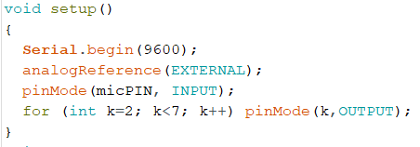
Modify setup()
We need to declare LED pins (2-6) to be OUTPUT
Can do them all using one ‘for’ loop:

Slide 15
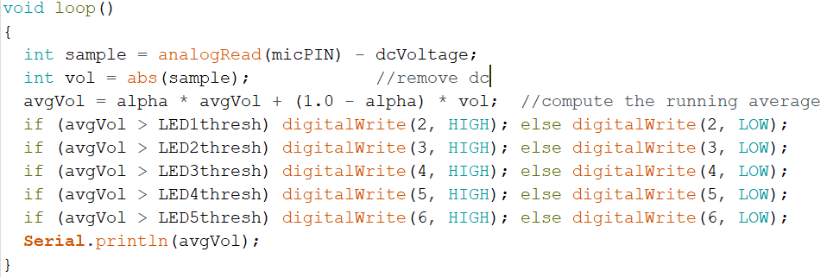
Modify loop()
Many ways to do this – one way is to check threshold for each LED

Slide 16
Experiment
Upload and activate Serial Plotter
Try different thresholds
Make it more or less sensitive
Try different alpha values
Make it quicker or slower to respond

Slide 17
Display Sound Volume in Decibels
In class if we have time
Do at home if we don’t

Slide 18
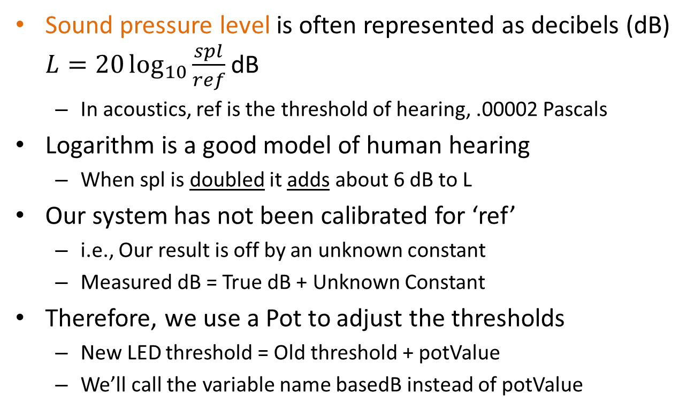
Decibels – how the Pro’s do it
Sound pressure level is often represented as decibels (dB) $L=20\log_{10}{\frac{spl}{ref}}$ dB
In acoustics, ref is the threshold of hearing, .00002 Pascals
Logarithm is a good model of human hearing
When spl is doubled it adds about 6 dB to L
Our system has not been calibrated for ‘ref’
i.e., Our result is off by an unknown constant
Measured dB = True dB + Unknown Constant
Therefore, we use a Pot to adjust the thresholds
New LED threshold = Old threshold + potValue
We’ll call the variable name basedB instead of potValue
0 dB: softest hearable sound
30 dB: soft whisper
40-50 dB: office
60 dB: normal conversation
70 dB: TV audio
80-90 dB: blender
110 dB: crying baby, rock concert
130 dB: chain saw, jack hammer
120-140 dB: Pain threshold

Slide 19
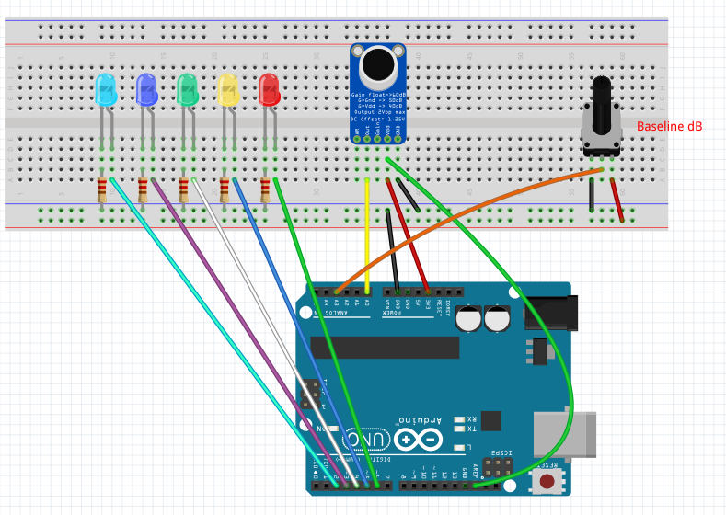
Pot sets baseline dB value:
Adjust so that LEDs are all turned off in ambient noise

Slide 20
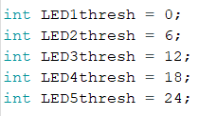
Decibel Program
What changes?
LED Thresholds are in dB
Each 6 dB is doubling of sound intensity
On Serial Plotter, notice that dB values are less sensitive than raw volume changes. That’s how the ear works!
Unadjusted Thresholds

Slide 21
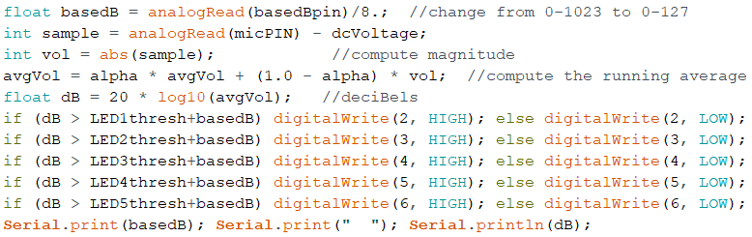
Other Software Changes

Slide 22
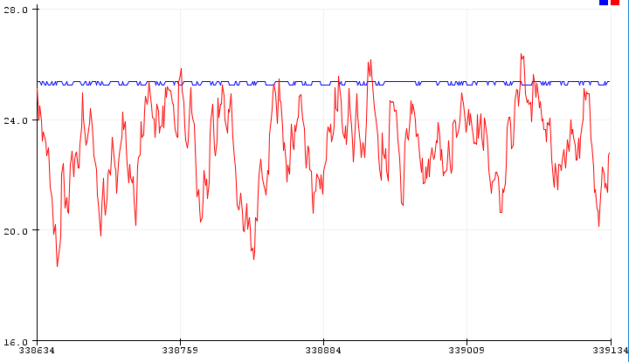
Adjustment
basedB set by Potentiometer
Adjust pot so ambient noise does not trigger LEDs (about 60 dB)
Each LED represents additional 6 dB
LEDs are ON
Ambient Noise

Slide 23
Arduino Output Sounds
Suppose we turn on and off an Arduino pin
And connect pin to a speaker
What do we get?
“Buzz” sound with “pitch” frequency F = 1000 Hz
pop
pop
pop
pop
pop
HIGH
LOW
.5ms
1ms
2ms
3ms
4ms
Time
500𝜇s
1000𝜇s
2000𝜇s
3000𝜇s

Slide 24
Generating a Buzz
Arduino Sketch to generate 1000 Hz buzz:
int BUZpin=8; //speaker connected to pin 8
loop(){
digitalWrite(BUZpin, HIGH);
delay(.5);
digitalWrite(BUZpin, LOW);
delay(.5);
}
Problem: delay values must be integers
Cannot use “.5”
Just like the BLINK program!
HIGH
delay
delay
BUZpin Output
delay
LOW
.5ms 1ms 1.5ms 2ms

Slide 25
delayMicroseconds(d)
Suppose we want F=1000 pulses per sec (1 kHz)
Time per pulse T = 1/F = 1/1000 =1 ms = 1000 μs (microseconds)
Time between pulses = T/2 = .5 ms = 500 μs
delay(.5); won’t work! Fraction delays not allowed.
delayMicroseconds(500) does work

Slide 26
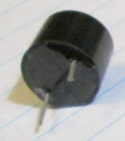
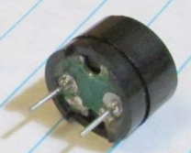
Active Buzzer Vs Passive Buzzer
Active buzzer
When you apply constant 5V, it emits a continuous tone, which is automatically generated by its built-in electronics. Nice for using in a Morse code generator.
Passive buzzer
Inside the canister a membrane moves out or in depending on applied voltage.
Apply constant 5V: membrane moves out and stays there. You might hear a click noise, but no continuous sound is generated
Apply a voltage that is alternately turned on and off; this causes the membrane to move in and out, which generates a sound (“buzz”). This is exactly how the speaker in your TV or cell phone works.
The pitch of the buzzer is controlled by how fast we change the voltage. Arduino’s “Tone” command automatically generates any desired frequency.
Active Buzzer
(black bottom)
Passive Buzzer
Acts like speaker
(green bottom)

Slide 27
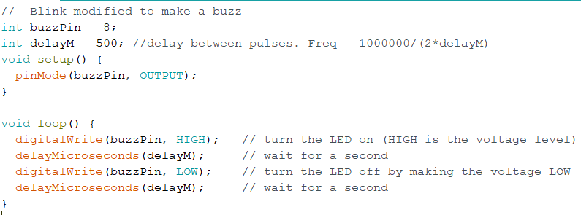
Buzzer Sketch
Type the following into a new sketch
You don’t have to type the comments

Slide 28
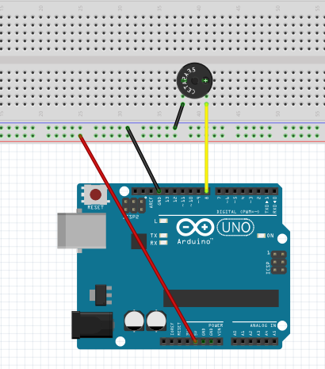
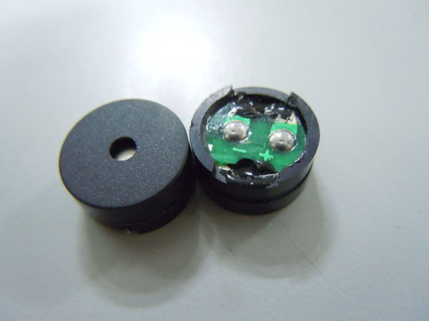
Build This (Just add buzzer to your current breadboard circuit)
Find your passive buzzer
Has green bottom
Careful! It’s polarized
Buzzer has + and -
Upload your buzzer sketch

Slide 29
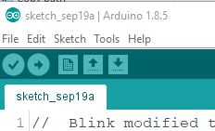
How to be less annoying
It gets pretty bad when 20 people are playing a buzzer.
To quiet your buzzer:
Unplug it
OR
Upload the empty sketch

Slide 30
Challenges
Modify to play a 250 Hz tone
Solution: Each pulse duration T = 1/250 s
Gives T=.004 Sec = 4000 microseconds
Gap between pulses is T/2 = 2000 microseconds
Change delays to: delayMicroseconds(2000)
Modify to play 100 Hz and 3000 Hz
T = 1/100 and T/2 = 1/200 = ? microseconds
T = 1/3000 and T/2 = 1/6000 = ? microseconds
Notes:
For 3000, T = 1000000/3000 = 333. delayM = 333/2 = 167 us
For 100, T=1000000/100 = 10000. delayM = 10000/2 = 5000 us
For 800, T=1000000/800 = 1250. delayM = 625 us

Slide 31
How to generate 1 Sec buzz
int t0=millis(); //get starting time in ms
while (millis()-t0<1000){ //make buzzer sound for 1000 ms
…write buzzer pin HIGH
…write buzzer pin LOW
}
delay(1000); //stay off for a second
millis() returns the number of milliseconds since Arduino power-up
millis()-t0 gives elapsed time since step 1
while loop runs until elapsed time > 1000 ms
Notes:
void loop() {
//this part makes buzzer turn on for 1 sec every 5 sec
long int t0 = millis();
while (millis() - t0 < 250) {
digitalWrite(buzzPin, HIGH); // turn the LED on (HIGH is the voltage level)
delayMicroseconds(delayM); // wait
digitalWrite(buzzPin, LOW); // turn the LED off by making the voltage LOW
delayMicroseconds(delayM); // wait
}
delay(250);
delayM = delayM + 100;
if (delayM > 3000) delayM = 100;
}

Slide 32
Please Solve These Challenges
Challenge #1
Make your buzzer buzz for 0.25 second
Then stay off 0.25 seconds
Repeat forever
Challenge #2
Modify Challenge #1 code so that delayM is initialized to 100
Each time it buzzes, delayM increases by 100
If delayM exceeds 3000, reset to 100

Slide 33
Arduino Music
Why?
Define statements
Arrays
More Functions

Slide 34
Play a tune
Examples -> Digital -> toneMelody
Push red “reset” button to replay
Let’s look at the new things Please have the toneMelody sketch displayed on your screen

Slide 35
“Tone” statement
Syntax tone(pin, frequency) tone(pin, frequency, duration)
E.g., tone(8,500)
plays 500 Hz tone on pin 8
Must be stopped using noTone(8) statement
E.g., tone(8,500,1000)
plays 500 Hz tone for 1 second on pin 8

Slide 36
Define Statements
Example:
#define AlarmPin 8 //pin number for LED1
#define longdelay 100 //# ms to delay
pinMode(AlarmPin, OUTPUT);
delay(longdelay);
Same as:
pinMode(8, OUTPUT);
delay(100);
Similar to:
int AlarmPin=8;
int longdelay=100;
Advantage: #define doesn’t use memory for variable storage

Slide 37
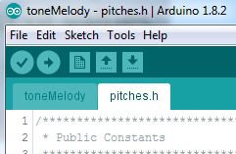
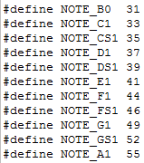

pitches.h is a “header file”
Click on pitches.h tab
Include statement in toneMelody:
Etc., etc.
equivalent ways to play 41 Hz tone:
tone(8,41)
tone(8,NOTE_E1)

Slide 38
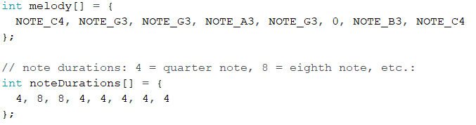
“Array”
An Array is just a list of values
The first note in the song is: melody[0]=NOTE_C4
The second note is: melody[1] =NOTE_G3
The k-th note is: melody[k-1]

Slide 39
Array Example
int LEDPins[] = {5, 7, 10, 8}; //LEDs connected to pins 5,7,8,10
void setup(){
for (int k=0; k<4; k++){
pinMode(LEDPins[k], OUTPUT);
}
This is same as the following:
pinMode(5, OUTPUT); //since LEDPins[0] = 5
pinMode(7, OUTPUT); //since LEDPins[1] = 7
pinMode(8, OUTPUT); //since LEDPins[2] = 10
pinMode(10, OUTPUT); //since LEDPins[3] = 8

Slide 40
toneMelody walk-through
void setup() {
for (int thisNote = 0; thisNote < 8; thisNote++) {
//e.g. quarter note = 1000 / 4, eighth note = 1000/8, etc.
int noteDuration = 1000 / noteDurations[thisNote];
tone(8, melody[thisNote], noteDuration);
// to distinguish the notes, set a minimum time between them.
int pauseBetweenNotes = noteDuration * 1.30;
delay(pauseBetweenNotes);
// stop the tone playing:
noTone(8);
}
}
Why does it play tune only once???
Push RESET to replay

Slide 41
Another Code Example
Load playSong1.ino
Changes made:
Plays song in loop() rather than setup()
Song repeats over and over
Detects end of song automatically (without needing to count exact number of notes)
Can adjust how fast song plays

Slide 42
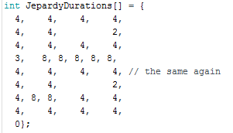
Detecting End of Song
Add a zero as last item in duration array
For loop goes until zero detected: for (int thisNote = 0; JepardyDurations[thisNote] != 0; thisNote++) {

Slide 43
Change Pace of Music
Find the line: int wholeNote = 1000;
‘wholeNote’ is the number of milliseconds in a whole note.
Changing wholeNote to 500 makes whole note ½ sec
Changing wholeNote to 2000 makes whole note 2 sec
Please try several values for wholeNote and see what happens

Slide 44
Optional Material
The following material (approximately 10 slides) on Arduino music is optional and will not be on a test.
However, you might find it useful to work through it if you have time

Slide 45
Multiple Songs
Load playSong3
Changes:
Three songs available
Uses a function to play the melody
Variable “song” set to 0, 1, or 2 to select song.
Find the line: int song = 0;
Change song to 0, 1, or 2 to select the melody

Slide 46
Look at loop()
int wholeNote = 1450; // change pace of music("speedy")
int song = 0; //select a song (set to 0, 1, or 2)
void loop() {
if (song == 0) {
singsong(marioDurations, Mario); //play Mario
}
else if (song == 1) {
singsong(BondDurations, Bond); //play James Bond
}
else {
singsong(JepardyDurations, Jepardy); //play Jepardy
}
}

Slide 47
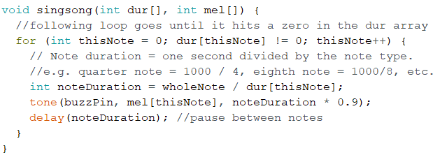
Look at singsong()
Shows how to pass values to function
Shows how to re-use code
Same code can play many different tunes

Slide 48
Whistles and Bells Mods to playSong3
Pushbutton Select
Pace adjustment

Slide 49
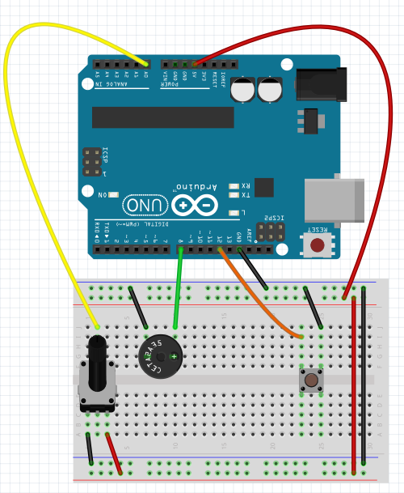
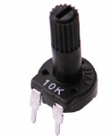
Add: Pot and Switch
Potentiometer
“Pot”
A0
Gnd +5
Add This
(selects song)
Add This
(adjusts pace)

Slide 50
Code Modifications
Where do these go?
int switchPin=12; //pushbutton pin
int potPin=A0; //pin that pot is connected to
int song = 0; //which song to play
int nsong = 3; //# songs
Where does this go?
pinMode(switchPin,INPUT_PULLUP)

Slide 51
Code to select song. Where does it go?
if (digitalRead(switchPin) == LOW) {
song = (song + 1) % nsong;
delay(1000); //wait a polite second
return;
}
What does it do?
digitalRead goes LOW when button pressed
“%” is modulo division by nsong=3
song stays in range: 0 ≤ song ≤ 2
Notes:
This goes in singsong function, within for loop

Slide 52
Modifications Continued
Code to modify pace. Where does it go?
wholeNote = analogRead(potPin) * 3; //read the pot setting
What does it do?
Remember: wholeNote is length of whole note (in ms)
And recall: analogRead value is 0 ≤ x ≤ 1023
Therefore: 0 ≤ wholeNote ≤ 3069
And So: whole notes range from 0 to 3.069 sec

Slide 53
Try it
Put these changes in yourself
You’ll have to figure out where they go
(OR just load the complete program)
playSongExtras.ino

Slide 54
Challenges
Get a melody off the internet and add it to sketch
Sometimes they are already in Arduino format
Sometimes you have to transcribe the notes
Changes required
Add two arrays: melody and duration
Add code to play the new song inside loop()
Make nsong equal to # songs
Add 3 or more LEDs to show frequency of each tone
if (mel[thisNote] < 200) light LED #1 //You have to write else if (mel[thisNote]<800) light LED #2 //this in proper C code! else light LED #3

