Slide 1
Sound Pitch Plus
Combination of
SoundPitch project: to estimates pitch
SoundLevel project: has 5 LEDs
Circuit is the same as SoundLevel, with added pitch estimation software

Slide 2
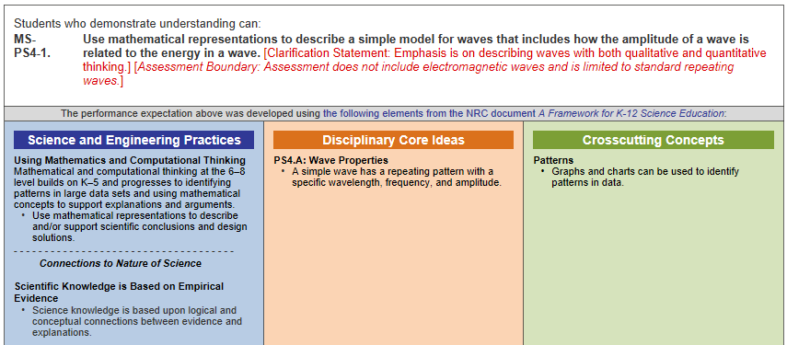
Standard
https://www.nextgenscience.org/pe/ms-ps4-1-waves-and-their-applications-technologies-information-transfer

Slide 3
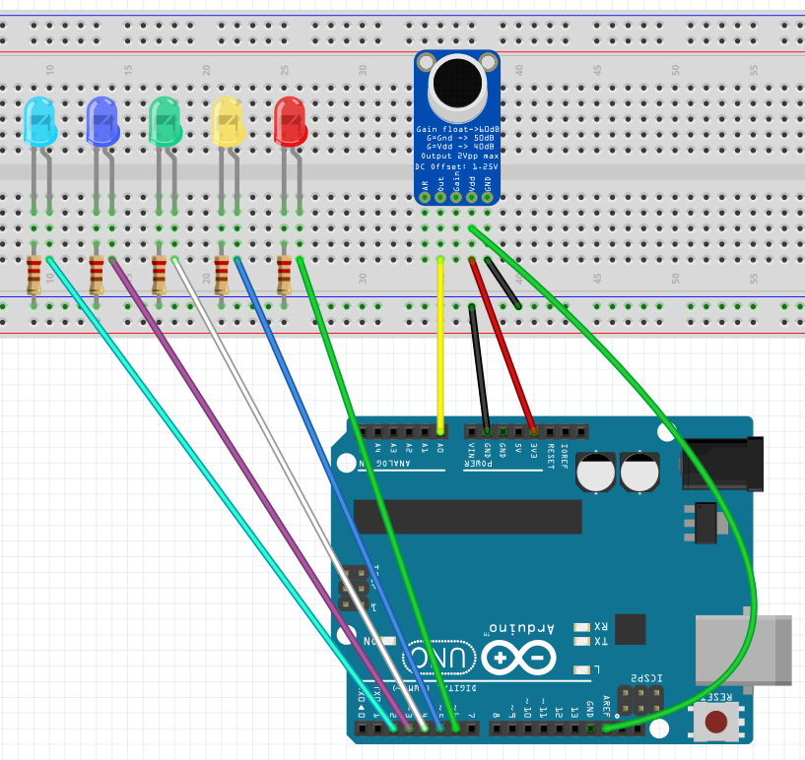
Build This
Higher Pitch
220
A0
3.3
23456 AREF

