Slide 1
Day 8
Using Arduino to Make “Music”
(not great music, but music none the less)

Slide 2
Arduino Output Sounds
Suppose we turn on and off an Arduino pin
And connect pin to a speaker
What do we get?
“Buzz” sound with “pitch” frequency F = 1000 Hz
pop
pop
pop
pop
pop
HIGH
LOW
.5ms
1ms
2ms
3ms
4ms
Time
500𝜇s
1000𝜇s
2000𝜇s
3000𝜇s

Slide 3
Generating a Buzz
Arduino Sketch to generate 1000 Hz buzz:
int BUZpin=8; //speaker connected to pin 8
loop(){
digitalWrite(BUZpin, HIGH);
delay(.5);
digitalWrite(BUZpin, LOW);
delay(.5);
}
Problem: delay values must be integers
Cannot use “.5”
Just like the BLINK program!
HIGH
delay
delay
BUZpin Output
delay
LOW
.5ms 1ms 1.5ms 2ms

Slide 4
delayMicroseconds(d)
delay(.5); won’t work! Fraction delays not allowed.
Time between pulses = T/2 = .5 ms = 500 μs
delayMicroseconds(500) does work

Slide 5
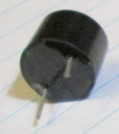
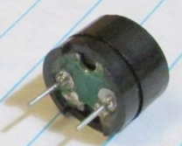
Active Buzzer Vs Passive Buzzer
Active buzzer
Apply constant 5V, it emits a continuous tone
Automatically generated by its built-in electronics.
Passive buzzer
A membrane moves out or in depending on applied voltage.
Constant 5V: membrane moves out and stays there. No continuous sound is generated
Voltage switched on and off: membrane moves in and out, which generates a sound (“buzz”).
Pitch frequency is controlled by how fast we change the voltage.
Passive Buzzer
Acts like speaker
(green bottom)
Active Buzzer
(black bottom)

Slide 6
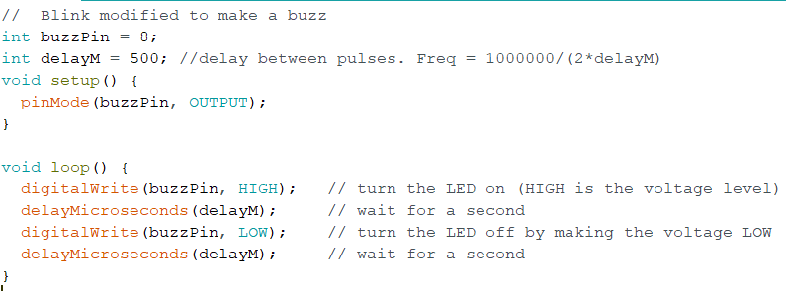
Buzzer Sketch
Type the following into a new sketch
You don’t have to type the comments

Slide 7
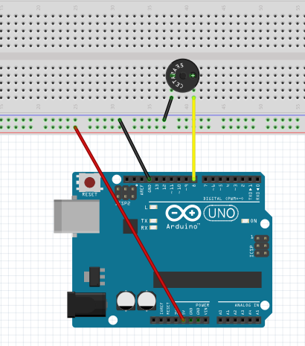
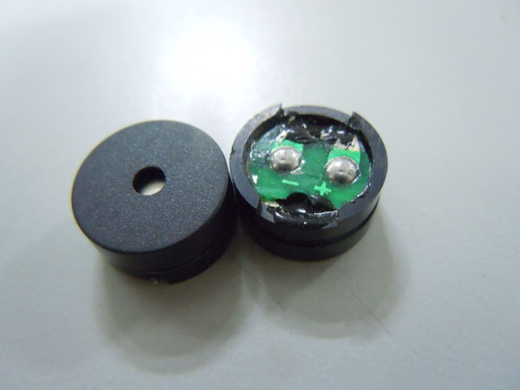
Build This (Just add buzzer to your current breadboard circuit)
Find your passive buzzer
Has green bottom
Careful! It’s polarized
Buzzer has + and -
Upload your buzzer sketch

Slide 8
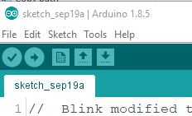
How to be less annoying
It gets pretty bad when 20 people are playing a buzzer.
To quiet your buzzer:
Unplug it
OR
Upload the empty sketch

Slide 9
Challenges
Modify to play a 250 Hz tone
Solution: Each pulse duration T = 1/250 s
Gives T=.004 Sec = 4000 microseconds
Gap between pulses is T/2 = 2000 microseconds
Change delays to: delayMicroseconds(2000)
Modify to play 100 Hz and 3000 Hz
T = 1/100 and T/2 = 1/200 = ? microseconds
T = 1/3000 and T/2 = 1/6000 = ? microseconds
Notes:
For 3000, T = 1000000/3000 = 333. delayM = 333/2 = 167 us
For 100, T=1000000/100 = 10000. delayM = 10000/2 = 5000 us
For 800, T=1000000/800 = 1250. delayM = 625 us

Slide 10
How to generate 1 Sec buzz
int t0=millis(); //get starting time in ms
while (millis()-t0<1000){ //make buzzer sound for 1000 ms
…write buzzer pin HIGH
…write buzzer pin LOW
}
delay(1000); //stay off for a second
millis() returns the number of milliseconds since Arduino power-up
millis()-t0 gives elapsed time since step 1
while loop runs until elapsed time > 1000 ms
Notes:
void loop() {
//this part makes buzzer turn on for 1 sec every 5 sec
long int t0 = millis();
while (millis() - t0 < 250) {
digitalWrite(buzzPin, HIGH); // turn the LED on (HIGH is the voltage level)
delayMicroseconds(delayM); // wait
digitalWrite(buzzPin, LOW); // turn the LED off by making the voltage LOW
delayMicroseconds(delayM); // wait
}
delay(250);
delayM = delayM + 100;
if (delayM > 3000) delayM = 100;
}

Slide 11
Solve These Challenges
Challenge #1
Make your buzzer buzz for 0.25 second
Then stay off 0.25 seconds
Repeat forever
Challenge #2
Modify Challenge #1 code so that delayM (time between pulses) is initialized to 100
Each time it buzzes (every .25 sec), delayM increases by 100
If delayM exceeds 3000, reset to 100

Slide 12
Arduino Music
Why?
Define statements
Arrays
More Functions

Slide 13
Play a tune
Examples -> Digital -> toneMelody
Push red “reset” button to replay
Let’s look at the new things Please have the toneMelody sketch displayed on your screen

Slide 14
“Tone” statement
Syntax tone(pin, frequency) tone(pin, frequency, duration)
E.g., tone(8,500)
plays 500 Hz tone on pin 8
Must be stopped using noTone(8) statement
E.g., tone(8,500,1000)
plays 500 Hz tone for 1 second on pin 8

Slide 15
“Define” Statements in C
Example:
#define AlarmPin 8 //pin number for LED1
#define longdelay 100 //# ms to delay
pinMode(AlarmPin, OUTPUT);
delay(longdelay);
Same as:
pinMode(8, OUTPUT);
delay(100);
Similar to:
int AlarmPin=8;
int longdelay=100;
Advantage: #define doesn’t use memory for variable storage

Slide 16
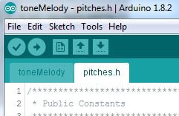
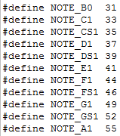

pitches.h is a “header file” (stored in the same directory)
Click on pitches.h tab
Include statement in toneMelody:
Etc., etc.
equivalent ways to play 41 Hz tone:
tone(8,41)
tone(8,NOTE_E1)

Slide 17
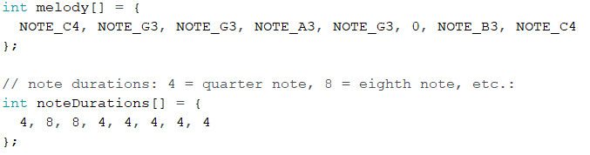
“Array”
An Array is just a list of values
The first note in the song is: melody[0]=NOTE_C4
The second note is: melody[1] =NOTE_G3
The k-th note is: melody[k-1]

Slide 18
Array Example
int LEDPins[] = {5, 7, 10, 8}; //LEDs connected to pins 5,7,8,10
void setup(){
for (int k=0; k<4; k++){
pinMode(LEDPins[k], OUTPUT);
}
This is same as the following:
pinMode(5, OUTPUT); //since LEDPins[0] = 5
pinMode(7, OUTPUT); //since LEDPins[1] = 7
pinMode(8, OUTPUT); //since LEDPins[2] = 10
pinMode(10, OUTPUT); //since LEDPins[3] = 8

Slide 19
toneMelody walk-through
void setup() {
for (int thisNote = 0; thisNote < 8; thisNote++) {
//e.g. quarter note = 1000 / 4, eighth note = 1000/8, etc.
int noteDuration = 1000 / noteDurations[thisNote];
tone(8, melody[thisNote], noteDuration);
// to distinguish the notes, set a minimum time between them.
int pauseBetweenNotes = noteDuration * 1.30;
delay(pauseBetweenNotes);
// stop the tone playing:
noTone(8);
}
}
Why does it play tune only once???
Push RESET to replay

Slide 20
Another Code Example
Load playSong1.ino
Changes made:
Plays song in loop() rather than setup()
Song repeats over and over
Detects end of song automatically (without needing to count exact number of notes)
Can adjust how fast song plays

Slide 21
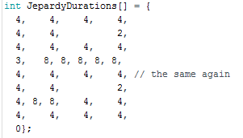
Detecting End of Song
Add a zero as last item in duration array
For loop goes until zero detected:

Slide 22
Change Pace of Music
Find the line: int wholeNote = 1000;
‘wholeNote’ is the number of milliseconds in a whole note.
Changing wholeNote to 500 makes whole note ½ sec
Changing wholeNote to 2000 makes whole note 2 sec
Please try several values for wholeNote and see what happens

Slide 23
Optional Material
If you have time

Slide 24
Multiple Songs
Load playSong3
Changes:
Three songs available
Uses a function to play the melody
Variable “song” set to 0, 1, or 2 to select song.
Find the line: int song = 0;
Change song to 0, 1, or 2 to select the melody

Slide 25
Look at loop()
int wholeNote = 1450; // change pace of music("speedy")
int song = 0; //select a song (set to 0, 1, or 2)
void loop() {
if (song == 0) {
singsong(marioDurations, Mario); //play Mario
}
else if (song == 1) {
singsong(BondDurations, Bond); //play James Bond
}
else {
singsong(JepardyDurations, Jepardy); //play Jepardy
}
}

Slide 26
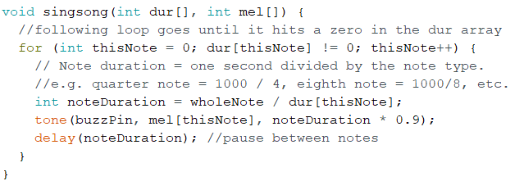
Look at singsong()
Shows how to pass values to function
Shows how to re-use code
Same code can play many different tunes

Slide 27
Whistles and Bells Mods to playSong3
Pushbutton Select
Pace adjustment

Slide 28
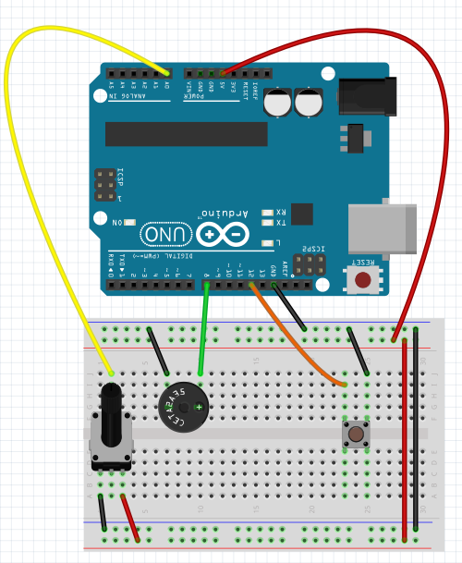
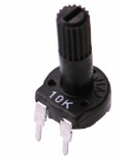
Add: Pot and Switch
Potentiometer
“Pot”
A0
Gnd +5
Add This
(selects song)
Add This
(adjusts pace)

Slide 29
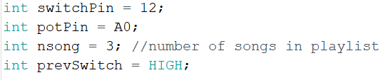
Code Modifications
Where do these statements go?
Where does this go?

Slide 30
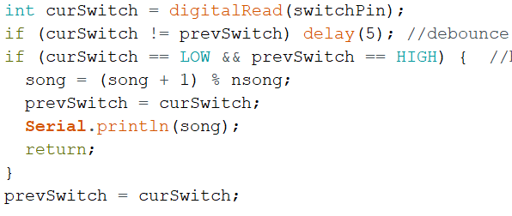
Code to select song. Where does it go?
What does it do?
digitalRead goes LOW when button pressed
“%” is modulo division by nsong=3
song stays in range: 0 ≤ song ≤ 2
Notes:
This goes in singsong function, within for loop

Slide 31
Modifications Continued
Code to modify pace. Where does it go?
What does it do?
Remember: wholeNote is length of whole note (in ms)
And recall: analogRead value is 0 ≤ x ≤ 1023
Therefore: 0 ≤ wholeNote ≤ 3069
And So: whole notes range from 0 to 3.069 sec

Slide 32
Try it
Put these changes in yourself
You’ll have to figure out where they go
(OR just load the complete program)
playSongExtras.ino

Slide 33
Challenges
Get a melody off the internet and add it to sketch
Sometimes they are already in Arduino format
Sometimes you have to transcribe the notes
Changes required
Add two arrays: melody and duration
Add code to play the new song inside loop()
Make nsong equal to # songs
Add 3 or more LEDs to show frequency of each tone
if (mel[thisNote] < 200) light LED #1 //You have to write else if (mel[thisNote]<800) light LED #2 //this in proper C code! else light LED #3

