Slide 1
Mobile Application Development with Titanium
BLUG October 2010 Meeting
John Blanford
http://github.com/jblanford/Learning-Minute
johnb@vaultechnology.com

Slide 2
Tech World is Changing
Steve Jobs “The post-PC era has arrived”
Internet = communication and sharing
Web and Web apps
Broadband media access
Cloud based applications and infrastructure
Ubiquitous connectivity via wireless
Netbooks, Smart Phones, Tablets

Slide 3
Learning Minute
Majorium = soft skills training
Free Windows app
Short bits of content on daily basis
Did design for web widget talking XML to back end
App version = chance to learn, maybe get them to pay for more development

Slide 4
Learning Minute App
Prototype only
Drupal based back end
Content is created and manged on server
App talks JSON-RPC to server
Content type in Drupal is matched to code in app
Active content (unlike rss)

Slide 5
Mobile Platforms
Apple IOS
Google Android
Blackberry
Nokia Symbian / MeeGo
HP / Palm WebOS
MS Windows Mobile

Slide 6
Native Development
Each platform has native SDK
Different languages used
Different API
Must create separate apps for each

Slide 7
Cross Platform Tools
Phonegap (Browser based)
Rhodes (Browser based, Ruby)
Titanium (Javascript and Native Objects)
MoSync (Custom VM)

Slide 8
Cross Platform Tools
Browser issues
  Performance
  Hardware Access
  Full native API
Browsers are adding features

Slide 9
Titanium
Appcelerator
Apache 2.0 license
Community, Professional, Enterprise
Support (free, $2,189, $7,689)
Analytics (7 days, 6 Mo, 36 Mo)
Appcelerator University

Slide 10
Titanium Architecture
Cross platform API objects
Objects are native on each platform
IOS / Android / Blackberry (beta)
Platform specific also available
App logic in interpreted Javascript
Call native objects from Javascript

Slide 11
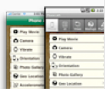




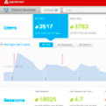
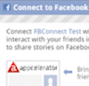
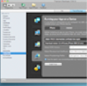
Titanium Features
Native UI
Rich Media APIs
Real native tables, tabs, sliders,
and views
Local and streaming audio and
video, media recording
Location APIs
Open Source and Extensible
Native Maps, Compass, and
Geolocation
Extend Titanium with custom
modules in native code
Local and Remote Data
Integrated Analytics
Local SQL Database, Lightweight
Key/Value Store, XHR
Baked-in analytics APIs to measure
results and behavior
Social APIs
Development Tools
Integrated Facebook Connect
and YQL
Develop and distribute your app for
multiple platforms from a single tool

Slide 12
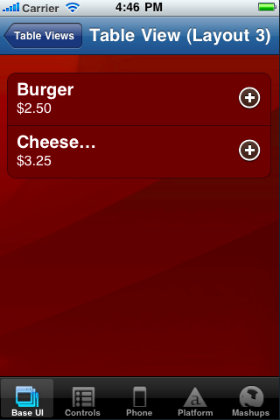
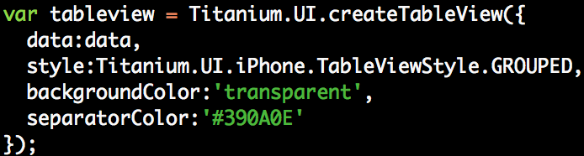
Example

Slide 13
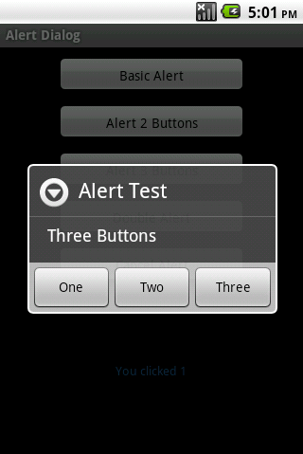
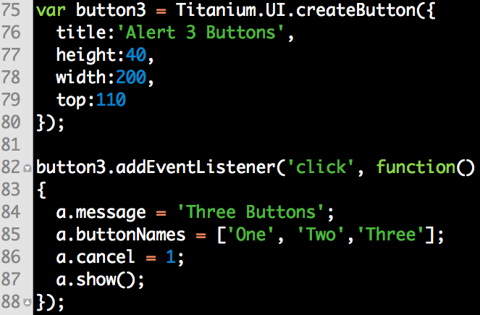
Example

Slide 14
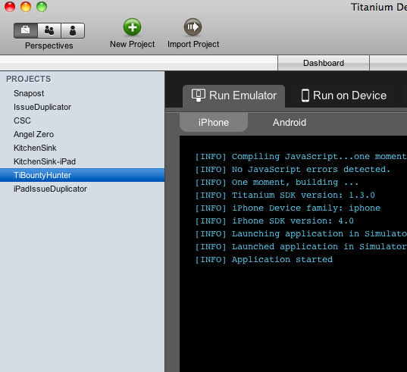
Titanium Developer
Manage and run Titanium applications
Package applications for distribution
Run on a device for testing
Manage Appcelerator account

Slide 15
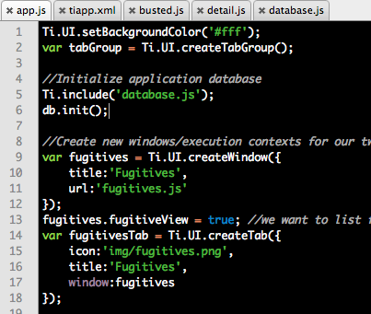
Titanium Fundamentals
A Titanium application is a JavaScript program that is interpreted at runtime on the device
app.js defines the root execution context of the app
Note that we are not running in a browser
We use the WebKit KJS JavaScript engine (iOS) or Rhino (Android/BB)

Slide 16
Cross-Platform Development
Not all UI is available across platforms
Titanium != “Write Once, Run Everywhere”
We try to enable native apps that look and feel like they were created in Objective-C or Java
Also note that even cross-platform UI components (like table views) will render differently cross platform
Cross Platform testing is critical during dev cycle

Slide 17
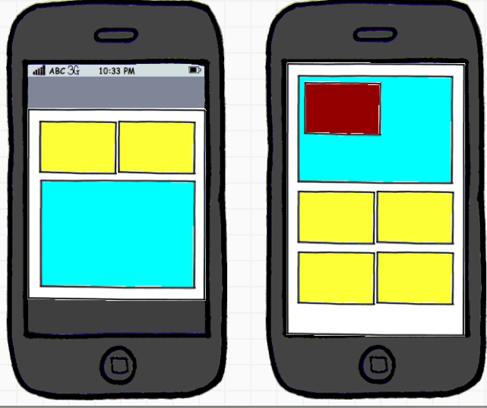
Typical App Composition
A single window or stack of windows
Tab Group containing many windows
Windows contain views

Slide 18
Windows and Contexts
Windows are the top level container for Titanium applications
Applications usually consist of one window or several windows in a tab group
Windows usually create new execution contexts
Execution context == A unique JavaScript symbol space
Such windows are “Heavyweight” windows
Can also create “Lightweight” windows (for apps that run in a single context)
3

Slide 19
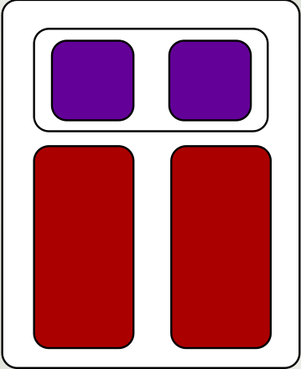
The View Hierarchy
Views are the building blocks of Titanium UIs
  Specialized views: table views, image views, map views, etc.
Views can contain child views, which are positioned relative to the parent
Layout Options: Absolute, vertical, or horizontal (currently iPhone only)
Vertical layouts require height to be set

Slide 20
The Good and Bad
Installation is very painful on Linux
Documentation SUCKS = API, Kitchensink, QA
Android is buggy
Performance is good for a simple app
Biggest surprise was productivity
Once figure out how – few lines of code for big results

