Slide 1

Initiation NodeJS
(Il va falloir aimer le vert… )
Licence ATC - MIW 2017 – Jérémy BLONDEAU

Slide 2

Plan de cours
Historique :
NodeJS et le V8 Engine
L’ écosystème Javascript Moderne
Rappel :
Architecture d’une application Web Classique
Architecture d’une application NodeJS
Changement d’habitudes avec NodeJS:
Programmation événementielle / asynchrone
TP:
NodeJS : Hello World
Express JS : Sandbox
MongoDB : Initiation
Express JS + MongoDB
Scrapper : Express JS + MongoDB + CasperJS
ReactJS : Initiation

Slide 3














NodeJS et le V8 Engine
Chronologie:
VS
(SpiderMonkey)
< 2009
2009
2010
2016
2017 >

Slide 4







L’ écosystème Javascript Moderne
Family portrait :
Interpreter
Tasks Manager
Serveur / Daemon
Package manager
Frameworks
SGBD NoSQL

Slide 5







Architecture d’une application Web Classique
Users
Requète
Réponse
HTTP
| |
| |
Autre…
Interpreter
| |
| |
Autre…
BDD
| |
| |
Autre…

Slide 6
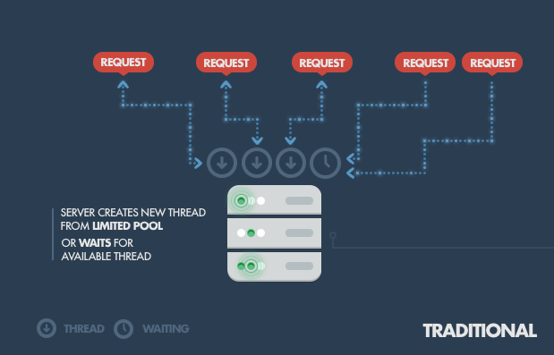
Architecture d’une application Web Classique

Slide 7

Architecture d’une application NodeJS
Users
Requète
Réponse
HTTP + Interpreter
BDD
| |
| |
Autre…

Slide 8
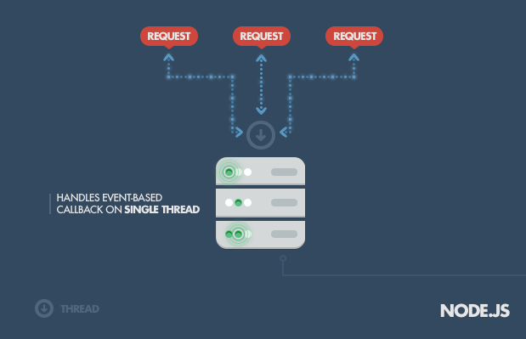
Architecture d’une application Web NodeJS
Enter the event loop:

Slide 9
Programmation événementielle / asynchrone
'use strict' const express = require('express') const superagent = require('superagent') const app = express() var TownElement = require("../model/town"); app.get('/', sendWeatherOfRandomCity); function sendWeatherOfRandomCity (request, response) { getWeatherOfRandomCity(request, response); sayHi(); } function getWeatherOfRandomCity (request, response) { TownElement.find({}, function( err, documents) { if (err) { console.log(err); }else { towns = documents; console.log(towns.length + ' Towns Founds'); res.render('towns', { title: 'Towns list', towns: towns, }); } }); console.log('Fetching the towns, please be patient'); } function sayHi () { console.log('Hi'); } app.listen(3000);
Fetching the towns, please be patient Hi 36 000 Towns Founds

Slide 10
Programmation événementielle / asynchrone
'use strict' const express = require('express') const superagent = require('superagent') const app = express() var TownElement = require("../model/town"); app.get('/', sendWeatherOfRandomCity); function sendWeatherOfRandomCity (request, response) { getWeatherOfRandomCity(request, response); sayHi(); } function getWeatherOfRandomCity (request, response) { TownElement.find({}, function( err, documents) { if (err) { console.log(err); }else { towns = documents; console.log(towns.length + ' Towns Founds'); res.render('towns', { title: 'Towns list', towns: towns, }); } }); console.log('Fetching the towns, please be patient'); } function sayHi () { console.log('Hi'); } app.listen(3000);
Fetching the towns, please be patient Hi 36 000 Towns Founds
3
1
2

Slide 11
Ressources:
NodeJS : https://nodejs.org/en/
Package Manager:
NPM : https://www.npmjs.com/
Yarn : https://yarnpkg.com/fr/
Outils serveur:
Nodemon : https://nodemon.io/
WebPack : https://webpack.js.org
Tasks Manager:
Gulp : http://gulpjs.com/
Grunt : https://gruntjs.com/
SGBD NoSQL:
MongoDB : https://docs.mongodb.com/
Redis : https://redis.io/
CouchDB : http://couchdb.apache.org/
Framework:
ExpressJS : http://expressjs.com/
EmberJS: http://emberjs.com/
AngularJS : https://angular.io/
Backbone: http://backbonejs.org/
ReactJS: https://facebook.github.io/react/
Articles:
Fonctionnement de base : https://www.toptal.com/nodejs/why-the-hell-would-i-use-node-js
Event Loop détails: https://blog.risingstack.com/node-js-at-scale-understanding-node-js-event-loop/

