Slide 1
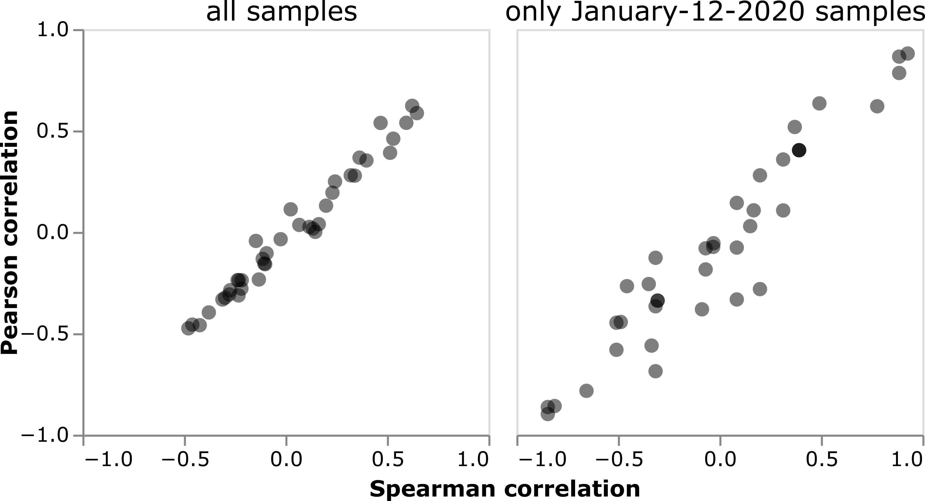
all sampling dates
only January-12-2020 samples
goat
human
largemouth bass
catfish
cow
sheep
spotted dove
pig
human
bamboo rat
bamboo rat
raccoon dog
raccoon dog

