Slide 1
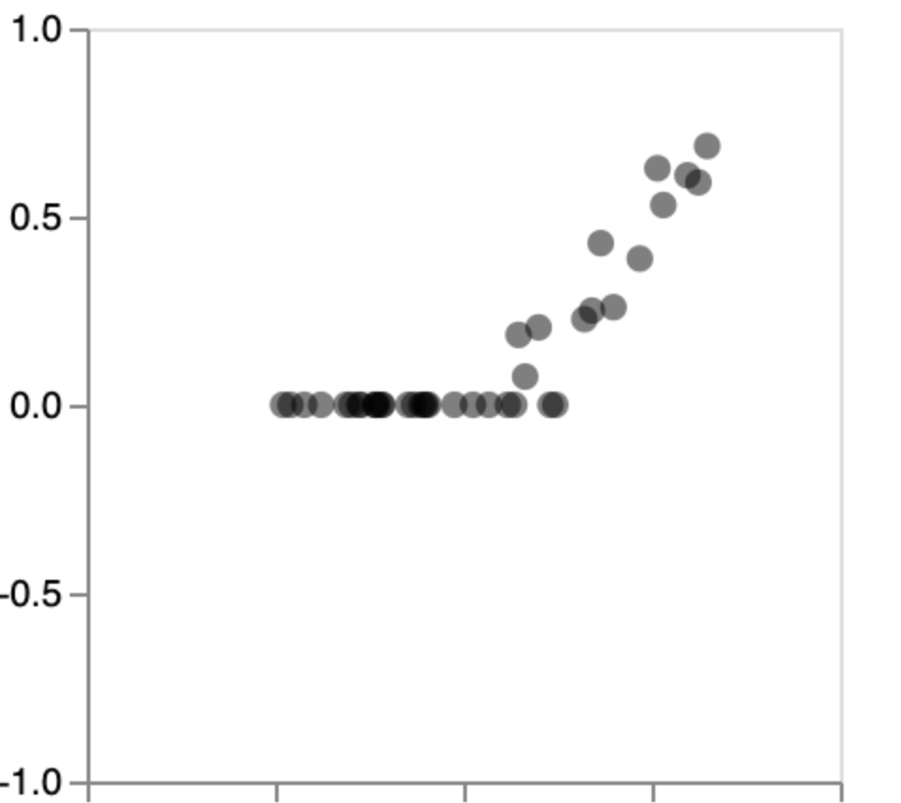
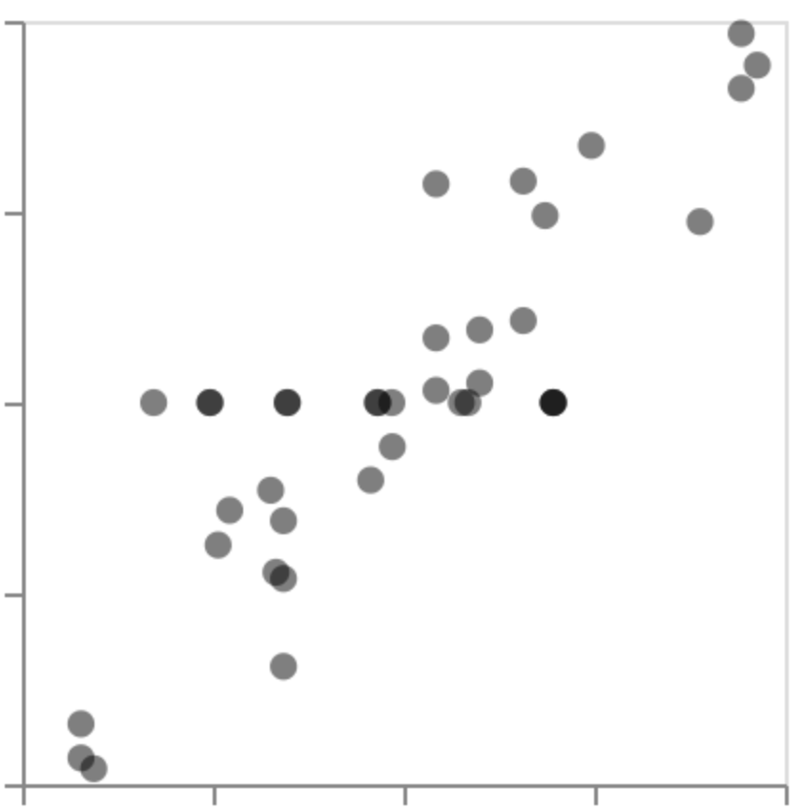
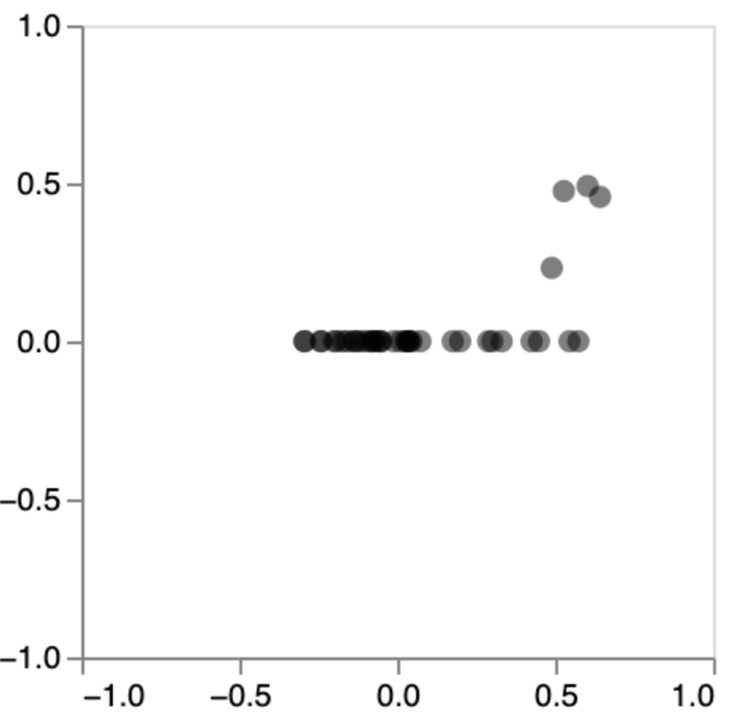
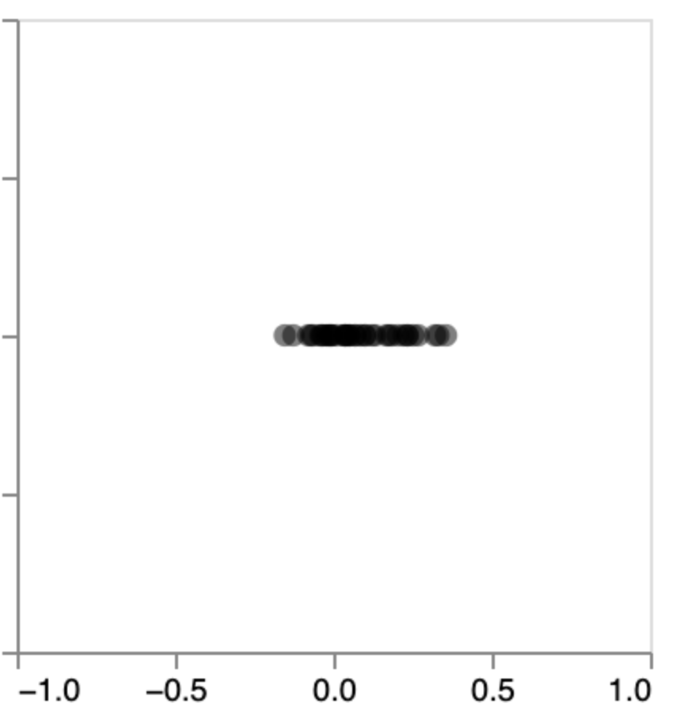
all dates
January-12-2020
goat
spotted dove
sheep
human
cow
human
largemouth bass
pig
bamboo rat
catfish
samples with SARS2 reads
raccoon dog
bamboo rat
raccoon dog
Theil-Sen correlation
snakehead fish
catfish
largemouth bass
swamp eel
all samples
Spearman correlation

