Slide 1
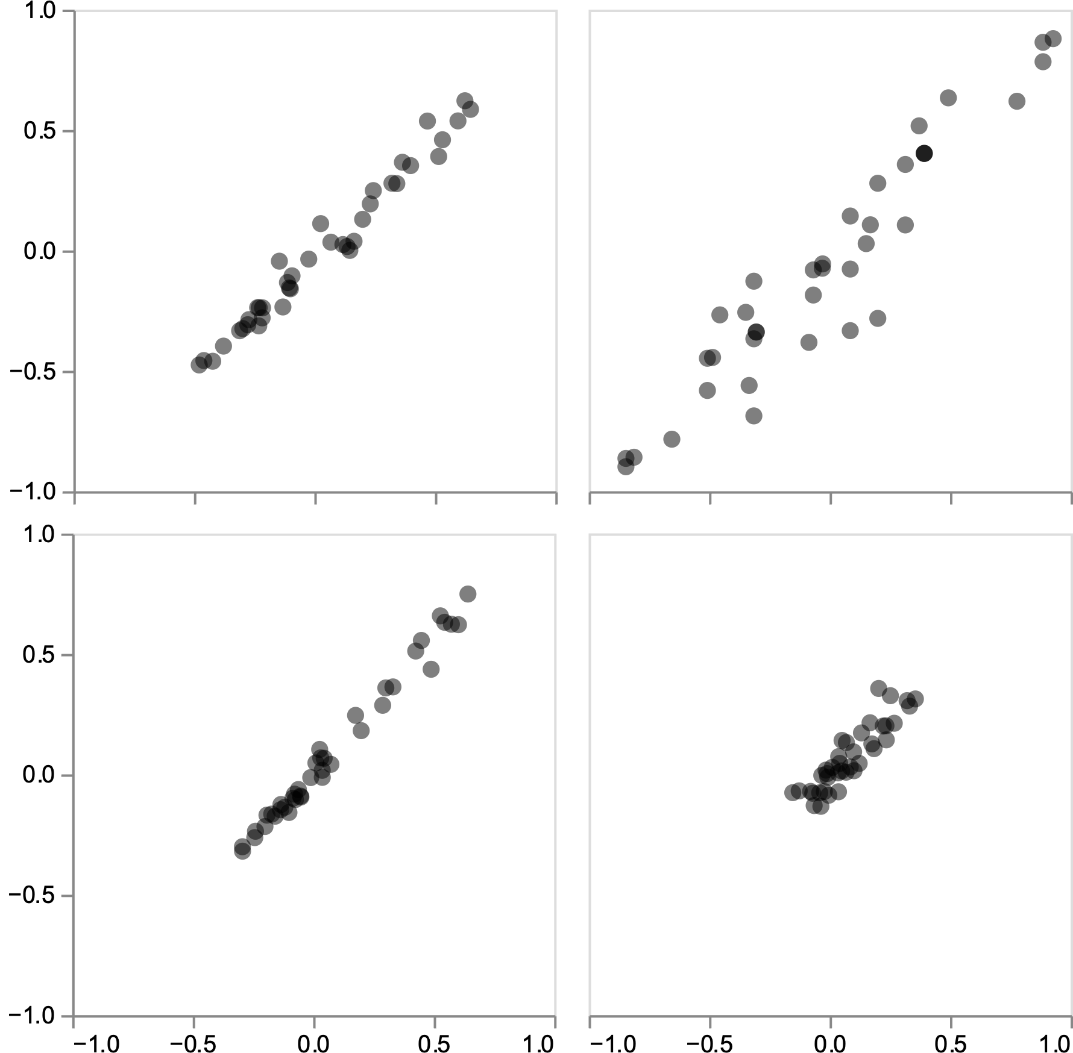
all dates
January-12-2020
goat
human
largemouth bass
catfish
cow
sheep
spotted dove
pig
human
samples with SARS2 reads
bamboo rat
bamboo rat
raccoon dog
raccoon dog
Pearson correlation
largemouth bass
catfish
snakehead fish
Malayan porcupine
human
human
raccoon dog
bamboo rat
bamboo rat
all samples
raccoon dog
Spearman correlation

