Slide 1
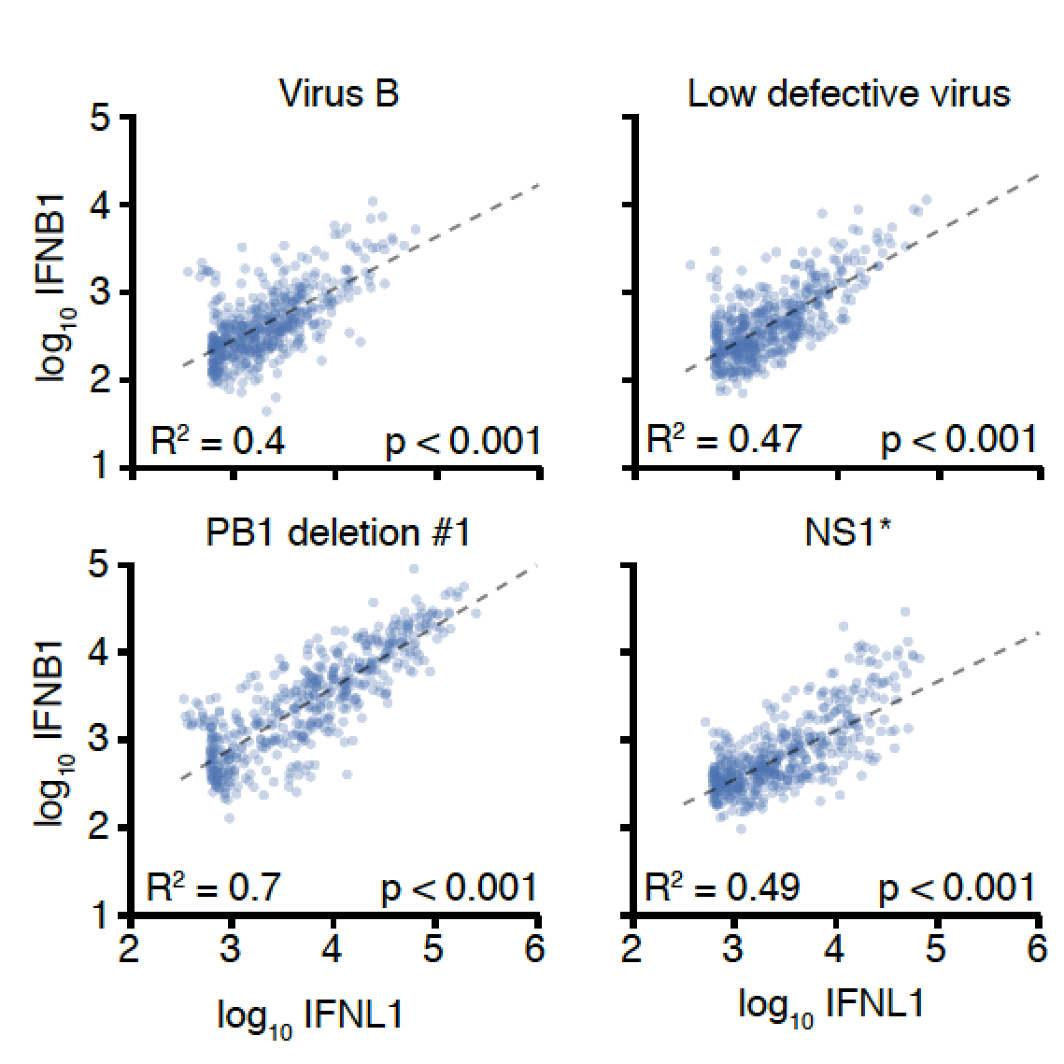
Influenza stock 1
Influenza stock 2
Influenza PB1 deletion
Influenza NS1 mutation

