Slide 1
Resequencing-Pavitra
Will Hannon

Slide 2
Here is a quick summary of the concordance between replicates and which samples might need to be sequenced again.

Slide 3
Here are all of the alleles identified in one replicate plotted against all alleles identified in the second replicate by frequency. In this plot, I’m not considering any minimum allele frequency or depth. The only filtering criteria is a minimum Base Quality Phred score of 25 (~ 0.3% chance of erroneous base call).

Slide 4
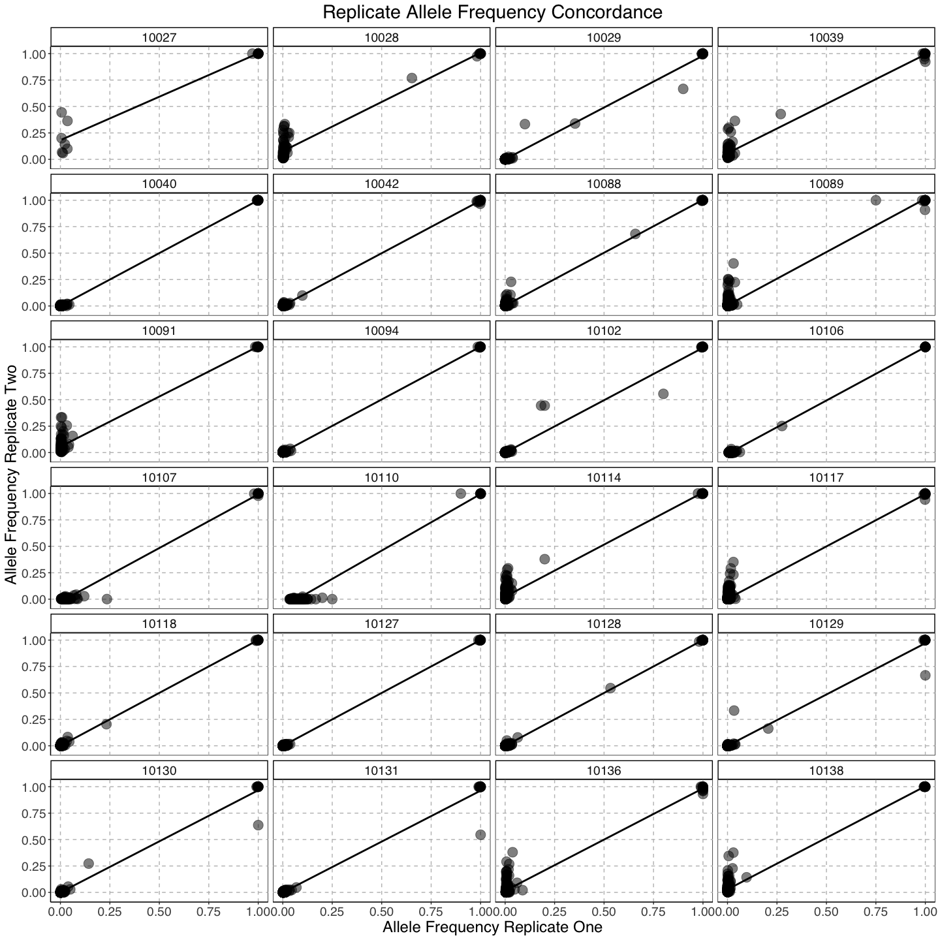

Slide 5
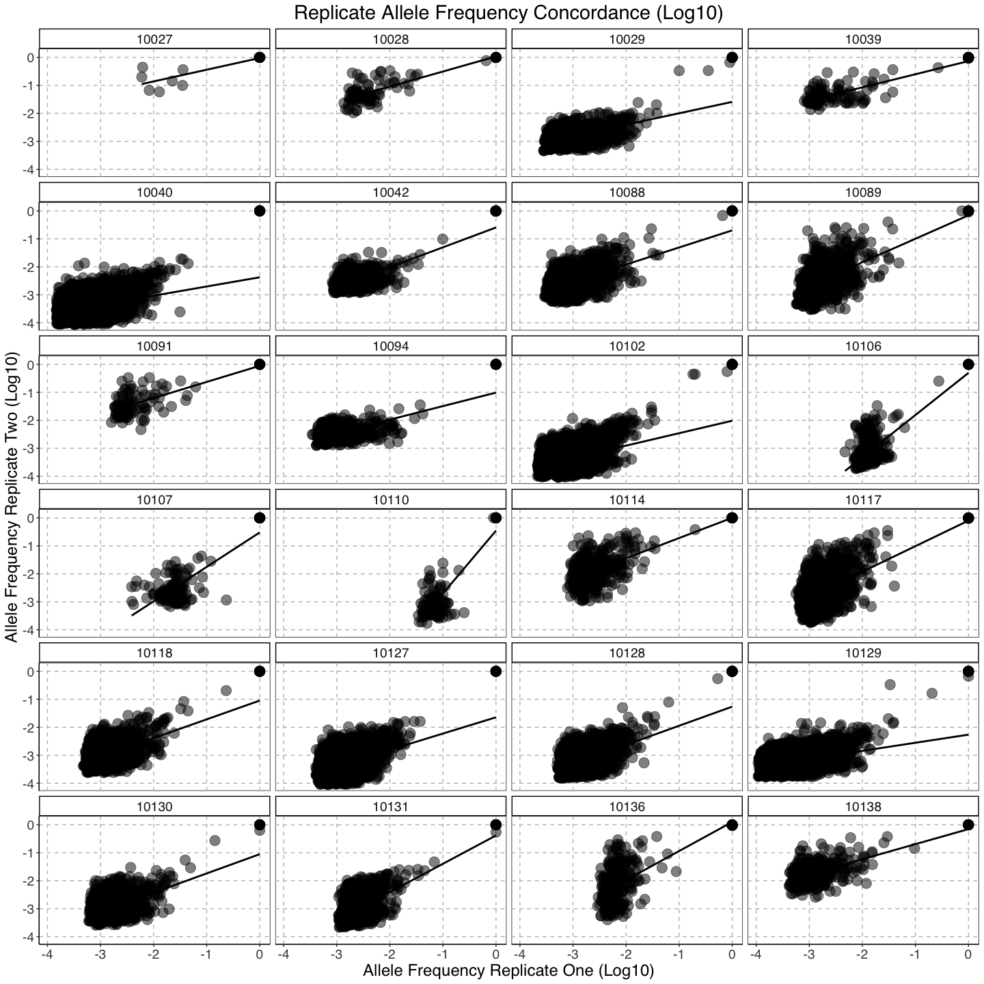

Slide 6
Here is the same plot, but this time I’ve identified all of the alleles by color if they were present at sites covered by more than 200 reads and present at an allele frequency greater then 0.5%. Ideally, we’d like to identify alleles at this frequency and greater, making 200 base observations at each site the bare minimum.

Slide 7
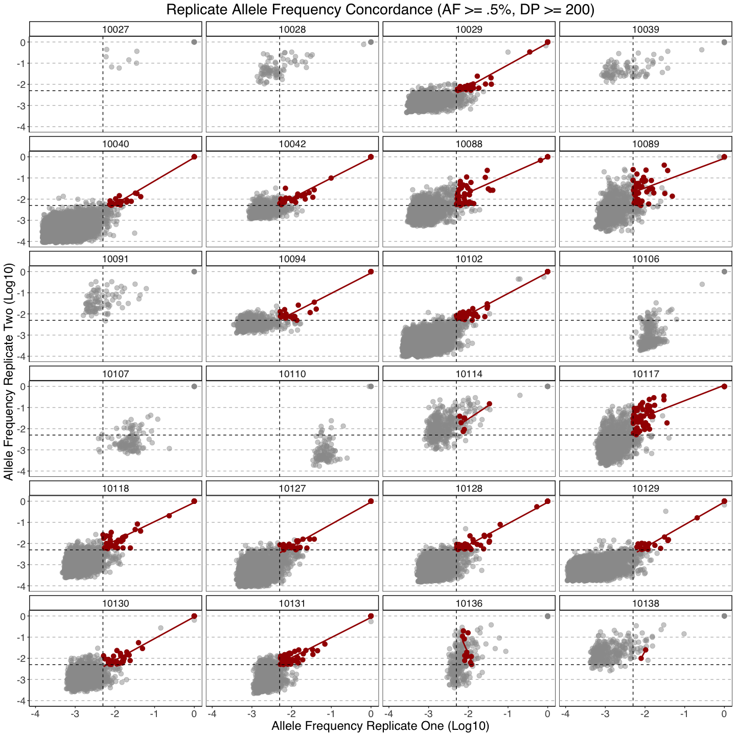

Slide 8
Using these alleles to identify concordance, I qualitatively lumped samples into categories based on whether they had good concordance, medium concordance, or bad concordance.

Slide 9
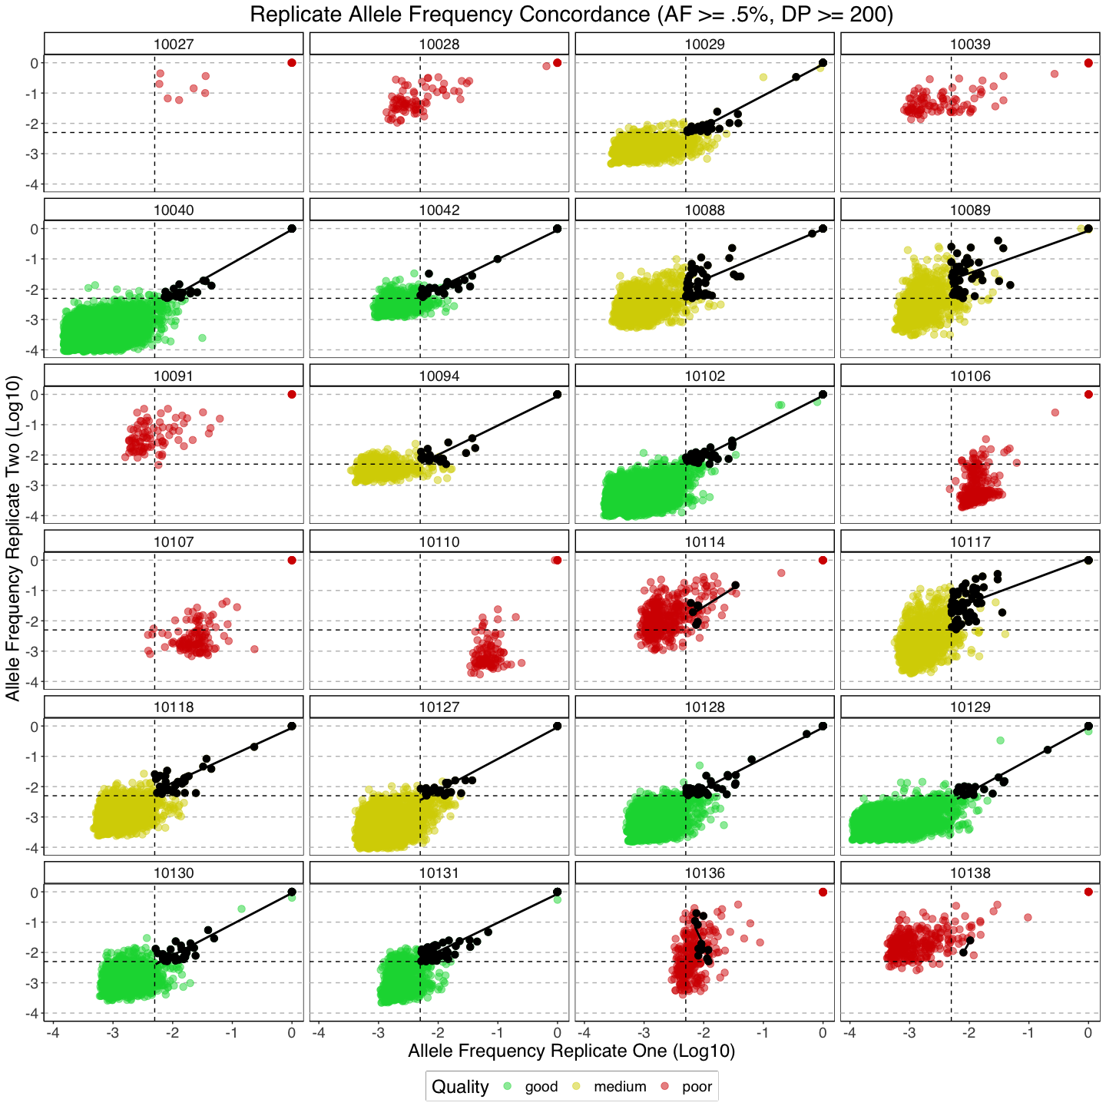

Slide 10
Next, I wanted to see if concordance for each sample was determined by depth or template number and whether re-sequencing could remedy the observed discrepancies.

Slide 11
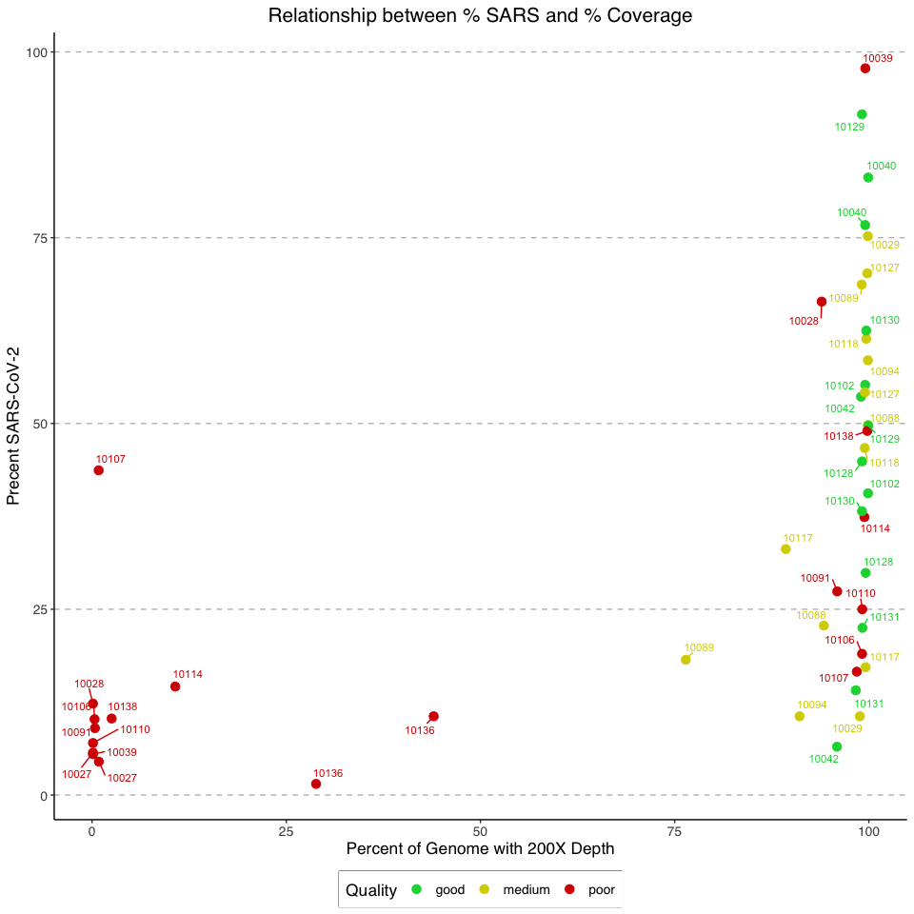

Slide 12
As you can see, some replicates have very little of their genome coverage by more than 200 base observations at each site. These samples likely need to be dropped or sequenced again.

Slide 13
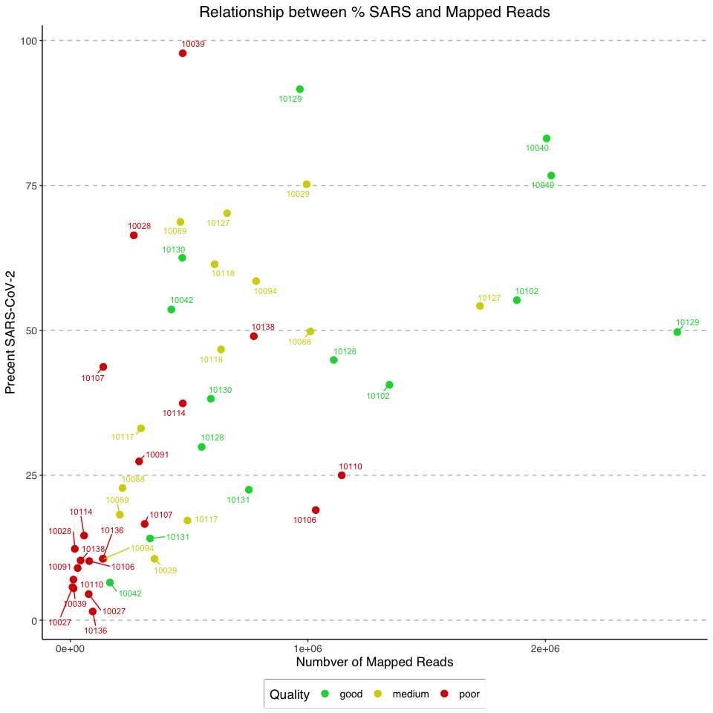

Slide 14
Here, I’ve plotted each replicate on the coordinates of the percent of SARS-CoV-2 reads in the initial library by the average coverage over the genome. It’s clear than some samples have huge differences between the coverage. For those with reasonably high % but few reads, we recommend sequencing from cDNA.

Slide 15
In this way, I can determine which samples need to be re-sequenced by looking at the average features of the samples with good concordance.
For those samples with high Ct and low % mapping in both replicates, we don’t recommend sequencing again.
For those samples with one replicate with a very low % of SARS-CoV-2 and the other with adequate sequencing, we should re-prep another sample from scratch.

