Slide 1
SARS-CoV-2 Chronic Infection
Will Hannon

Slide 2
Summary
This notebook contains the code for generating the main figures associated with the deep sequencing analysis of SARS-CoV-2 from an immunocompromised patient. The associated publication for these samples is located here.
Runs containing raw paired-end(?) reads (fastq) for each of nine timepoints since initial infection (days 18, 25, 75, 81, 128, 130, 143, 146, and 152) were filtered and trimmed using fastp. Reads matching SARS-CoV-2 sequences were filtered using kmer matching with BBDuk. These reads were aligned to the Wuhan-Hu-1 reference genome (NC_045512.2) with BWA. SNPs were identified in each sample with the variant caller lofreq and confirmed by parsing the read pileup statistics generated by samtools mpileup.

Slide 3
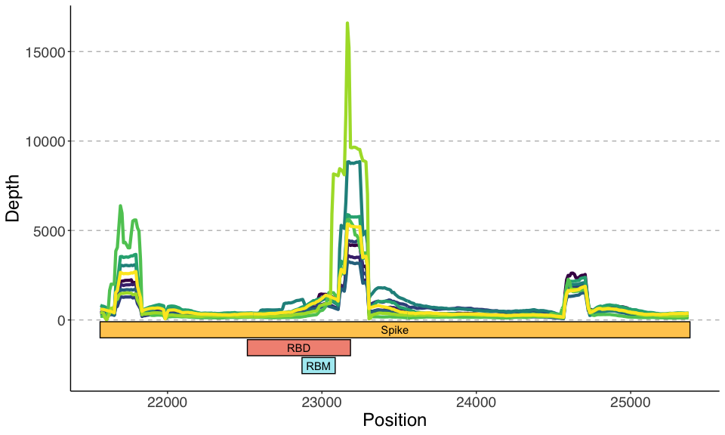
Coverage Over Spike

Slide 4
Coverage Over Spike Capped at 500X

Slide 5
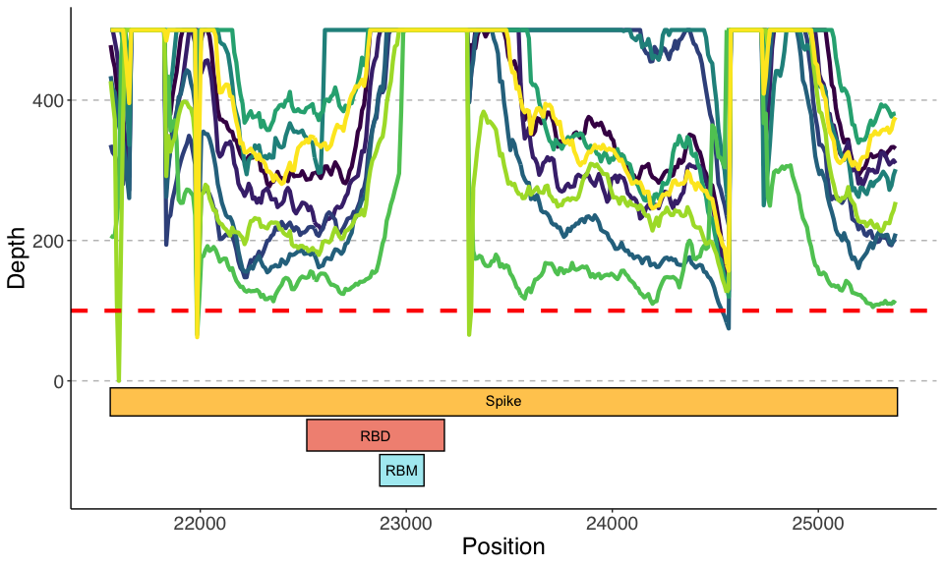

Slide 6
Variants over Spike (>0.01)

Slide 7
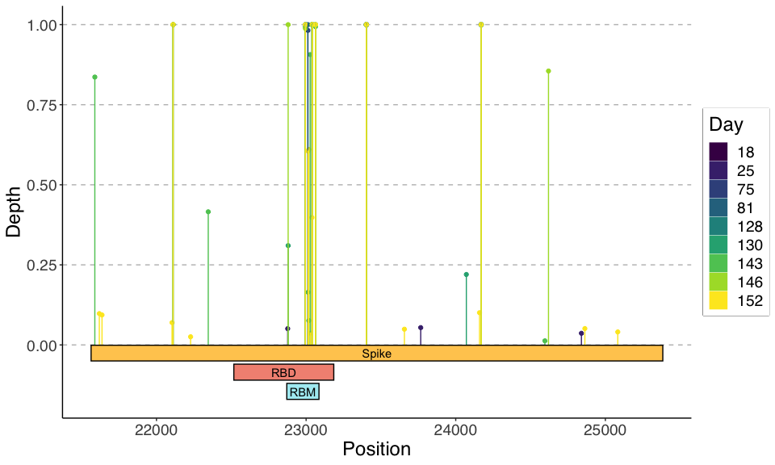

Slide 8
Variants over Spike (>0.01), Cluster

Slide 9
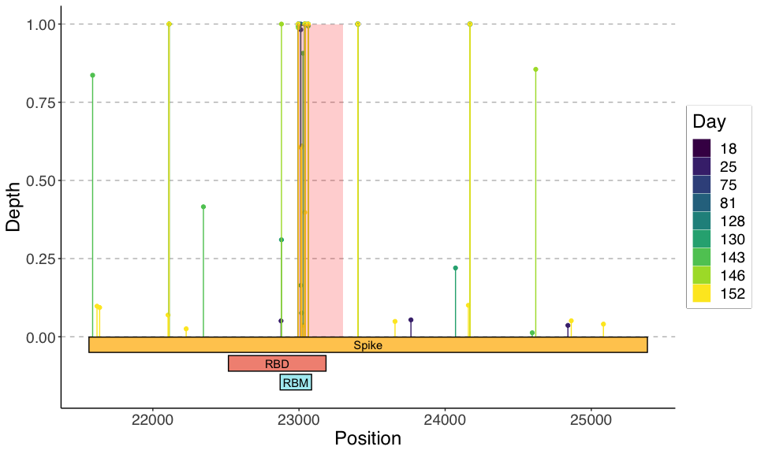

Slide 10
Variants over RBD (>0.01)

Slide 11
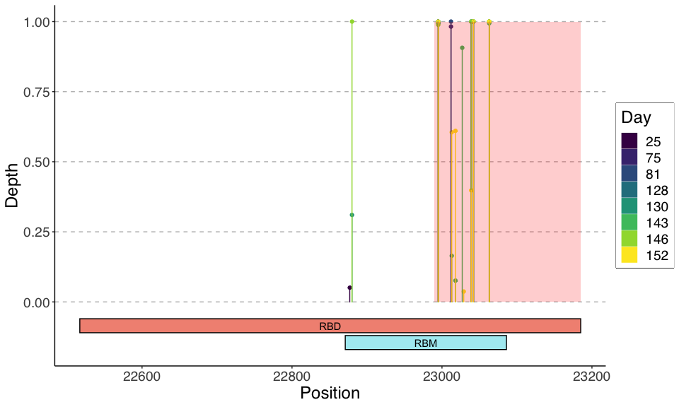

Slide 12
Variant Frequency over Time – lofreq

Slide 13
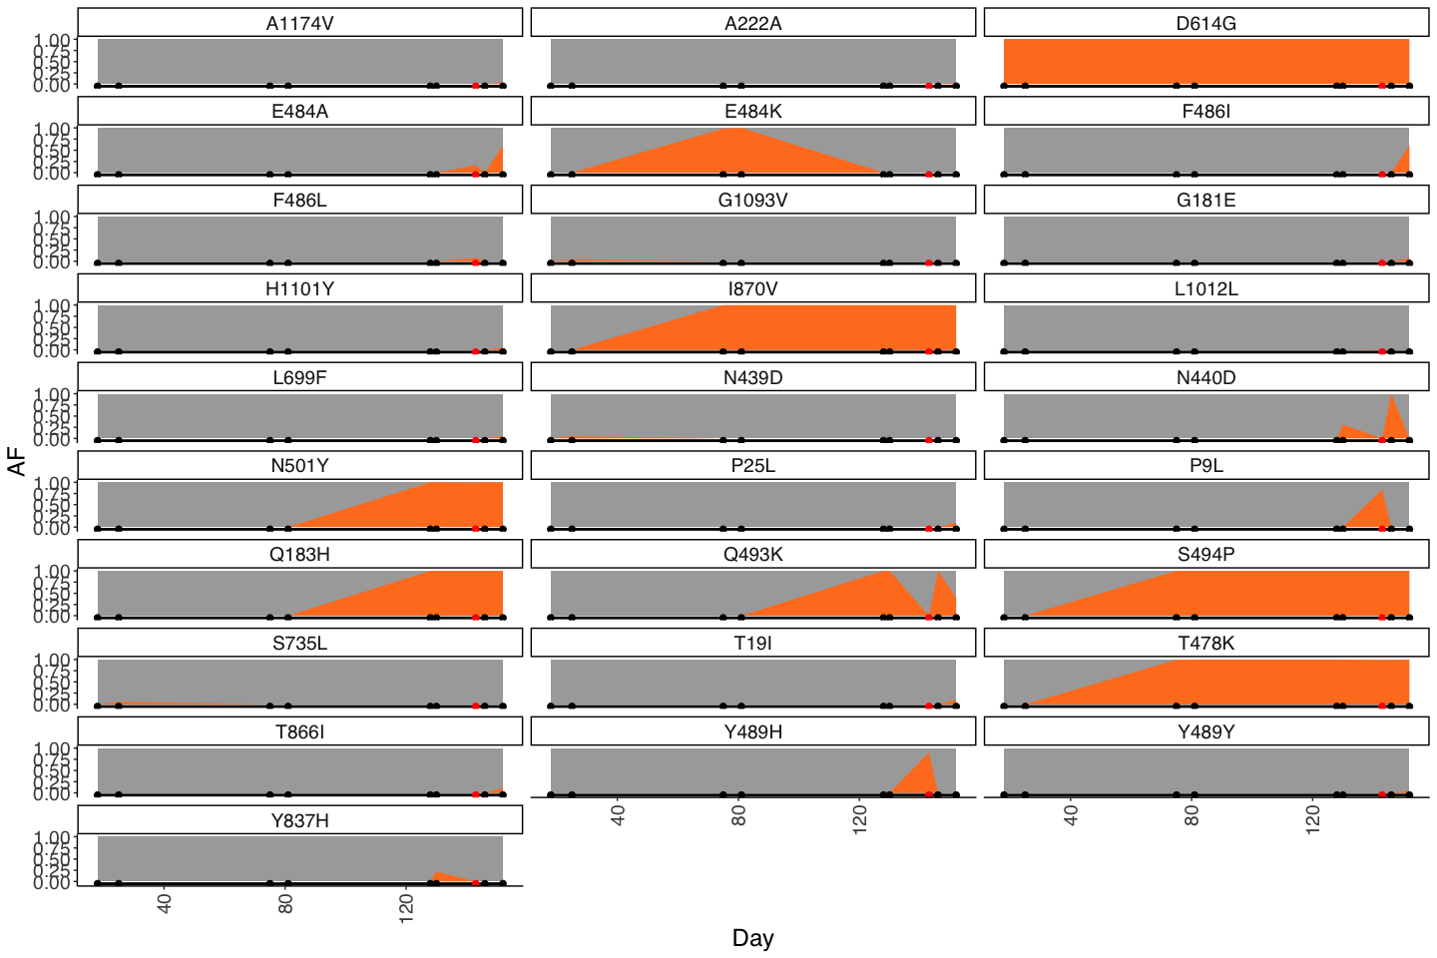

Slide 14
Variant Frequency over Time – mpileup

Slide 15
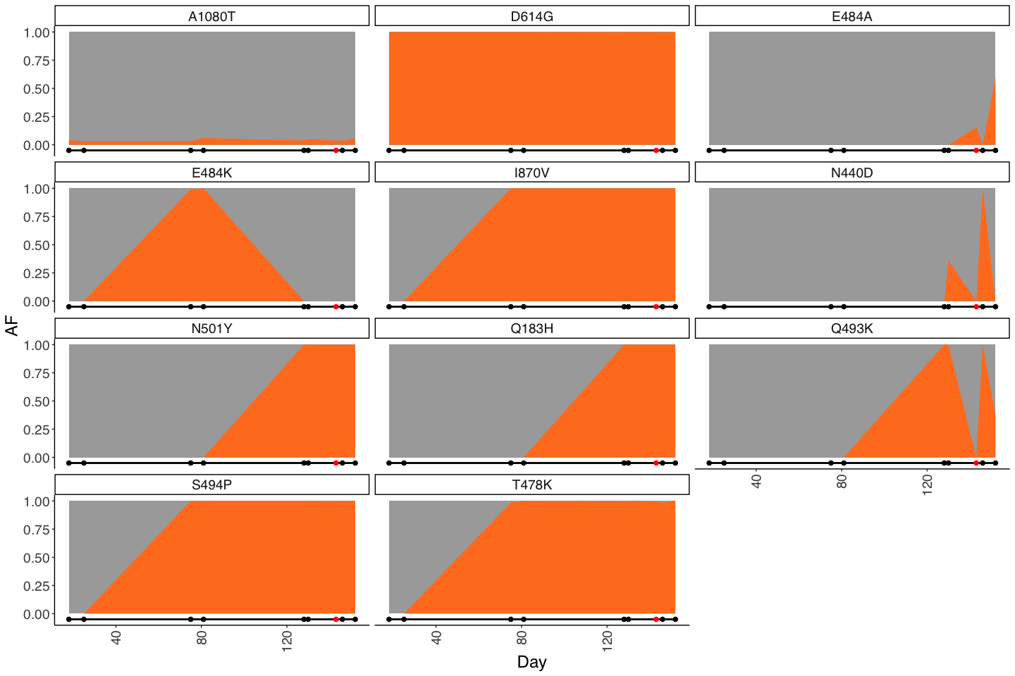

Slide 16
Primers

Slide 17
