Slide 1
SARS-CoV-2 Chronic Infection
Will Hannon

Slide 2
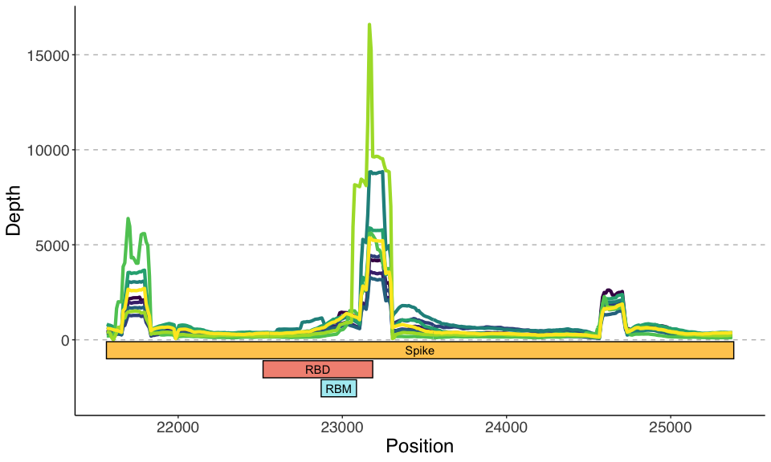
Coverage Over Spike

Slide 3
The depth pattern shows up as sharp peaks throughout the whole genome. They sequenced amplicons from PCR amplification with the tiled ARTIC primers. This could be the reason for this patter. I didn’t remove duplicates.

Slide 4
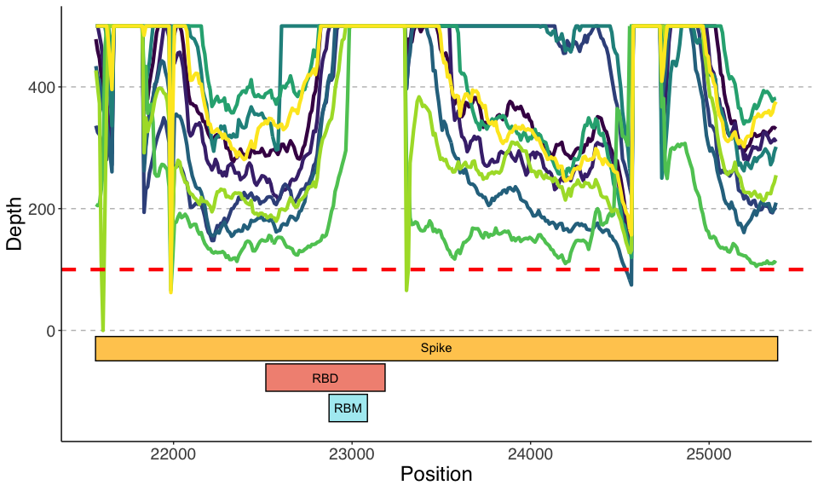
Coverage Over Spike – Capped at 500X

Slide 5
To see the what the pattern of depth is for the least covered regions, I limited the y-axis to 500X. Most sites have more than 100X depth with a Phred score greater than 25.

Slide 6
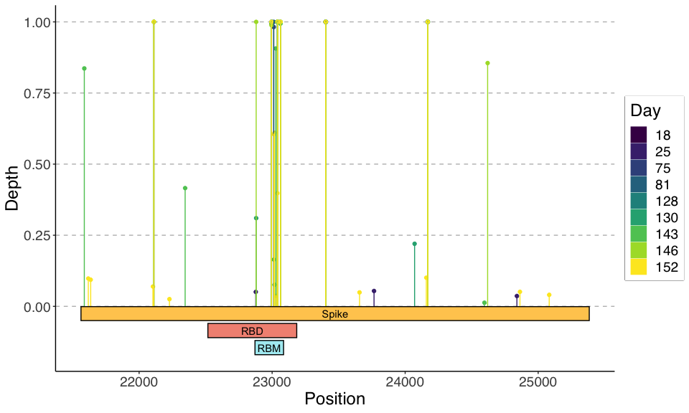
Variants in Spike (> 1% AF)

Slide 7
Like the paper mentions, the distribution of variants is tightly clustered in the RBD/RBM.

Slide 8
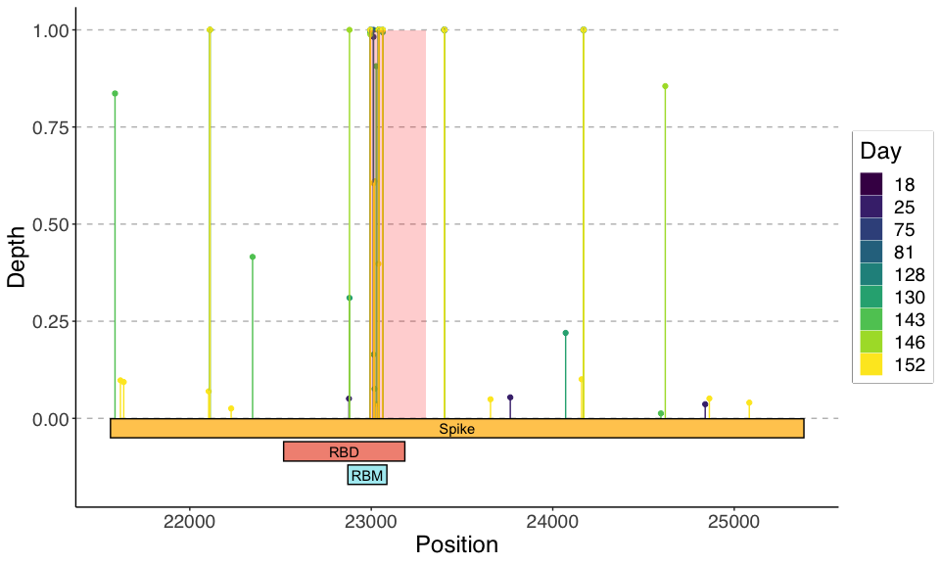
Variants in Spike (> 1% AF)

Slide 9
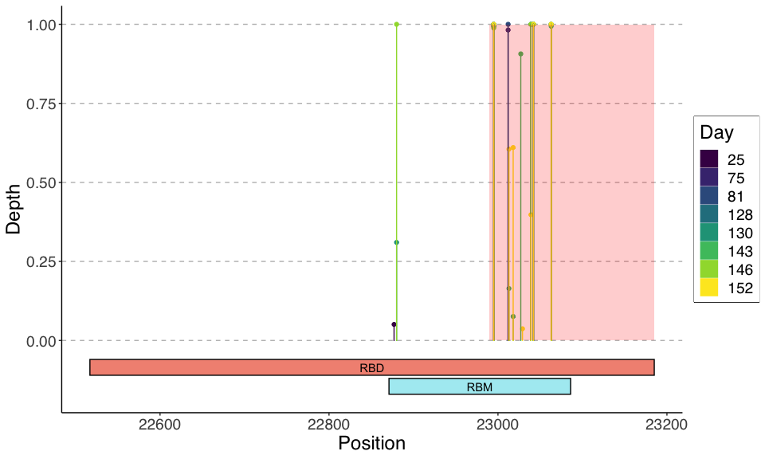
Variants in RBD (> 1% AF)

Slide 10
I was curious if these overlapped some primer sequence or other feature of the amplification.
In the next slide, I plotted the tiled inserts underneath the variants. Most variants in the RBD are in the same insert. This could just be a coincidence.

Slide 11
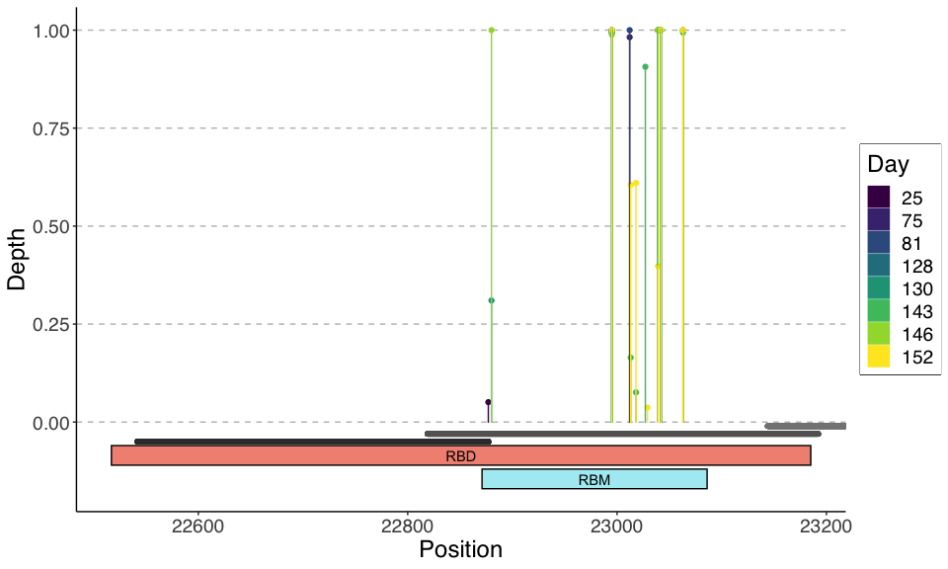
Variants in RBD tiled inserts

Slide 12
Finally, in the next two slides, I plotted the variant allele frequencies over time. I identified variants and their frequencies with both a variant caller (lofreq) and by counting the occurrences of bases in the SAM file at each location (mpileup).
The results mostly agree.

Slide 13
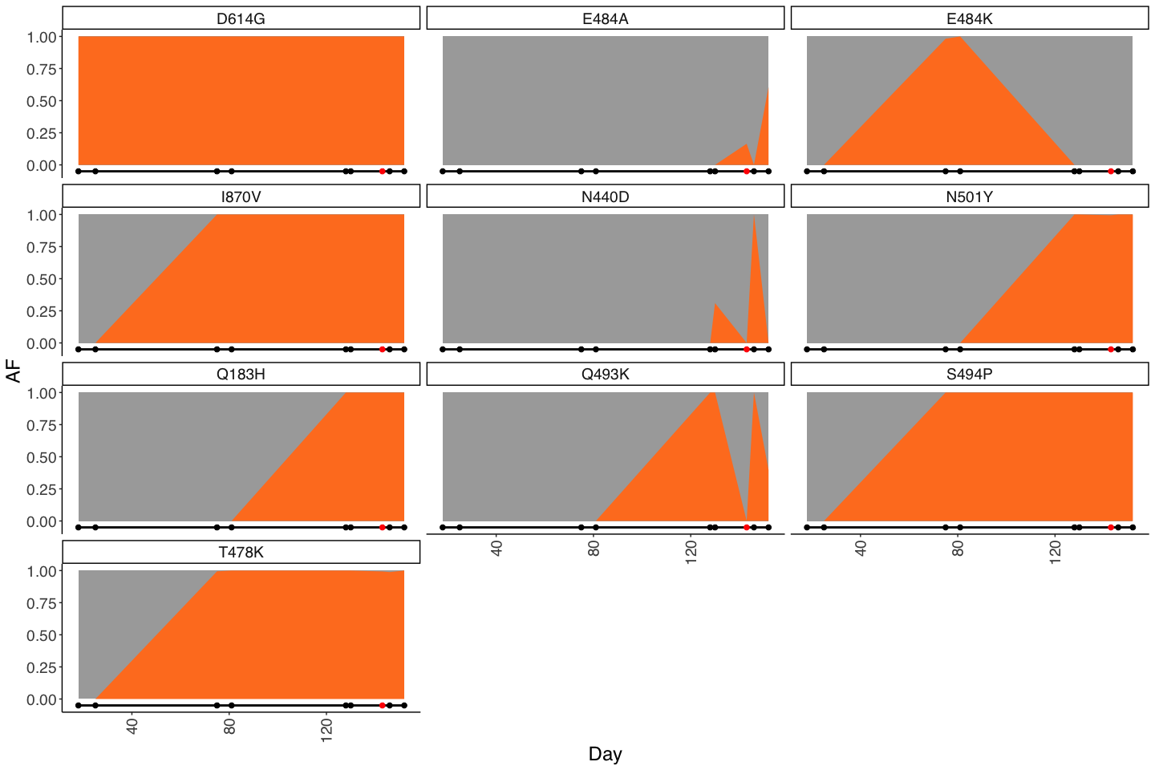
Variants in S over time (lofreq)

Slide 14
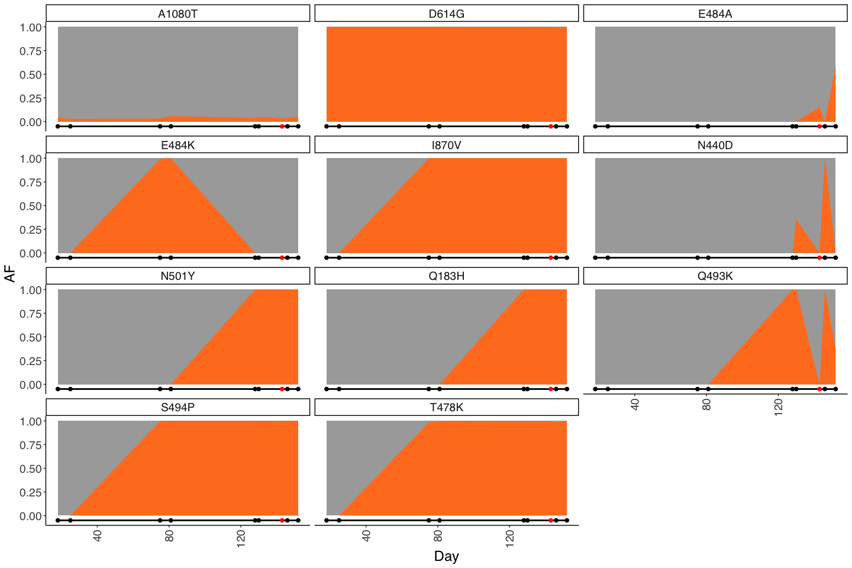
Variants in S over time (mpileup)

Slide 15
There is one mutation that is present in the consensus at all time points: D614G.
There are three that show up at nearly 100% frequency in the first recurrence: I870V, S494P, T478K
There is one that is only in the first recurrence: E484K
There are three that show up at nearly 100% frequency in the second recurrence : N510Y, Q183H

