Slide 1
SARS-CoV-2 Chronic Infection
Will Hannon

Slide 2
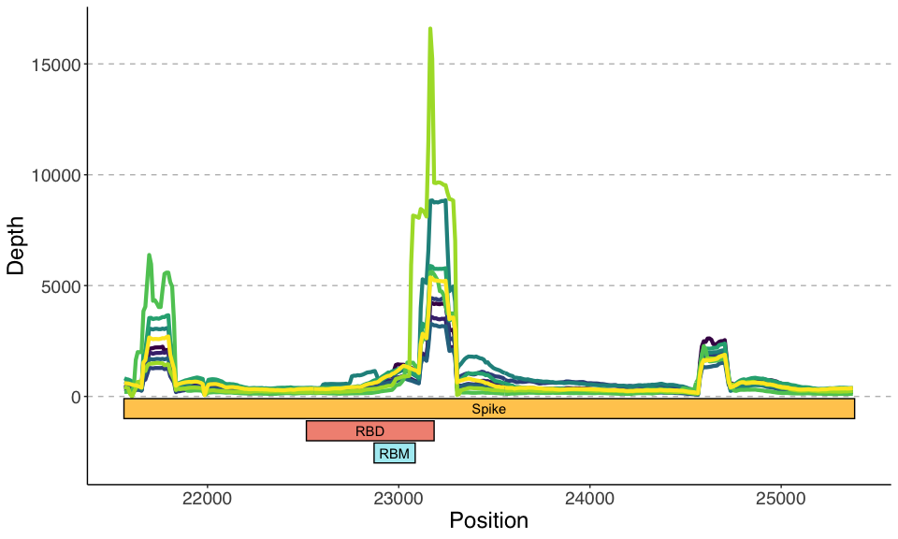
Coverage Over Spike

Slide 3
Coverage Over Spike Capped at 500X

Slide 4
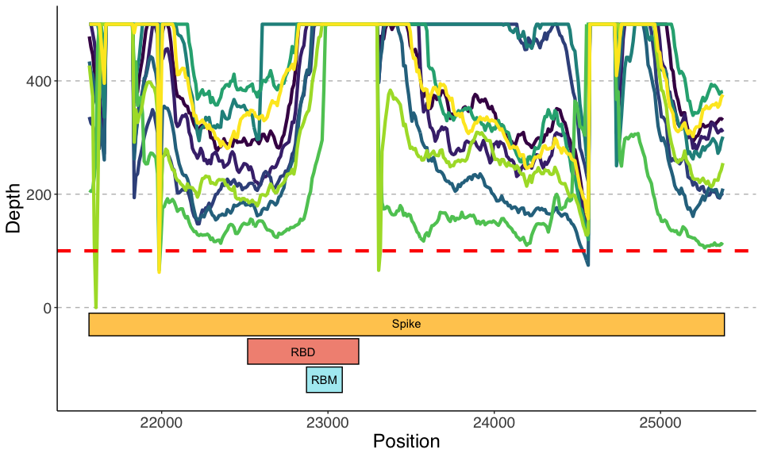

Slide 5
Variants over Spike (>0.01)

Slide 6
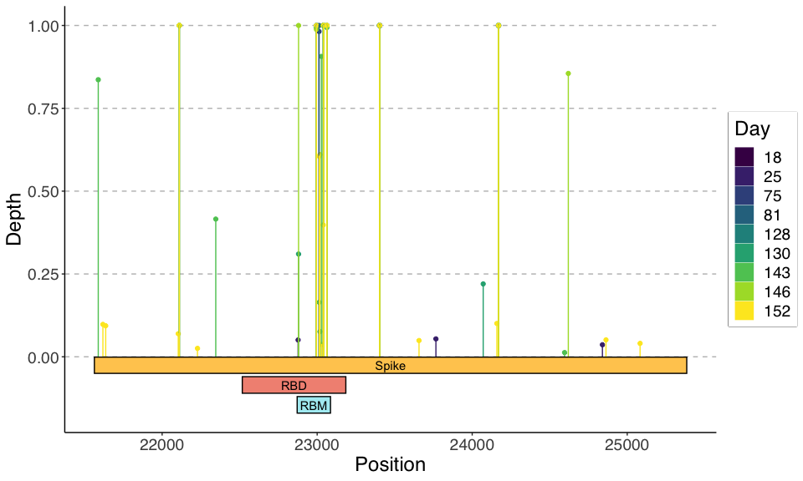

Slide 7
Variants over Spike (>0.01), Cluster

Slide 8
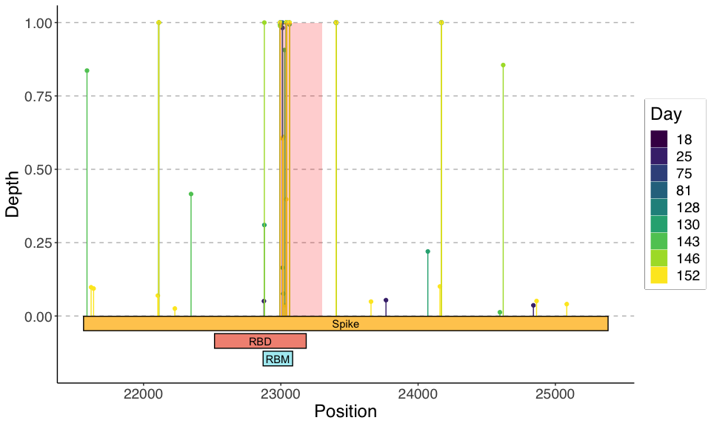

Slide 9
Variants over RBD (>0.01)

Slide 10
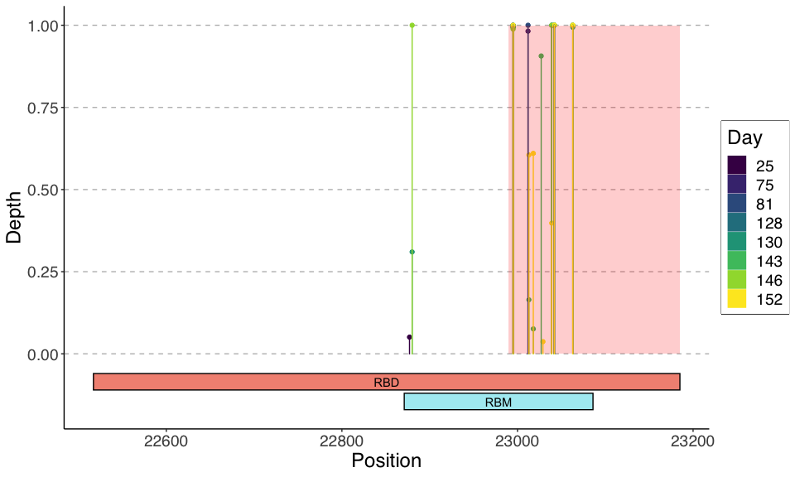

Slide 11
Variant Frequency over Time – lofreq

Slide 12
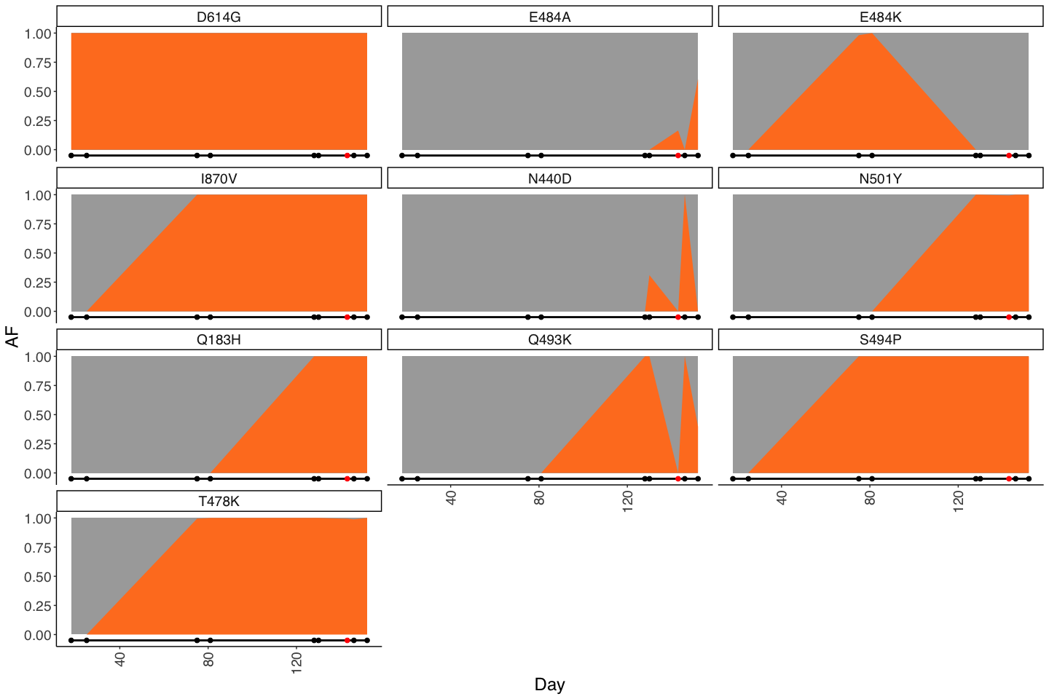

Slide 13
Variant Frequency over Time – mpileup

Slide 14
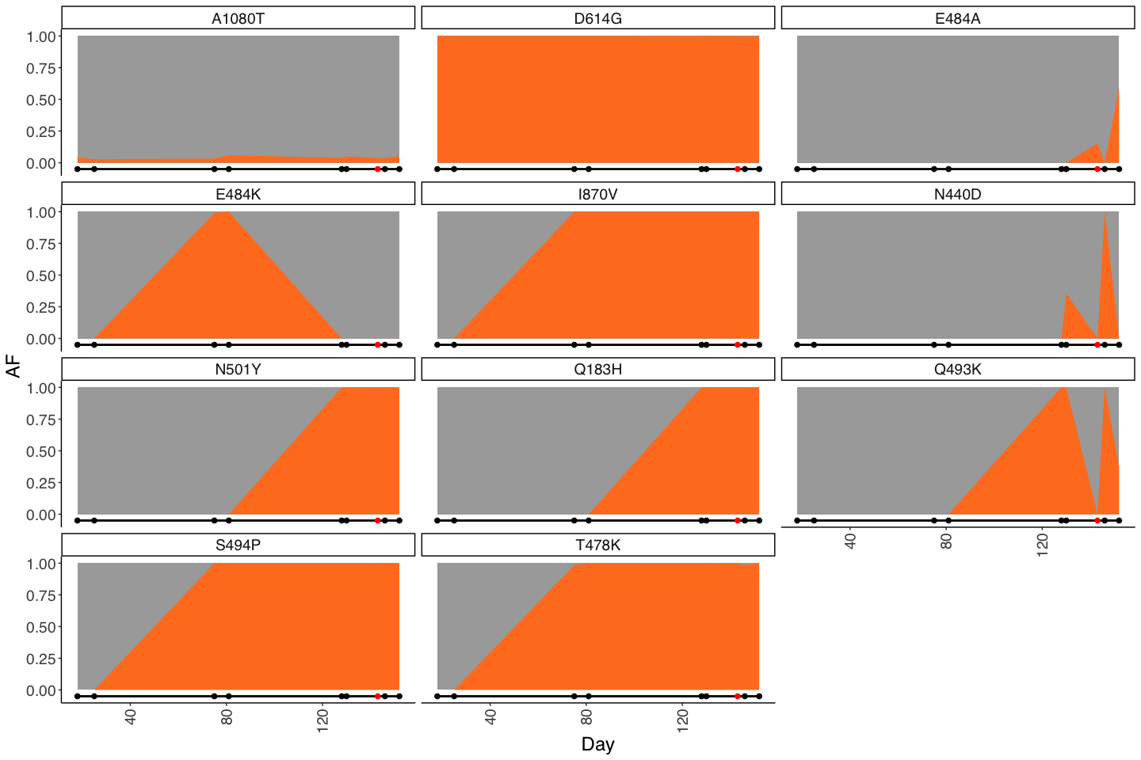

Slide 15
Primers

Slide 16
