Slide 1
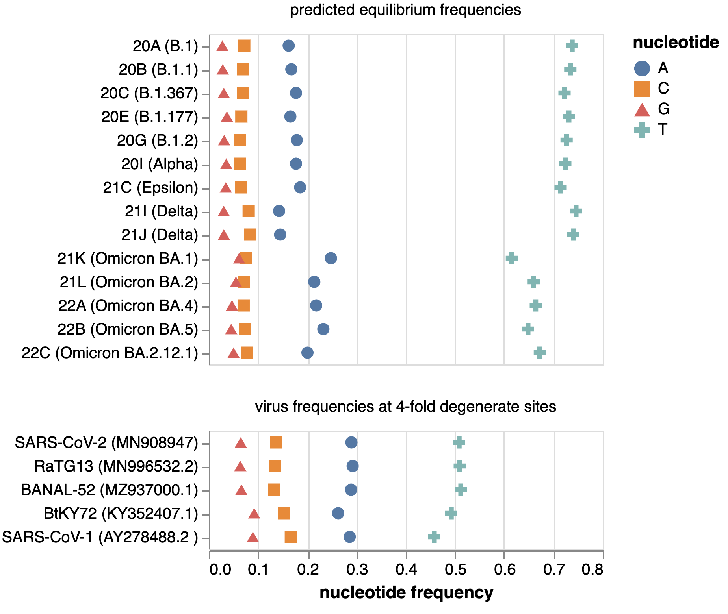
A
SARS-CoV-2 predicted equilibrium frequencies
B
sarbecovirus frequencies at 4-fold degenerate sites
C
influenza virus predicted and observed frequencies

