Slide 1
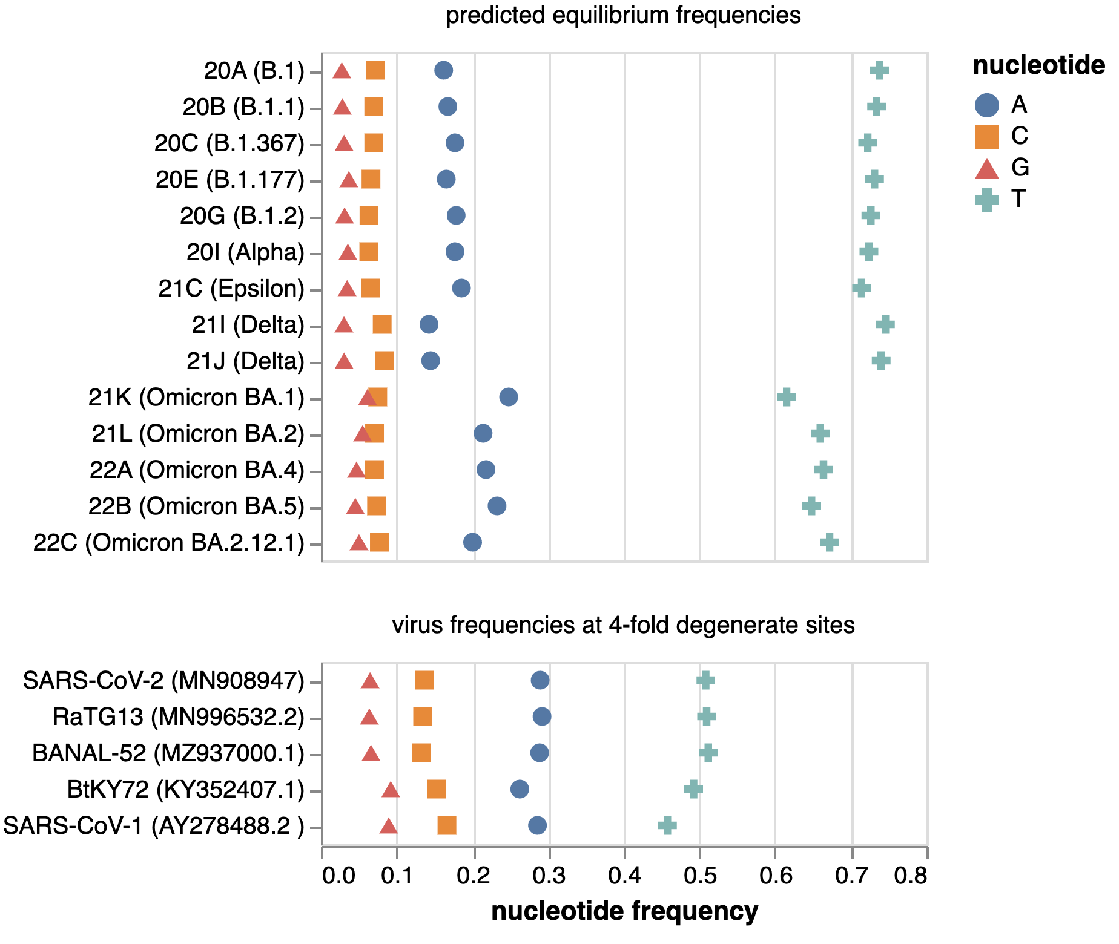
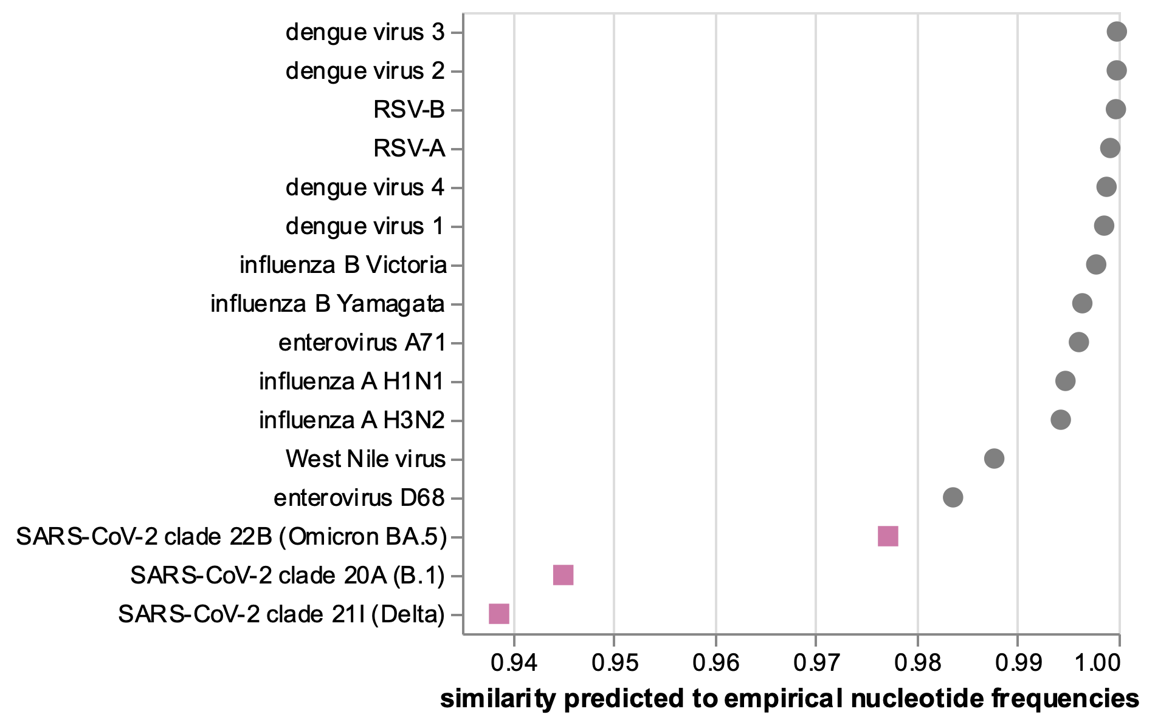
A
SARS-CoV-2 predicted equilibrium frequencies
B
sarbecovirus empirical frequencies at 4-fold degenerate sites
C
similarity of predicted vs empirical frequencies for many viruses

