Slide 1
Picking ACE2 sequences for broader survey/evolution experiments. We want to address questions such as:
What is the ACE2 binding ability of the ancestrsral sarbecovirus?
How do ACE2 binding specificities vary over the RBD tree, including acquisition of non-bat ‘spillover’ potential?
How is binding to different ACE2s correlated
How do dynamics of ACE2 binding specificity change particularly on the trajectories to SARS-CoV-1 and SARS-CoV-2? (e.g. evidence for exaptation versus adaptation)
Do “clade 2” sequences, like, for sure, really, not bind ACE2?
We intend to begin with a broad survey of extant homologs and ancestrally reconstructed RBDs. I think for this experiment, we want a panel of ACE2 sequences with relevance and “breadth” in their sequence determinants of binding. Since the panel of RBDs is relatively small (on the order of ~50-100), these titrations should be less demanding than the full DMS libraries (i.e. a solid handful of ACE2s for independent titration experiments should be doable). Also means we shouldn’t consume too much of the ACE2 products, leaving plenty for subsequent experiments.
This broad survey will likely reveal intervals of interesting functional change, for which we can follow up with combinatorial mutational scans, full-mut DMS in new extant (or ancestral) backgrounds of interest, etc.
Purpose of these slides is to work through deciding on ACE2 sequences to order for protein products for this broad functional survey and subsequent experiments

Slide 2
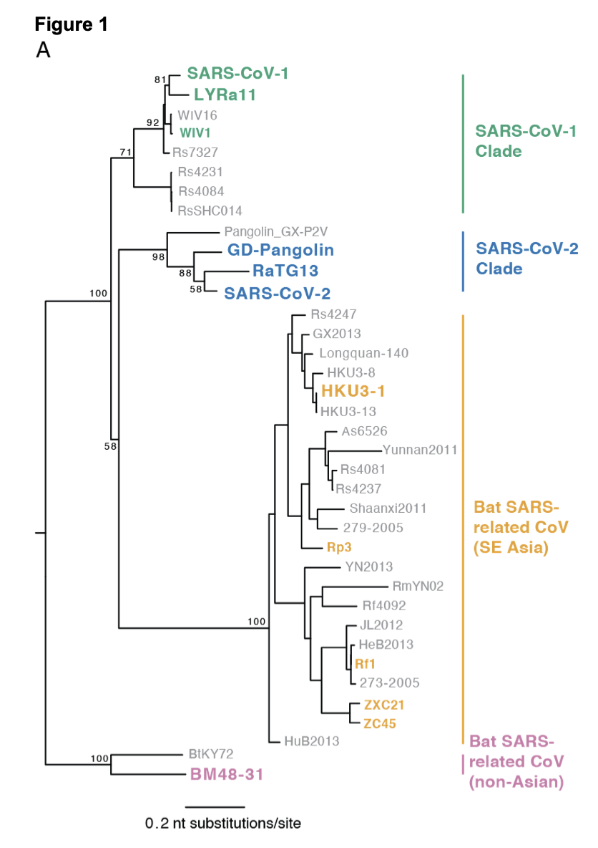
Reminder of what things look like from the RBD side

Slide 3
Phylogeny of all available Rhinolophus ACE2 sequences to date (including multiple sampled R. sinicus and affinis sequences from Zheng-Li Shi paper, which reveals particularly diverse ACE2 sequences among R. sinicus spp).
What do we know about these bats and the viruses they host?
R. alcyone and R. landeri are African species, I do not know of SARSr-CoV identified in these hosts
R. ferrumequinum has large range from Europe, to Northern Africa, to Asia. Quite a few SARSr-CoV have been recovered from this spp in SE Asia (all “clade 2” RBDs [not known to use ACE2] , e.g. Rf1, Rf4092. Some of these Rf isolates are from the same caves in Yunnan from the 2017 PLOS Pathogens paper that found many SARS-CoV-1 clade sequences from R. sinicus in the same cave)
R. pearsonii is SE Asian range, quite a few (clade 2) isolates found from the spp (e.g. Rp1,2,3)
R. macrotis and R. pusillus are both found in SE Asia and Himalayas. Have a few clade 2 SARSr-CoV isolated from these spp, e.g. Rm1
R. sinicus is SE Asian, has the most SARSr-CoV isolated from this spp, including virtually all SARS-CoV-1 clade RBD isolates. There is a lot of diversity in R. sinicus ACE2 sequences in particular, possibly reflecting ACE2:RBD arms races in this spp
R. affinis is SE Asian, also has ACE2-tropic (SARS-CoV-1-clade LYRa11 and SARS-CoV-2-clade RaTG13) isolates. Less variable ACE2 among sampled bats. Also in the same Yunnan caves as R. sinicus and R. ferrumequinum

Slide 4
What are some important functional details we know about these bat ACE2s?
All of the R. sinicus alleles can support some SARS-CoV-1-clade variants. ”Allele 6” is resistant to WIV1, WIV16 infection; ”Alleles 7 and 8” are resistant to SARS-CoV-1, RsSHC014, Rs4231 infection. “Allele 1” appears to be closest to the global consensus across R. sinicus alleles
R. affinis alleles have not been tested, newly reported
SARS-CoV-1 cannot use R. pearsonii ACE2, but swapping just three residues (40-42: FYQ in huACE2, SHE in RpACE2) is sufficient to allow SARS-CoV-1 usage
R. ferrumequinum, R. macrotis, and R. pusillus alleles, in one study, were not able to support SARS-CoV-1 pseudovirus entry.
Of our available spp with any functional info/SARSr-CoV isolates, R. ferrumequinum might be the best option for addressing the ‘breadth’ of ACE2 usage with respect to ACE2 binding among non-SE-Asian outgroup/deep ancestral nodes – R. ferrumequinum is the most closely related spp here to a European bat (R. blasii – no sequence available, and still perhaps quite distant from R. ferrumequinum) from which a sarbecovirus (BM48-31) was isolated outside of SE Asia. (However, ACE2 sequence might vary dramatically across R. ferrumequinum’s range, particularly in SE Asia where it’s in the same caves as these R. sinicus coronavirus breeding grounds!)

Slide 5
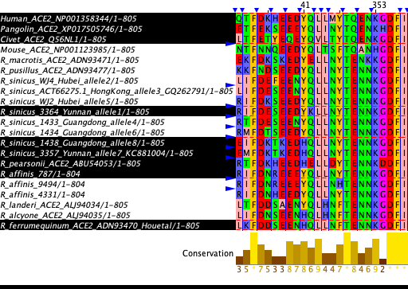
On left is the same phylogeny, on right is an alignment showing just positions that contact ACE2 in the SARS-CoV-2 or SARS-CoV-1 crystal structures. Redundant sequences of R. affinis and R. sinicus at these contact positions are collapsed. I apologize the orderings here are different and in general not pleasing to look at. The highlighted sequences in the alignment are those I think we are most interested in moving forward, as described on the next slide.
Notes:
Alignment shows positions: 24,27,28,30,31,34,35,37,38,41,42,45,79,82,83,324,325,329,330,353,354,355,356,393
(Note, the Michael Farzan paper I posted the other day with some alignments is misnumbered, off by one.)

Slide 6
What do I think we should do?
At least one R. sinicus and one R. affinis allele are no-brainers. For the first-priority of each of these, I would elect to choose the sequence that is closest to the consensus among sequences. For R. sinicus, I would imagine this being not a pure consensus, but rather each of the 8 ‘alleles’ I would derive a consensus, and then take the consensus of the 8 consensuses. (That is, don’t let alleles that have more representatives dominate). When I did this by eye, it appeared to be allele 1 (infectable by all SARS-CoV-1 strains tested) that was the consensus at the important contact positions. I would then probably choose the representative of allele (1) that was actually tested in the functional assays in the Zheng-Li Shi paper
Human we have, and I think both pangolin and civet would be interesting to include – for the question of ‘accidental’ acquisitions of ACE2 binding for non-bat hosts, these are the two clear candidates of interest for the SARS-CoV-1 and -2 clades
This puts us at 4 protein preps. I think there are two different routes for moving up to 6 (or just moving up to all 8 with both of the following, depending on final pricing structure etc.)
I favor going more ‘general’ with the next options to prioritize. I would choose R. pearsonii as a good representative of a bat from which Clade 2 sequences have been isolated, and for which it has been shown just a couple amino acid subs are sufficient to enable SARS-CoV-1 usage, indicating it is “close” to sufficient binding affinity to enable entry; second, I would choose R. ferrumequenum because of its broad host range and potential link to European sarbecoviruses/questions about large-scale breadth, its identification in Yunnan caves where SARS-CoV-1 clade isolates circulate, and the fact it hosts clade 2 isolates from within these Yunnan caves. I don’t think any isolates have been shown to be able to bind these two spp ACE2s well (though not much has been tried), so I think these are simultaneously ‘scary’ in that we don’t know whether anything will bind, but then also quite useful if a true negative result for clarifying relevant hosts for ACE2-utilizing SARSr-CoVs (and perhaps the clade 2 sequences, as well)
The other “next two” options to prioritize are hammering in on the interesting variation in R. sinicus alleles. The reason I initially favor the ‘broader’ selections in the bullet above, is although tons of these SARSr-CoVs are sampled from R. sinicus, we *don’t* yet know whether this host is relevant in the SARS-CoV-2 clade trajectory, as all of the R. sinicus isolates to date are in the SARS-CoV-1 clade and in clade 2. Nonetheless, this degree of ACE2 variation in this spp is extremely crazy and we probably want to incorporate it. If we were to add some of this here, I would favor using “allele 6” and one of “allele 7 or 8”, as those capture the different phenotypic variabilities seen in the paper in terms of utilization by SARS-CoV-1-clade isolates.

Slide 7
helix 1
helix 2
N90
glycan
helix 12
K353
hairpin
R393
*
*
*
*
*
*
*
*
*
*
*
*
*
*
*
*
*
*
*
*
*
Notes:
Structural contacts: 24+27+28+30+31+34+35+37+38+41+42+79+82+83+330+353+354+355+357+393

