Slide 1


Weekly Leadership Agenda
What are we doing? Building the leading franchise operating company in the country — where great people grow, guests are cared for, and operational excellence drives lasting success.
How are we doing it? Taking care of the little things to accomplish the big things.
© 2026 Hudson Restaurant Group | Proprietary & Confidential

Slide 2
Hudson Restaurant Group Values
Our Values | Description | Supporting Behaviors / Notes
Take care of each other | The guest experience will never exceed the team’s experience—so we put the team first. | - Talk openly and honestly - Celebrate wins - Tackle problems head-on - Respect, kindness, appreciation
Deliver a great experience | We bring energy, respect, and attention to every interaction—so guests leave happy and want to return. | - If we deliver for the guest, they’ll deliver for the business
Take pride in everything | We take pride in who we are, how we serve, and the space we create for others. | - Own the outcome - Everyone plays a part in success - Step up and lead from where you are
Be reliable, be ready | Show up on time, be ready to go, and bring your best every shift. | - Follow through on commitments—every time
Keep getting better | We’re always improving and welcome new ideas from everyone on the team. | - Ask for feedback - Help others grow - Push yourself to improve every shift
© 2026 Hudson Restaurant Group | Proprietary & Confidential

Slide 3
What We’ll be Talking About Today
1
2
3
4
Our Stores
Our People
Our Metrics
Administrative
Expectations of Leaders at HRG - Connor
© 2026 Hudson Restaurant Group | Proprietary & Confidential

Slide 4
Expectations of Leaders at HRG
Ownership → You own your market. We expect you to know what's working, what's not, and what you're doing about it.
Don't just report problems upward.
Accountability → If you make a commitment, close the loop. If an issue needs correcting, address it promptly.
Coaching without follow-up isn't sufficient.
People Development → Your success is ultimately determined by the quality of leaders you build. We want strong GMs, promotable talent, structured onboarding, and succession depth.
Operational Discipline → Numbers tell us where to look; visiting restaurants and understanding their teams tell us why.
Our systems and standards exist to create consistency (not paperwork).
Candor and Communication → We want bad news early. We would much rather hear about an issue immediately than discover it two weeks later.
Disagreement is welcome; surprises are not.
Continuous Improvement → HRG is not perfect. We're building the operating model as we grow.
We expect you to challenge processes that aren't working and bring better ideas.

Slide 5
Social Post of the Week
KIDZ NIGHT → FRIDAY NIGHT LIGHTZ → CHURCH BULLETIN
© 2026 Hudson Restaurant Group | Proprietary & Confidential

Slide 6
TN Critical Maintenance — Live WBR Worksheet
HUDSON
RESTAURANT
Review last week’s commitment, record the outcome, and leave with a clear next action and deadline.
GROUP
MEETING FLOW
Last week’s commitment → outcome → next step → owner → new target
STORE
Issue
PRIOR TARGET
UPDATE / OUTCOME
OWNER
NEXT STEP
NEW TARGET
Brentwood
N/A
—
N/A
Tommy
N/A
N/A
Columbia
Rick installing new hose parts
—
Rick coming this week
Tommy
N/A
10/22
Spring Hill
Pole light part missing; Fryer ¾ valve stripped; Rick installing new hose parts
—
Pole light still not fixed. ATech coming to fix fryer.
Tommy
Delayed. Needs follow-up.
10/22
Portland
Drain needs to be fixed from where it was concreted; FOH monitors (Rick)
—
—
Maegan
—
—
Springfield
Fry Freezer door, Back door not Locking; Left side door arm not shutting
—
Waiting on Rick
Maegan
Rick
10/21
White House
Fly fan (Waiting on Fly Motor); Set station Reach-in Cooler; hose
—
Waiting on Rick
Maegan
Rick
10/21
Was last week’s commitment completed? If not, what is the specific next action—and by when?
© 2026 Hudson Restaurant Group | Proprietary & Confidential

Slide 7
VA Critical Maintenance — Live WBR Worksheet
HUDSON
RESTAURANT GROUP
Review last week’s commitment, record the outcome, and leave with a clear next action and deadline.
MEETING FLOW
Last week’s commitment → outcome → next step → owner → new target
STORE
LAST WEEK’S COMMITMENT
PRIOR TARGET
UPDATE / OUTCOME
OWNER
NEXT STEP
NEW TARGET
Jefferson
N/A
N/A
Star
N/A
Oyster
Trying sprayer from College.
N/A
N/A
Star
N/A
10/20
Hampton
Flat top temp control knobs (wrong one); bottom of filter-pad tank leaking
N/A
Star to call 5 point
Star
Roger to Weld Filter pans
10/20
College Dr
Tender Station underneath is still down (waiting on Masters); left half of the flat top
N/A
Call 5Point for flat-top and Masters for Tender Station
Star
N/A
10/21
Square
Hole in wall in dining room
N/A
Breader station ordered on the way, but in a few weeks
Chris
Preston to text ServiceMaster
10/21
Hillcrest
YESCO for lights
N/A
Waiting on both vendors
Chris
N/A
10/21
VA Beach
N/A
N/A
N/A
Chris
N/A
N/A
Was last week’s commitment completed? If not, what is the specific next action—and by when?
© 2026 Hudson Restaurant Group | Proprietary & Confidential

Slide 8
Weekly Workstream Audit
October 19, 2026 | 12:01 PM
Three stores are out of compliance with the daily Workstream requirement.
11 / 13
2
0
Checked today
Need follow-up
48+ hours inactive
11 store accounts were active as of the AM audit.
5/6 above-store leaders active within 24 hours.
Brentwood
Hillcrest
Every store checks Workstream every single day.
DAILY STANDARD

Slide 9
Weekly GroupMe Audit
October 19, 2026 | 12:01 PM
One store is materially out of compliance with the daily GroupMe requirement.
Every store is required to check GroupMe every day; activity within 24 hours is the expectation.
12 / 13
1
0
Messaged today
Need follow-up
48+ hours inactive
12 store accounts were active as of the AM audit.
Hillcrest - TWO Weeks IN A ROW
Every store communicates in GroupMe every single day.
DAILY STANDARD

Slide 10
October Drive-Thru RBG Mystery Shop Results
October Shops
Market | Store | Shop Date | Score
VA | Jefferson | 10/2 | 100%
VA | Hillcrest | 10/3 | 100%
TN | Columbia | 10/1 | 95%
TN | Oyster Point | 10/4 | 95%
TN | White House | 10/2 | 94%
TN | Springfield | 10/5 | 91%
TN | Brentwood | 10/3 | 91%
TN | Spring Hill | 10/1 | 87%
VA | Hampton | 10/5 | 83%
VA | Chesapeake Square | 10/2 | 82%
VA | Beach | 10/4 | 68%
VA | College Drive | 10/2 | 50%
HUDSON RESTAURANT GROUP

Slide 11
HUDSON
Our People: Leadership Bench & Hiring Commitments (TN)
RESTAURANT GROUP
Store
GM
AGM(s)
Directors
Shift Leads
Crew Need
This Week’s Commitment
Owner
Due
Brentwood
Caleb Haney
1/1
Dale Dotson
1/1
Jayla G (TD)
1/4
0/4
Add 5
Fill 3-Director opening (DT,HD,QD); need to add 4 shift leads
Tommy
Set today
Columbia
Kei Barner
1/1
Ron S
1/1
Ben W (QD)
Kayla M (TD)
Kaitlin W (HD)
3/4
9/9
Add 1-3
Fill DTD opening
Tommy
Set today
Springfield
Dani
1/1
Tori
1/1
David (DT)
Janaejah (HD)
Russell (TD)
Audrey (QD)
4/4
9/7
2
Adding Crew members
N/A
Set today
Spring Hill
Brandon Mason
1/1
Emma
1/1
Stephanie D (QD)
David D (DTD)
Brylee C (TD)
Kaitlyn D (HD)
4/4
4/6
Add 3
Tommy
Set today
White House
Chelsea Hewitt
1/1
Bonita Frey
1/1
Kira (TD)
Amanda (DT)
Amber (HD)
Josh (QD)
4/4
6/7
3
BOH shift leaders/ Crew needed
Maegan
Set today
Portland
Faith
1/1
Amethyst Lindsay
1/1
Ryan (QD)
Sky (DT)
Matthew (TD)
Michael (HD)
4/4
7/7
N/A
Maegan
Set today
Meeting prompt: Who is the next named hire or promotion, what happens this week, and by when?
© 2026 Hudson Restaurant Group | Proprietary & Confidential

Slide 12
HUDSON
Our People: Leadership Bench & Hiring Commitments (VA)
RESTAURANT GROUP
Store
GM
AGM(s)
Directors
Shift Leads
Crew Need
This Week’s Commitment
Owner
Due
Jefferson
Cliff
1/1
0/1
0/4
2/3
N/A
Need ALL Directors
Star / Clifton
Set today
Oyster
Maurice R
1/1
Purvina - AGM
1/1
Thomas Newton (DTD)
Antonio H (QD)
2/4
2/3
Add 2
Fill 3 Director openings
Star / Maurice
Set today
Hampton
Latonya
1/1
Carol
1/1
Meka (DT)
Anthony Cox (HD)
Watanza (TD)
3/4
1/5
Add 15
1 - Directors
2- Potential Internal SL
Star / Latonya
Set today
College Dr
Kristine
1/1
Sidnell
1/1
Shanika - (QD)
Jasmine- (DT)
2/4
1/4
Add 2
Looking for TD, HD
Kristine / Star
Set today
Square
Raynesha
1/1
Kristine Cabasa
1/1
Makayla Y- QD
Tony R- DT
Derrick- TD
3/4
2/4
Add 10
Add 2 Director and 2 Shift Leads
Raynesha / Chris
Set today
Hillcrest
Kelly Rogers
1/1
Jonathan Pinchbeck
1/1
Roger - DT
Maurita W - HD
Tre’von - QD (training - needs test)
Aidan B (Toby) - TD
2/3
Add 6
1 Shift Leads , 1 Director
Kelly / Chris
Set today
VA Beach
Eddie
1/1
Will M
1/1
Jackie- TD
Chaz- QD
2/4
3/4
Add 10
Fill 2 Director openings, 1 Shift Leads
Eddie / Chris
Set today
Meeting prompt: Who is the next named hire or promotion, what happens this week, and by when?
© 2026 Hudson Restaurant Group | Proprietary & Confidential

Slide 13
HUDSON RESTAURANT GROUP / WEEKLY BUSINESS REVIEW
OCT 12–18, 2026
MAEGAN / NORTH TENNESSEE
3 RESTAURANTS
NET SALES
WoW
YoY
TRANSACTIONS
WoW
YoY
AVERAGE CHECK
WoW
YoY
$200.2K
-10.9%
-5.7%
11,300
-8.2%
-5.4%
$17.72
-2.9%
-0.3%
WoW: all stores • YoY: legacy stores only
WoW: all stores • YoY: legacy stores only
WoW: all stores • YoY: legacy stores only
LOCATION
SALES
TRANSACTIONS
AVERAGE CHECK
CURRENT
WoW
YoY
CURRENT
WoW
YoY
CURRENT
WoW
YoY
Portland
$77.9K
-19.9%
N/A
4,165
-15.1%
N/A
$18.69
-5.7%
N/A
Springfield
$59.8K
-5.6%
-1.4%
3,386
-6.1%
-1.4%
$17.66
+0.6%
-0.1%
White House
$62.6K
-2.5%
-9.4%
3,749
-1.4%
-8.7%
$16.69
-1.1%
-0.8%
DISTRICT TOTAL
$200.2K
-10.9%
-5.7%
11,300
-8.2%
-5.4%
$17.72
-2.9%
-0.3%
READOUT
PORTLAND SALES −19.9% WoW AND TRAFFIC −15.1% • FULL DISTRICT SALES −10.9% WoW
SOURCE: Zaxby’s ReportHub • WTD through Sunday 10/18/2026 | Prior week 10/5–10/11/2026
01 / 04

Slide 14
HUDSON RESTAURANT GROUP / WEEKLY BUSINESS REVIEW
OCT 12–18, 2026
TOMMY / SOUTH TENNESSEE
3 RESTAURANTS
NET SALES
WoW
YoY
TRANSACTIONS
WoW
YoY
AVERAGE CHECK
WoW
YoY
$162.3K
-0.6%
-12.9%
9,421
+0.6%
-14.8%
$17.23
-1.2%
+2.2%
Full district • same-store comparisons
Full district • same-store comparisons
Full district • same-store comparisons
LOCATION
SALES
TRANSACTIONS
AVERAGE CHECK
CURRENT
WoW
YoY
CURRENT
WoW
YoY
CURRENT
WoW
YoY
Brentwood
$25.9K
-9.0%
-2.3%
1,537
-5.6%
-5.1%
$16.84
-3.5%
+2.9%
Columbia
$71.9K
+1.6%
-22.6%
4,180
+3.6%
-23.0%
$17.20
-2.0%
+0.4%
Spring Hill
$64.5K
+0.7%
-3.6%
3,704
-0.0%
-7.6%
$17.41
+0.7%
+4.4%
DISTRICT TOTAL
$162.3K
-0.6%
-12.9%
9,421
+0.6%
-14.8%
$17.23
-1.2%
+2.2%
READOUT
COLUMBIA IS THE BIGGEST DRAG • SALES −22.6% YoY, DESPITE A +1.6% WEEK-OVER-WEEK REBOUND
SOURCE: Zaxby’s ReportHub • WTD through Sunday 10/18/2026 | Prior week 10/5–10/11/2026
02 / 04

Slide 15
HUDSON RESTAURANT GROUP / WEEKLY BUSINESS REVIEW
OCT 12–18, 2026
STAR / VIRGINIA | PENINSULA + SUFFOLK
4 RESTAURANTS
NET SALES
WoW
YoY
TRANSACTIONS
WoW
YoY
AVERAGE CHECK
WoW
YoY
$207.1K
+4.5%
+3.2%
11,563
+2.9%
+1.8%
$17.91
+1.6%
+1.4%
Full district • same-store comparisons
Full district • same-store comparisons
Full district • same-store comparisons
LOCATION
SALES
TRANSACTIONS
AVERAGE CHECK
CURRENT
WoW
YoY
CURRENT
WoW
YoY
CURRENT
WoW
YoY
Jefferson
$36.9K
+4.7%
-4.6%
2,054
+2.2%
-8.4%
$17.95
+2.5%
+4.2%
Oyster
$38.6K
+6.7%
+0.3%
2,162
+5.3%
-2.8%
$17.86
+1.4%
+3.3%
Hampton
$79.1K
+6.9%
+12.2%
4,310
+5.0%
+11.1%
$18.36
+1.8%
+1.0%
College Drive
$52.5K
-0.4%
-1.1%
3,037
-1.2%
+0.7%
$17.30
+0.8%
-1.8%
DISTRICT TOTAL
$207.1K
+4.5%
+3.2%
11,563
+2.9%
+1.8%
$17.91
+1.6%
+1.4%
READOUT
HAMPTON LEADS THE DISTRICT • +12.2% SALES YoY AND +6.9% WoW
SOURCE: Zaxby’s ReportHub • WTD through Sunday 10/18/2026 | Prior week 10/5–10/11/2026
03 / 04

Slide 16
HUDSON RESTAURANT GROUP / WEEKLY BUSINESS REVIEW
OCT 12–18, 2026
CHRIS / VIRGINIA | CHESAPEAKE + BEACH
3 RESTAURANTS
NET SALES
WoW
YoY
TRANSACTIONS
WoW
YoY
AVERAGE CHECK
WoW
YoY
$125.5K
+1.0%
-1.8%
6,471
-1.2%
-2.1%
$19.39
+2.3%
+0.4%
Full district • same-store comparisons
Full district • same-store comparisons
Full district • same-store comparisons
LOCATION
SALES
TRANSACTIONS
AVERAGE CHECK
CURRENT
WoW
YoY
CURRENT
WoW
YoY
CURRENT
WoW
YoY
Beach
$33.8K
-1.4%
-0.3%
1,687
+0.2%
-1.2%
$20.05
-1.7%
+0.9%
Chesapeake Square
$54.8K
+3.8%
-0.7%
2,951
+1.7%
+0.3%
$18.58
+2.0%
-1.0%
Hillcrest
$36.8K
-0.6%
-4.5%
1,833
-6.8%
-6.5%
$20.08
+6.6%
+2.1%
DISTRICT TOTAL
$125.5K
+1.0%
-1.8%
6,471
-1.2%
-2.1%
$19.39
+2.3%
+0.4%
READOUT
SALES ARE NEGATIVE YoY AT ALL 3 STORES • HILLCREST TRAFFIC IS −6.5% YoY
SOURCE: Zaxby’s ReportHub • WTD through Sunday 10/18/2026 | Prior week 10/5–10/11/2026
04 / 04

Slide 17
HUDSON RESTAURANT GROUP / WEEKLY BUSINESS REVIEW
MAEGAN
WEEK ENDED OCT 18, 2026
NORTH TENNESSEE
PRODUCTIVITY AT TARGET
TPLH AT TARGET
PRODUCTIVITY IMPROVED
TPLH IMPROVED
0 / 3
0 / 3
1 / 3
1 / 3
stores meeting goal
stores meeting goal
vs. prior week
vs. prior week
LOCATION & SALES
PRODUCTIVITY / SALES PER LABOR HOUR
TPLH / TRANSACTIONS PER LABOR HOUR
Portland
$60.57
▼ −$21.18 WoW
BELOW TARGET
3.24
▼ −0.89 WoW
BELOW TARGET
TARGET $82–87
−$21.43 to floor
TARGET 5.25+
−2.01 to floor
NET SALES
$77,851
SEP 28 —
OCT 05 $81.75
OCT 12 $60.57
SEP 28 —
OCT 05 4.13
OCT 12 3.24
Springfield
$74.33
▲ +$3.98 WoW
BELOW TARGET
4.21
▲ +0.20 WoW
BELOW TARGET
TARGET $82–87
−$7.67 to floor
TARGET 5.25+
−1.04 to floor
NET SALES
$59,807
SEP 28 $73.29
OCT 05 $70.35
OCT 12 $74.33
SEP 28 4.07
OCT 05 4.01
OCT 12 4.21
White House
$77.68
▼ −$2.41 WoW
BELOW TARGET
4.65
▼ −0.10 WoW
BELOW TARGET
TARGET $82–87
−$4.32 to floor
TARGET 5.25+
−0.60 to floor
NET SALES
$62,580
SEP 28 $83.55
OCT 05 $80.09
OCT 12 $77.68
SEP 28 4.80
OCT 05 4.75
OCT 12 4.65
DISTRICT TAKEAWAY
Portland had the sharpest week-over-week decline in both metrics; all three stores remain below both goals.
1 / 4

Slide 18
HUDSON RESTAURANT GROUP / WEEKLY BUSINESS REVIEW
TOMMY
WEEK ENDED OCT 18, 2026
SOUTH TENNESSEE
PRODUCTIVITY AT TARGET
TPLH AT TARGET
PRODUCTIVITY IMPROVED
TPLH IMPROVED
1 / 3
0 / 3
1 / 3
1 / 3
stores meeting goal
stores meeting goal
vs. prior week
vs. prior week
LOCATION & SALES
PRODUCTIVITY / SALES PER LABOR HOUR
TPLH / TRANSACTIONS PER LABOR HOUR
Brentwood
$51.42
▼ −$4.67 WoW
BELOW TARGET
3.05
▼ −0.16 WoW
BELOW TARGET
TARGET $60+
−$8.58 to floor
TARGET 4.00+
−0.95 to floor
NET SALES
$25,876
SEP 28 $59.01
OCT 05 $56.09
OCT 12 $51.42
SEP 28 3.46
OCT 05 3.21
OCT 12 3.05
Columbia
$82.91
▲ +$9.29 WoW
ON TARGET
4.82
▲ +0.63 WoW
BELOW TARGET
TARGET $82–87
At / above floor
TARGET 5.25+
−0.43 to floor
NET SALES
$71,913
SEP 28 $77.46
OCT 05 $73.62
OCT 12 $82.91
SEP 28 4.48
OCT 05 4.19
OCT 12 4.82
Spring Hill
$77.31
▼ −$1.28 WoW
BELOW TARGET
4.44
▼ −0.12 WoW
BELOW TARGET
TARGET $82–87
−$4.69 to floor
TARGET 5.25+
−0.81 to floor
NET SALES
$64,491
SEP 28 $77.62
OCT 05 $78.59
OCT 12 $77.31
SEP 28 4.53
OCT 05 4.56
OCT 12 4.44
DISTRICT TAKEAWAY
Columbia is the only location meeting its productivity target. All three stores remain below TPLH standards.
2 / 4

Slide 19
HUDSON RESTAURANT GROUP / WEEKLY BUSINESS REVIEW
STAR
WEEK ENDED OCT 18, 2026
VIRGINIA • HAMPTON / NEWPORT NEWS
PRODUCTIVITY AT TARGET
TPLH AT TARGET
PRODUCTIVITY IMPROVED
TPLH IMPROVED
2 / 4
0 / 4
3 / 4
3 / 4
stores meeting goal
stores meeting goal
vs. prior week
vs. prior week
LOCATION & SALES
PRODUCTIVITY / SALES PER LABOR HOUR
TPLH / TRANSACTIONS PER LABOR HOUR
Jefferson
$69.81
▲ +$3.38 WoW
BELOW TARGET
3.89
▲ +0.10 WoW
BELOW TARGET
NET SALES
$36,867
TARGET $70–80
−$0.19 to floor
TARGET >4.00
−0.11 to floor
SEP 28 $65.20
OCT 05 $66.43
OCT 12 $69.81
SEP 28 3.72
OCT 05 3.79
OCT 12 3.89
Oyster
$62.14
▲ +$9.04 WoW
BELOW TARGET
3.48
▲ +0.47 WoW
BELOW TARGET
NET SALES
$38,609
TARGET $70–80
−$7.86 to floor
TARGET >4.00
−0.52 to floor
SEP 28 $51.92
OCT 05 $53.10
OCT 12 $62.14
SEP 28 2.92
OCT 05 3.01
OCT 12 3.48
Hampton
$77.79
▲ +$3.63 WoW
ON TARGET
4.24
▲ +0.13 WoW
BELOW TARGET
NET SALES
$79,121
TARGET $75–85
At / above floor
TARGET >4.75
−0.51 to floor
SEP 28 $67.79
OCT 05 $74.16
OCT 12 $77.79
SEP 28 3.66
OCT 05 4.11
OCT 12 4.24
College Drive
$77.48
▼ −$0.30 WoW
ON TARGET
4.48
▼ −0.05 WoW
BELOW TARGET
NET SALES
$52,532
TARGET $75–85
At / above floor
TARGET >4.75
−0.27 to floor
SEP 28 $69.68
OCT 05 $77.78
OCT 12 $77.48
SEP 28 4.00
OCT 05 4.53
OCT 12 4.48
DISTRICT TAKEAWAY
Hampton and College Drive are within the productivity target band. Oyster posted the largest week-over-week improvement.
3 / 4

Slide 20
HUDSON RESTAURANT GROUP / WEEKLY BUSINESS REVIEW
CHRIS
WEEK ENDED OCT 18, 2026
VIRGINIA • SOUTH SIDE
PRODUCTIVITY AT TARGET
TPLH AT TARGET
PRODUCTIVITY IMPROVED
TPLH IMPROVED
0 / 3
0 / 3
1 / 3
0 / 3
stores meeting goal
stores meeting goal
vs. prior week
vs. prior week
LOCATION & SALES
PRODUCTIVITY / SALES PER LABOR HOUR
TPLH / TRANSACTIONS PER LABOR HOUR
VA Beach
$59.56
▼ −$4.42 WoW
BELOW TARGET
2.98
▼ −0.16 WoW
BELOW TARGET
TARGET $70–80
−$10.44 to floor
TARGET >4.00
−1.02 to floor
NET SALES
$33,686
SEP 28 $58.75
OCT 05 $63.98
OCT 12 $59.56
SEP 28 3.06
OCT 05 3.14
OCT 12 2.98
Chesapeake Square
$69.37
▼ −$3.55 WoW
BELOW TARGET
3.73
▼ −0.27 WoW
BELOW TARGET
TARGET $75–85
−$5.63 to floor
TARGET >4.75
−1.02 to floor
NET SALES
$54,844
SEP 28 $65.08
OCT 05 $72.92
OCT 12 $69.37
SEP 28 3.64
OCT 05 4.00
OCT 12 3.73
Hillcrest
$55.96
▲ +$0.61 WoW
BELOW TARGET
2.79
▼ −0.15 WoW
BELOW TARGET
TARGET $70–80
−$14.04 to floor
TARGET >4.00
−1.21 to floor
NET SALES
$36,800
SEP 28 $56.10
OCT 05 $55.35
OCT 12 $55.96
SEP 28 2.85
OCT 05 2.94
OCT 12 2.79
DISTRICT TAKEAWAY
Every location remains below both goals; TPLH declined at all three stores versus the previous week.
4 / 4

Slide 21
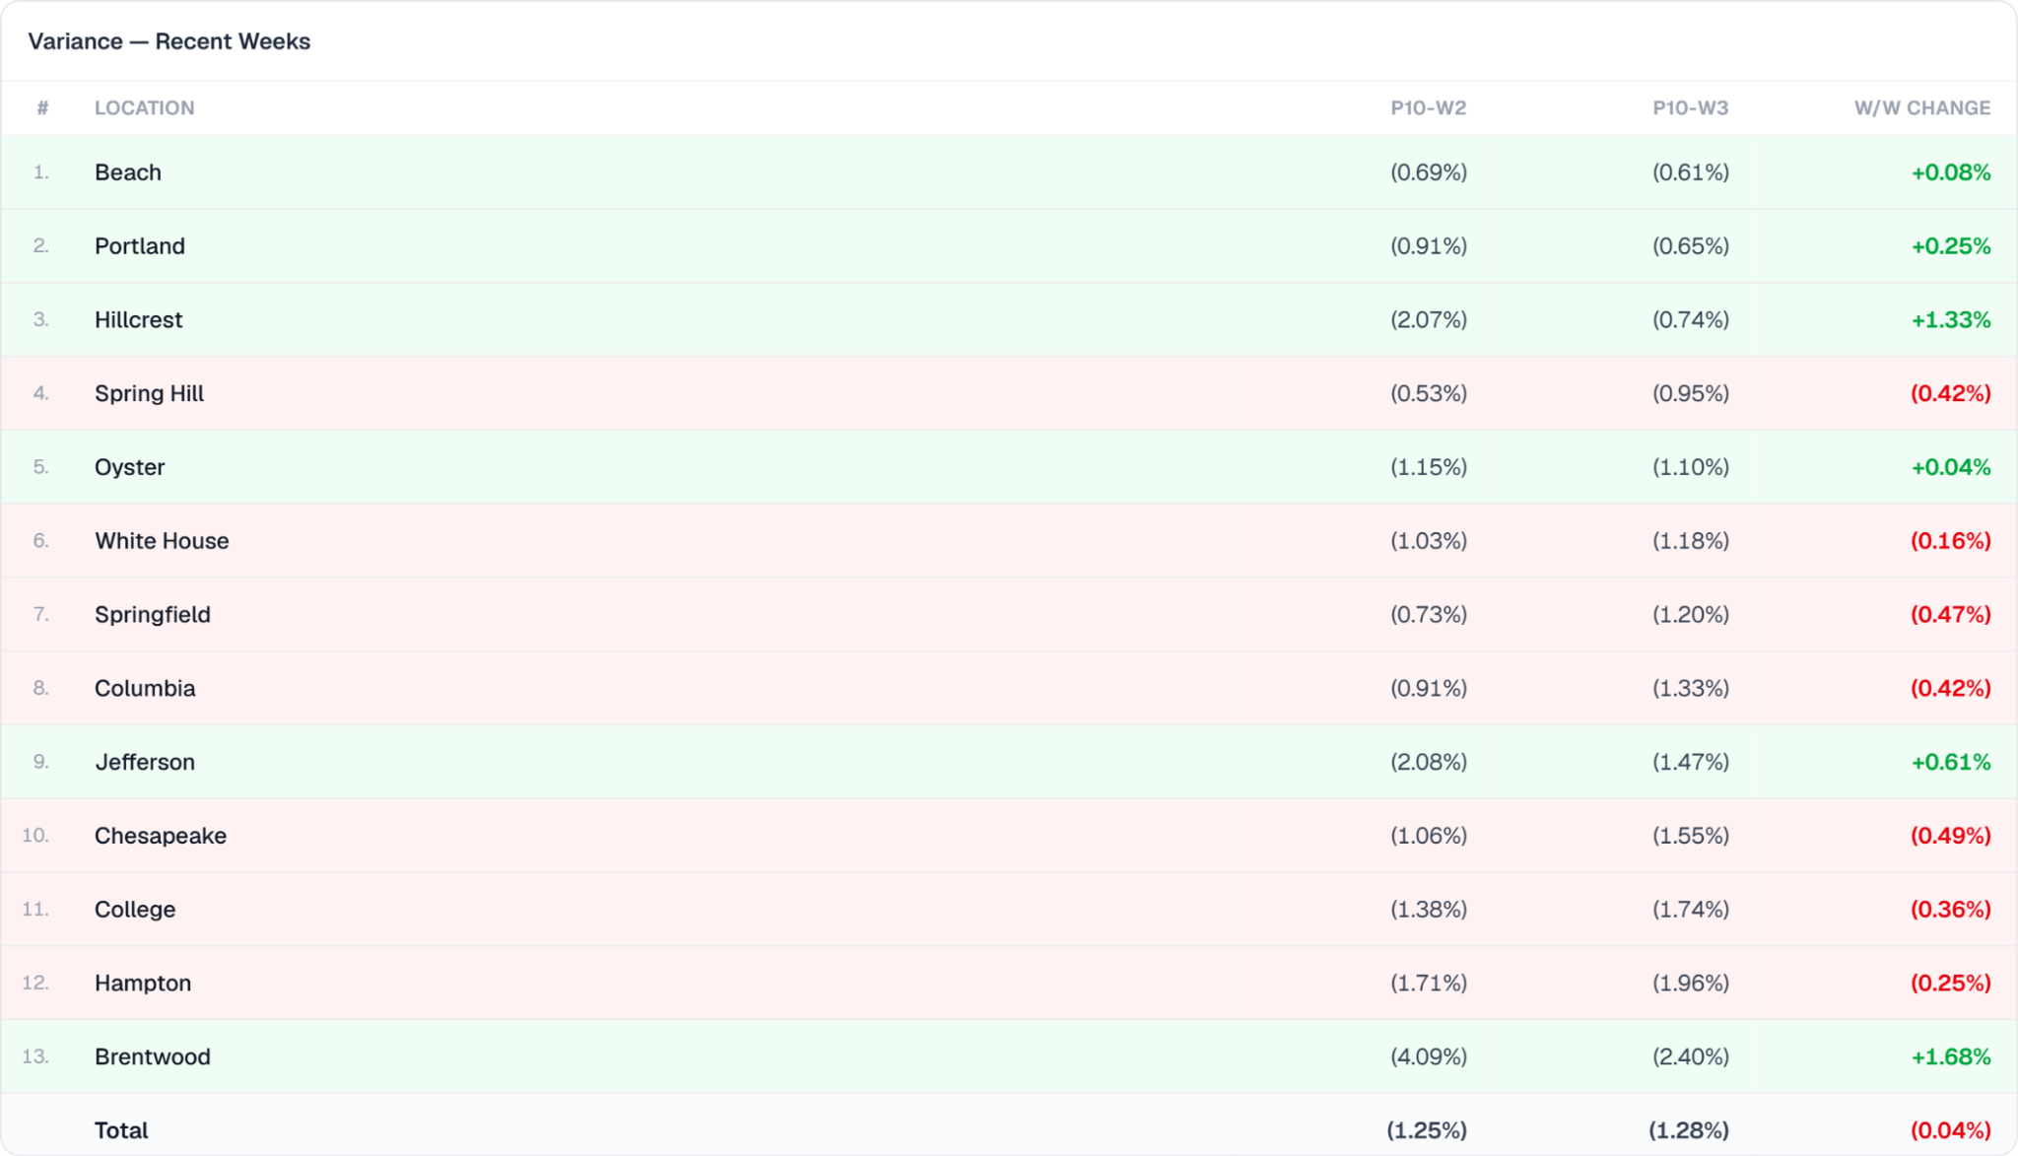
Portfolio Variance
© 2026 Hudson Restaurant Group | Proprietary & Confidential

Slide 22
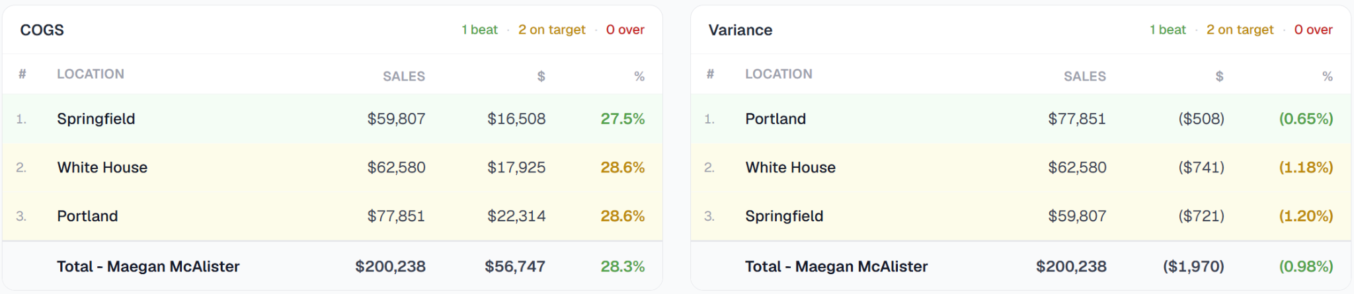
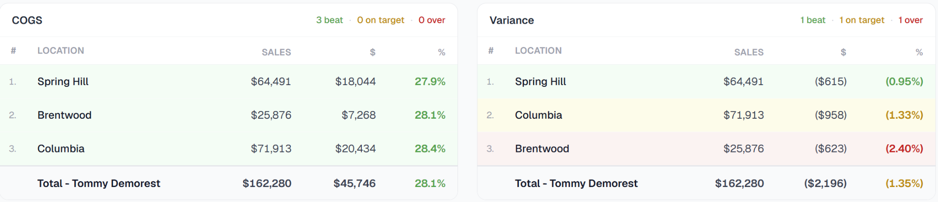
TN COGS
© 2026 Hudson Restaurant Group | Proprietary & Confidential

Slide 23
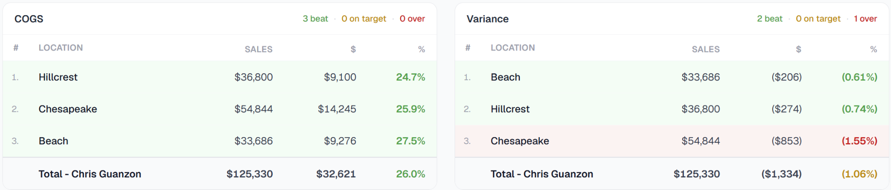
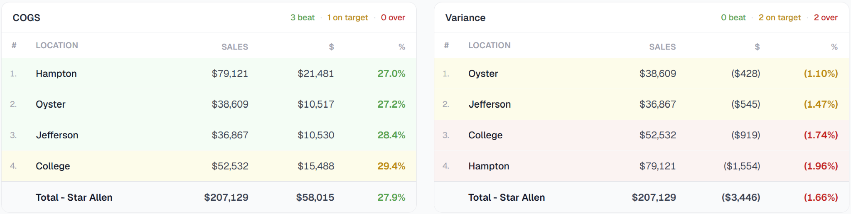
VA COGS
© 2026 Hudson Restaurant Group | Proprietary & Confidential

Slide 24
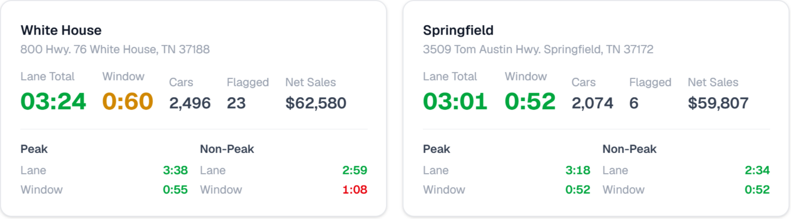
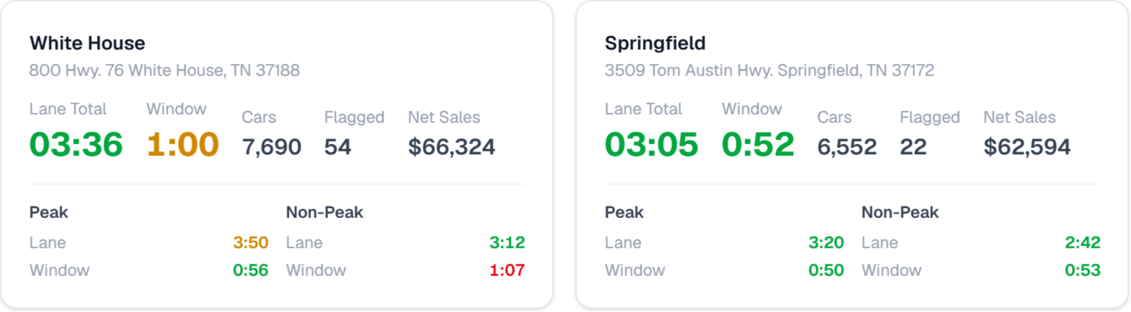
Drive Times – Maegan
Last Week
PTD
© 2026 Hudson Restaurant Group | Proprietary & Confidential

Slide 25
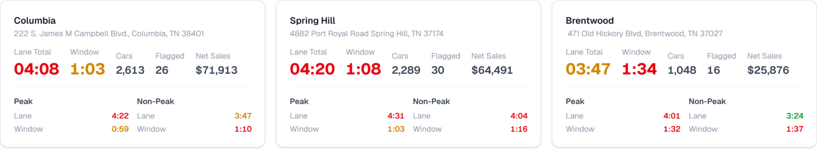
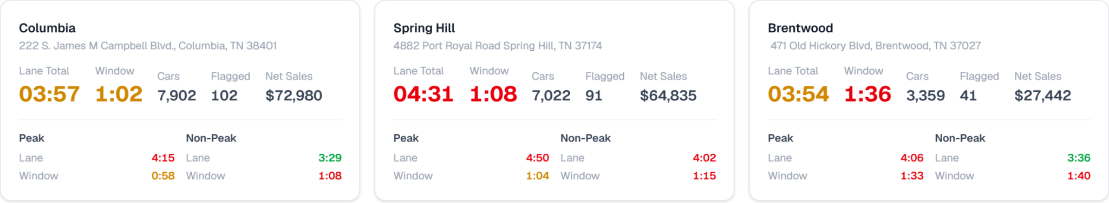
Drive Times – Tommy
Last Week
PTD
© 2026 Hudson Restaurant Group | Proprietary & Confidential

Slide 26
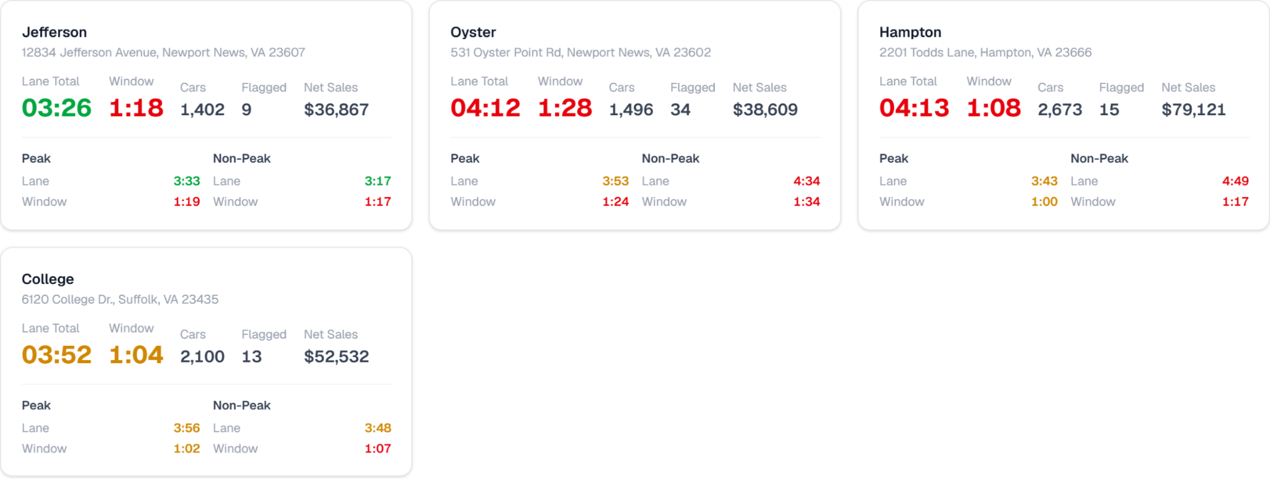
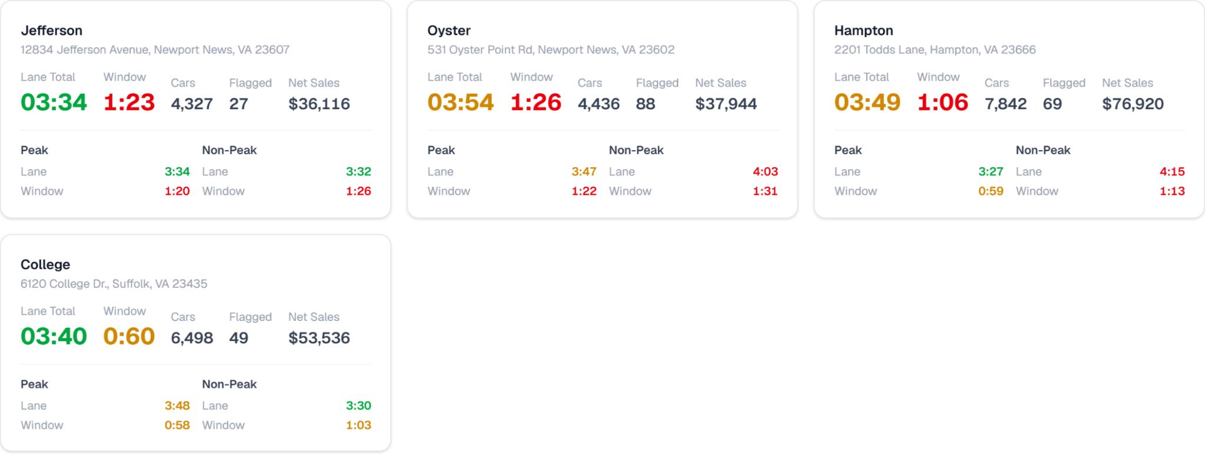
Drive Times – Star
Last Week
PTD
© 2026 Hudson Restaurant Group | Proprietary & Confidential

Slide 27
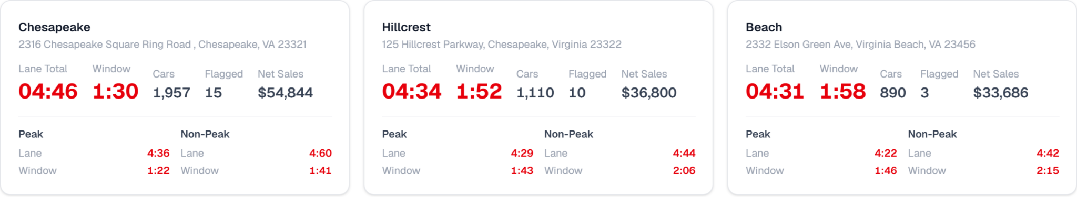
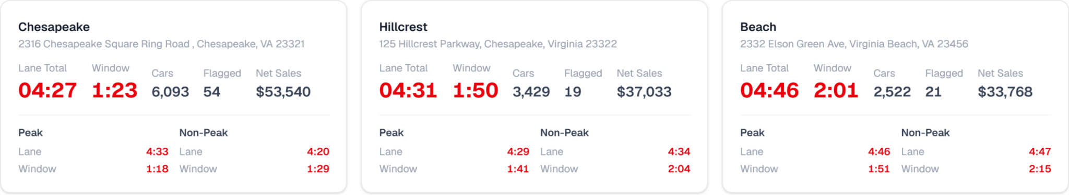
Drive Times – Chris
Last Week
PTD
© 2026 Hudson Restaurant Group | Proprietary & Confidential

Slide 28
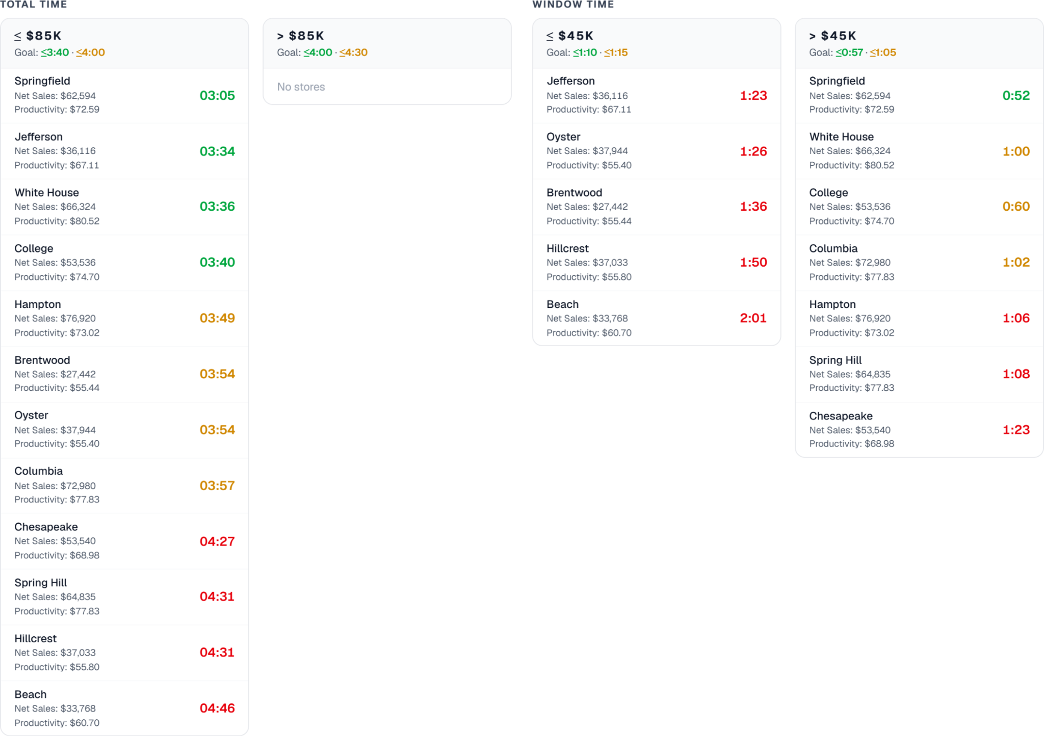
Volume-Based SOS Rankings – PTD
© 2026 Hudson Restaurant Group | Proprietary & Confidential

Slide 29
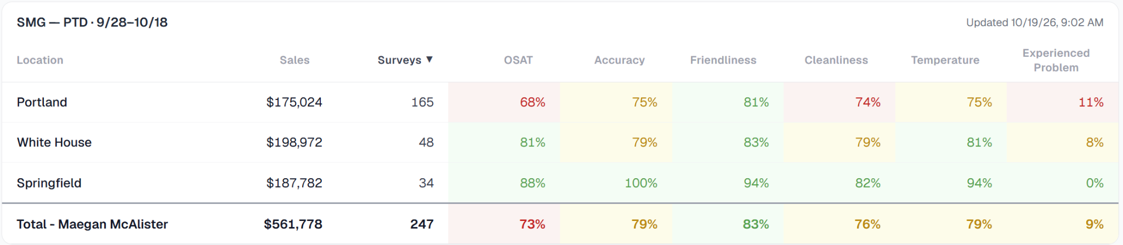
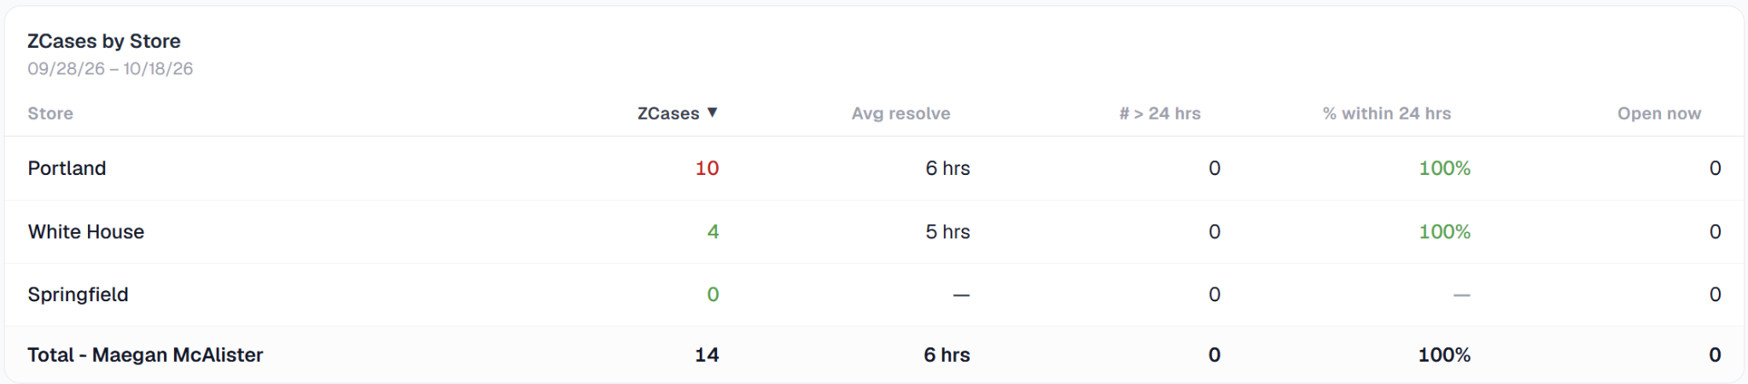
SMG - Maegan
© 2026 Hudson Restaurant Group | Proprietary & Confidential

Slide 30
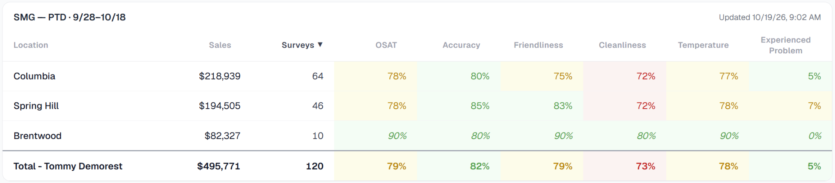
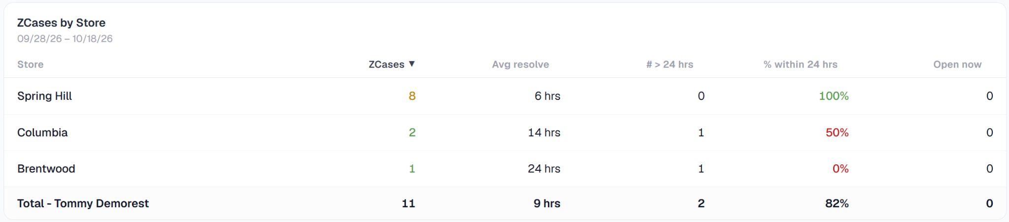
SMG - Tommy
© 2026 Hudson Restaurant Group | Proprietary & Confidential

Slide 31
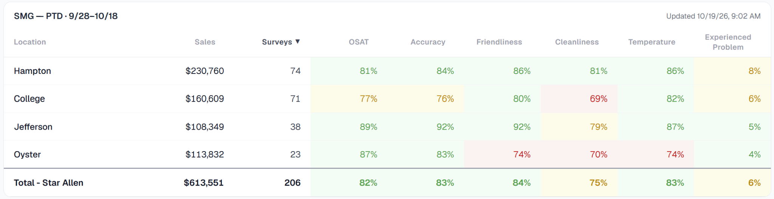
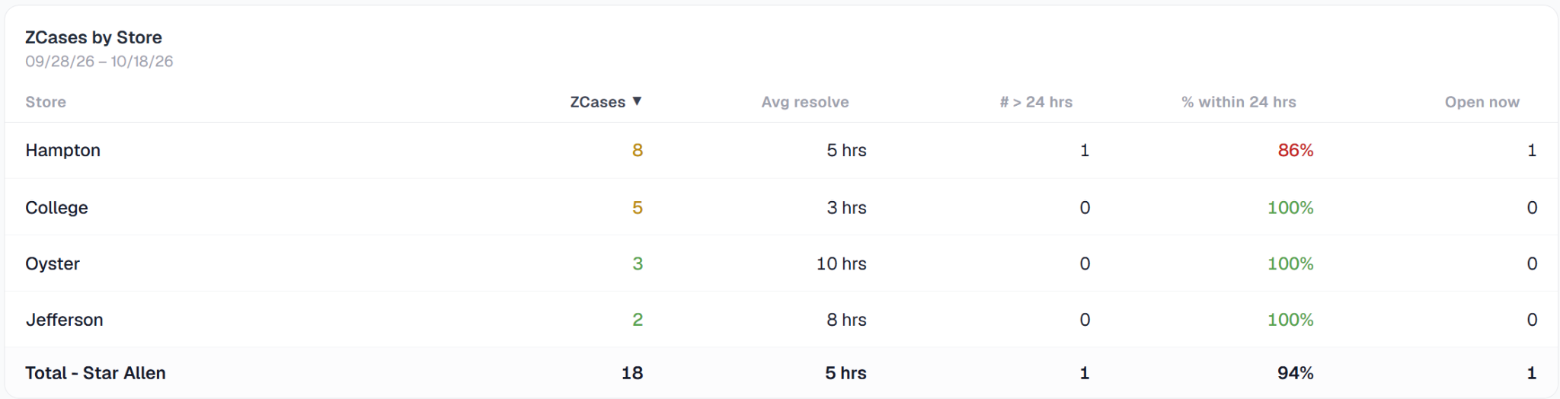
SMG - Star
© 2026 Hudson Restaurant Group | Proprietary & Confidential

Slide 32
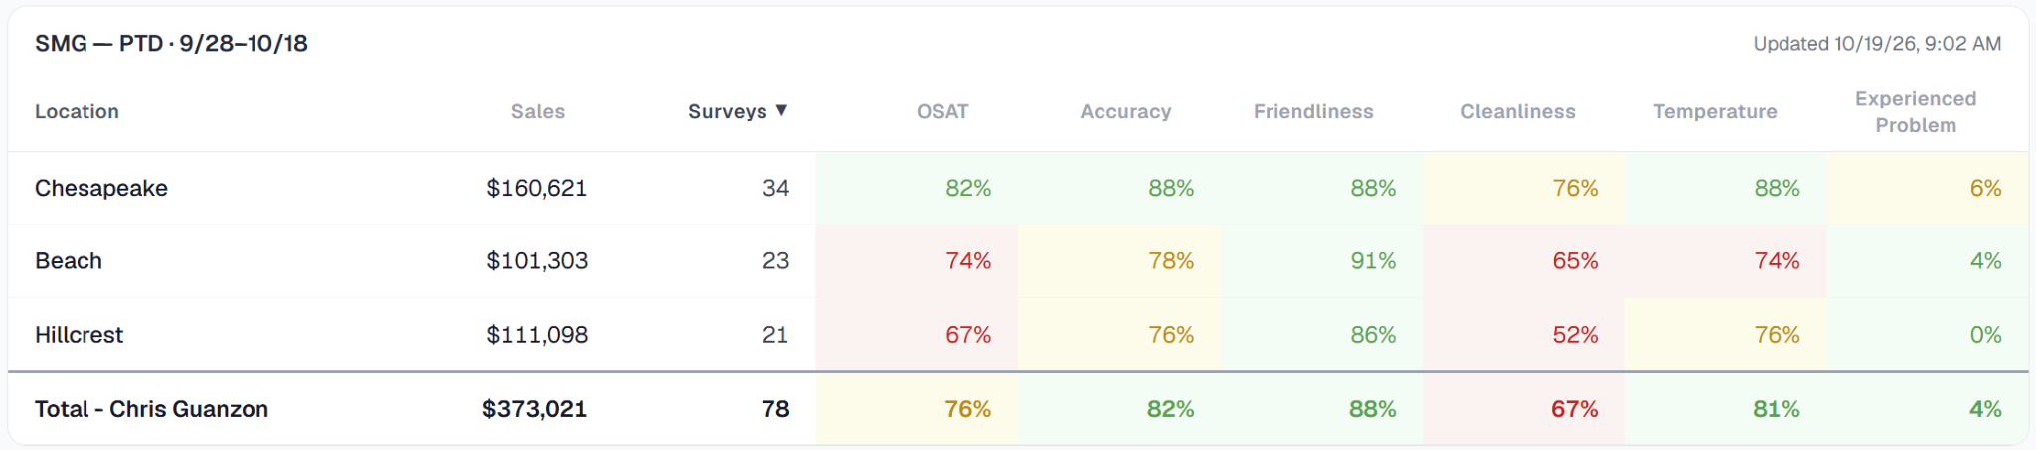
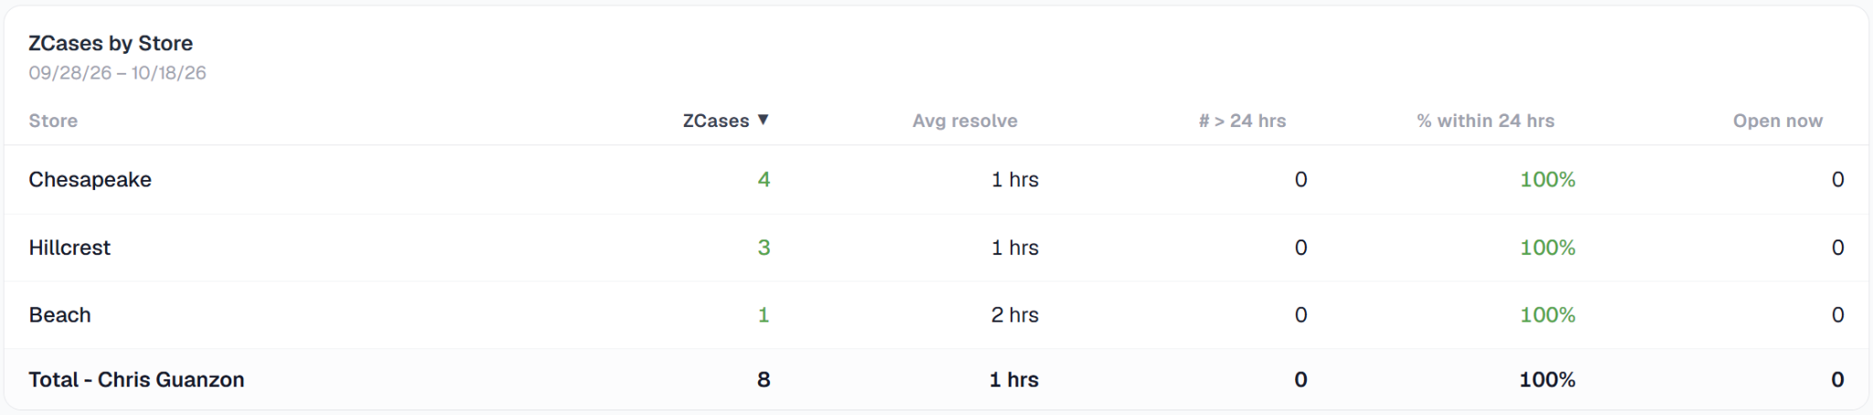
SMG - Chris
© 2026 Hudson Restaurant Group | Proprietary & Confidential

Slide 33
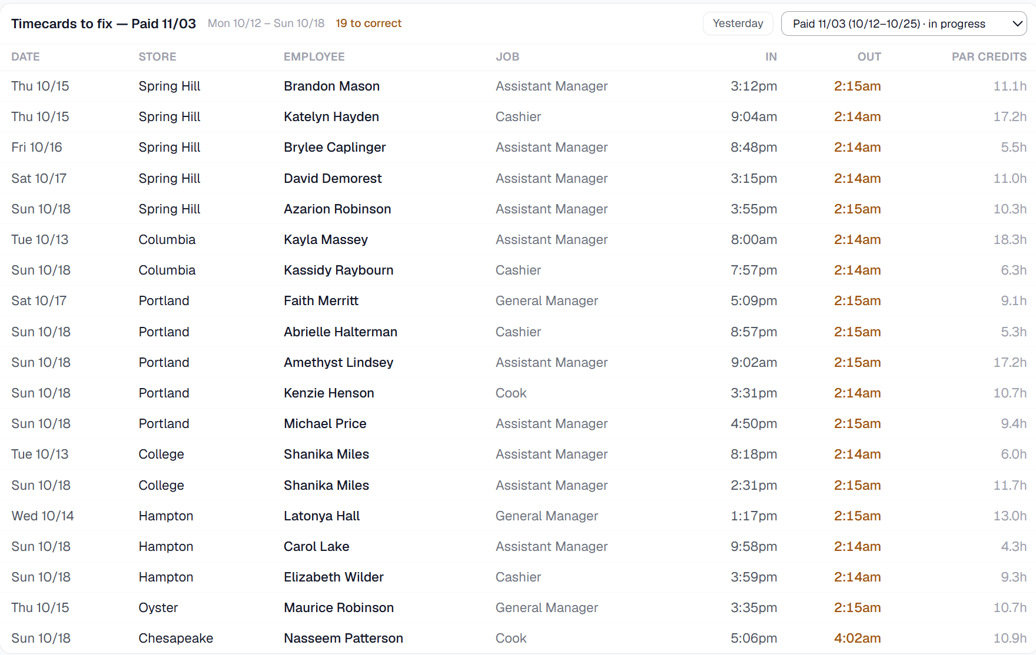
Clock-Out Report - Pay Period to Date
© 2026 Hudson Restaurant Group | Proprietary & Confidential

Slide 34
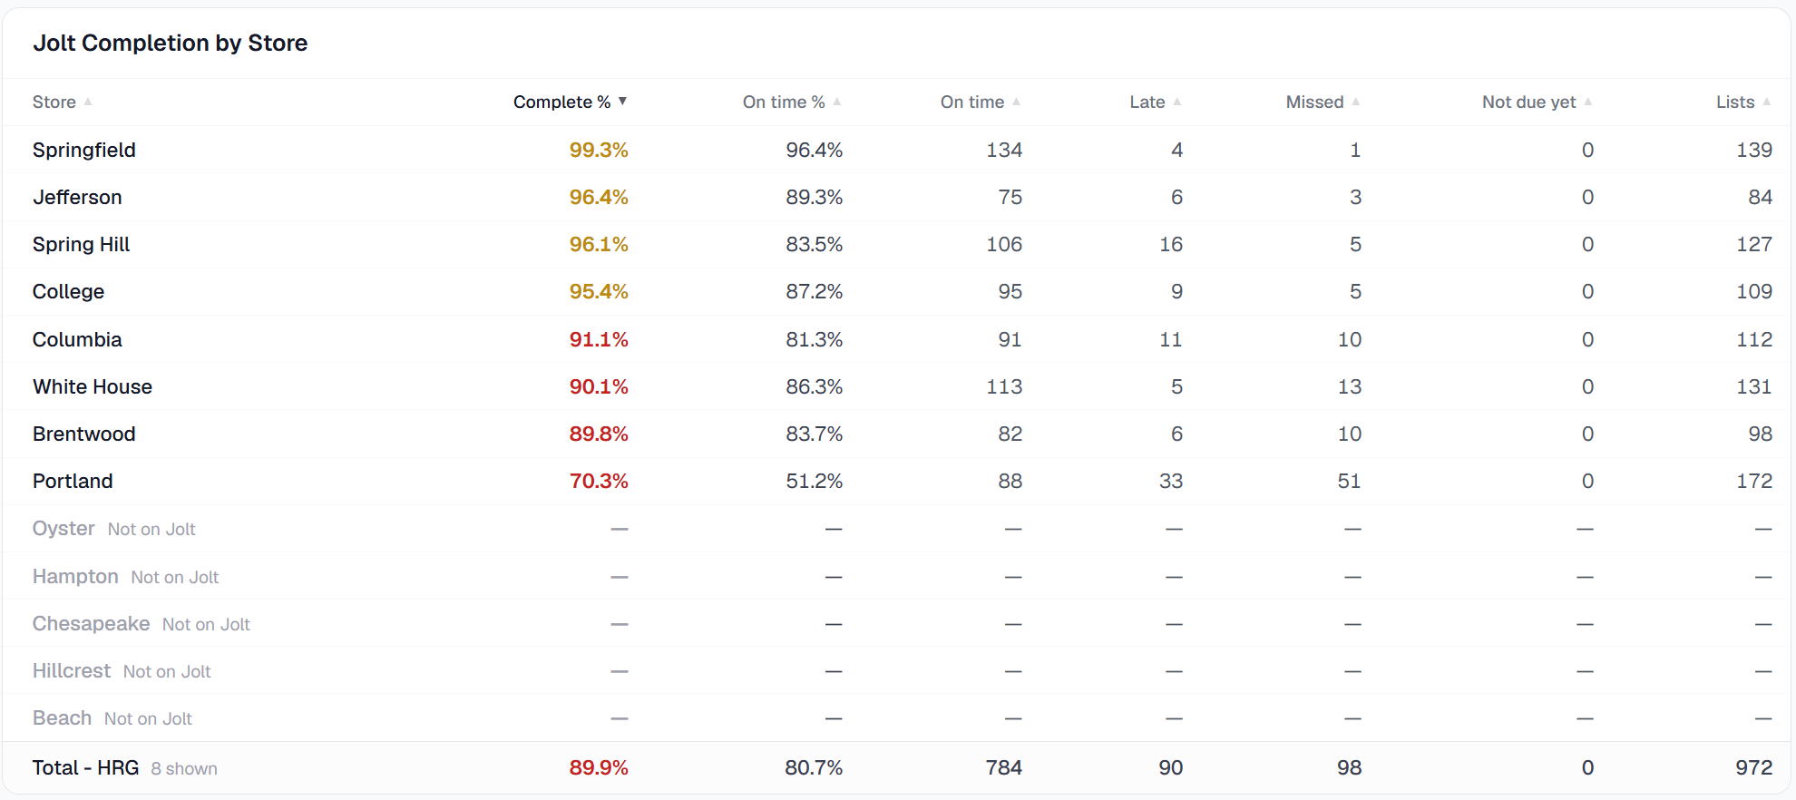
Jolt Completion - Last Week
© 2026 Hudson Restaurant Group | Proprietary & Confidential

Slide 35
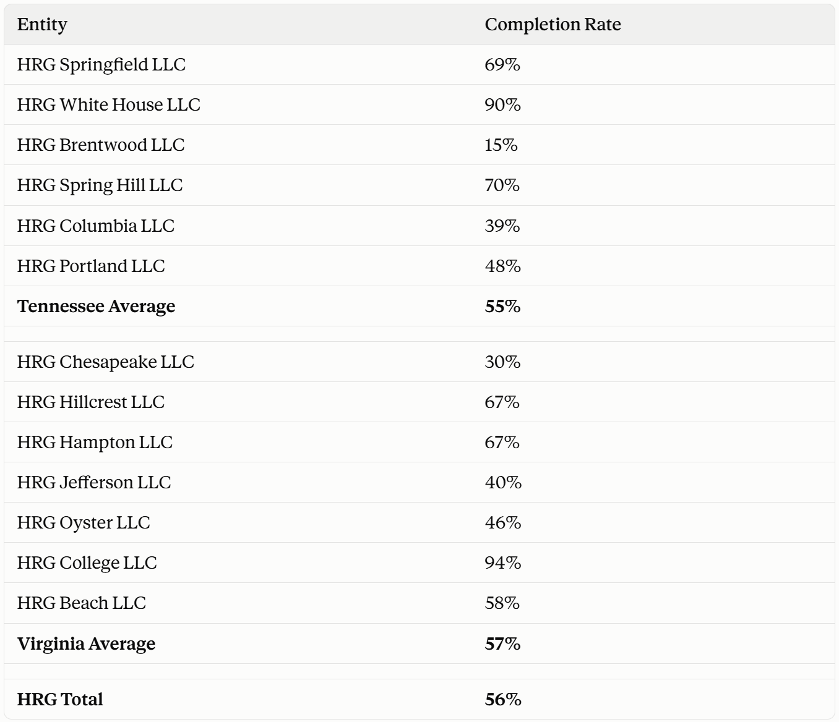
ZU Completion - W6
© 2026 Hudson Restaurant Group | Proprietary & Confidential

Slide 36
Administrative Notes & Hot Fires
Steritech:
New cycle starts, let teams know to be on alert!
Cleaning Focus:
TN: Base of Booths in lobby
VA: Organize / clean FOH cabinets
Weather:
TN: 70s & Sunny all week
VA: Mid 60s & Windy
Promotions:
Window 6 promo ongoing! Due by Friday 10/23
Secret Shops:
Monthly secret shops are DONE!
DM Hot Fires
Audit Timecards
Write ups - uploading to Workstream
Follow through in your districts (It’s great to identify areas of opportunity but what processes will you put in place to ensure they are resolved?)
Managing Overtime
GM Hot Fires
Audit Timecards
Catering outreach - TN
Write ups - uploading to Workstream
Overtime focus & how it affects business
No mention of store survey contest permitted when asking the guest to fill out survey → use BOGO
© 2026 Hudson Restaurant Group | Proprietary & Confidential

Slide 37
