Slide 1
Version Control and Git
By: James Milam

Slide 2
Contents of Presentation
What is and why use version control
Two main types of version control
Git conceptually
Git commands
Github brief overview
Moving Forward

Slide 3


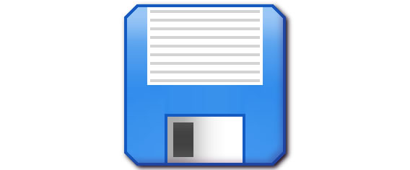
Traditional Saving of Files

Slide 4

Version Control Saving of Files
“Started work on rotation matrix function”
“Added comments to the transition matrix function”
- John
- Steve

Slide 5
Extra Uses of Version Control

Slide 6
Repository vs. File

Slide 7
Main Types of Version Control

Slide 8
Centralized Version Control

Slide 9
Decentralized Version Control

Slide 10
Git Conceptually Save vs. Commit

Slide 11
Git Conceptually Commit Staging Process

Slide 12
Git Conceptually Push/Pull

Slide 13
Git Commands Obtain/ git clone

Slide 14
Git push/pull

Slide 15
Git status/add/reset

Slide 16
Git commit

Slide 17
Git diff/git help

Slide 18
Git commands diagram

Slide 19
Github Brief Overview

Slide 20
Moving Forward

Slide 21
Conclusion

