Slide 1
A bit about python…

Slide 2
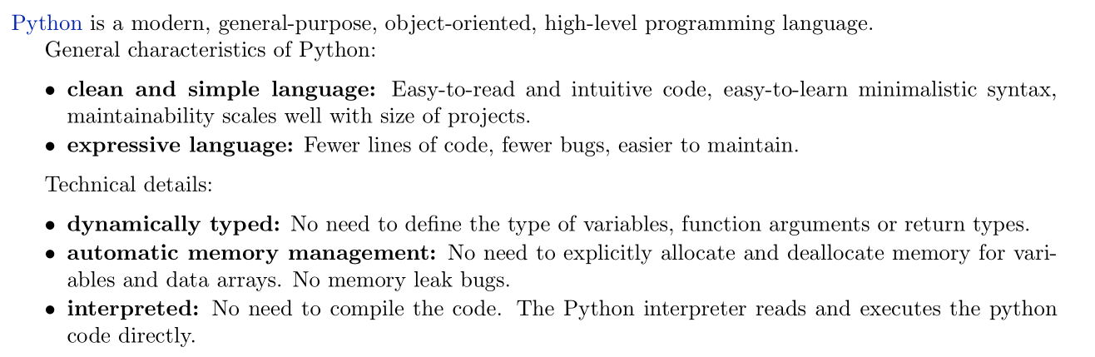

Slide 3
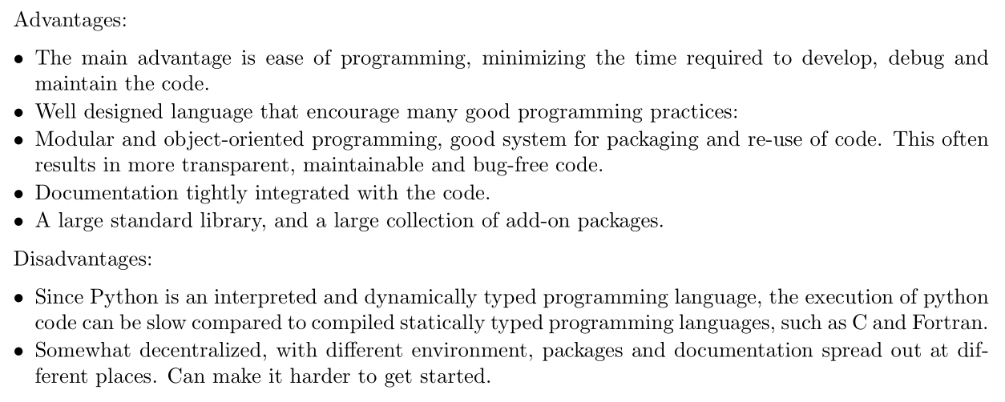
https://benchmarksgame-team.pages.debian.net/benchmarksgame/fastest/python3-gcc.html

Slide 4
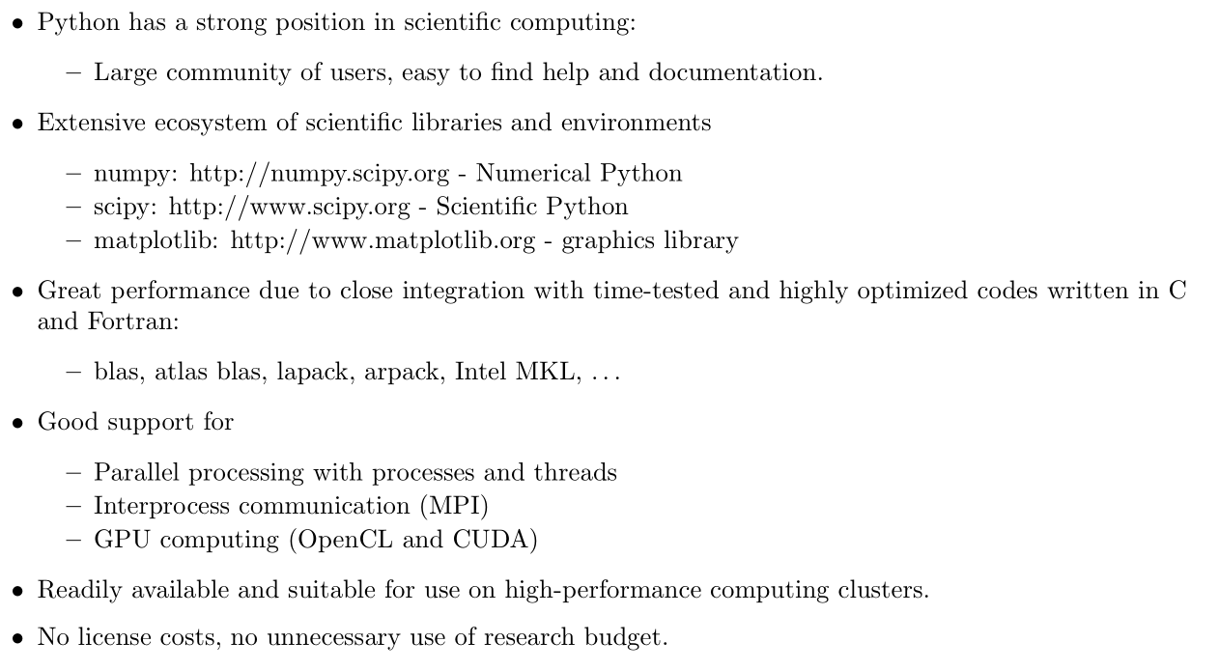

Slide 5



Also check out:

