Slide 1



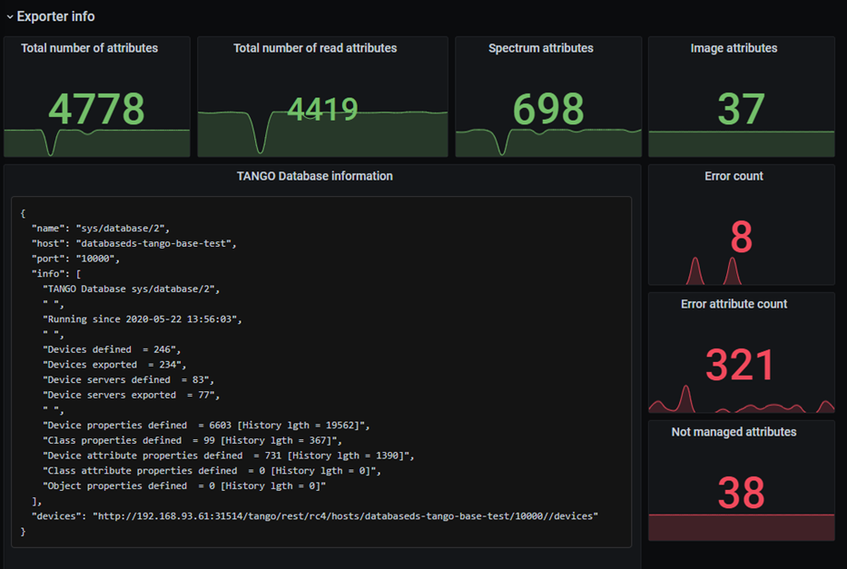





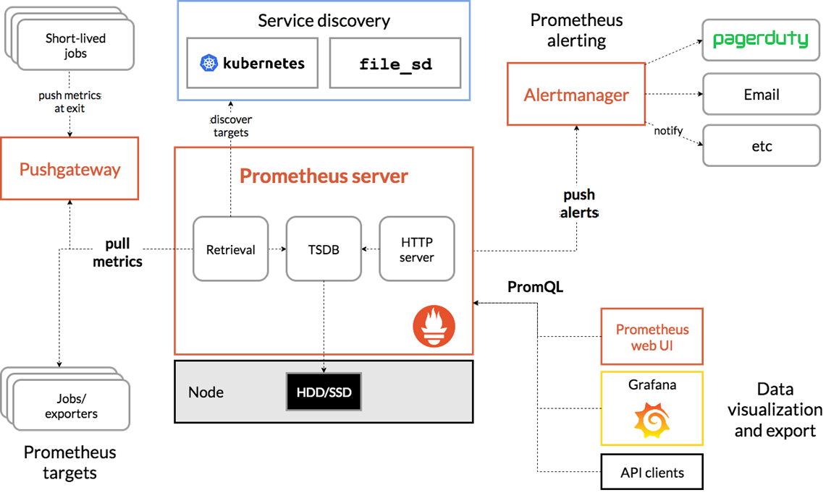
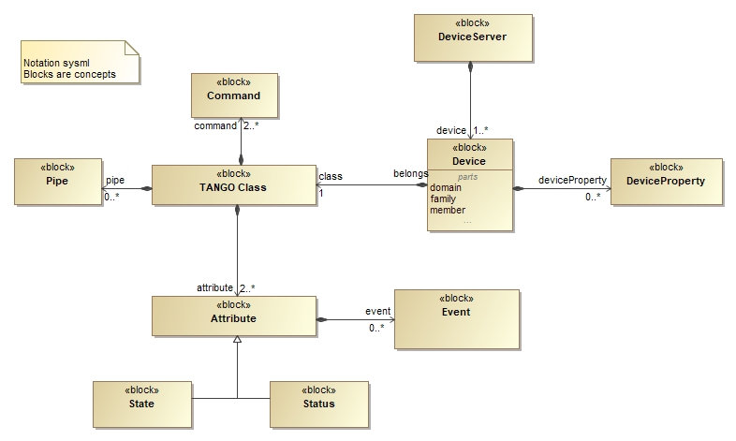
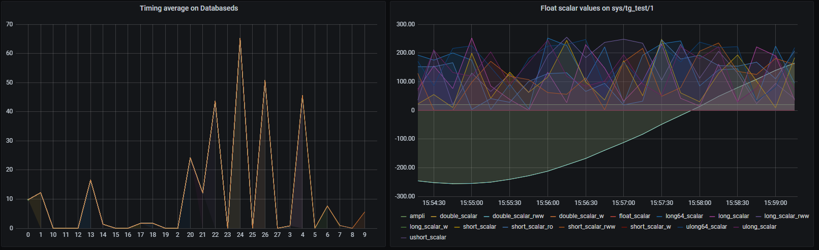

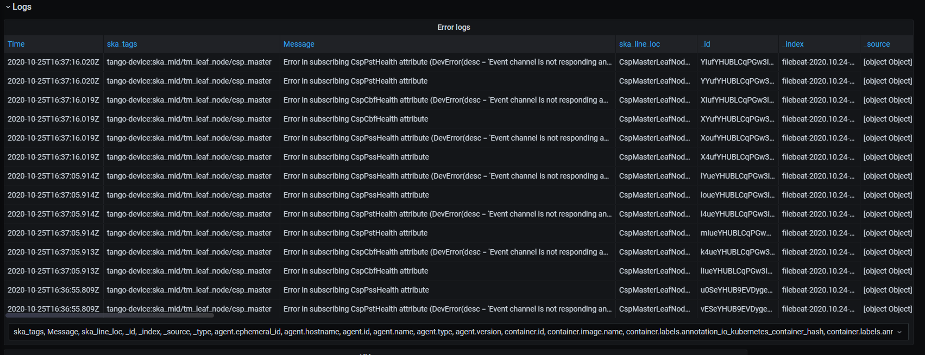
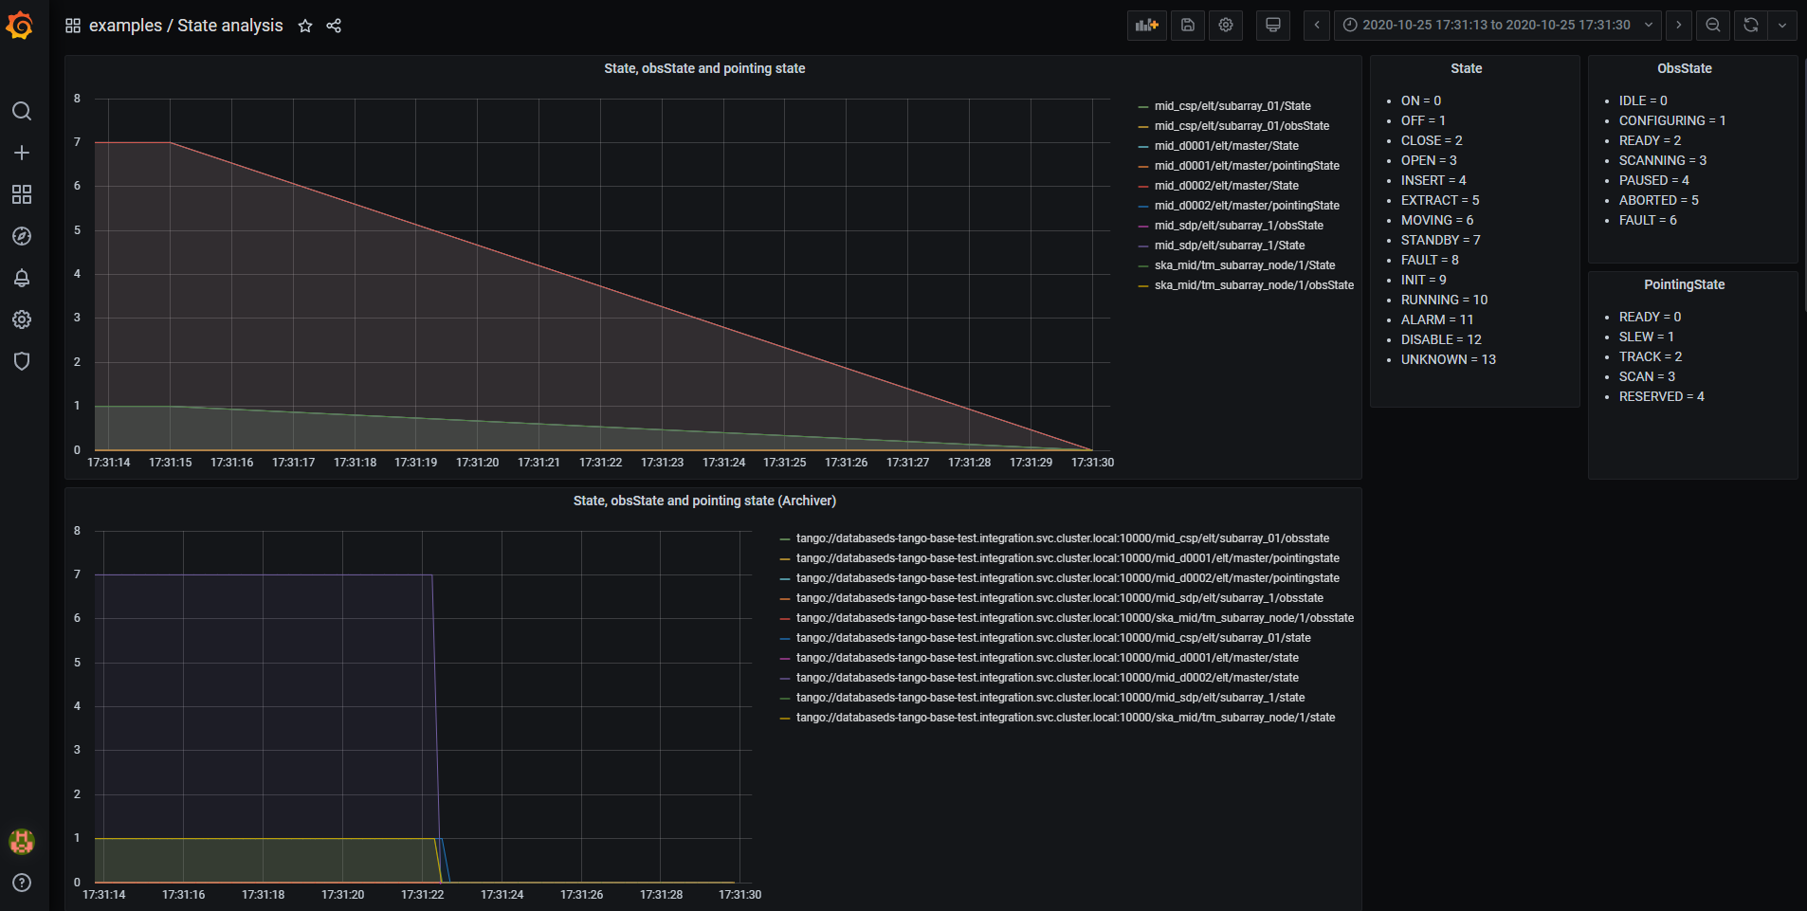
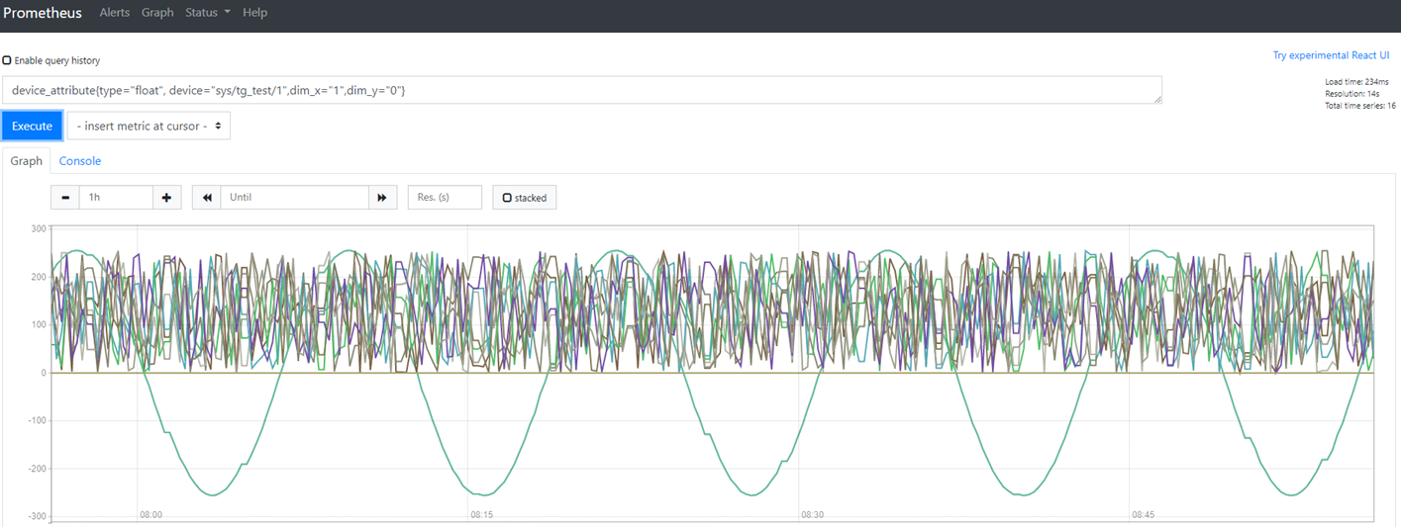
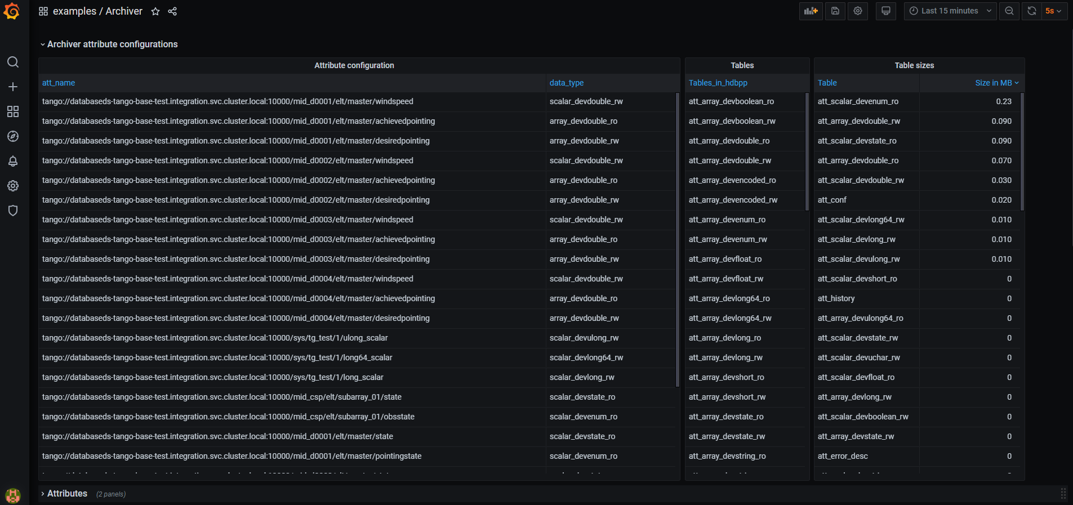
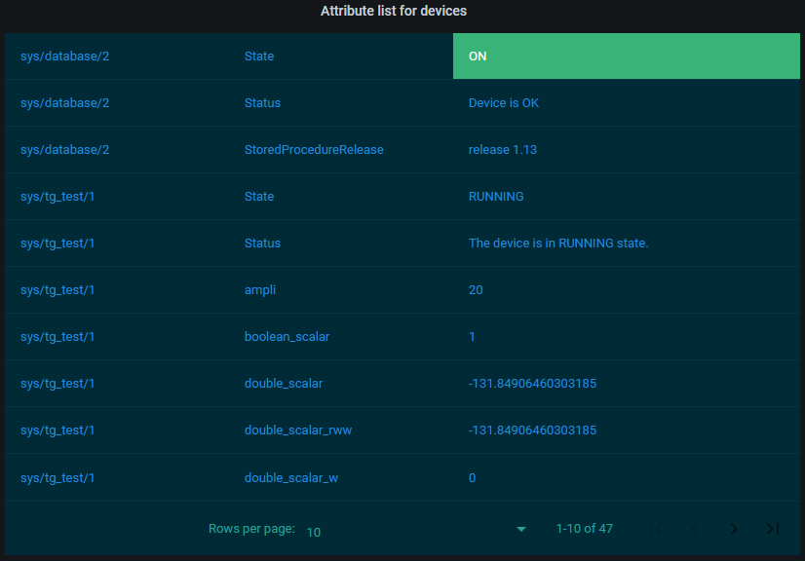
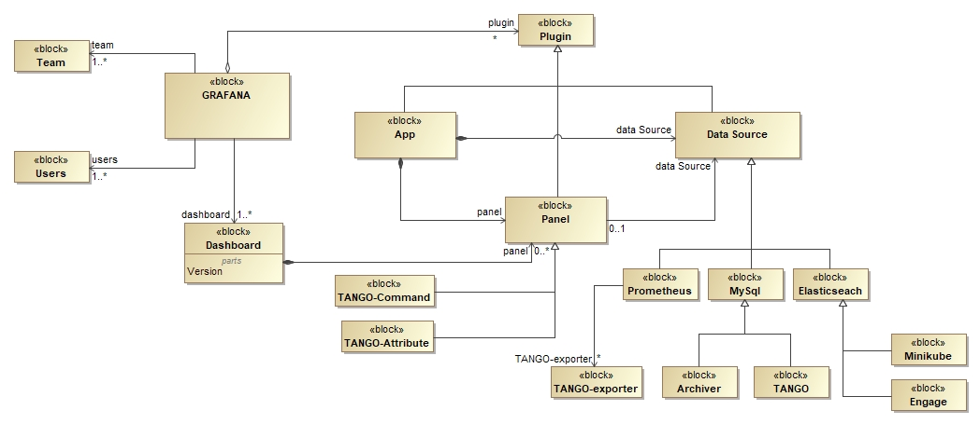
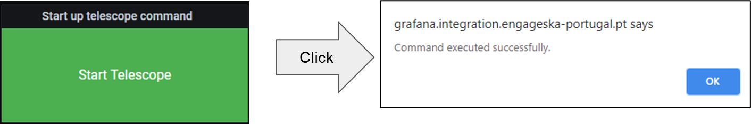

Paper No. 11452-160
TANGO-Grafana:
an online diagnostic tool to assist in the analysis of interconnected problems difficult to debug in the context of the Square Kilometre Array (SKA) telescope project
M. Di Carlo*ª, P. Harding^{b}, G. Le Roux^{c}, M. Dolciª
ªINAF Osservatorio Astronomico d’Abruzzo, Teramo, Italy; ^{b}SKA Organisation, Macclesfield, UK; ^{c}Instituto de Telecomunicações, ^{d}SKA South Africa, SA
The selected solution for monitoring the SKA Minimum Viable Product (MVP) Prototype Integration (SKAMPI) is Prometheus. Starting from a study on the modifiability aspects of it, the Grafana project emerged as an important tool for displaying data in order to make specific reasoning and debugging of particular aspect of SKAMPI. Its plugin architecture easily allow to add new data sources like prometheus but the TANGO related data sources has been added as well. The main concept of grafana is the dashboard, which enable to create real analysis. In this paper four example analysis are presented which take advantage of four different datasources and a variety of different panel (widget) for reasoning on archiving data, monitoring data, state of the system and general health of it.
INTRODUCTION
GRAFANA CUSTOMIZATIONS
DIAGNOSTIC TOOL
The🌍 SKA MVP Prototype Integration (SKAMPI)
Set of software artefacts, the corresponding repository and continuous integration facilities for the development, testing, and integration of the SKA prototype software systems
Many data sources
TANGO database (mysql)
TANGO archiving database (mariadb)
Elasticsearch
Prometheus monitoring system (with TANGO-exporter)
Working with Grafana means to create dashboards in order to perform a particular analysis on a set of monitoring data.
Fig.1 Prometheus monitoring
Fig.2 Tango-controls
Fig.5 TANGO spectrum and scalar available from prometheus
Fig.10 Generic system analysis
EXTENDING PROMETHEUS
TANGO-Exporter
Simple http server which provide a well defined metrics information for reading all the attributes from a TANGO control system like SKAMPI
Fig.6 Logs from Elasticsearch
Fig.11 State analysis with data coming from Prometheus and Archiving system
CONCLUSIONS
Fig.3 TANGO-Exporter graph view from Prometheus GUI
Massive customizations thanks to the plugin architecture of Grafana and Prometheus
Next steps:
      Improve customizations
      Achieving a rolled-up view of SKA TM health status and state
DATA VISUALIZATION
Fig.7 Tables of configured attributes from the archiving database
TANGO-Grafana
Grafana is an engine for displaying data on web coming from many data sources
Plugin architecture: panel, data sources and App
Custom plugins of type Panel
TANGO-attribute: view attributes of any king in table format
TANGO-command: send control commands to the TANGO eco-system
Ryantxu-ajax-panel: community plugin for AJAX web requests
REFERENCES
1. SKAMPI, https://gitlab.com/ska-telescope/skampi/
2. Openstack, https://www.openstack.org
3. Kubernetes, https://kubernetes.io/
4. Ceph, https://ceph.io/
5. Elasticsearch, https://www.elastic.co
6. Prometheus,https://prometheus.io/
7. TANGO-controls, https://www.tango-controls.org/
8. Grafana,https://grafana.com/
9. TANGO archiver, https://tango-controls.readthedocs.io/en/latest/tools-and-extensions/archiving/HDB++.html
10. TANGO-grafana,https://gitlab.com/ska-telescope/TANGO-grafana
11. Ajax panel for grafana, https://grafana.com/grafana/plugins/ryantxu-ajax-panel
12. Dolci, M. et all., Achieving a rolled-up view of SKA TM health status and state[...], SPIE (2018).
Fig.8 TANGO-attribute panel
Fig.4 TANGO-Grafana data model
Fig.9 TANGO-command panel
*matteo.dicarlo@inaf.it; phone +39 0861 439706;
This work has been made possible thanks to the financial support by the Italian Government (MEF - Ministero dell'Economia e delle Finanze, MIUR - Ministero dell'Istruzione, dell'Università e della Ricerca).

